Slide 1
City of Monterey MEASURE X PROJECTS
KEEP AREA TO THE RIGHT BLANK FOR ZOOM ATTENDEES
This photo can be changed out to match a relevant topic. (Right-click and select “replace image”). Or it can remain as the generic cover slide image.
Marissa Garcia
Engineering Asst. II
KEEP AREA BELOW HERE BLANK FOR CHYRON
KEEP AREA BELOW HERE BLANK FOR CHYRON
KEEP AREA TO THE RIGHT BLANK FOR ZOOM ATTENDEES

Slide 2
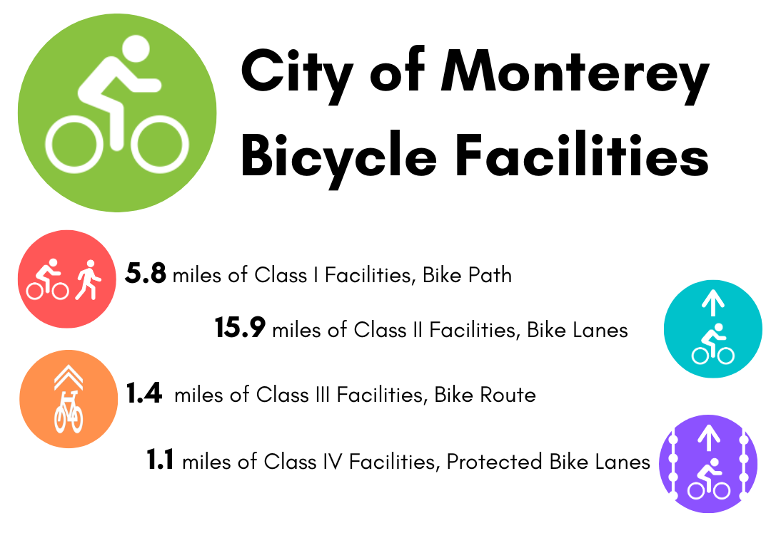
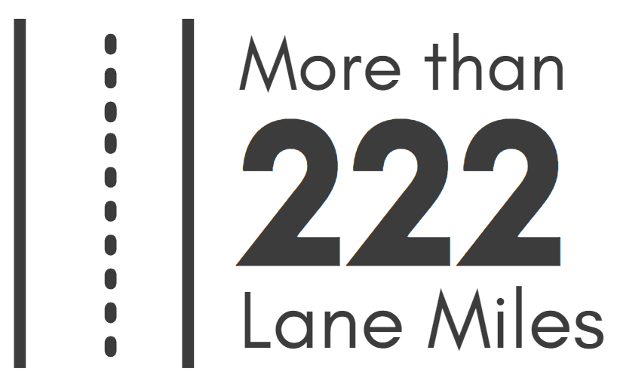
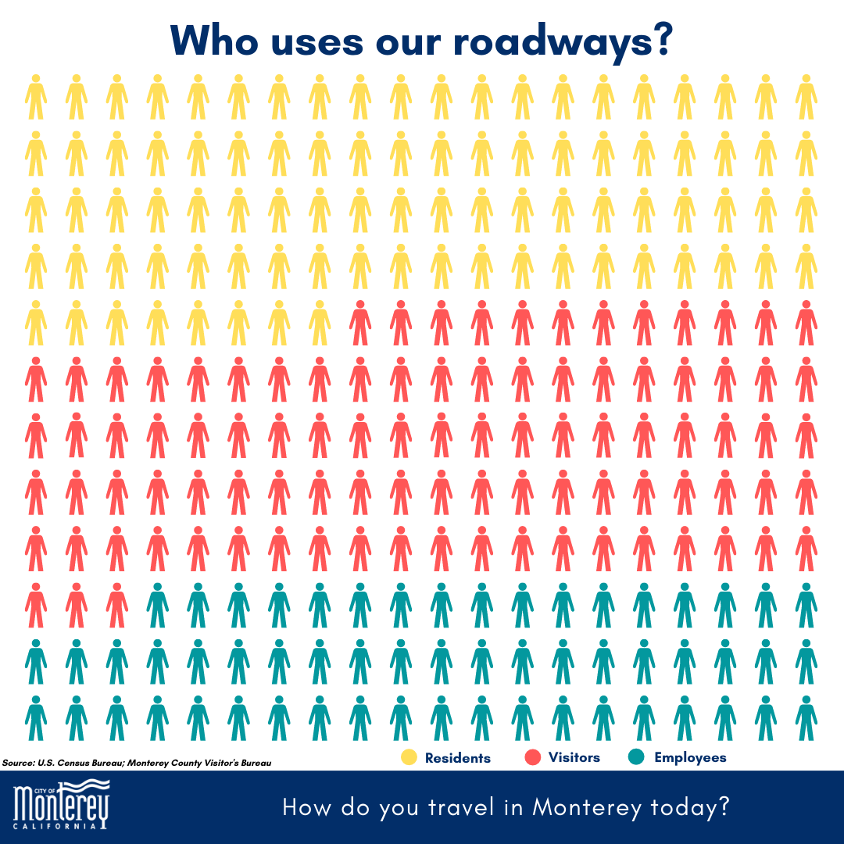
Quick Monterey Traffic Facts
KEEP AREA TO THE RIGHT BLANK FOR ZOOM ATTENDEES
KEEP AREA BELOW HERE BLANK FOR CHYRON
KEEP AREA BELOW HERE BLANK FOR CHYRON
KEEP AREA TO THE RIGHT BLANK FOR ZOOM ATTENDEES
Notes:
March 2018

Slide 3
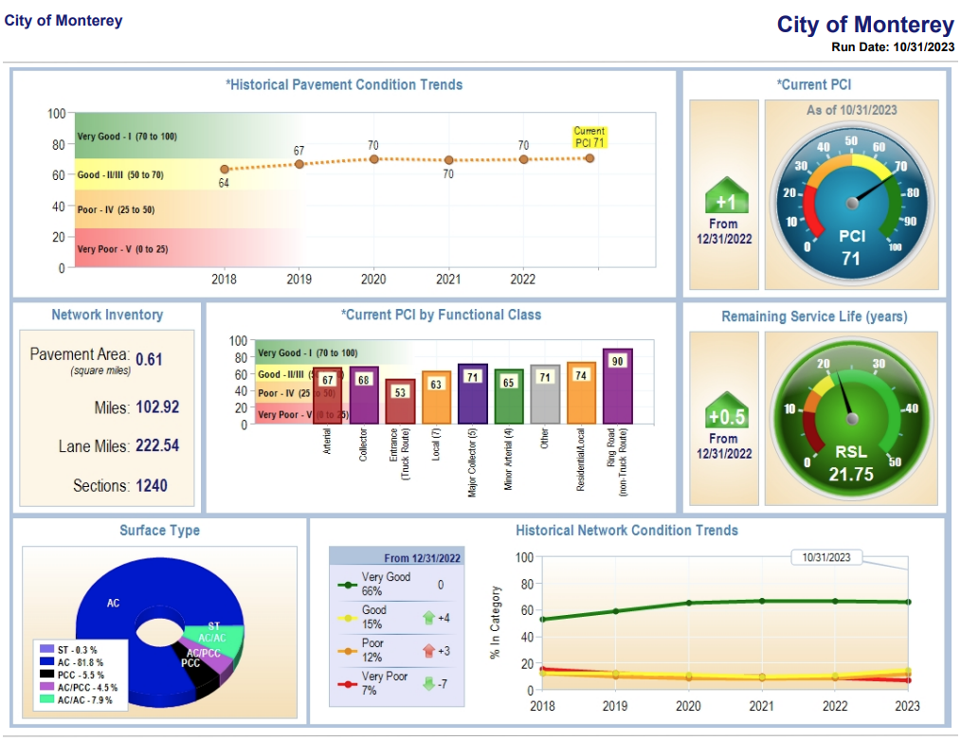
City of Monterey Pavement Condition (PCI)
KEEP AREA TO THE RIGHT BLANK FOR ZOOM ATTENDEES
KEEP AREA BELOW HERE BLANK FOR CHYRON
KEEP AREA BELOW HERE BLANK FOR CHYRON
KEEP AREA TO THE RIGHT BLANK FOR ZOOM ATTENDEES
Notes:
Citywide PCI – 71
Unconstrained Need is $34 million

Slide 4
The City of Monterey uses Measure X funds in the following CIP Projects:
KEEP AREA TO THE RIGHT BLANK FOR ZOOM ATTENDEES
Critical Maintenance
Identified Safety Projects
Operational Improvements to Transportation System
Citywide Adaptive Signal System
KEEP AREA BELOW HERE BLANK FOR CHYRON
KEEP AREA BELOW HERE BLANK FOR CHYRON
KEEP AREA TO THE RIGHT BLANK FOR ZOOM ATTENDEES

Slide 5
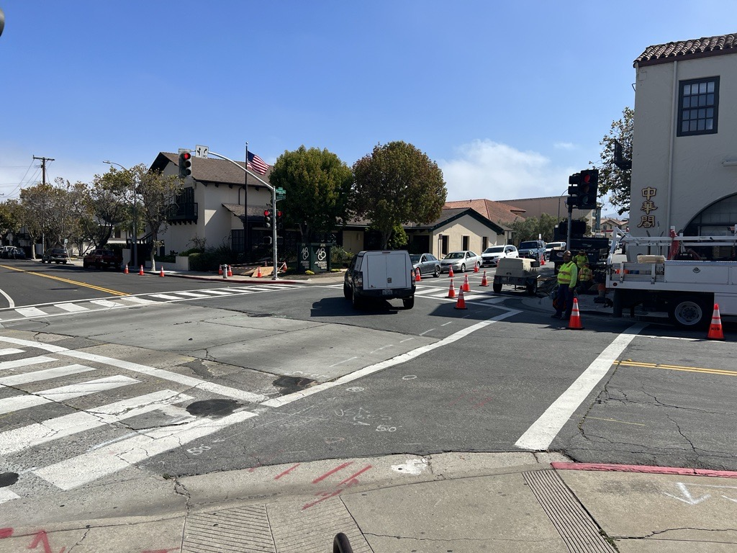
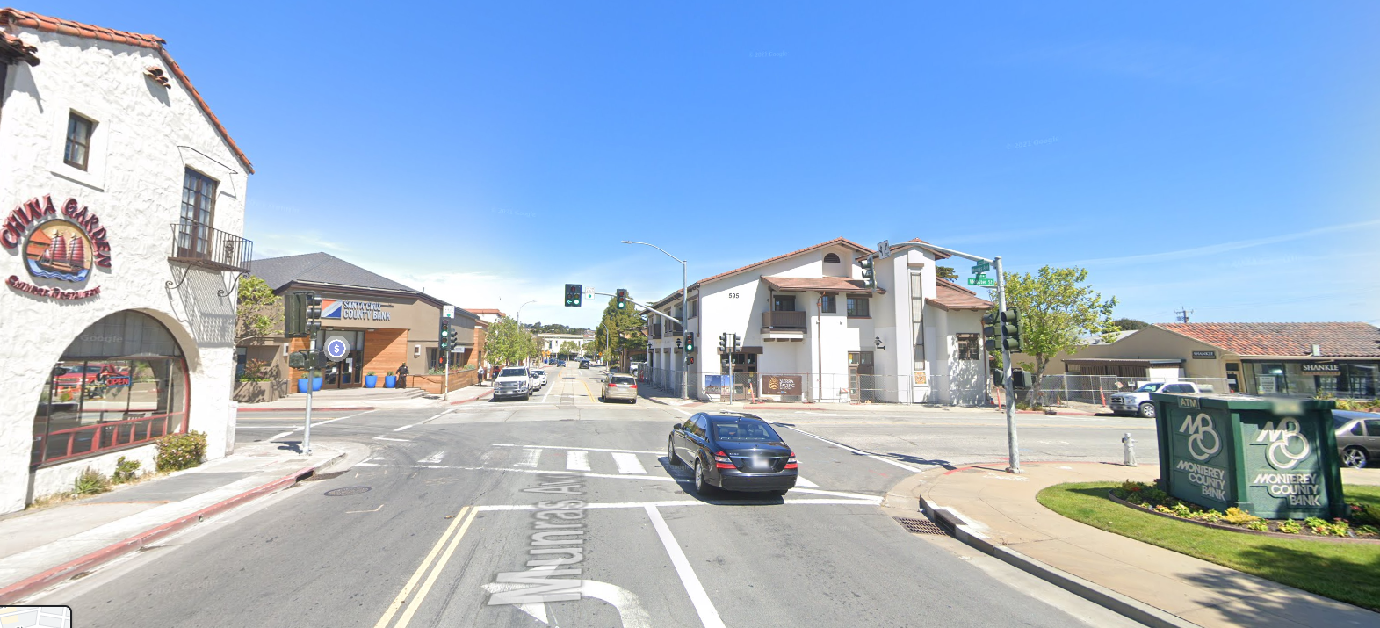
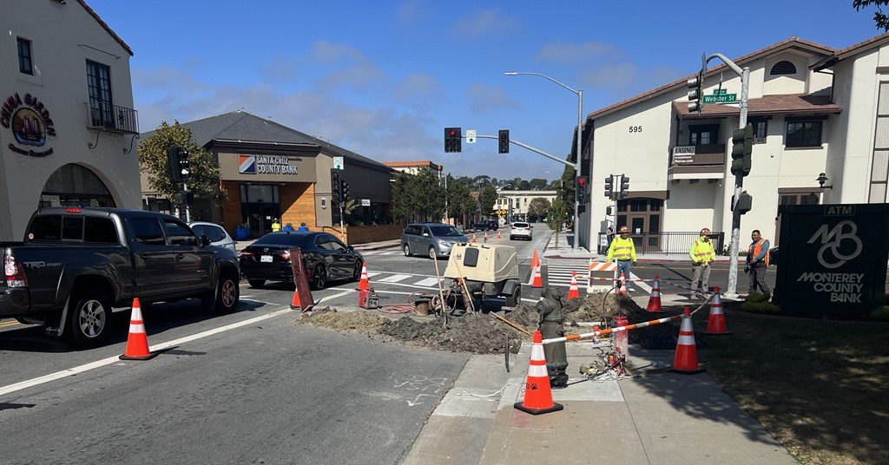
Critical Maintenance
KEEP AREA TO THE RIGHT BLANK FOR ZOOM ATTENDEES
Munras/Webster Conduit & Undergrounding
KEEP AREA BELOW HERE BLANK FOR CHYRON
KEEP AREA BELOW HERE BLANK FOR CHYRON
KEEP AREA TO THE RIGHT BLANK FOR ZOOM ATTENDEES
Notes:
Preliminary Undergrounding and conduit repair and new Traffic Signal Cabinet and Controller to allow for SCOOT installation. The Cabinet was in imminent failure

Slide 6
Identified Safety Projects
KEEP AREA TO THE RIGHT BLANK FOR ZOOM ATTENDEES
Grant Applications, Preliminary Engineering & Design
RSTP Grant Application – Del Monte/Washington, Quick Build
ATP Grant Application – Del Monte/Washington, Mark Thomas/Garden/Sloat
Design – North Fremont Gap Closure
Infrastructure Improvements
Marina Parking Lot Improvements – Recreation Trail Improvements Only
KEEP AREA BELOW HERE BLANK FOR CHYRON
KEEP AREA BELOW HERE BLANK FOR CHYRON
KEEP AREA TO THE RIGHT BLANK FOR ZOOM ATTENDEES

Slide 7
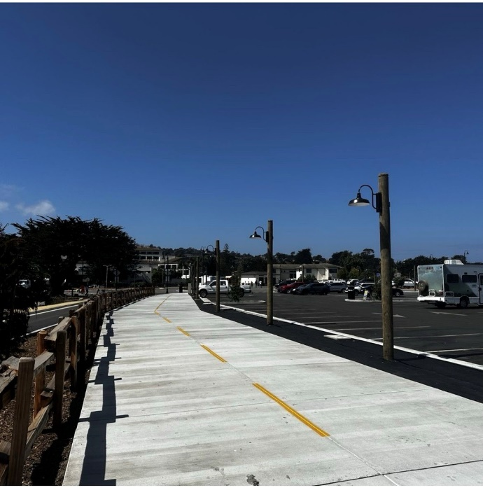
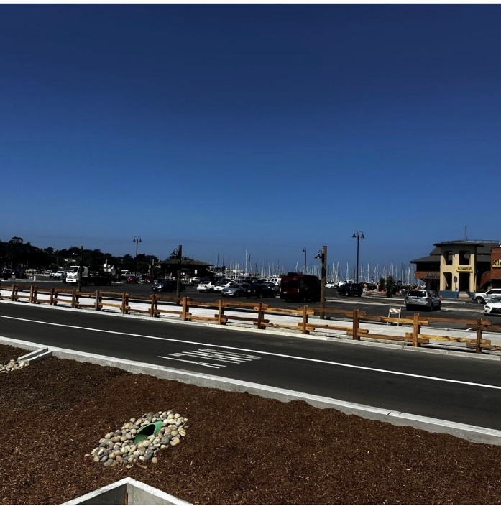
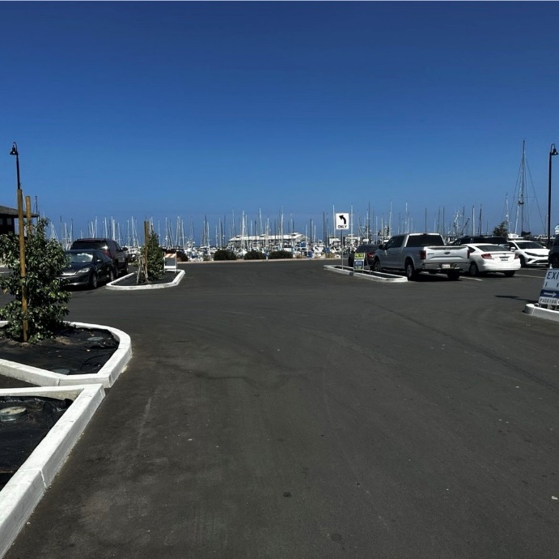
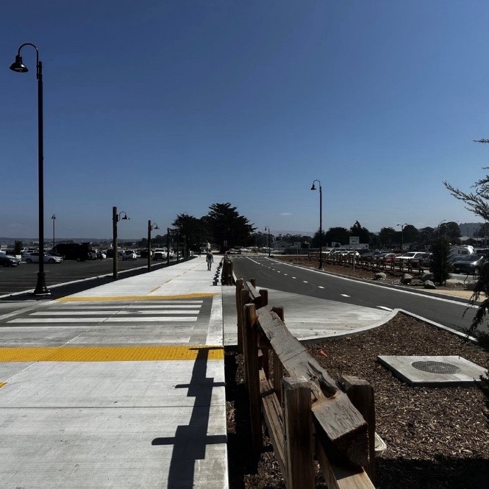
Identified Safety Projects
KEEP AREA TO THE RIGHT BLANK FOR ZOOM ATTENDEES
KEEP AREA BELOW HERE BLANK FOR CHYRON
KEEP AREA BELOW HERE BLANK FOR CHYRON
KEEP AREA TO THE RIGHT BLANK FOR ZOOM ATTENDEES

Slide 8
Operational Improvements to Transportation System
KEEP AREA TO THE RIGHT BLANK FOR ZOOM ATTENDEES
Traffic Signal Operations
Protected Left Turn Installation at Del Monte/Figueroa & Soledad/Pacific
Speed Limit
Speed Radar Trailer for Monterey PD
Engineering & Traffic Survey for Speed Limit
Traffic Sign
Citywide Wayfinding Sign Program
Post and Median Alerts
Pedestrian & Bike Improvements
Rectangular Rapid Flashing Beacons (RRFB)
Recreational Trail Bike & Ped Counters
KEEP AREA BELOW HERE BLANK FOR CHYRON
KEEP AREA BELOW HERE BLANK FOR CHYRON
KEEP AREA TO THE RIGHT BLANK FOR ZOOM ATTENDEES

Slide 9
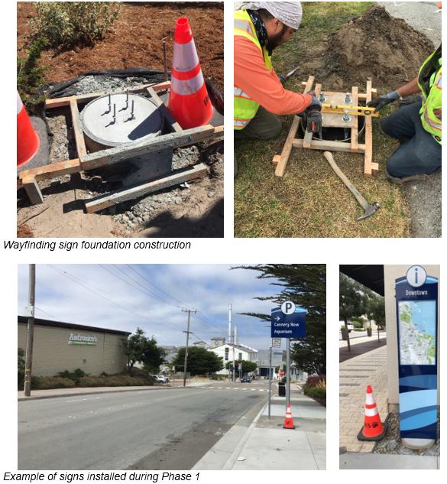
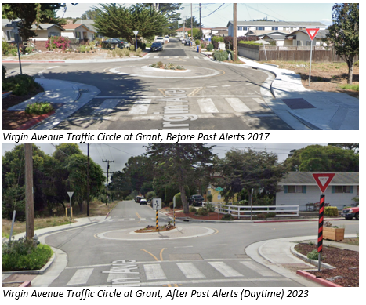
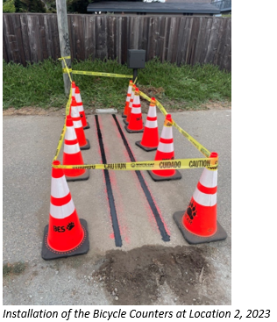
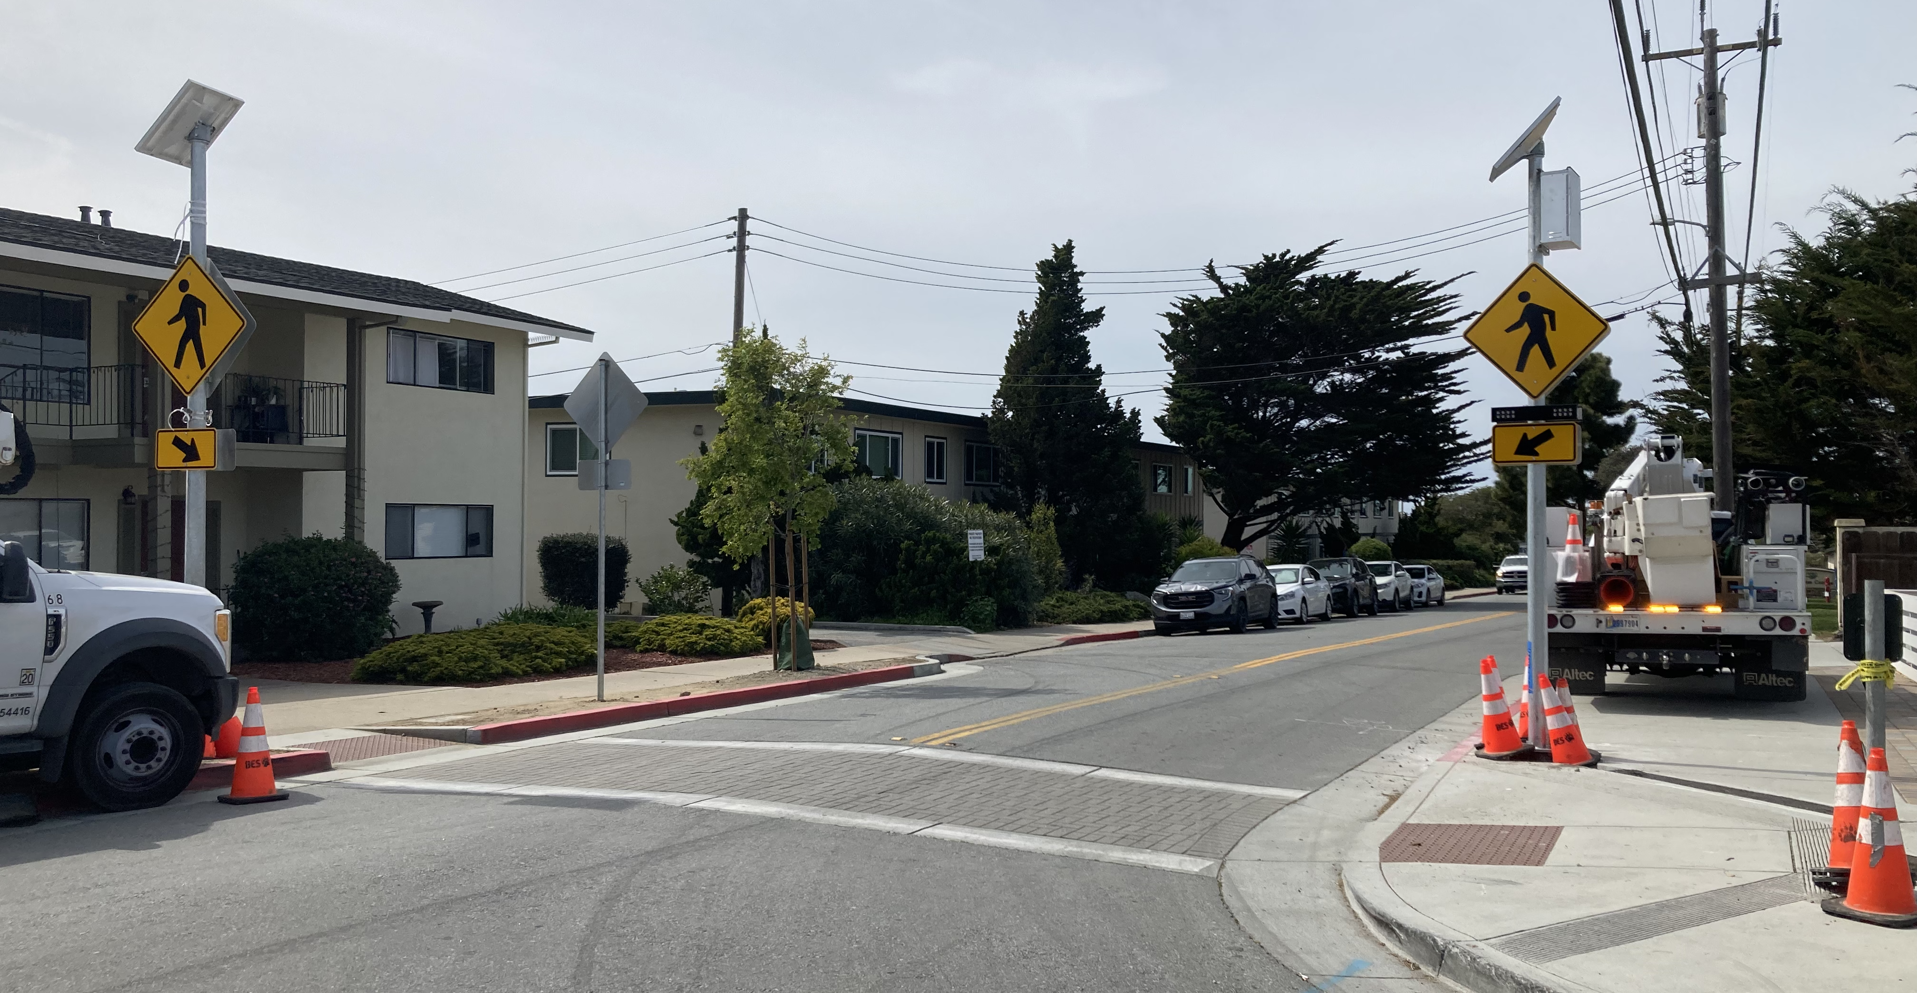
Operational Improvements to Transportation System
KEEP AREA TO THE RIGHT BLANK FOR ZOOM ATTENDEES
KEEP AREA BELOW HERE BLANK FOR CHYRON
KEEP AREA BELOW HERE BLANK FOR CHYRON
KEEP AREA TO THE RIGHT BLANK FOR ZOOM ATTENDEES

Slide 10
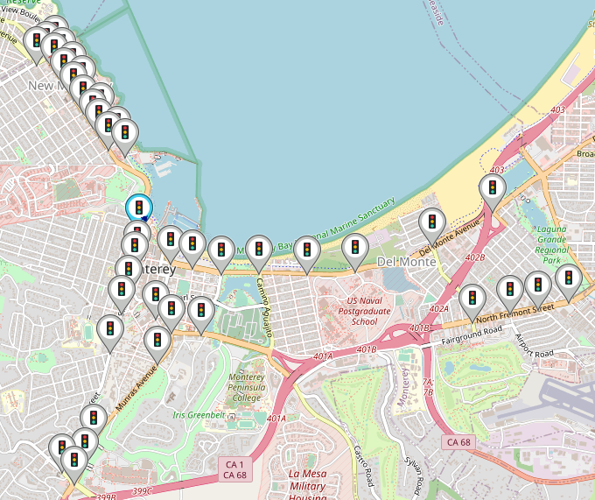
Citywide Adaptive Traffic Signal System
KEEP AREA TO THE RIGHT BLANK FOR ZOOM ATTENDEES
The City's Adaptive Traffic Signal System is active on 6 of the City's 7 arterial corridors.
Completed: Lighthouse, Del Monte, N Fremont, Foam, Munras, Pacific
In Progress: Franklin
41 intersections on the system currently
51 of the 56 intersections will be on the system at the end
KEEP AREA BELOW HERE BLANK FOR CHYRON
KEEP AREA BELOW HERE BLANK FOR CHYRON
KEEP AREA TO THE RIGHT BLANK FOR ZOOM ATTENDEES
Notes:
SCOOT (Split Cycle Offset Optimisation Technique)

Slide 11
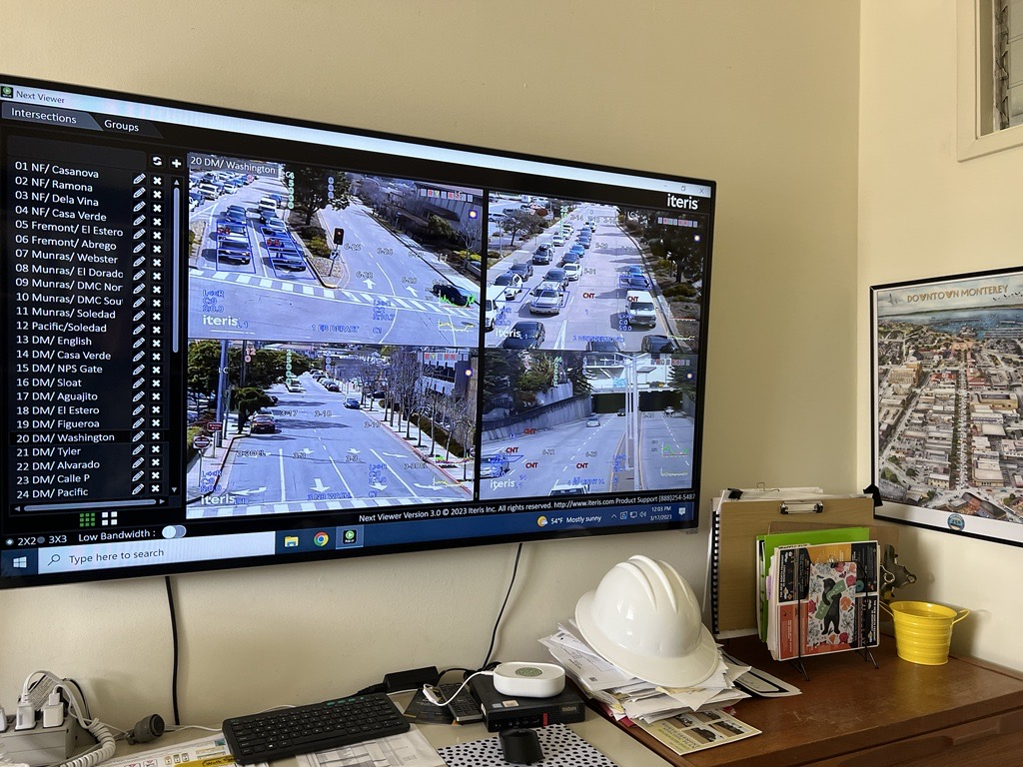
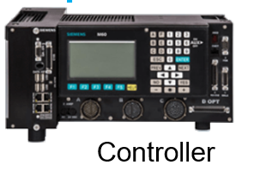
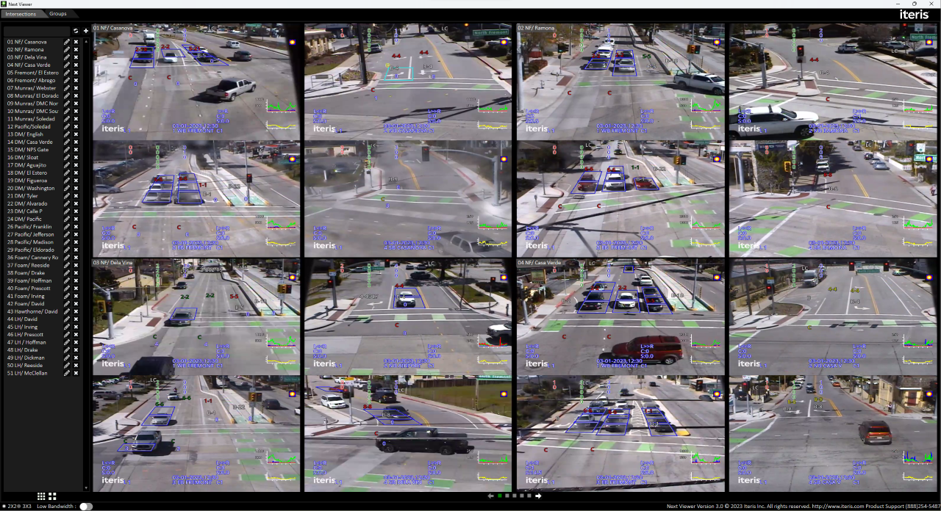
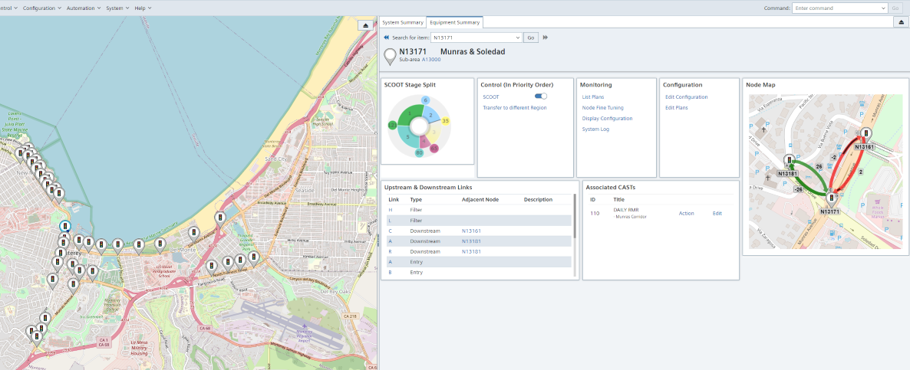
Citywide Adaptive Traffic Signal System
KEEP AREA TO THE RIGHT BLANK FOR ZOOM ATTENDEES
How does the Adaptive Traffic Signal Work?
With this information the traffic signal changes the cycle time, splits, and offsets between signals to manage the flow of vehicles as efficiently
The signal system can change these every 2-3 minutes
KEEP AREA BELOW HERE BLANK FOR CHYRON
KEEP AREA BELOW HERE BLANK FOR CHYRON
KEEP AREA TO THE RIGHT BLANK FOR ZOOM ATTENDEES
Notes:
Hans

Slide 12
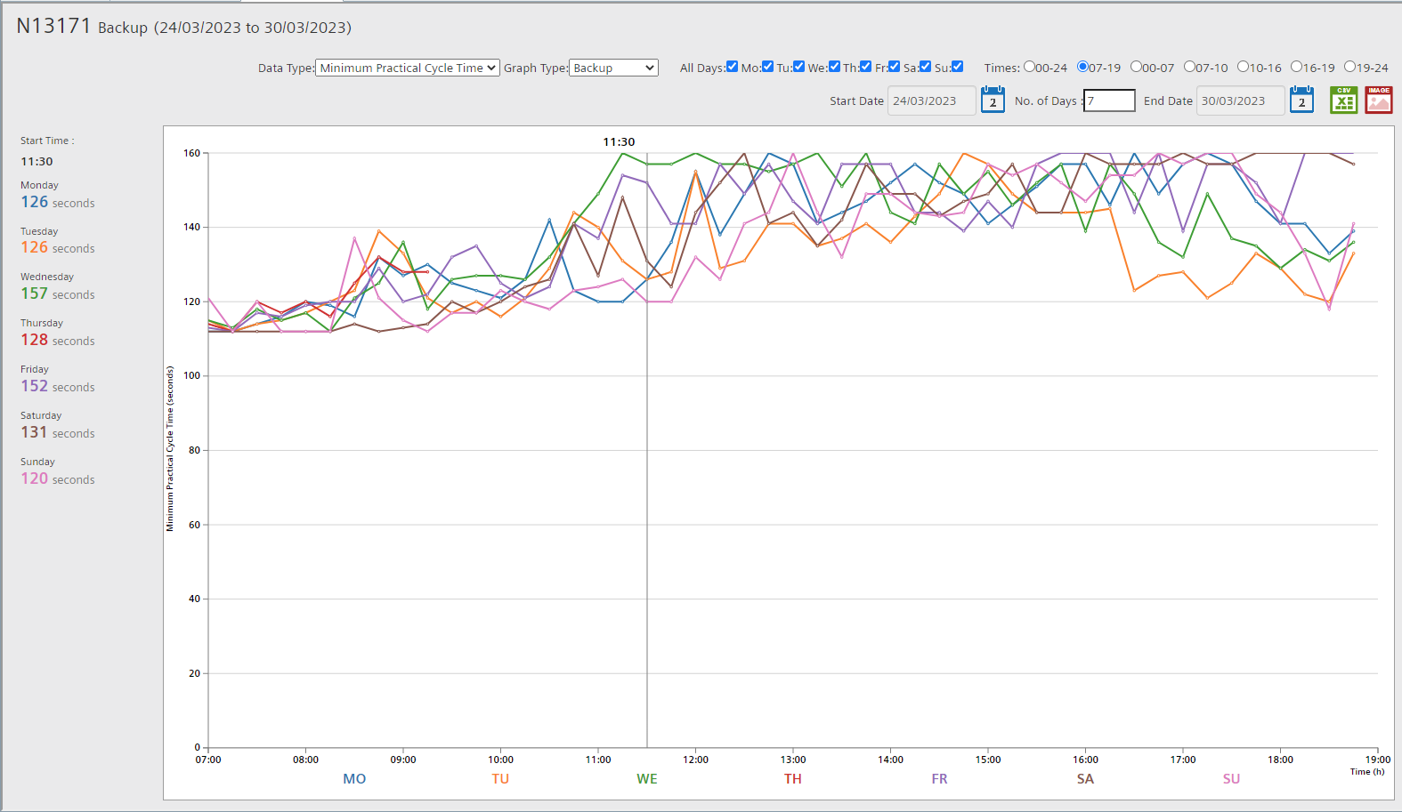
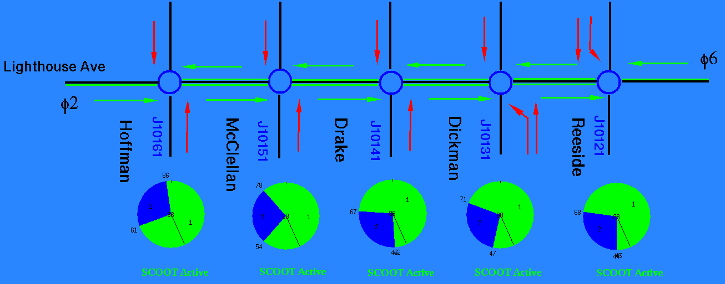
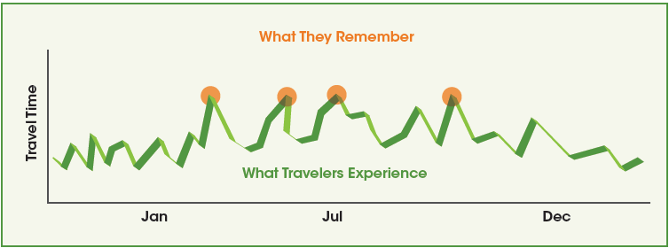
Citywide Adaptive Traffic Signal System
KEEP AREA TO THE RIGHT BLANK FOR ZOOM ATTENDEES
KEEP AREA BELOW HERE BLANK FOR CHYRON
KEEP AREA BELOW HERE BLANK FOR CHYRON
KEEP AREA TO THE RIGHT BLANK FOR ZOOM ATTENDEES

Slide 13
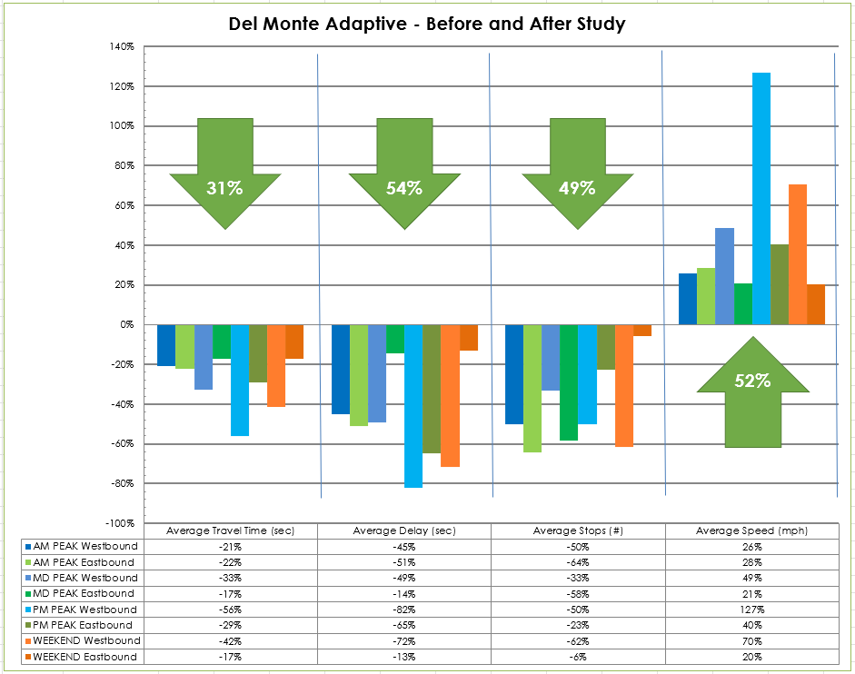
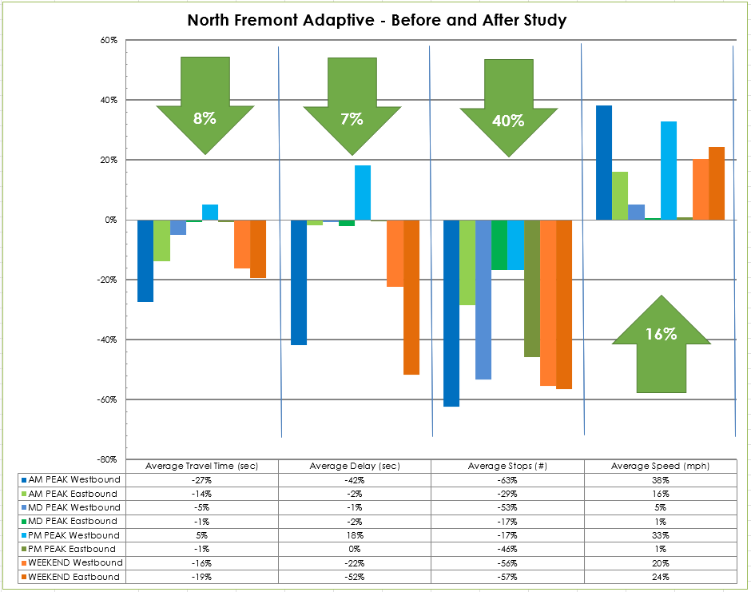
Citywide Adaptive Traffic Signal System
KEEP AREA TO THE RIGHT BLANK FOR ZOOM ATTENDEES
KEEP AREA BELOW HERE BLANK FOR CHYRON
KEEP AREA BELOW HERE BLANK FOR CHYRON
KEEP AREA TO THE RIGHT BLANK FOR ZOOM ATTENDEES
Notes:
We are scheduling Before and After Studies for Munras & Foam corridors which were delayed by weather
60 - 66 seconds of wait is generally the limit of tolerance.
Drivers prefer to split the waiting time rather than sit for the full wait time at one signal. However if drivers are stopped at back to back and a short time at the second signal, the second stop is especially annoying and perceived as longer.
High Income residents have a lower tolerance for waiting times.
Men have a lower tolerance for waiting times
People who use Transit or Active Modes view waiting more positively
Perceived waiting time for transit is 1.2-1.3 times higher than actual time
For signalized intersection waiting times up to 70 seconds(in India) users were generally close but beyond that it overestimated. In the Netherlands both short and very long wait times were over estimated but normal 40-60 seconds was perceived close to the actual time
For those who have a negative perception of waiting time they generally overestimated their wait time by 2.4 times.
unused green time for conflicting traffic is considered annoying and generally negative

Slide 14
Upcoming Measure X Efforts
KEEP AREA TO THE RIGHT BLANK FOR ZOOM ATTENDEES
Installing Adaptive Traffic Signal System in Downtown Del Monte & Franklin
Installing Rectangular Rapid Flashing Beacons
Local Road Safety Plan (matching grant funds)
ATP Grant Applications for:
Construction of the North Fremont Gap Project
Design & Construction of Mark Thomas – Garden – Sloat Bicycle Facilities
KEEP AREA BELOW HERE BLANK FOR CHYRON
KEEP AREA BELOW HERE BLANK FOR CHYRON
KEEP AREA TO THE RIGHT BLANK FOR ZOOM ATTENDEES

