Slide 1
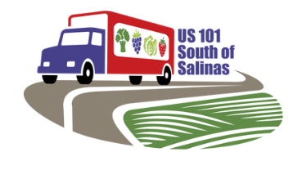
Agenda
Introductions
Project Overview
Interchange to north of south of Abbott
West-side frontage road

Slide 2
Configuration: No Build
Legend
Existing Facilities
Notes:
I want to acknowledge the work of Traffic Operations and Design putting these together. It helps to see everything easily.
The first is the No Build configuration, which is a standard option for the majority of projects.
It would be good to use this to set us up for the actual configurations.
Legend: Existing Features in Blue
Orientation
Chualar and Abbott
What resurrected the project was the Traffic Safety Alliance’s concerns on the need for enhanced safety for the traveling public and agricultural trucks.
Slower moving trucks mixing with higher speed traffic at access openings and median openings was leading to collisions.
6+ at grade access points on east side
6-7 at grade access points with railroad crossings on west side not shown yet
~11 median openings throughout project limit
One most direct solution is to close all at-grade access, close all median openings. That would eliminate all mixing of trucks accelerating and decelerating with general traffic and eliminate conflict points.
To mitigate the loss of access, we can provide frontage roads to connect all parallel communities.
Those frontage roads would connect to US 101 through Interchanges designed to handle that kind of volume.
These new Interchanges can also provide U-turn opportunities on US101.
We can provide all those features in the following Configuration.

Slide 3
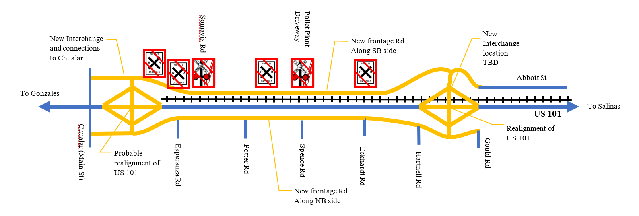
Configuration 4 – Full Freeway Build
Close all at-grade access points and median openings.
Replace interchange at Abbott/Spreckels.
Relocate interchange for Chualar.
Frontage road on both sides connect Abbott and Chualar Interchanges.
Legend
Existing Facilities
Proposed Facilities
Notes:
We’re starting with what we consider the Ultimate Configuration even though it is numbered last- number 4. And I will work backwards.
This is the Full Freeway Build.
You’ll notice that the Legend now includes yellow for Proposed Facilities.
Upgrade from Expressway to Freeway to eliminate at-grade intersections and median openings. This includes eliminating all railroad crossings. See icons. There are signalized and unsignalized crossing icons.
Build full frontage roads on both sides.
New Interchange to replace the ramps at Abbott.
New Interchange at Chualar.
These new interchange along with US 101 may need to be shifted east to make room for southbound ramps between the mainline and railroad tracks.
Railroad crossings will be limited to the Interchange areas.
Please note that the new interchanges are symbolically shown as diamond interchanges, but the configuration type has not been determined yet.
This is what could be done if there is no limitations of funds, can have all right of way, there is no community objection.
At this point, we anticipate that there could be challenges on all or a combination of funds, right of way, or community; therefore, we are considering other alternatives to help phase the project.
Next.

Slide 4
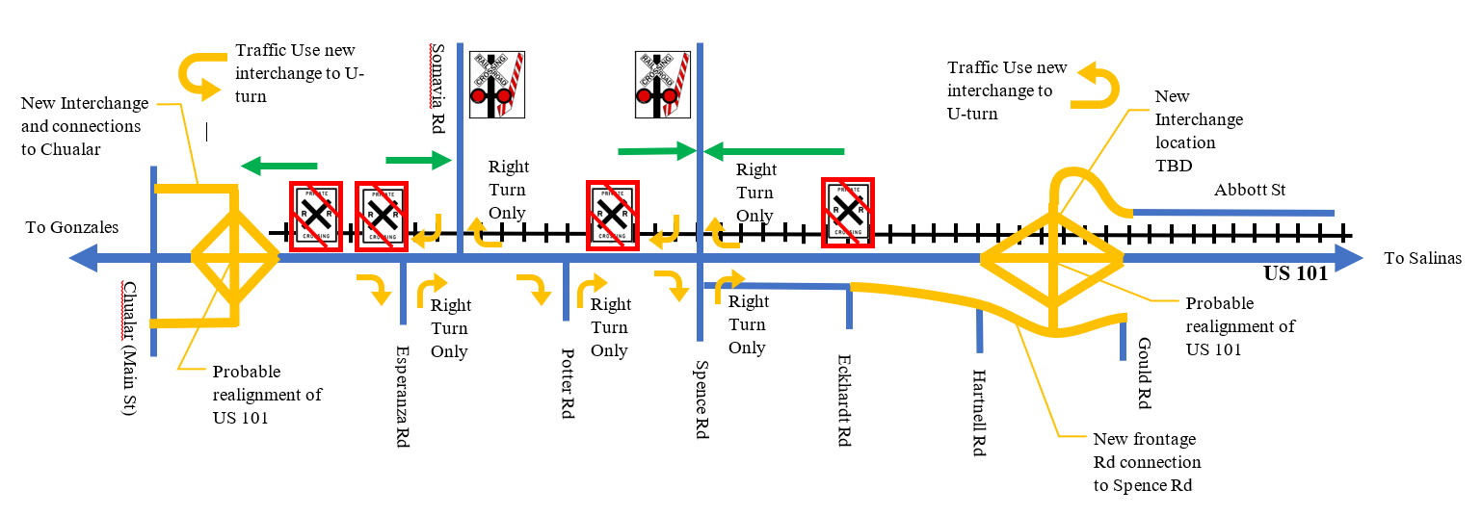
Configuration 3: Expressway Variation
Similar to Configuration 4 except…
Connect frontage road on east side to Spence Rd.
Access to west side could be public road of easements/property agreements
Maintain Right in/Right Out Access
Legend
Existing Facilities -- Proposed Facilities -- Access After Removing Railroad Crossings
Notes:
Configuration 3 is a step down from Full Freeway Build, and it is called an Intermediate Expressway Variation
Here are the similarities to Full Freeway Build
This will still Replace the Interchange at Abbott.
Provide U-turn opportunities
Provide access to Abbott Street and Spreckles.
Provide access to Frontage road on East Side. Modest investment that can tap into the only existing frontage road in the project limit.
We will have a frontage road connecting Spence Road and the New Abbott Interchange.
Still keep the New Interchange at Chualar to provide U-turn opportunities, Railroad crossing, minimize ROW impact to Chualar
Still close all median openings to eliminate majority of higher risk conflict points.
Here are the differences from Full Freeway Build
At grade connections on the east side will remain at the connections shown on screen, like Esperanza and Spence, but they will be made right in and right out only. They won’t be able to cross the median. This will help maintain access without frontage roads.
On the west side, Signalized railroad crossings will stay and all unsignalized railroad crossings will close.
By eliminating unsignalized railroad crossings, traffic will have to make use of the remaining signalized railroad crossings to get to where they use to be able to go.
Notice that there are green arrows showing those movements, and the Legend now shows Green.
The form of access in green can be in the form of frontage roads or private landowners granting some form of access easement to neighbors- similar to private residents sharing a long driveway. This will require cooperation between owners.
Let’s now look at Configuration 2.

Slide 5
Configuration 2: Interm. Expressway Variation
Similar to Configuration 3 except…
Modify Chualar interchange instead of relocation.
Legend
Existing Facilities -- Proposed Facilities -- Access After Removing Railroad Crossings
Notes:
Configuration 2 is very similar to configuration 3, and the only difference would be that there would not be a new relocated interchange at Chaular.
We may find out from the locals that what they want is only to fix an operational deficiency at the interchange, and the solution could be a very low cost modification of intersection controls that is supported by a traffic study.
In that case, there would be significant savings.
We will still close median openings, keep most at-grade access on east side, eliminate unsignalized railroad crossings, and build frontage road to connect new interchange with Eckhardt Road.
This takes us to the last Configuration.

Slide 6
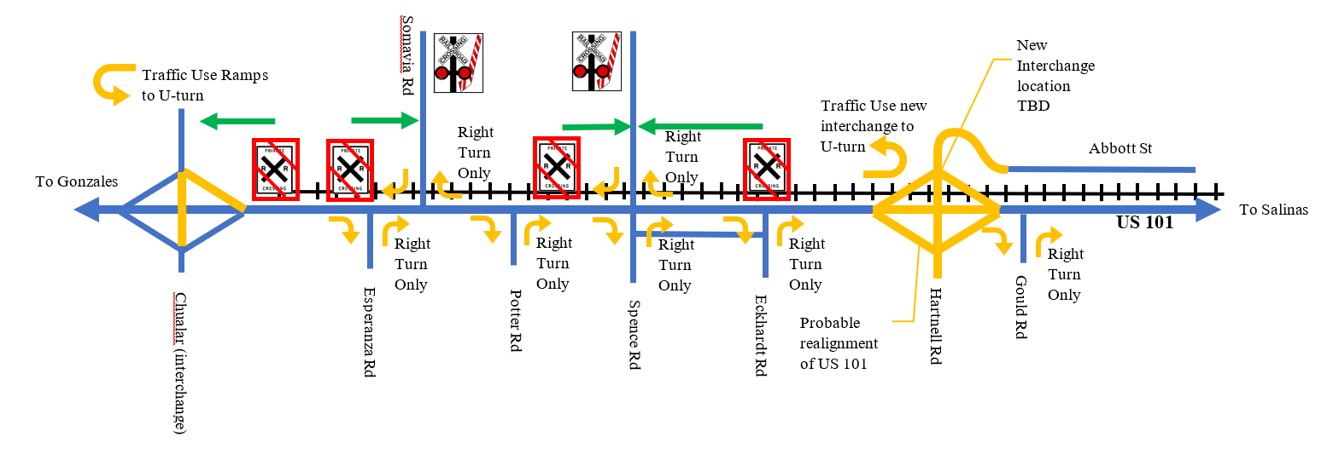
Configuration 1: Minimum Expressway Build
Similar to Configuration 2 except…
No frontage roads at all.
Legend
Existing Facilities -- Proposed Facilities -- Access After Removing Railroad Crossings
Notes:
This is the Minimum Expressway Build
It is similar to Configuration 2- except there won’t be any frontage roads at all on east side.
West side: still close unsignalized railroad crossings.
Still close median openings, and construct Abbott Interchange
Provide a more standard interchange configuration.
Provide U-turn opportunities and overcrossing at Abbott.
Some community members said that if there is phasing, they will not accept any frontage roads without first having a new interchange at Abbott.

Slide 7
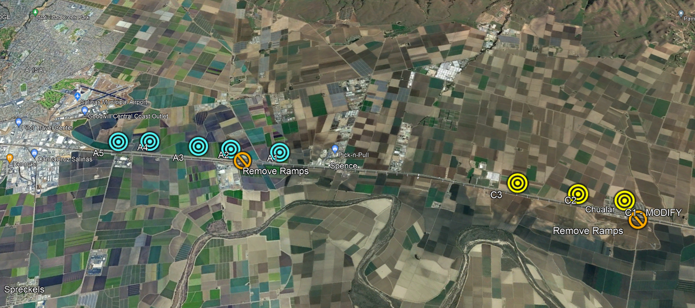
Potential Interchange Locations

Slide 8
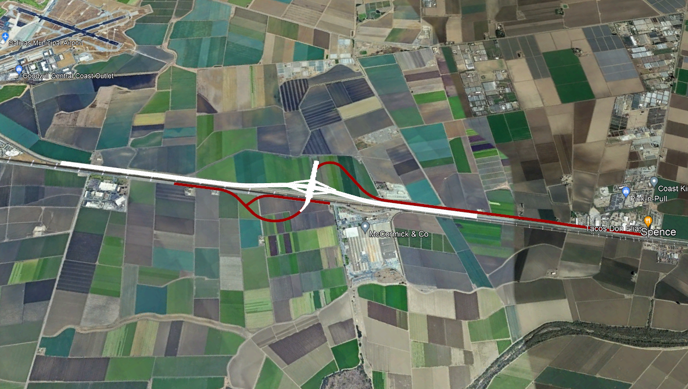
Concept at A3: North of Existing Abbott

Slide 9
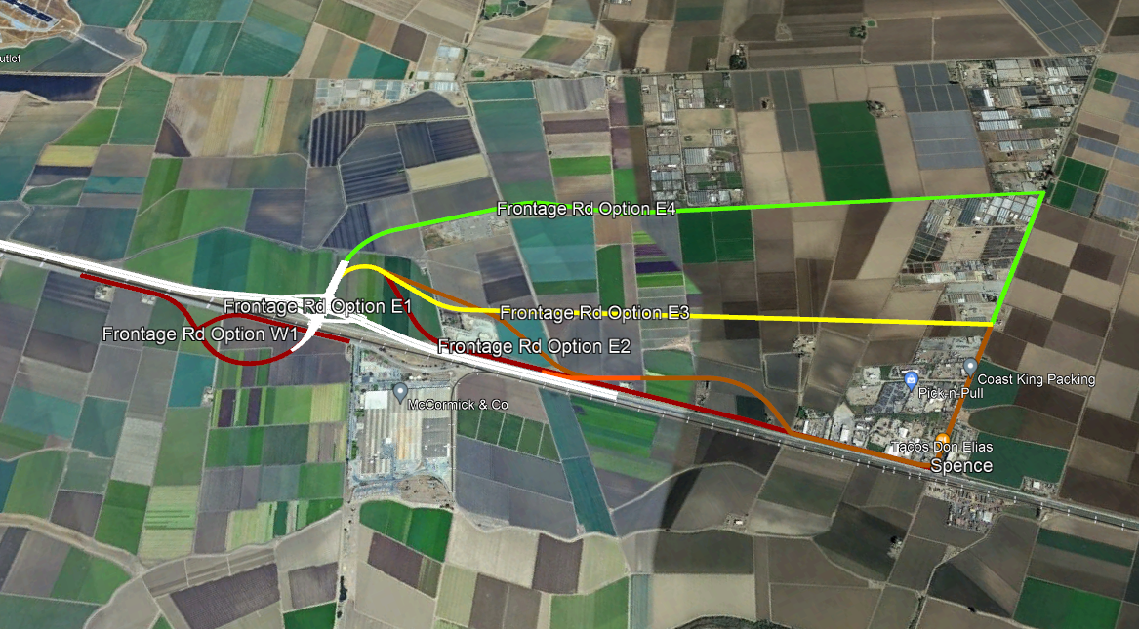
Concept at A3: Frontage Road Options

Slide 10
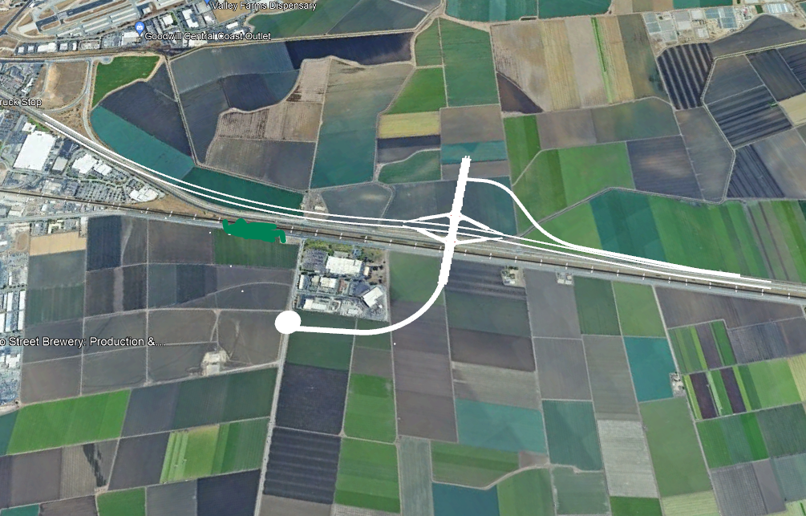
Concept at A4: South of Harris Rd.

Slide 11
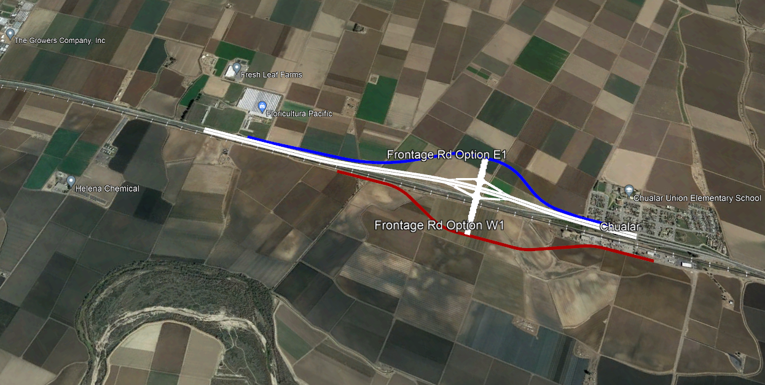
Concept at C2: North of Chualar

Slide 12
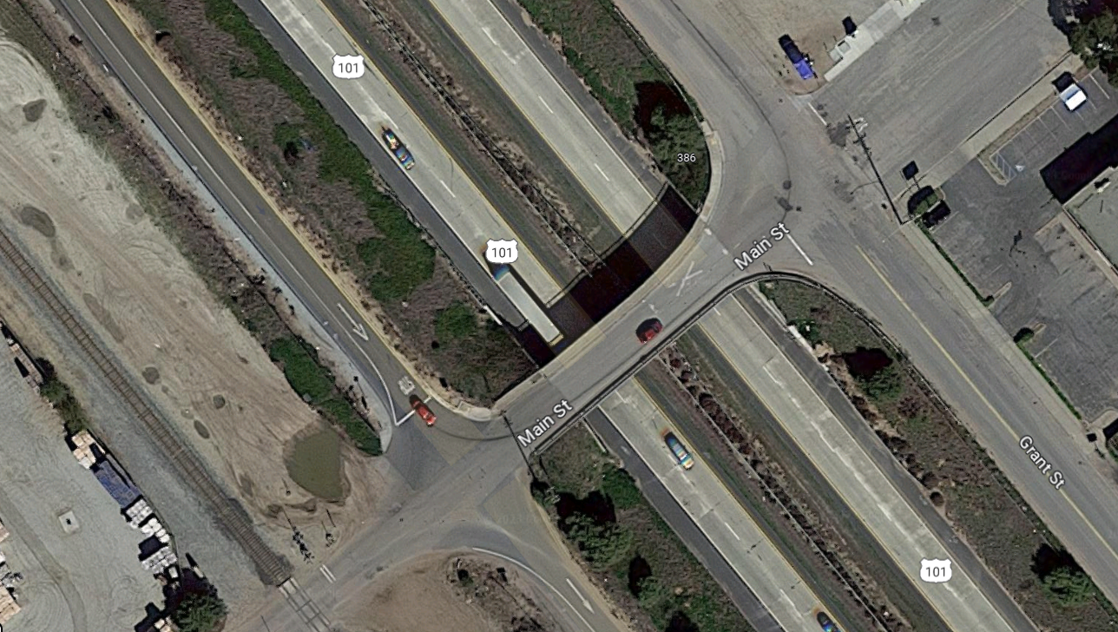
Interim Solution
STOP
STOP

Slide 13
Interim Solution
STOP
STOP
STOP

