Slide 1
Senate Bill 125 Funding Background and Discussion
Alissa Guther, Assistant Transportation Planner

Slide 2
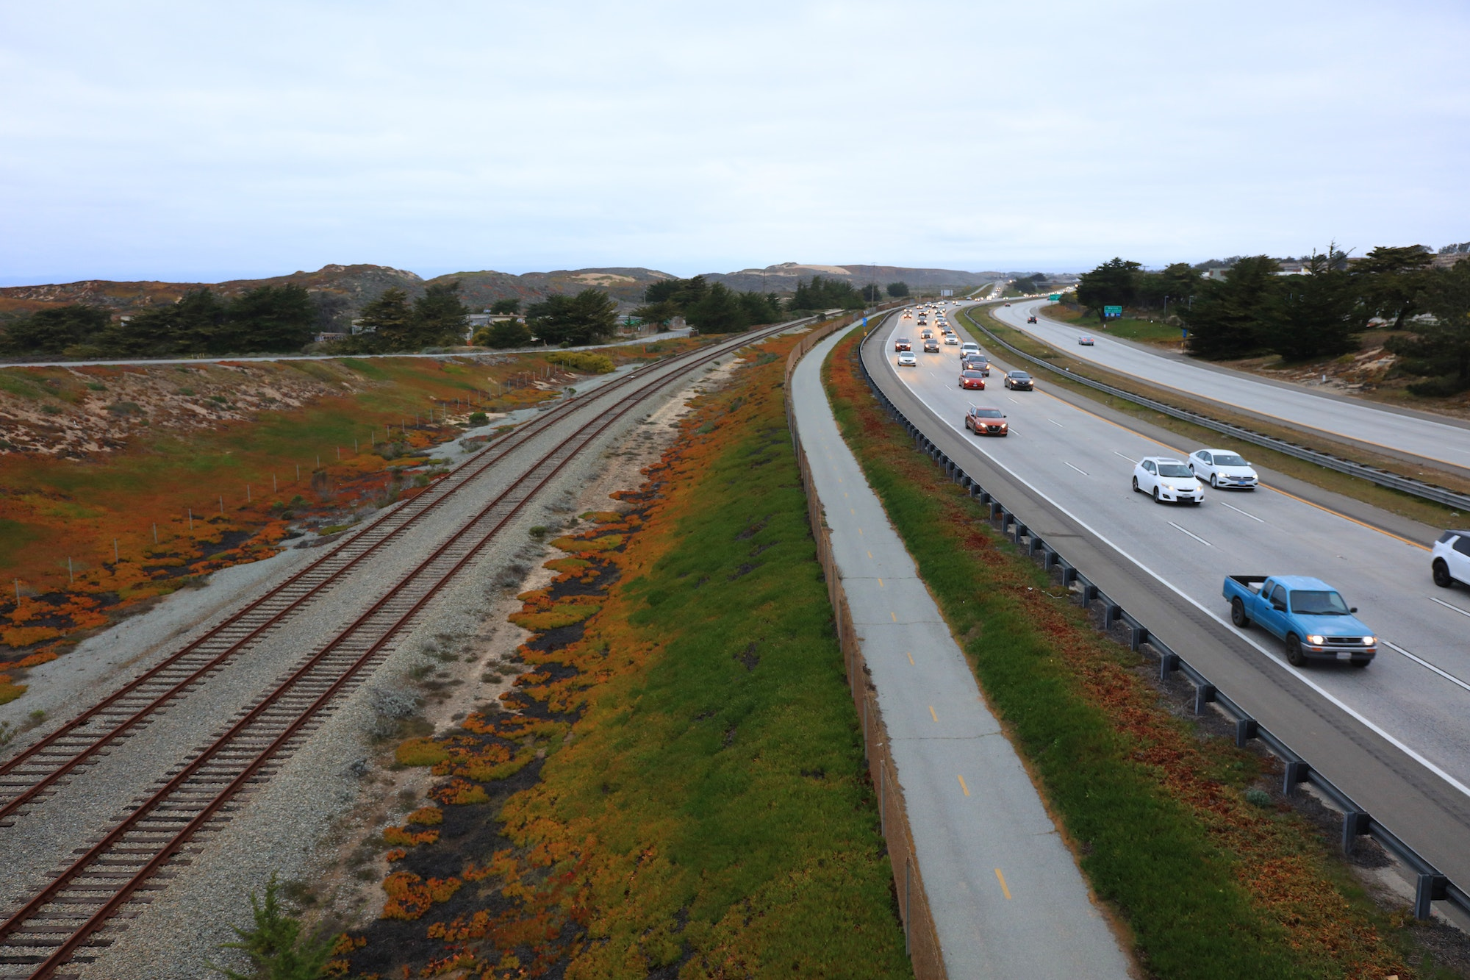
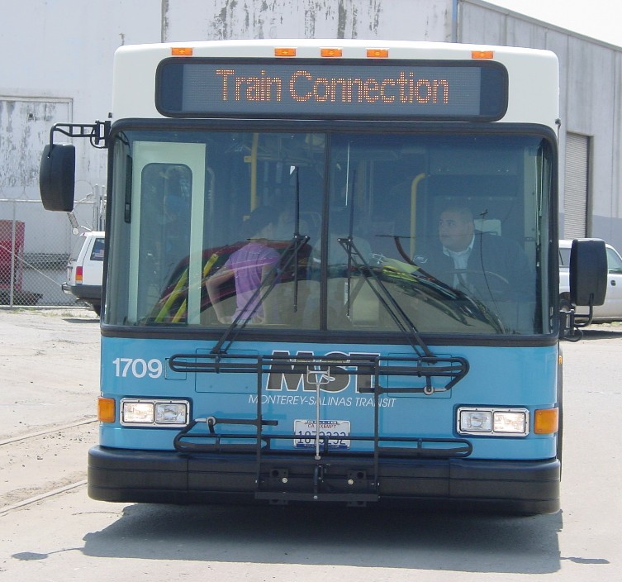
SB 125 Overview
SB 125 provides formula funding:
  Transit and Intercity Rail Capital Program
  Zero Emission Transit Capital Program
Reporting and accountability measures

Slide 3
SB 125 Legislative Intent
Address transit operational costs
Prevent transit service cuts and increase ridership
Prioritize transit dependent riders
Prioritize transit agencies that represent a significant percent of regions ridership

Slide 4
Funding Distribution
Budget
TIRCP | $44.5M
ZETCP | $8M
Total | $52.5M
Admin Budget | max $524,758
No time limit for fund expenditure
Notes:
Admin is 1% of total allotted

Slide 5
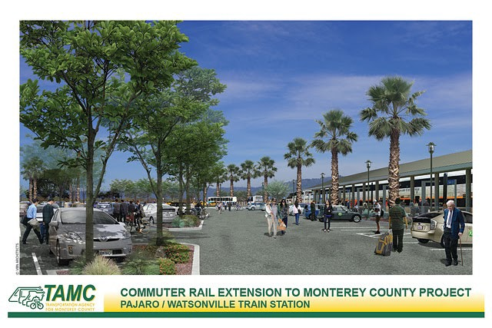
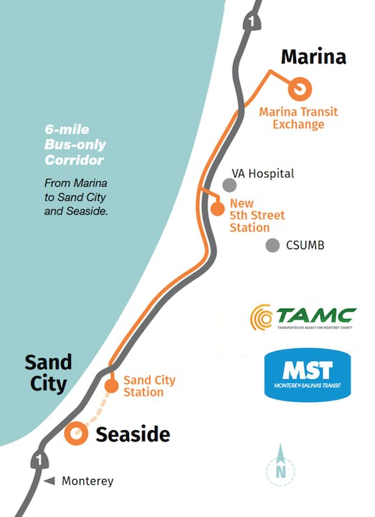
Eligible Projects
Rail Capital Projects
Rail and Transit Preconstruction Activities
Bus Rapid Transit and Bus Investments
Zero Emission Transit Fleets
Zero Emission charging infrastructure
Transit operations

Slide 6
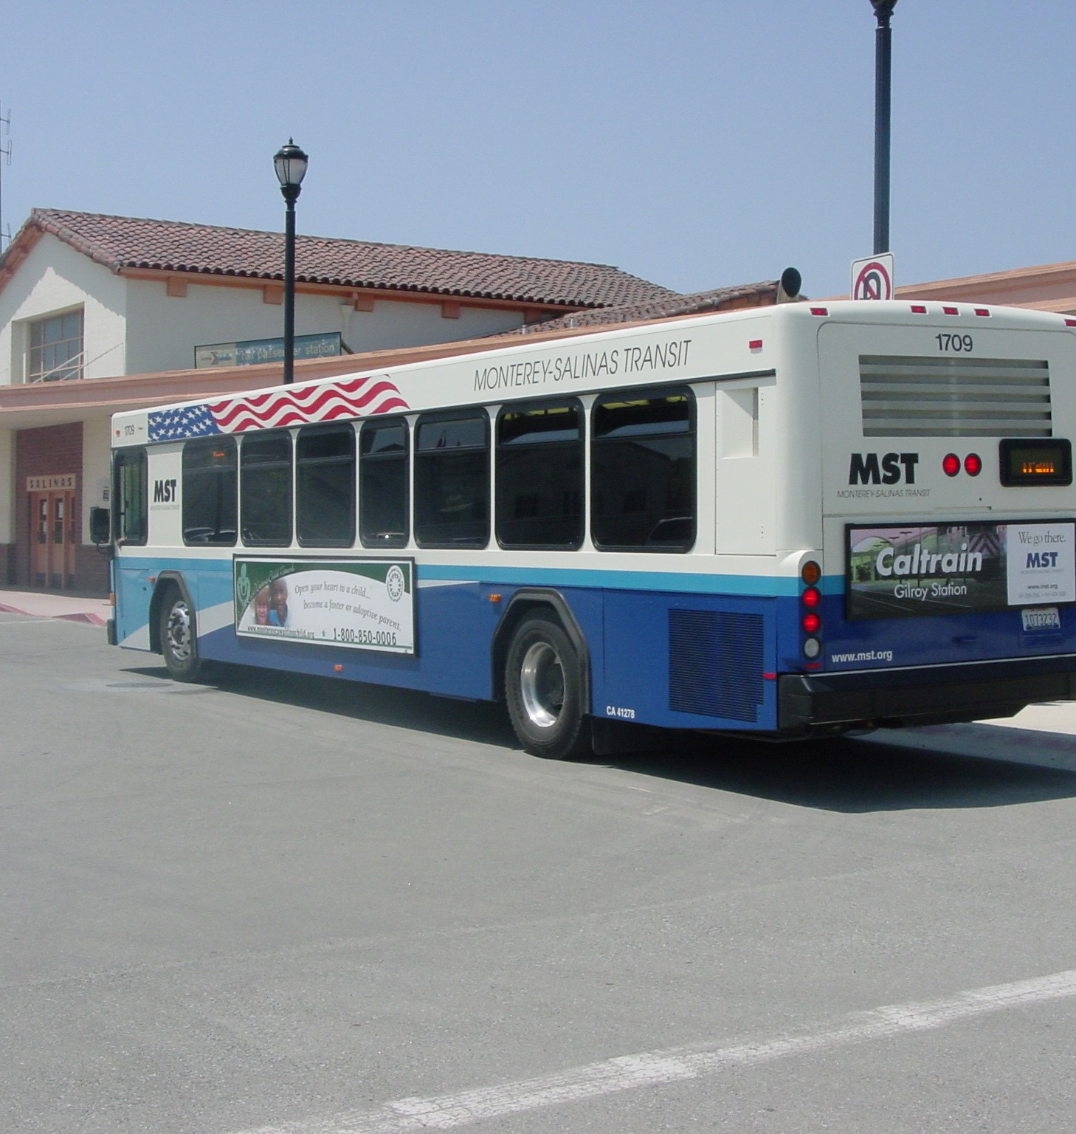
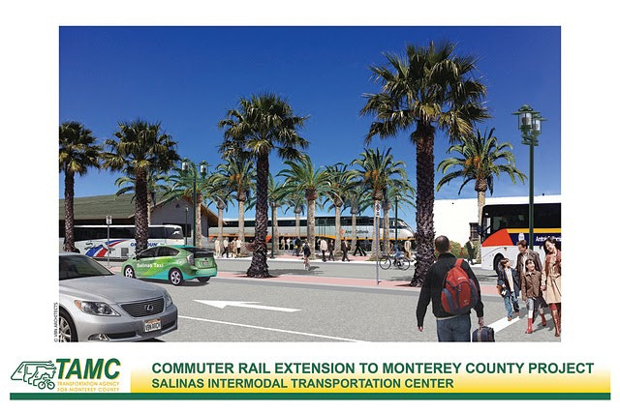
Allocation Timeline
Allocation Request
  December 31, 2023
  Narrative
  Short Term Financial Plan
Long Term Financial Plan
  June 30, 2026

Slide 7
Possible Projects
Rail
Bus
Pajaro/Watsonville Multimodal Station
Salinas Rail Extension
King City Train Platform
Central Coast Rail Positive Train Control (PTC)
MST Operating Shortfall
SURF! Busway
Electric Bus Charging
Zero Emission Buses
Monterey Bay Microgrid & Hydrogen Electric Bus
Salinas Valley Hydrogen Electric Bus

Slide 8
Thank you
Contact: Alissa Guther
(831)775-4402
alissa@tamcmonterey.org

