Slide 1
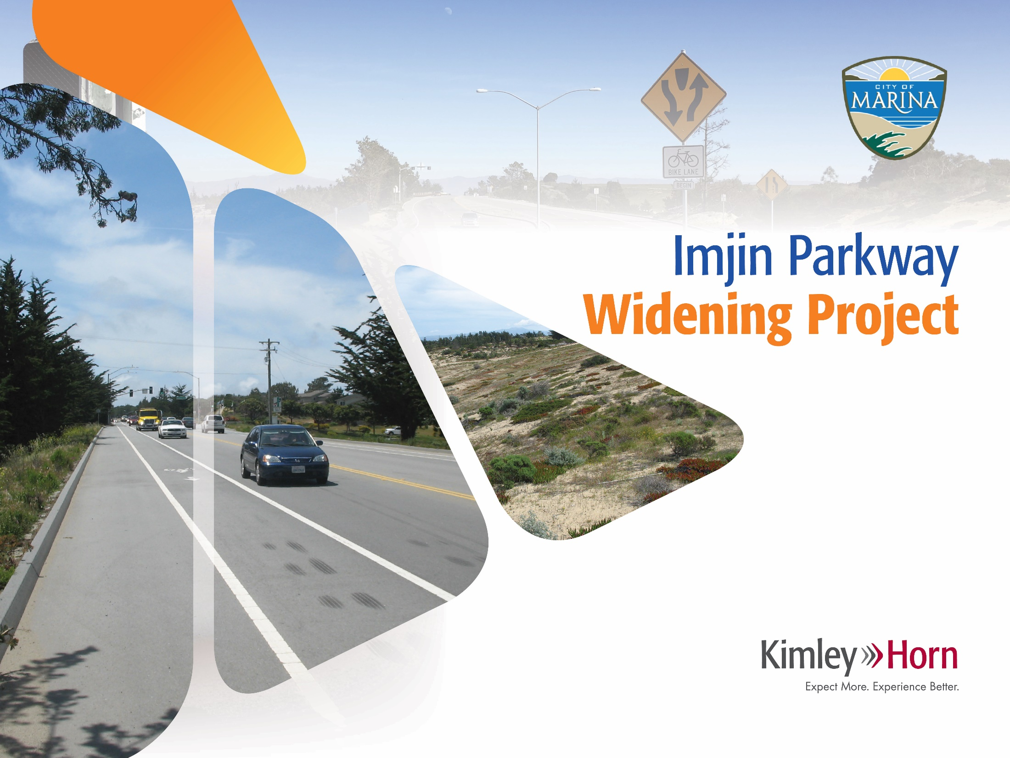

Notes:
TAMC Board

Slide 2
Summary
Project Overview
Traffic Safety
Finalize Environmental Clearance
Funding Summary

Slide 3
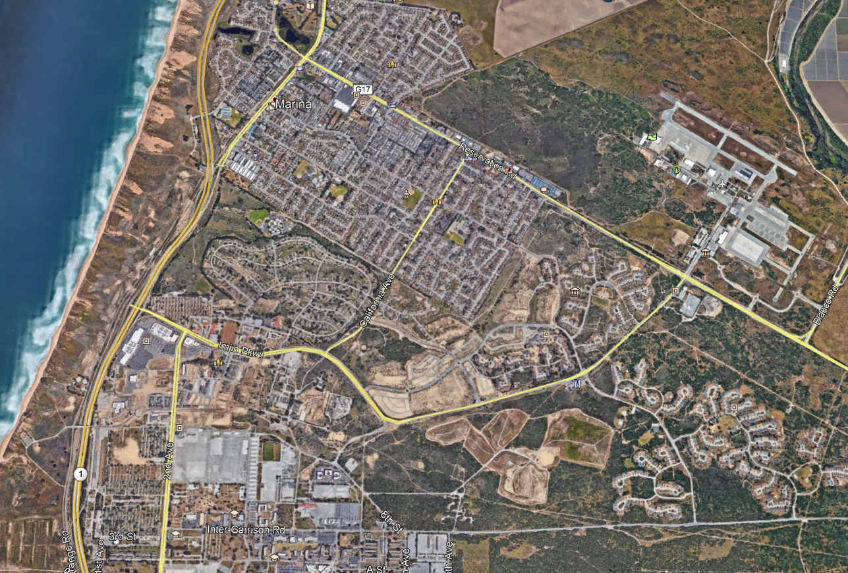

Project Overview
Notes:
Widening from 2 to 4 lanes, from Imjin Road to Reservation Road (1.8 miles)
13 Years – Design, Environmental Clearance, Right of Way, Interested Parties
Total cost $43.5M

Slide 4
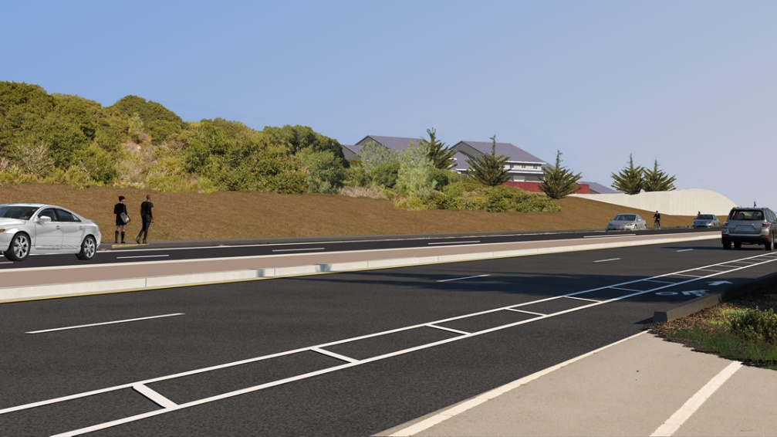
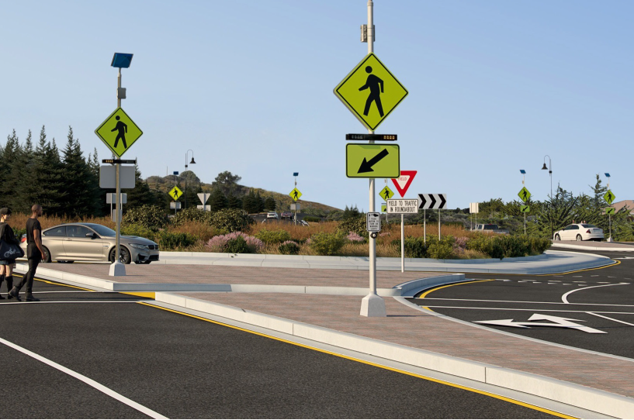
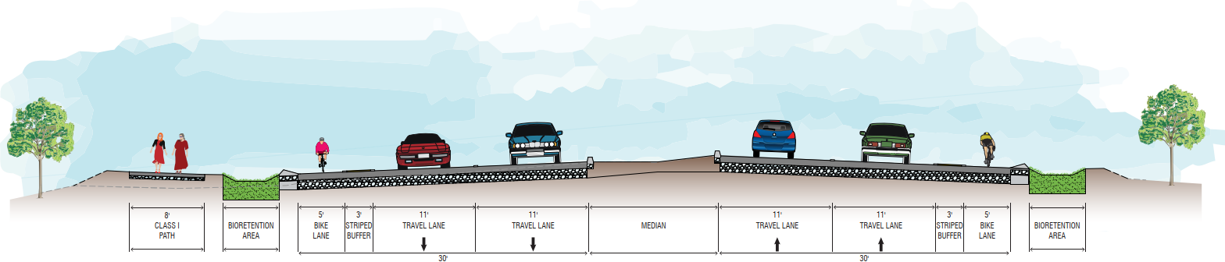
Project Overview
Notes:
Widen to four lanes
Install four roundabouts
Install mixed use path
On-street buffered bike lanes
Stormwater treatment areas
Retaining and sound walls
Landscaping and irrigation

Slide 5
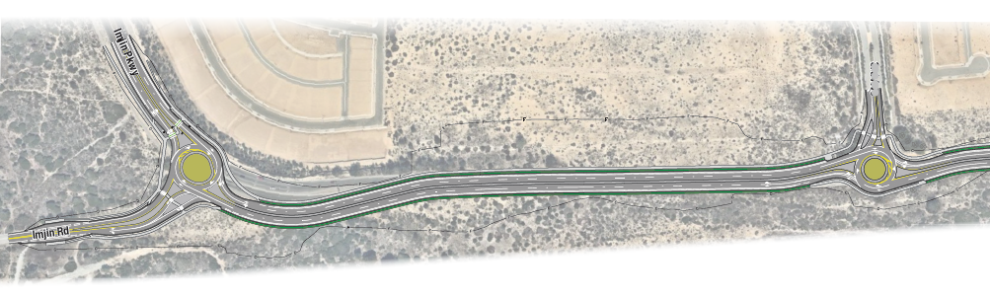
Corridor Layout
Notes:
Roundabouts at Imjin Rd (getting a new name) along with Marina Heights Drive.
These roundabouts will have new pedestrian and bicycle crossings as well as transition elements for Class 2 Bike riders to travers the roundabouts either within the roundabout or on an off-road Class 1 pathway.

Slide 6
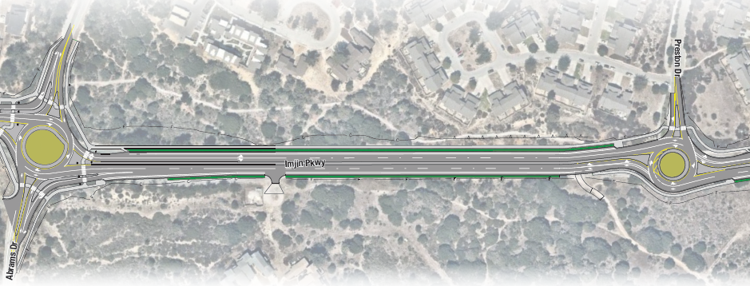
Corridor Layout
Notes:
Busiest Intersection of Abrams/Imjin will be designed to reduce the intersection delay in half
Grades at Preston Drive will be adjusted to allow better sight distance for all modes of travel

Slide 7
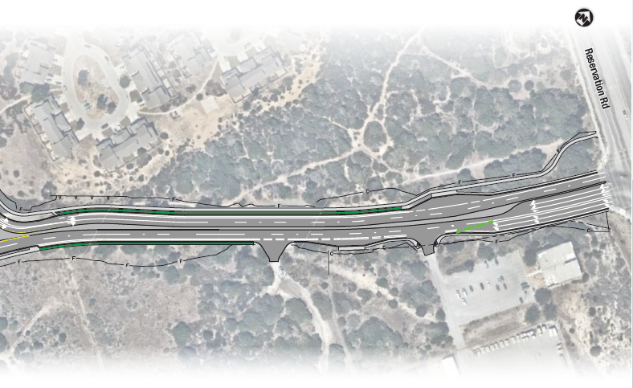
Corridor Layout
Notes:
Improvements to MST bus stop and Army Corp entrance has been incorporated into the project design. Improvements to the Signal at the Reservation/Imjin intersection will also adjust for the new turning configurations and bike timing

Slide 8
Safety Characteristics of Modern Roundabouts
Convert signalized intersection
to roundabout
All crashes
48%
Fatal/injury crashes
in rural area
78%
Fatal/injury crashes
in urban area
60%
Source: 2010 US Department of Transportation: Federal Highway Administration
Notes:
This slide shows typical crash reduction data for converting a standard signalized intersection to a modern roundabout.
The top two numbers shown are for all roundabouts (1- and 2-lane, rural and urban).
However, studies show that crashes are reduced significantly for both 1- and 2-lane configurations.

Slide 9
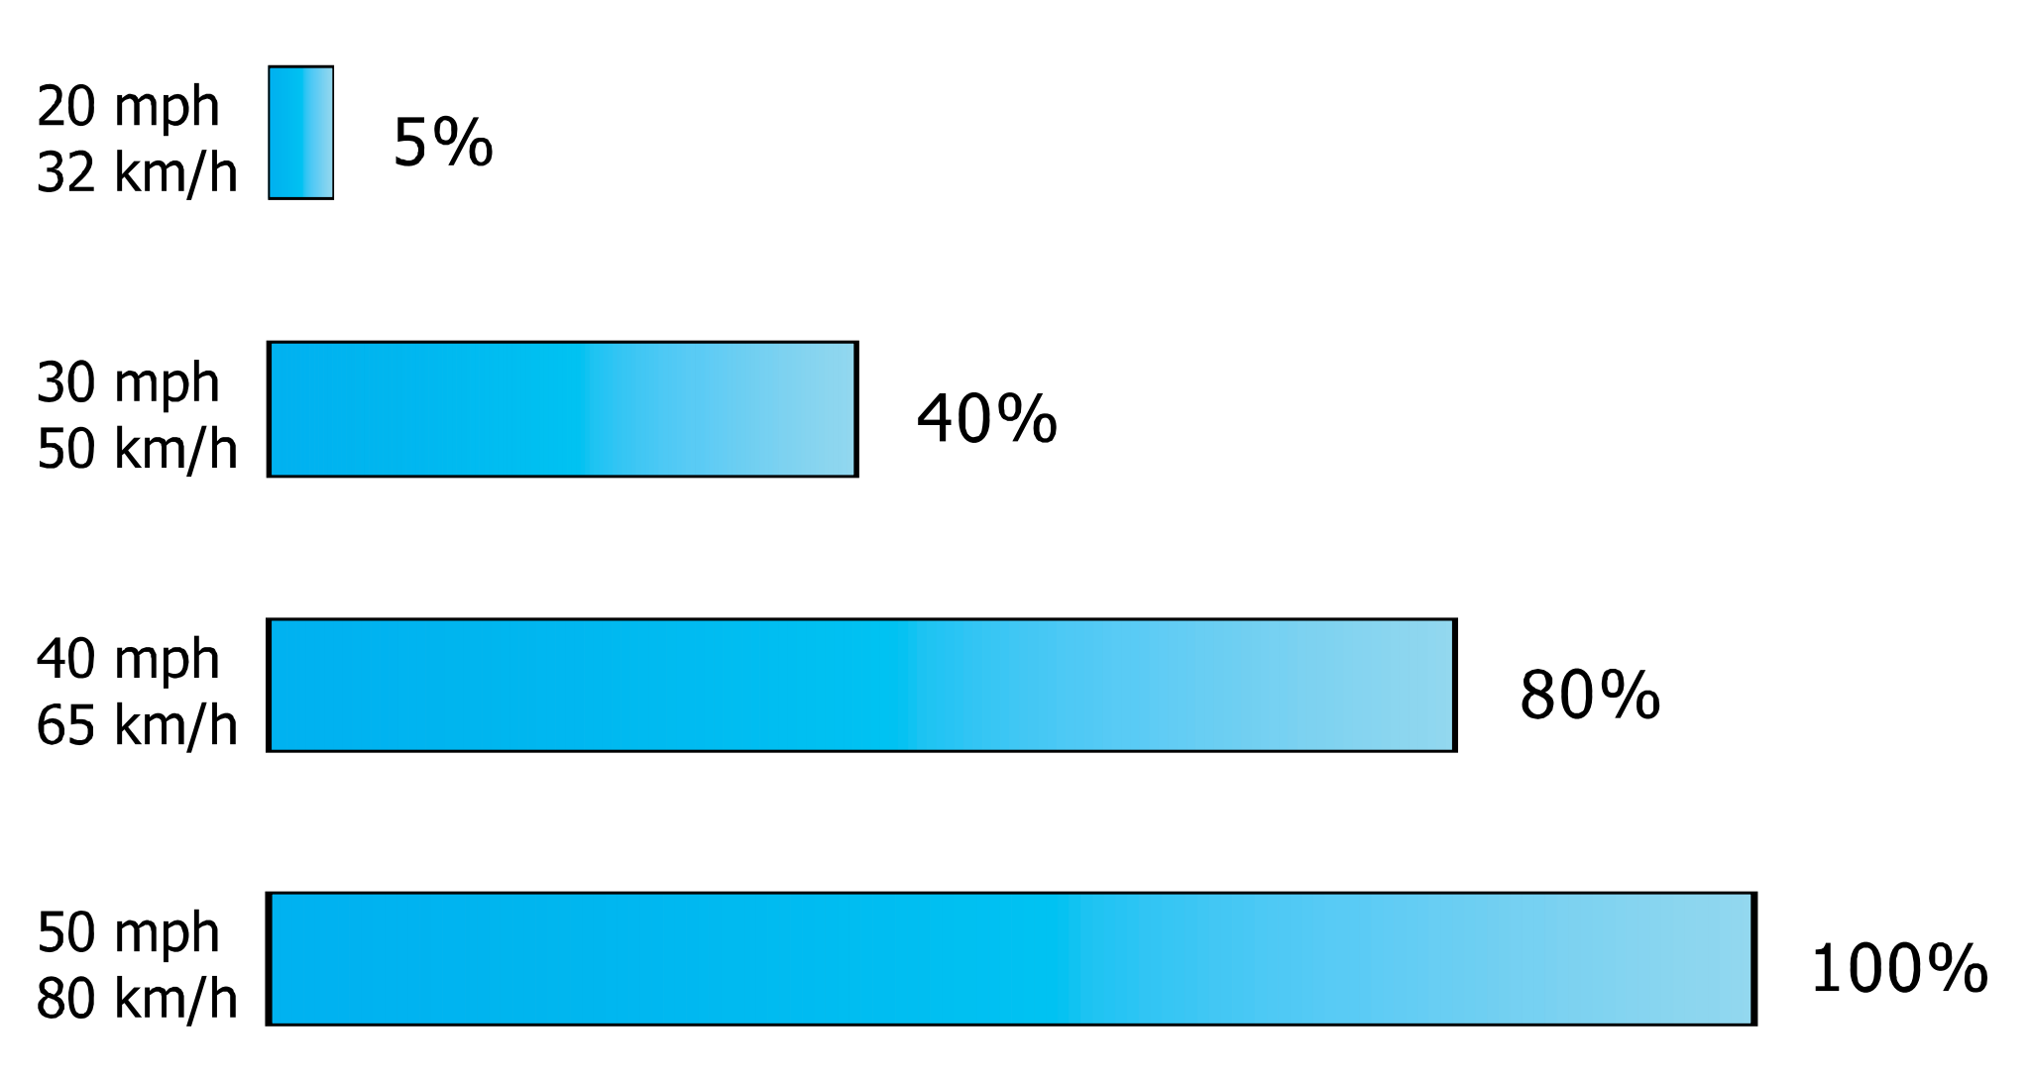
Safety Characteristics of Modern Roundabouts
Chance of Pedestrian Fatality if Hit by a Motor Vehicle
Typical Roundabout Travel Speeds (20-30 mph)
Typical Rural Intersection Travel Speeds
Source: Literature Review on Vehicle Travel Speeds and Pedestrian Injuries, National Highway Traffic Safety Administration DOT, 1999
Notes:
National Highway Traffic Safety Administration found that travel speeds through intersections have direct relation to Pedestrian Fatalities when hit by motor vehicles.
Benefits from Roundabout Geometry prevents excessive speeds through major intersections, greatly reducing the likelihood of fatalities during pedestrian-vehicle accidents.

Slide 10

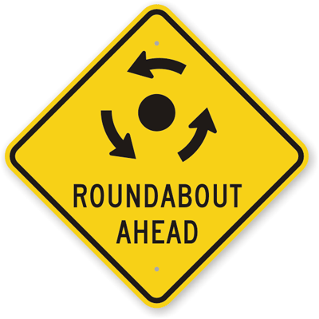
Traffic Comparison Analysis (2035)
Average Travel Time
(Minutes)
Time | Traffic Signals | Roundabouts
Average Off-Peak Hour | 2.9 | 2.1
*1 min. reduction, 15-30%, Emergency Response effectiveness
Notes:
1.3 mi long corridor
Signal Failure, gridlock occurs – power outage, disasters when Emergency Vehicle Response is critical;

Slide 11



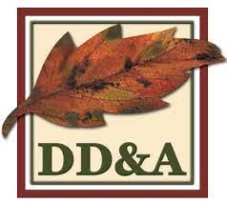


Current Project Schedule
Environmental Clearance:
  April-June 2023
Celebratory Construction Start:
  June 2023
Construction Timeline:
  June 2023 – September 2025

Slide 12
Funding
Component | Funding Source | Amount
Construction | Local Impact Fee | $2.00 million
 | Measure X | $18.25 million
 | Senate Bill 1 (SB1) Local Partnership Program (LPP) | $20.25 million
 | TOTAL | $40.5 million

Slide 13
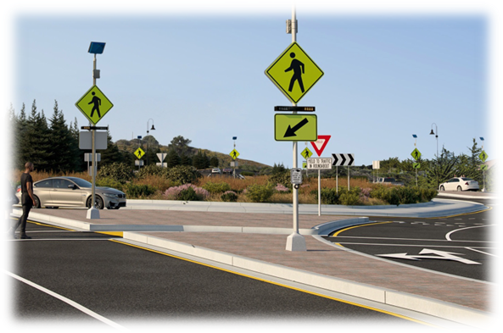
Summary
Project Overview
Traffic Safety
Finalize Environmental Clearance
Funding Summary
Notes:
Next Steps:
Dedicated Website: FAQ, Newsletters, Traffic Updates, Live Camera Feeds
Stakeholder Meeting
Project Celebration in June, more info to come

