Slide 1

Fiscal Year 2019/20 Measure X Audit Reports
Citizens oversight Committee
February 16, 2021

Slide 2
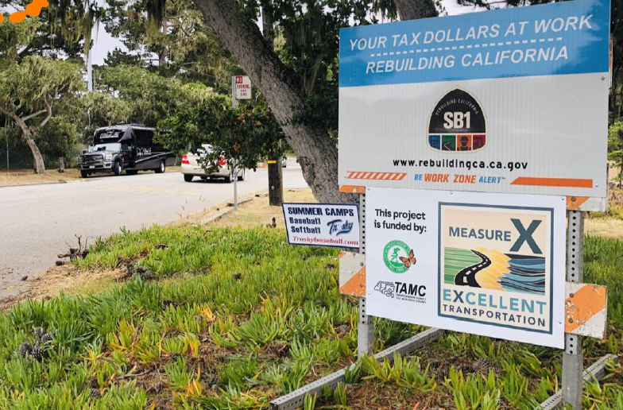
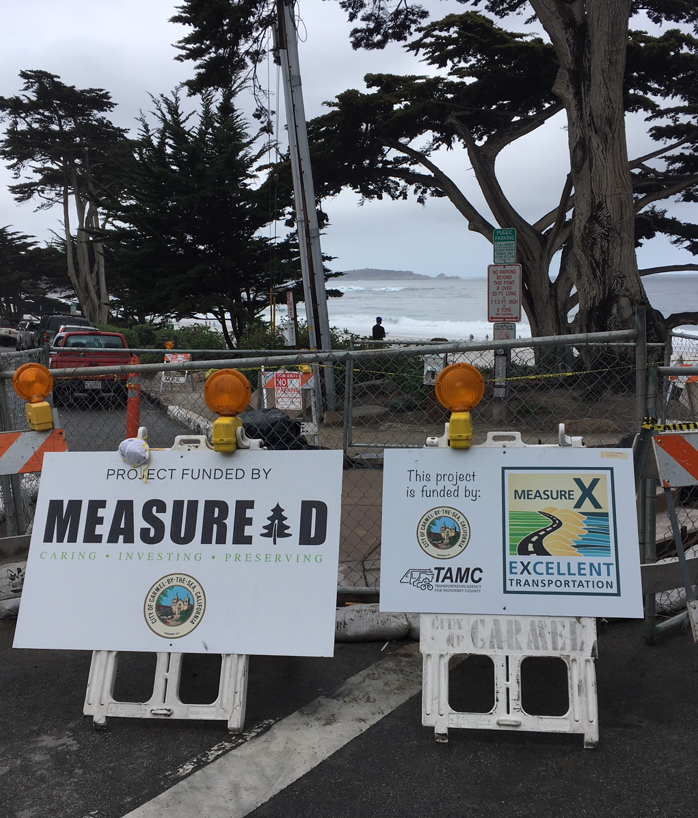
Local Jurisdiction Compliance with Measure X

Slide 3
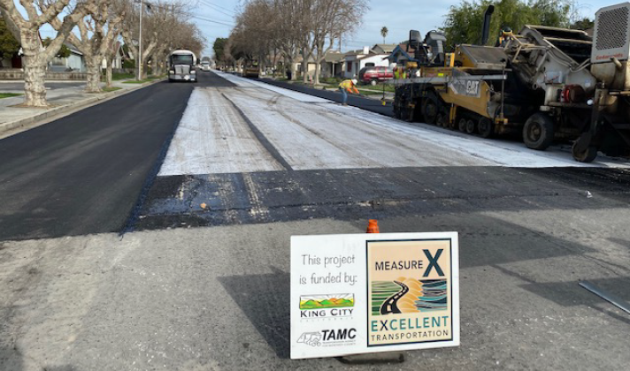
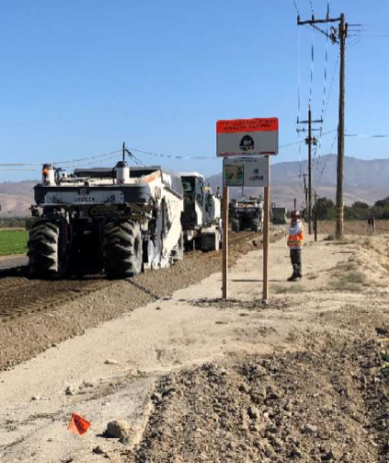
Local Jurisdiction Compliance with Measure X
Notes:
North Vandurhurst Avenue in King City
Arroyo Seco Road Reconstruction – County – Full Depth Reclamation

Slide 4
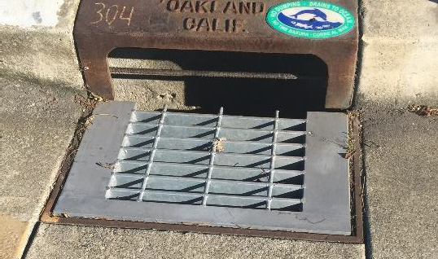
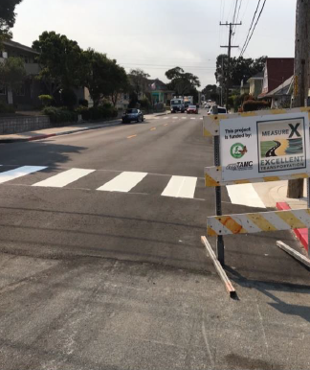
Local Jurisdiction Compliance with Measure X
Notes:
Bike Safe Grates - Seaside
Central Ave - PG

Slide 5
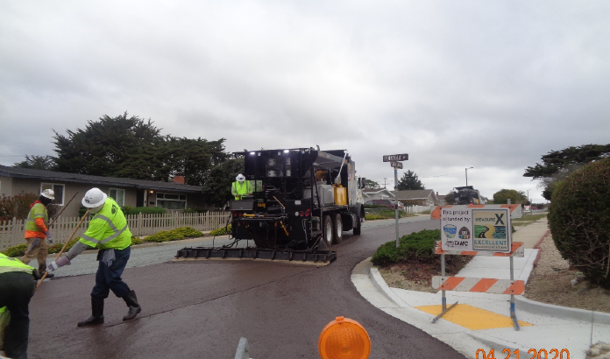
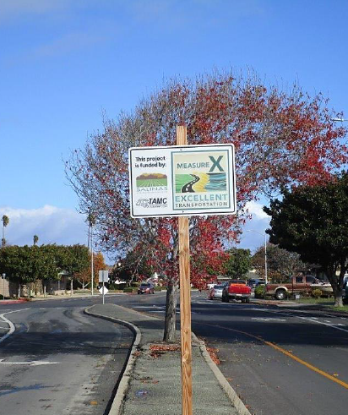
Local Jurisdiction Compliance with Measure X
Notes:
Slurry seal in Marina
Salinas Downtown Complete Streets

Slide 6
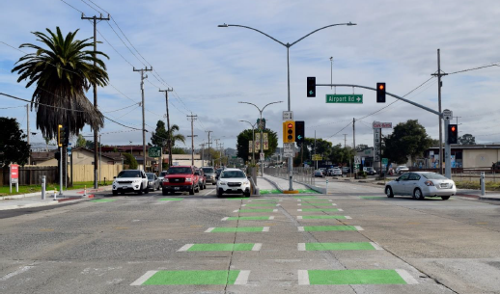
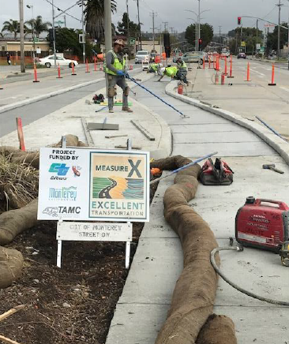
Local Jurisdiction Compliance with Measure X
Notes:
Monterey – North Fremont

Slide 7
Strategic Goals
City (or County) | Reports Submitted on time? | Annual Program Compliance Report | Maintenance of Effort | 5-Year Program of Projects | Independent Financial Audit | Pavement Management Report
Monterey County | Yes | Yes | Yes | Yes | Yes | Yes
Carmel-by-the-Sea | Yes | Yes | Yes | Yes | Yes | Yes
Del Rey Oaks | Yes | Yes | Yes | Yes | Yes | Yes
Gonzales | Yes | Yes | Yes | Yes | Yes | Yes
Greenfield | Yes | Yes | Yes | Yes | Yes | Yes
King City | Yes | Yes | Yes | Yes | Yes | Yes
Marina | Yes | Yes | Yes | Yes | Yes | Yes
Monterey | Yes | Yes | Yes | Yes | Yes | Yes
Pacific Grove | Yes | Yes | Yes | Yes | Yes | Yes
Salinas | Yes | Yes | Yes | Yes | Yes | Yes
Sand City | Yes | Yes | No | Yes | Yes | Yes
Seaside | Yes | Yes | Yes | Yes | Yes | Yes
Soledad | Yes | Yes | Yes | Yes | Yes | Yes
FY2019/20 Measure X Audit Reports

