Slide 1
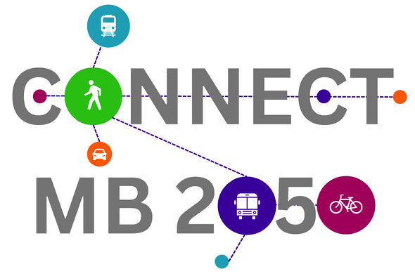
2050 MTP/SCS Update
Heather Adamson, AICP
October 5, 2023
ASSOCIATION OF MONTEREY BAY AREA GOVERNMENTS
1

Slide 2
Background
Long range plan for transportation investments
Federal and state law requires that an MTP/SCS be prepared every four years
Must provide a 20+ year horizon planning period
Detailed work program and schedule approved in April 2023
2050 MTP/SCS scheduled for adoption in June 2026
Highlight a number of key components under development
2

Slide 3
MTP/SCS Development
Develop Vision and Goals
Performance Measures
Update
Project List
Create Scenarios
Select Preferred Scenario
Create
Draft Plan
Generate Revenue Projections
Public Participation and Interagency Coordination
3

Slide 4
2026 Regional Growth Forecast
Developing the tri-county forecast for population, housing, and employment using the Cohort Component Population Method
This method implements a cohort component model for the population forecast that uses birth, death, and migration information to predict future population
AMBAG Board will be asked to accept the tri-county regional numbers later this fall/early 2024
Begin subregional disaggregation to the jurisdiction level in 2024
Growth forecast is scheduled to be approved for planning purposes in fall 2024
4

Slide 5
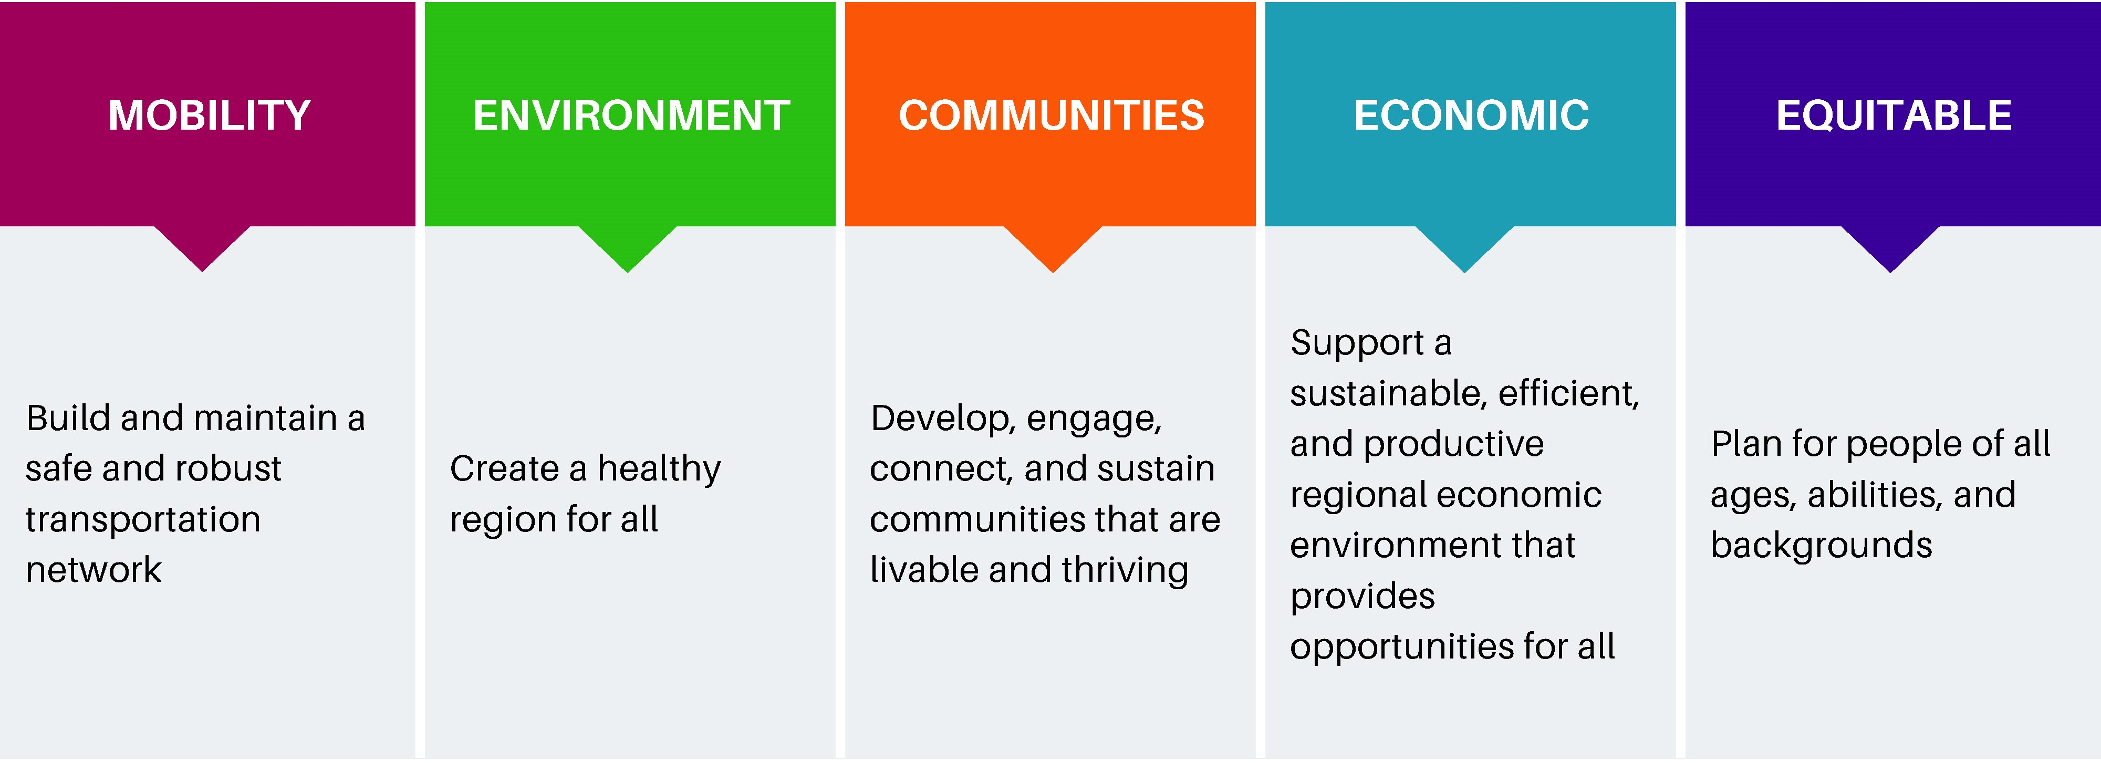
Vision &
Policy Goals
Vision: An accessible and connected region for a safe, resilient, and equitable future
5

Slide 6
MTP/SCS Project List
Developing a new transportation project database
In 2024, AMBAG will begin work with the RTPAs, transit operators, Caltrans, and local jurisdictions to update the project list for the 2050 MTP/SCS
“Call for Projects” will allow for changes to existing 2045 MTP/SCS projects, adding new projects or delete those that have been completed
Projects will be evaluated using MTP/SCS performance measures for inclusion in the Plan
6

Slide 7
Next Steps
Continue to develop the 2026 Regional Growth Forecast
Finalize the Vision and Policy Goals
Update MTP/SCS performance measures
Continue to implement the 2050 MTP/SCS work plan components, including updating the project list, revenue forecasts, and scenario development
7

Slide 8
Input/Questions
8

