Slide 1
New Mobility Laws passed in 2022
TAMC Board
February 23, 2023

Slide 2
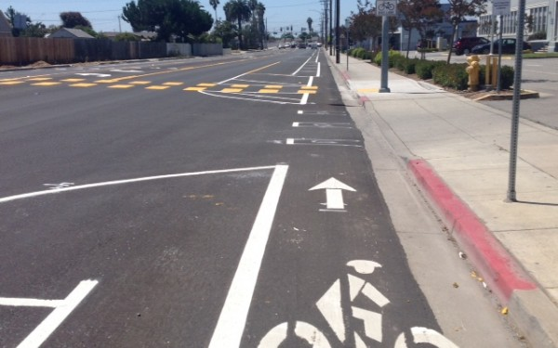
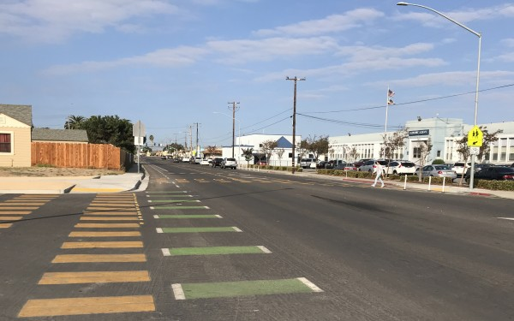
New Mobility Laws Enacted in 2022 AB 1909 is Groundbreaking
Notes:
Assembly Bill 1909 (OmniBike Bill)
Assembly Bill 1946
Assembly Bill 2000
Assembly Bill 1732
Senate Bill 1472

Slide 3
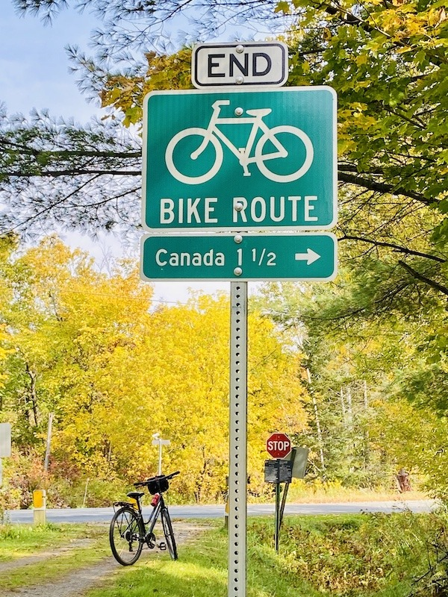
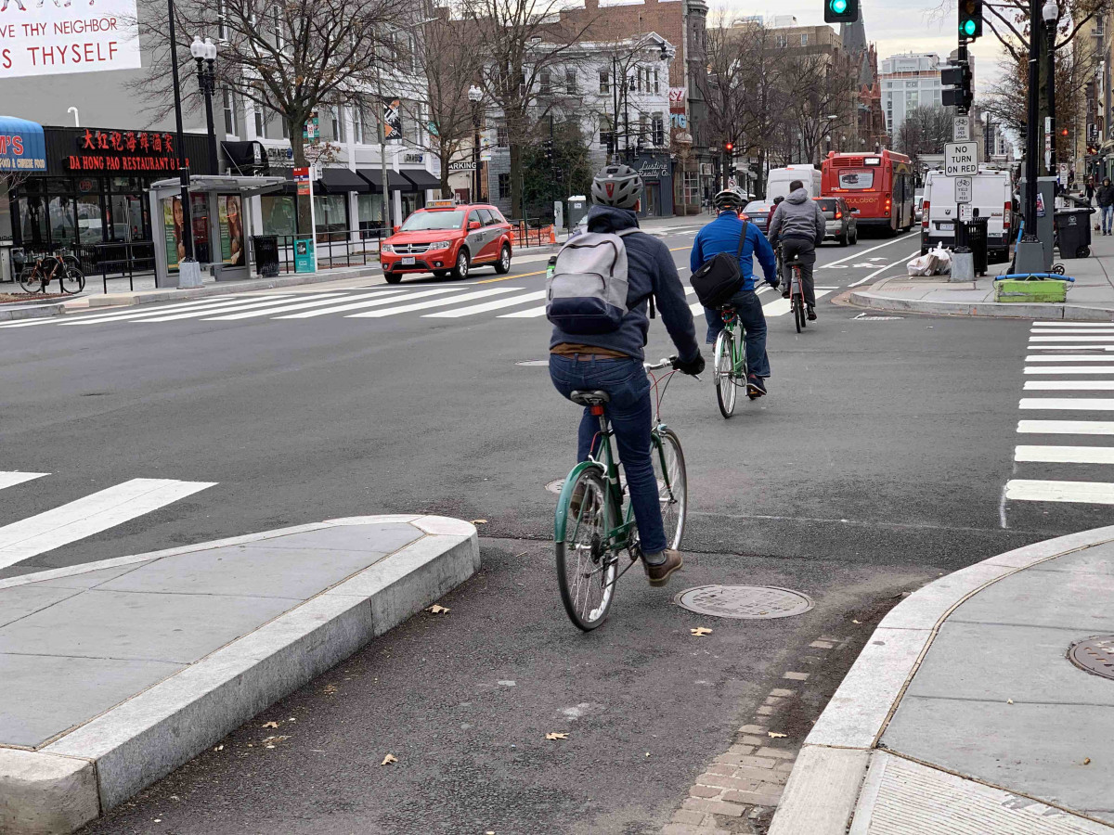
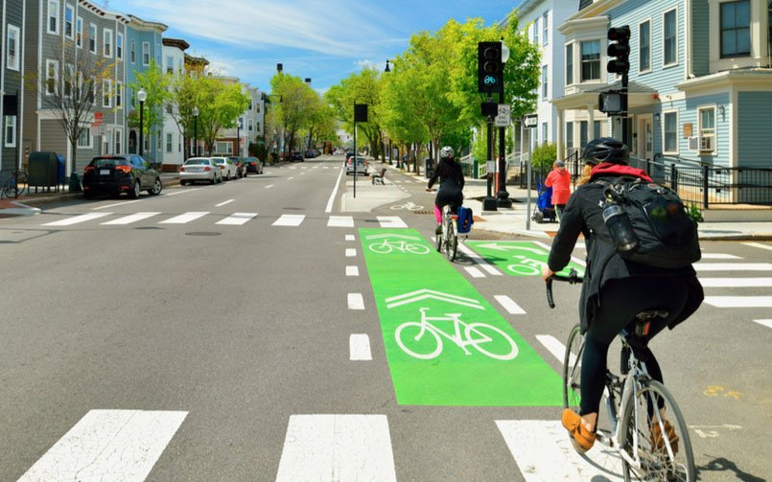
Bicycles previously had to follow the rules of the road for automobiles (vehicular cycling)
Must cross intersections with cars
Bicyclists required to register in some cities
No motor vehicles allowed in a bicycle lane (e.g., e-bikes)

Slide 4
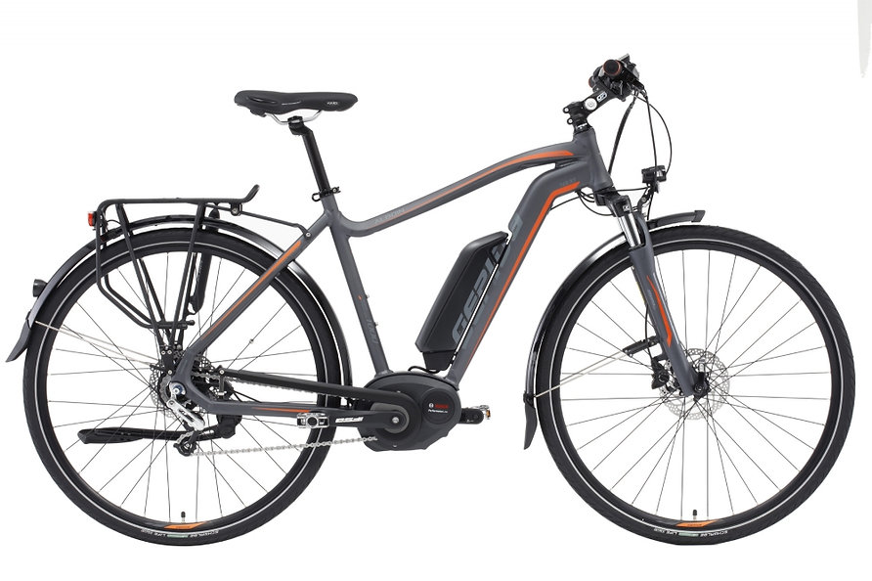
New Definition for E-Bikes
Several Assembly and Senate Bills were approved last year that go into effect in 2023 that impact mobility. Some of these new rules represent a revolutionary change in the way California treats bicyclists. Until now, the California Vehicle Code (CVC) has generally treated bikes as cars. Bicyclists were required to cross intersections with cars. Cars are required to be registered with the state and bicyclists were required to register with cities. Electric bicycles (e-bikes), like cars, were banned from some bikeways. The OmniBike Bill recognizes that bikes are not cars and acknowledges that forcing bike riders to behave like auto drivers (a practice known as vehicular cycling) targets aggressive bike riders and disincentivizes less experienced bike users.
​
Some of the new laws change the way e-bikes are regulated in California. In 2021, more people bought electric bikes than electric cars in the U.S., and sales do not appear to be slowing down. CVC 231 now states that an "electric bicycle is a bicycle" and therefore not a motor vehicle. This determination that an e-bike is not a motorized vehicle is an important distinction because CVC section 21209(a) stipulates that “no person shall drive a motor vehicle in a bicycle lane….” CVC section 312.5 defines an electric bicycle as a bicycle equipped with fully operable pedals and an electric motor of less than 750 watts (1 horsepower) that also falls into one of the following 3 classes:
Class 1 (low-speed pedal-assisted electric bicycle): a bicycle equipped with a motor that provides assistance only when the rider is pedaling, and that ceases to provide assistance when the bicycle reaches the speed of 20 miles per hour.
Class 2 (low-speed throttle-assisted electric bicycle): a bicycle equipped with a motor that may be used exclusively to propel the bicycle, and that is not capable of providing assistance when the bicycle reaches the speed of 20 miles per hour.
Class 3 (speed pedal-assisted electric bicycle): a bicycle equipped with a motor that provides assistance only when the rider is pedaling, that ceases to provide assistance when the bicycle reaches the speed of 28 miles per hour, and is equipped with a speedometer.
​
All other motorized vehicles that do not meet the definition of an e-bike (e.g., scooters, mopeds) must follow the laws established for automobile use, including insurance and registration. Pedicabs can be considered electric bicycles, but CVC Section 21215.5 allows a local authority to impose more stringent operating or equipment requirements on a pedicab.
CVC §231 now states that an "electric bicycle is a bicycle“ when it meets the following:
operable pedals
electric motor of less than 750 watts (1 horsepower)
falls into one of following 3 classes
Notes:
An e-bike is not a motor vehicle

Slide 5
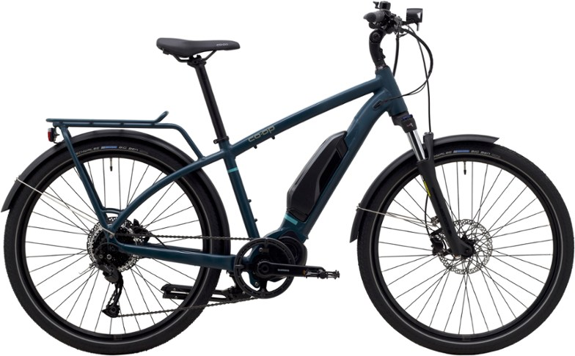
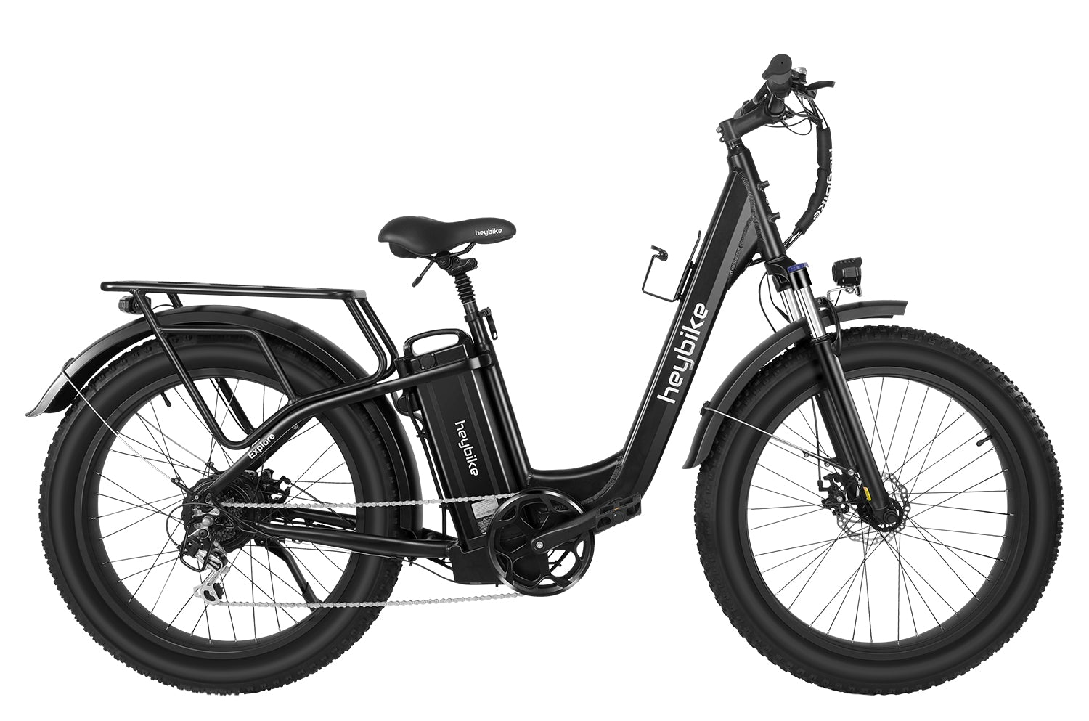
3 Classes of E-Bikes
Class 1: low-speed pedal-assisted electric bicycle
Class 2: low-speed throttle-assisted electric bicycle
Class 3: speed pedal-assisted electric bicycle
Notes:
Class 1: bicycle equipped with a motor that provides assistance only when the rider is pedaling, and stops assistance when the bicycle reaches 20 mph
Class 2: bicycle equipped with a motor that may be used exclusively to propel the bicycle, and stops providing assistance at 20 mph
Class 3: bicycle with motor that assists only when the rider is pedaling, that stops assisting at 28 miles per hour, and is equipped with a speedometer.

Slide 6
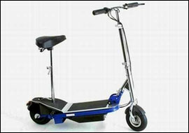
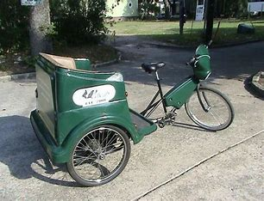
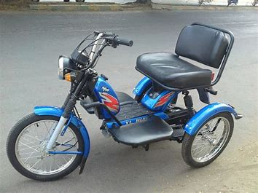
Other Motorized Vehicles
Other motorized vehicles (e.g., scooters, mopeds) must follow the laws established for automobile use
Pedicabs can be considered electric bicycles, but local authority can impose operating or equipment requirements
Notes:
This includes insurance and registration

Slide 7
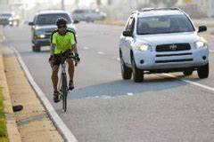
OmniBike Bill Has 5 Components
1. Creates a Margin of Safety for Passing Vehicles
Current 3-foot passing rule difficult to enforce
New law drivers must pass bikes going into the next lane, if possible
Notes:
Someone on the driver’s side of a car may have difficulty estimating a 3-foot distance on the opposite side of their vehicle

Slide 8
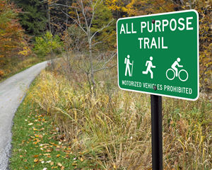
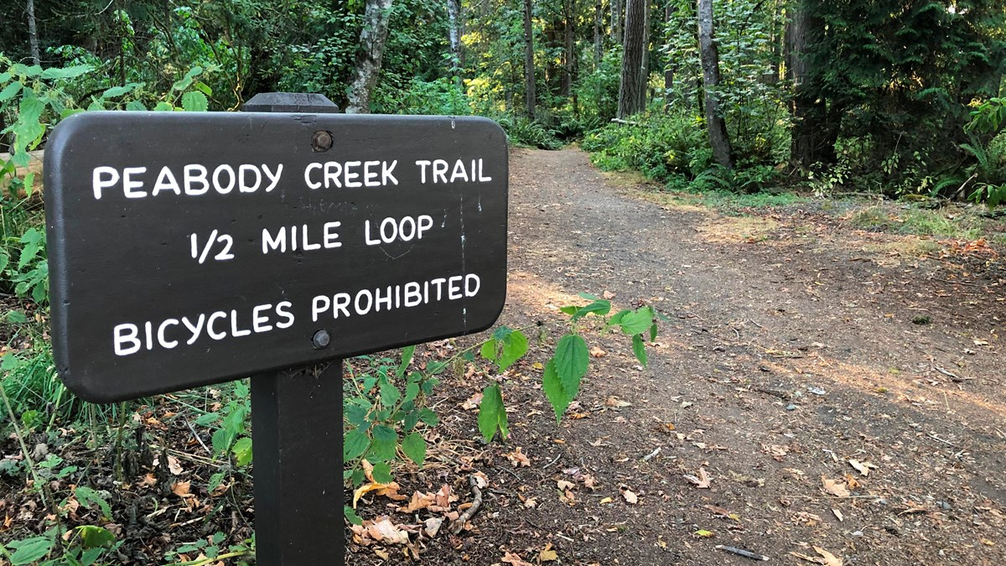
OmniBike Bill Has 5 Components (con’t)
2. Clarifies E-Bike Access on bikeways, bicycle lanes, equestrian trails, hiking trails and recreational trails
Previous laws:
prohibited Class 3 e-bikes on all bicycle paths without posting signage
allowed prohibition of any class of e-bikes on any of these facilities with signage
New laws:
e-bikes allowed to bike anywhere a bike is allowed unless a sign is posted
can prohibit Class 3 e-bikes on bikeways, bike paths, bike lanes with a posted sign
can prohibit any class of e-bikes on equestrian, hiking trail, or recreational trail
Notes:
Local authority must adopt ordinance and post signs before enforcing these prohibitions

Slide 9
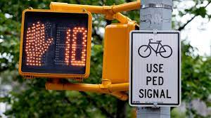
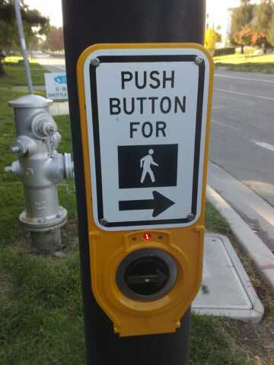
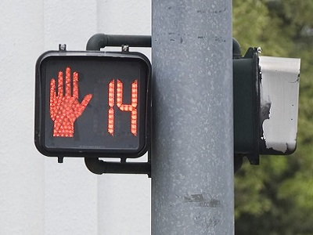
OmniBike Bill Has 5 Components (con’t)
3. Walk Signals Are For Bikes Too
Advance walk signals for pedestrians allows pedestrians to start crossing the street 3 to 7 seconds before cars are allowed to move
Its now legal for bicyclists to start crossing the street during advanced walk phase
Now the Caltrans default and will lead a trend in California
Notes:
also referred as a (leading pedestrian interval) This allows pedestrians to be more visible to turning vehicles by giving them a head start to claim their space on the street before conflicting vehicles enter the intersection
LPI will be used by Caltrans except when prohibited by the California Manual on Uniform Traffic Control Devices

Slide 10
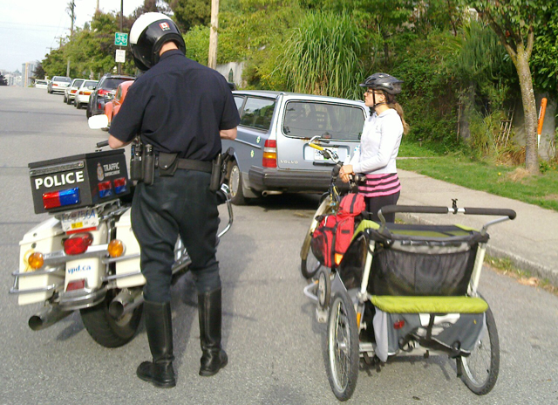
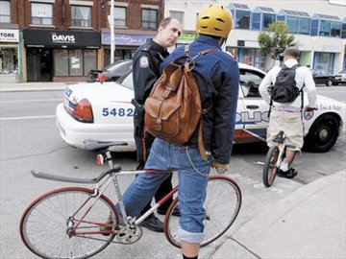
OmniBike Bill Has 5 Components (con’t)
4. No More Bicycle Licensing Ordinances:
previous ordinances required bike registration (or license)
Many bicyclists rode illegally unaware of these laws
Can no longer prohibit operation of unlicensed bike
Notes:
Municipalities can still offer voluntary licensing programs

Slide 11
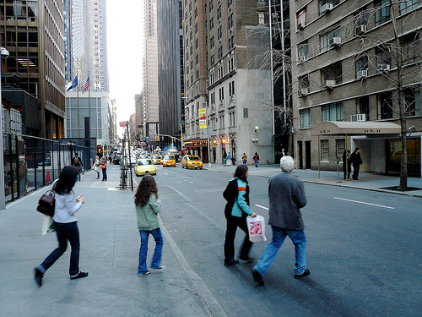
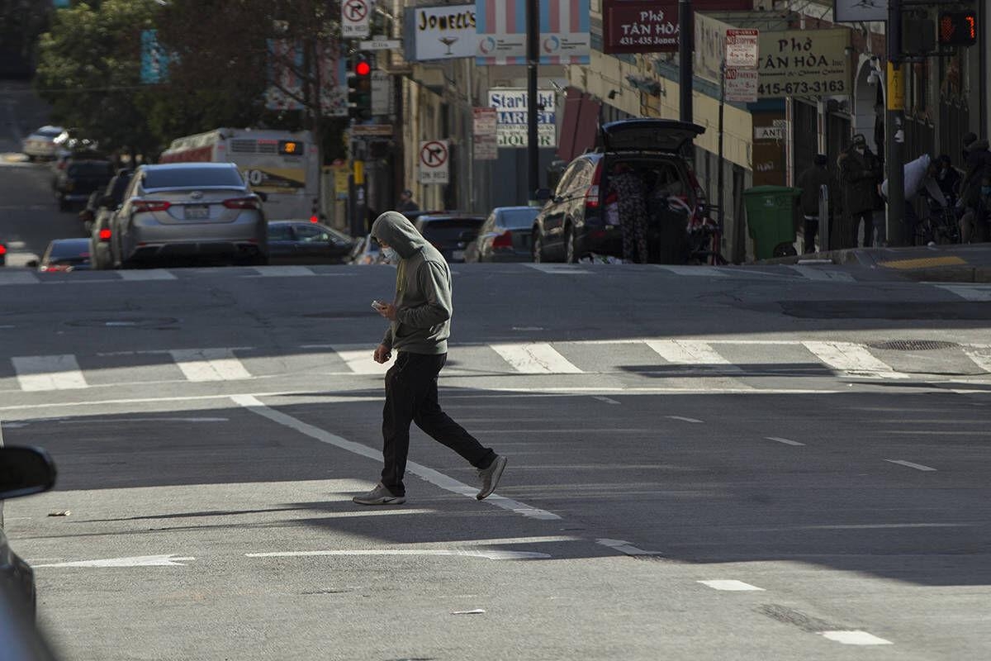
OmniBike Bill Has 5 Components (con’t)
5. Mid-Block Pedestrian Crossing is allowed
Police can no longer ticket midblock "jaywalking" when it’s safe
Can ticket “jaywalking” where there is immediate danger of crash

Slide 12
Questions

