Slide 1

2022 Transportation Excellence Awards Nominees
TAMC Board of Directors Meeting January 25, 2023
Notes:
Each year, the Transportation Agency presents this Excellence Awards Ceremony to honor individuals, businesses, groups, programs and projects in recognition of their efforts to improve transportation in Monterey County. While we continue to recover from the pandemic and the recent winter storms, we are pleased to showcase one outstanding employee, who has exceled at his job and has gone above and beyond, in performing his duties to benefit of the people of Salinas, and to recognize an outstanding transportation project, that true to its designed, weather the 2023 winter storm.

Slide 2
20th Annual Transportation Excellence Awards
Individual Award Nominee: Public Servant
Notes:
Our first award is an individual award to the public servant, who as exceled at their job and has gone above and beyond,

Slide 3
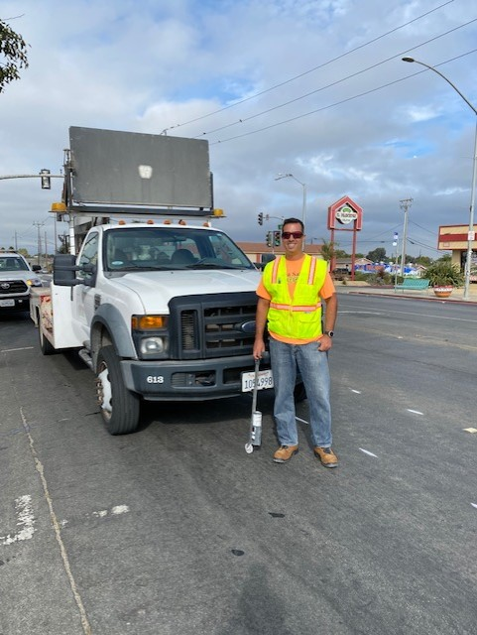
Norm Groot
,
City of Salinas
Traffic Engineer
Andrew Easterling
Notes:
Meet Andrew Easterling:
Andrew Easterling is the Traffic Engineer for the City of Salinas

Slide 4

Notes:
He is being recognized for his development and implementation of the Vision Zero Integrated into Maintenance (VZIM) program

Slide 5

Notes:
and dedication to safe routes to schools planning and projects.

Slide 6
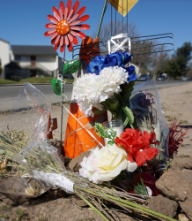
Vision Zero
Safe Travel for All
Safe Streets
Safe Speeds
Safe Vehicles
Safe People
Notes:
“Vision Zero” is a strategy to eliminate all traffic fatalities and severe injuries while increasing safe, healthy, equitable mobility for all. It is a movement that began in Europe and spread to American cities, rooted in the philosophy that no loss of life due to road crashes is acceptable or inevitable and therefore sets the goal of reducing fatalities and severe injuries to zero.

Slide 7
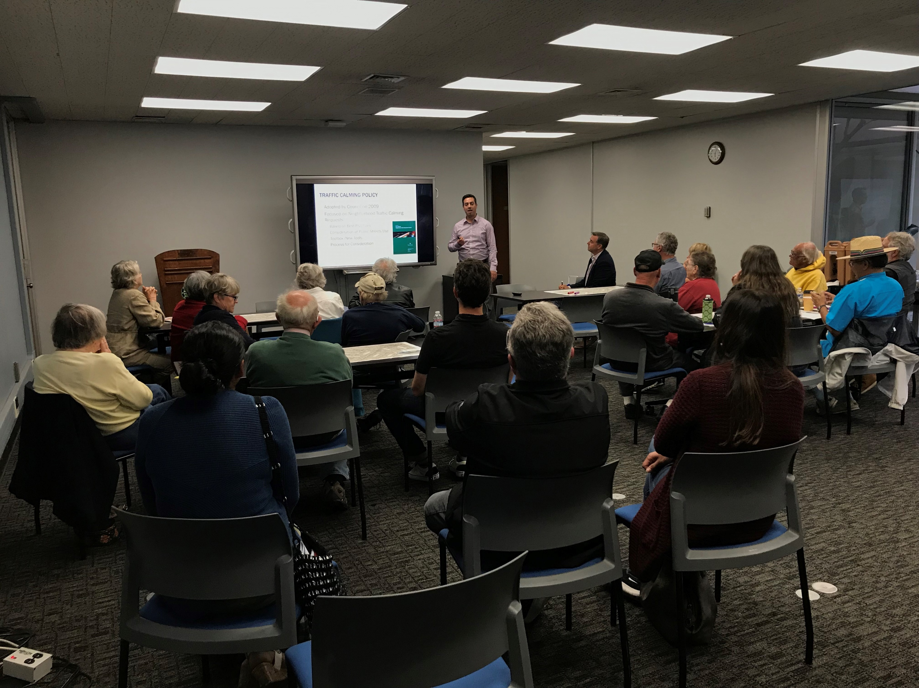
Notes:
The City of Salinas adopted a Vision Zero Policy on February 11, 2020 and directed staff to develop a Vision Zero Action Plan. The Plan developed and implemented by Andrew Easterling

Slide 8
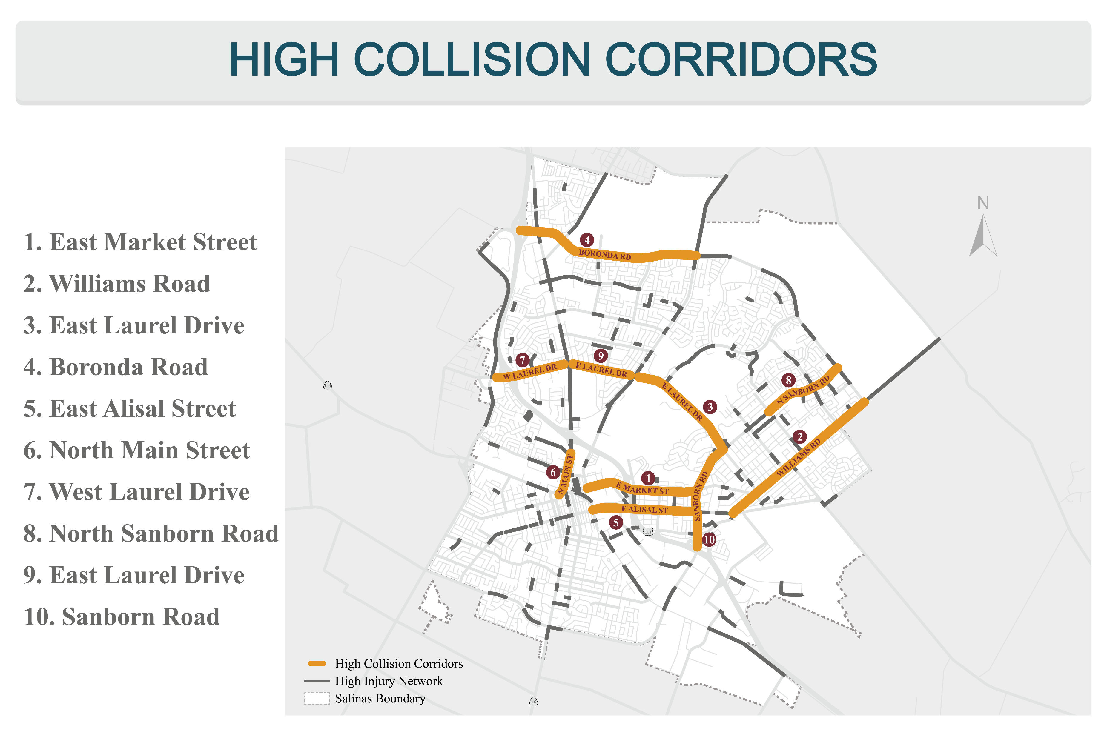
Notes:
identifies where fatal and severed injury collisions are occurring within the City, and GIS technology helps reveal emphasis areas where a higher frequency of collisions can be evaluated to achieve the goal of zero fatalities and serious injuries most effectively.
The Vision Zero Action Plan, guides the City’s Vision Zero Integrated into Maintenance Program.

Slide 9
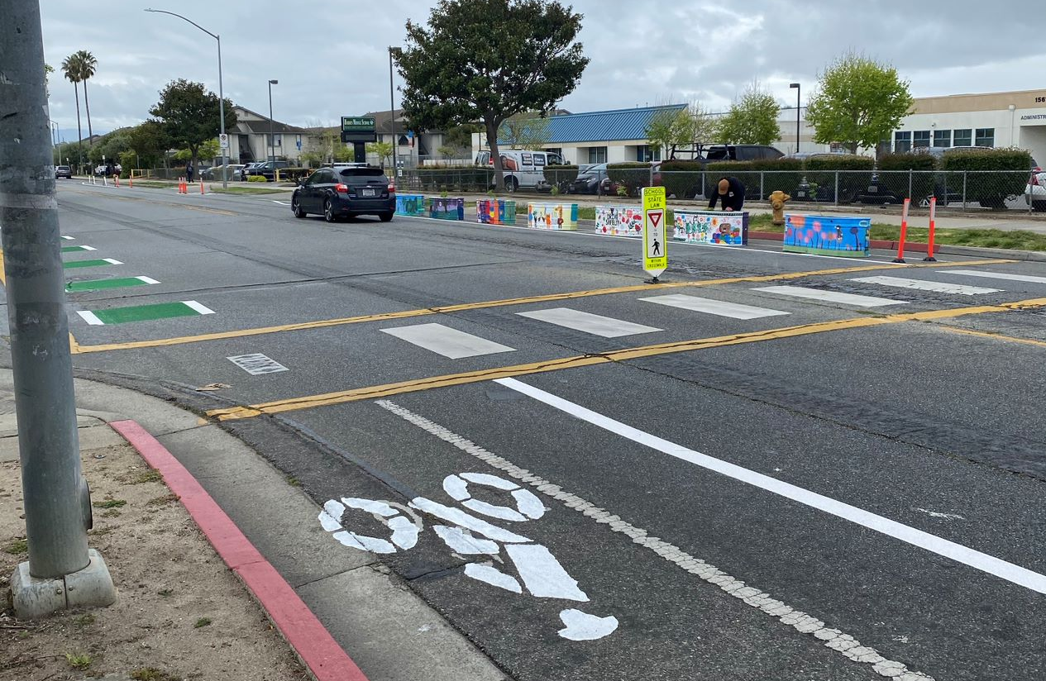
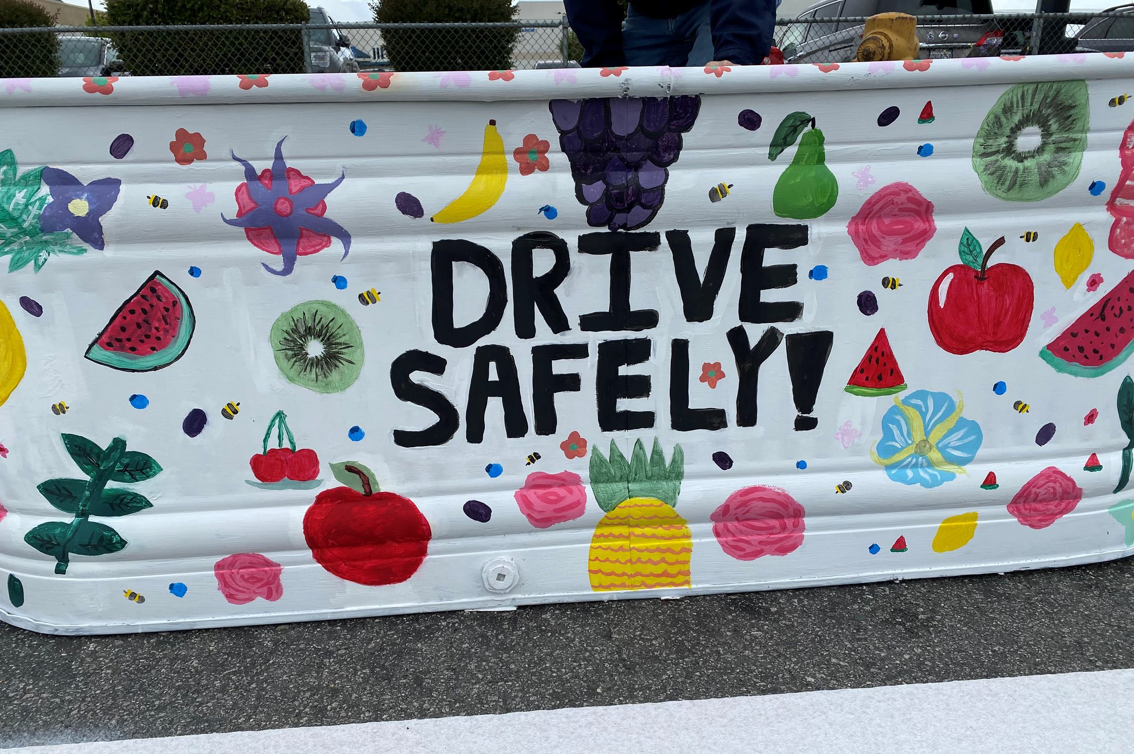


McKinnon Street
April 20 – May 18
https://saferoutesmonterey.org/planning-salinas/

Slide 10
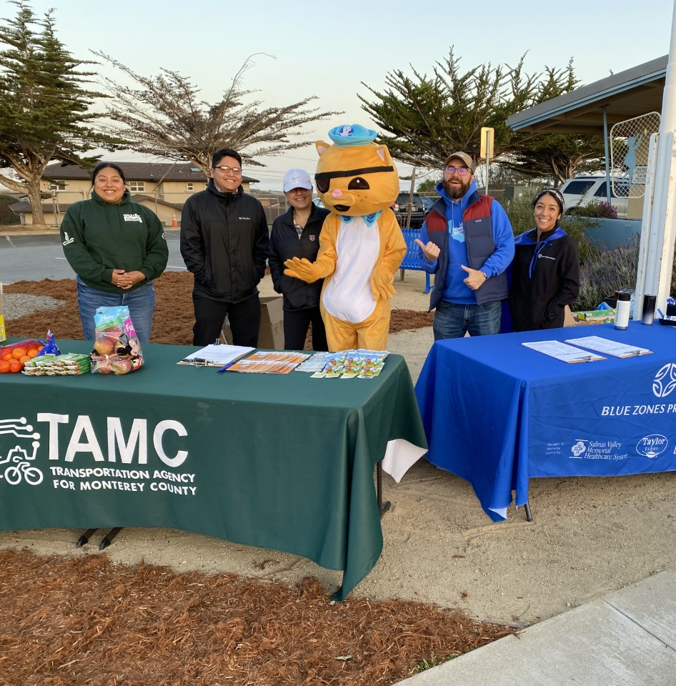
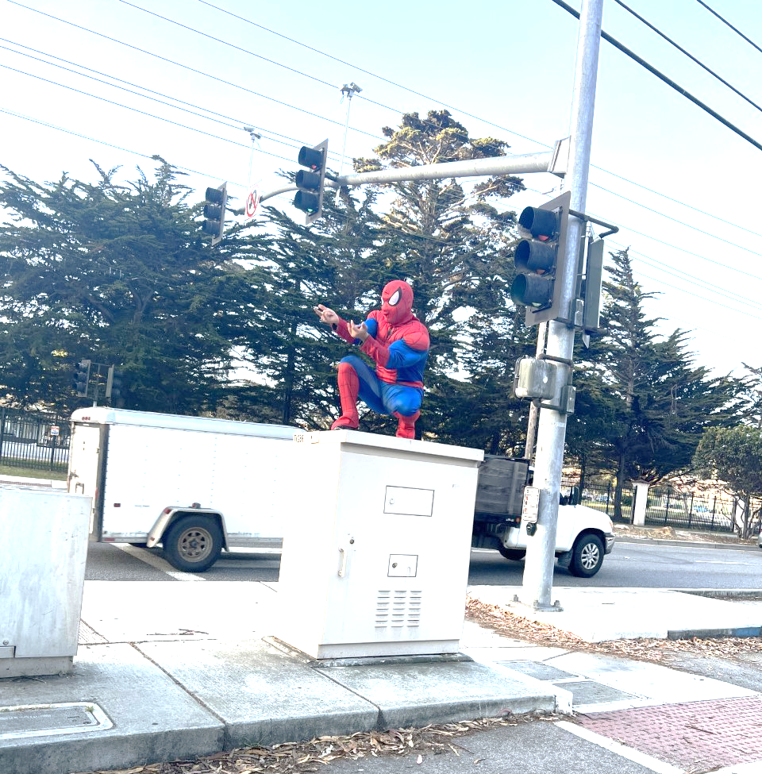

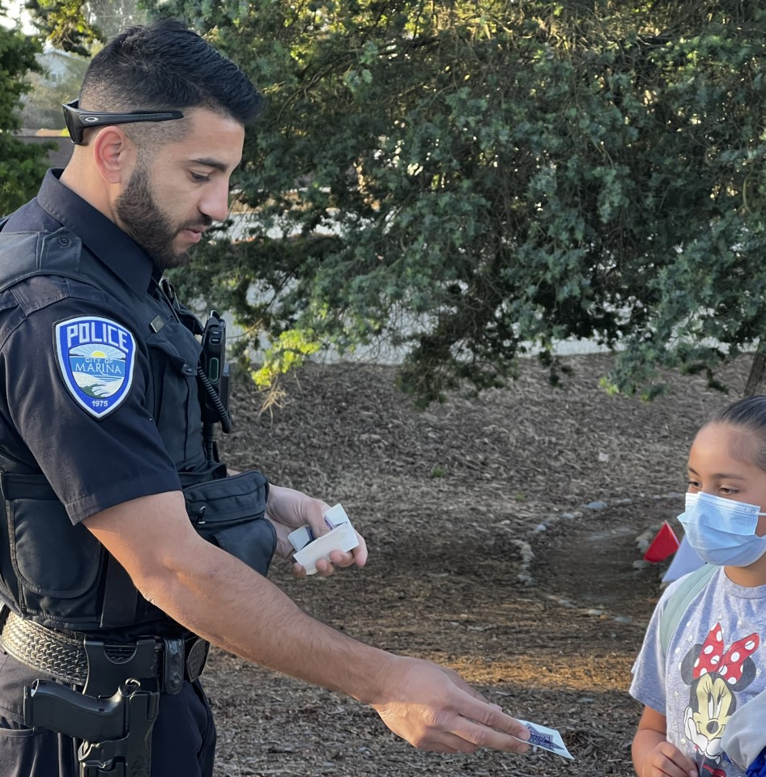
Dedication
Notes:
Andrew is also be recognized for his dedication to safe routes to schools planning and projects in the City of Salinas.

Slide 11
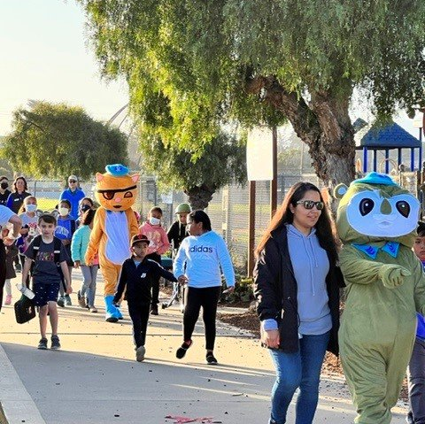


Safe Routes to School Program
Notes:
The Safe Routes to School is a regional Measure X funded program designed to improve safety and health of children

Slide 12
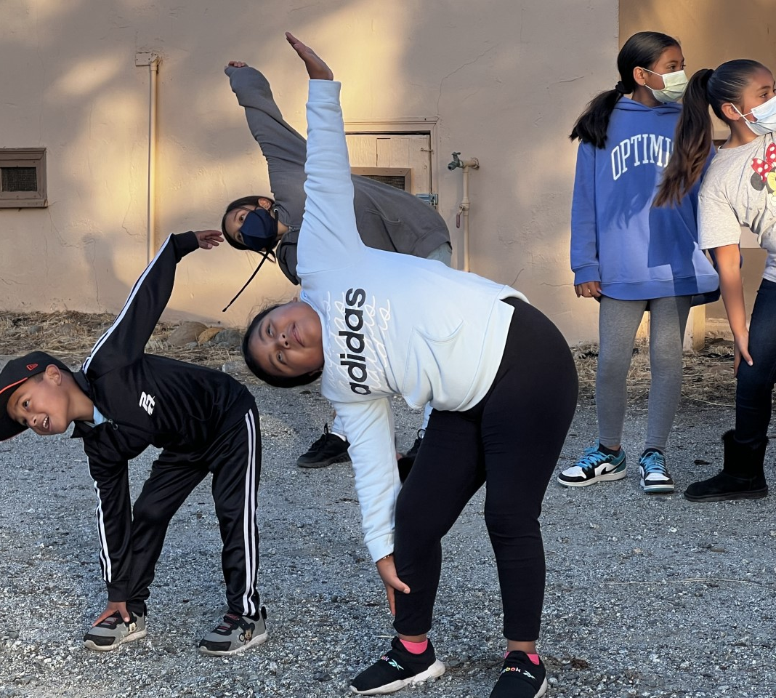
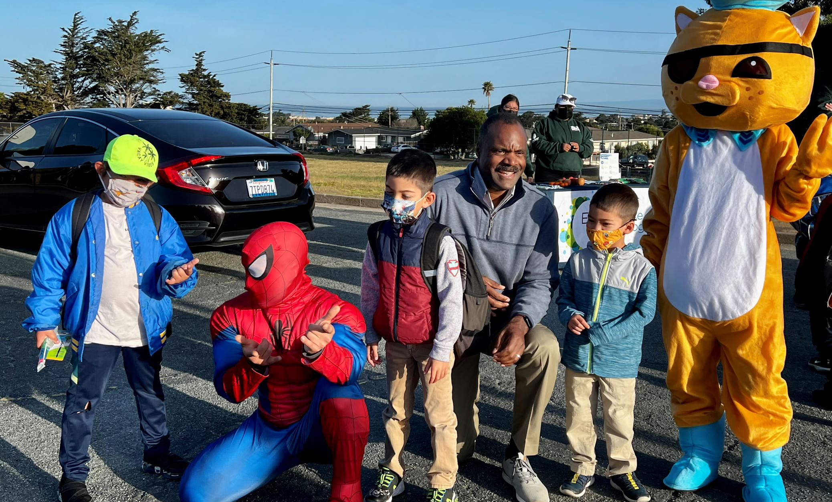
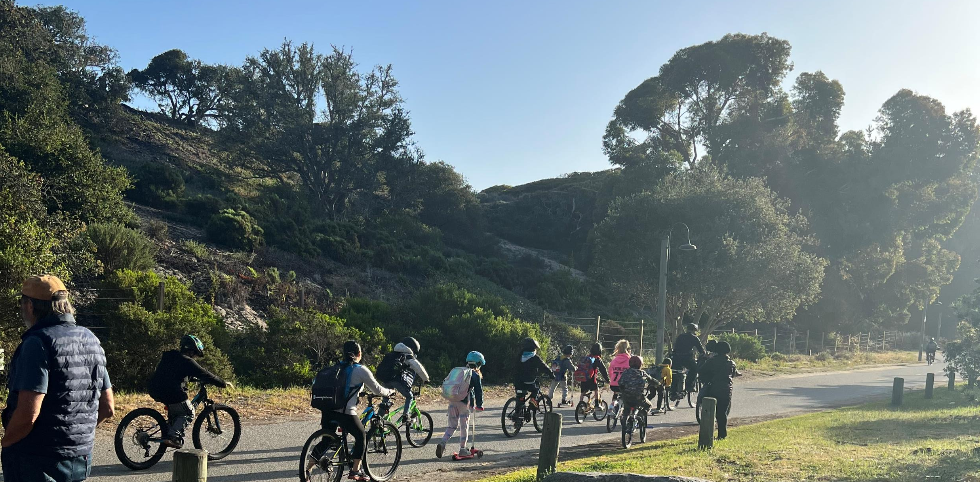
Walk & Roll
More than just a walk to school
Notes:
By funding projects and programs

Slide 13
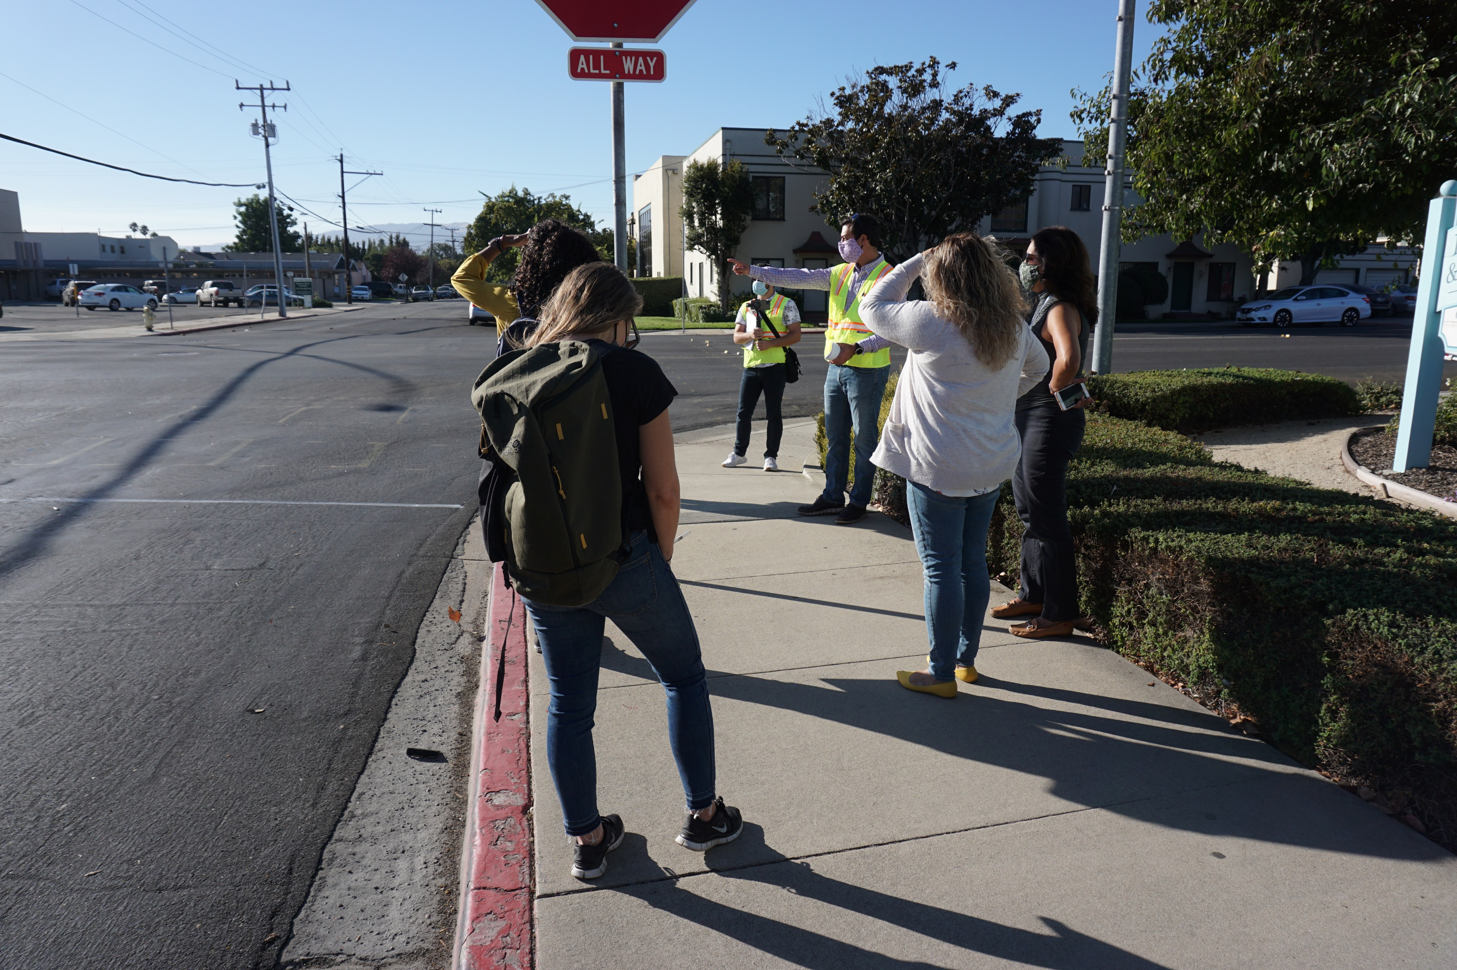
Notes:
such as sidewalks, bikeways and educational programs)that promote safe walking, bicycling or scooting to school.

Slide 14
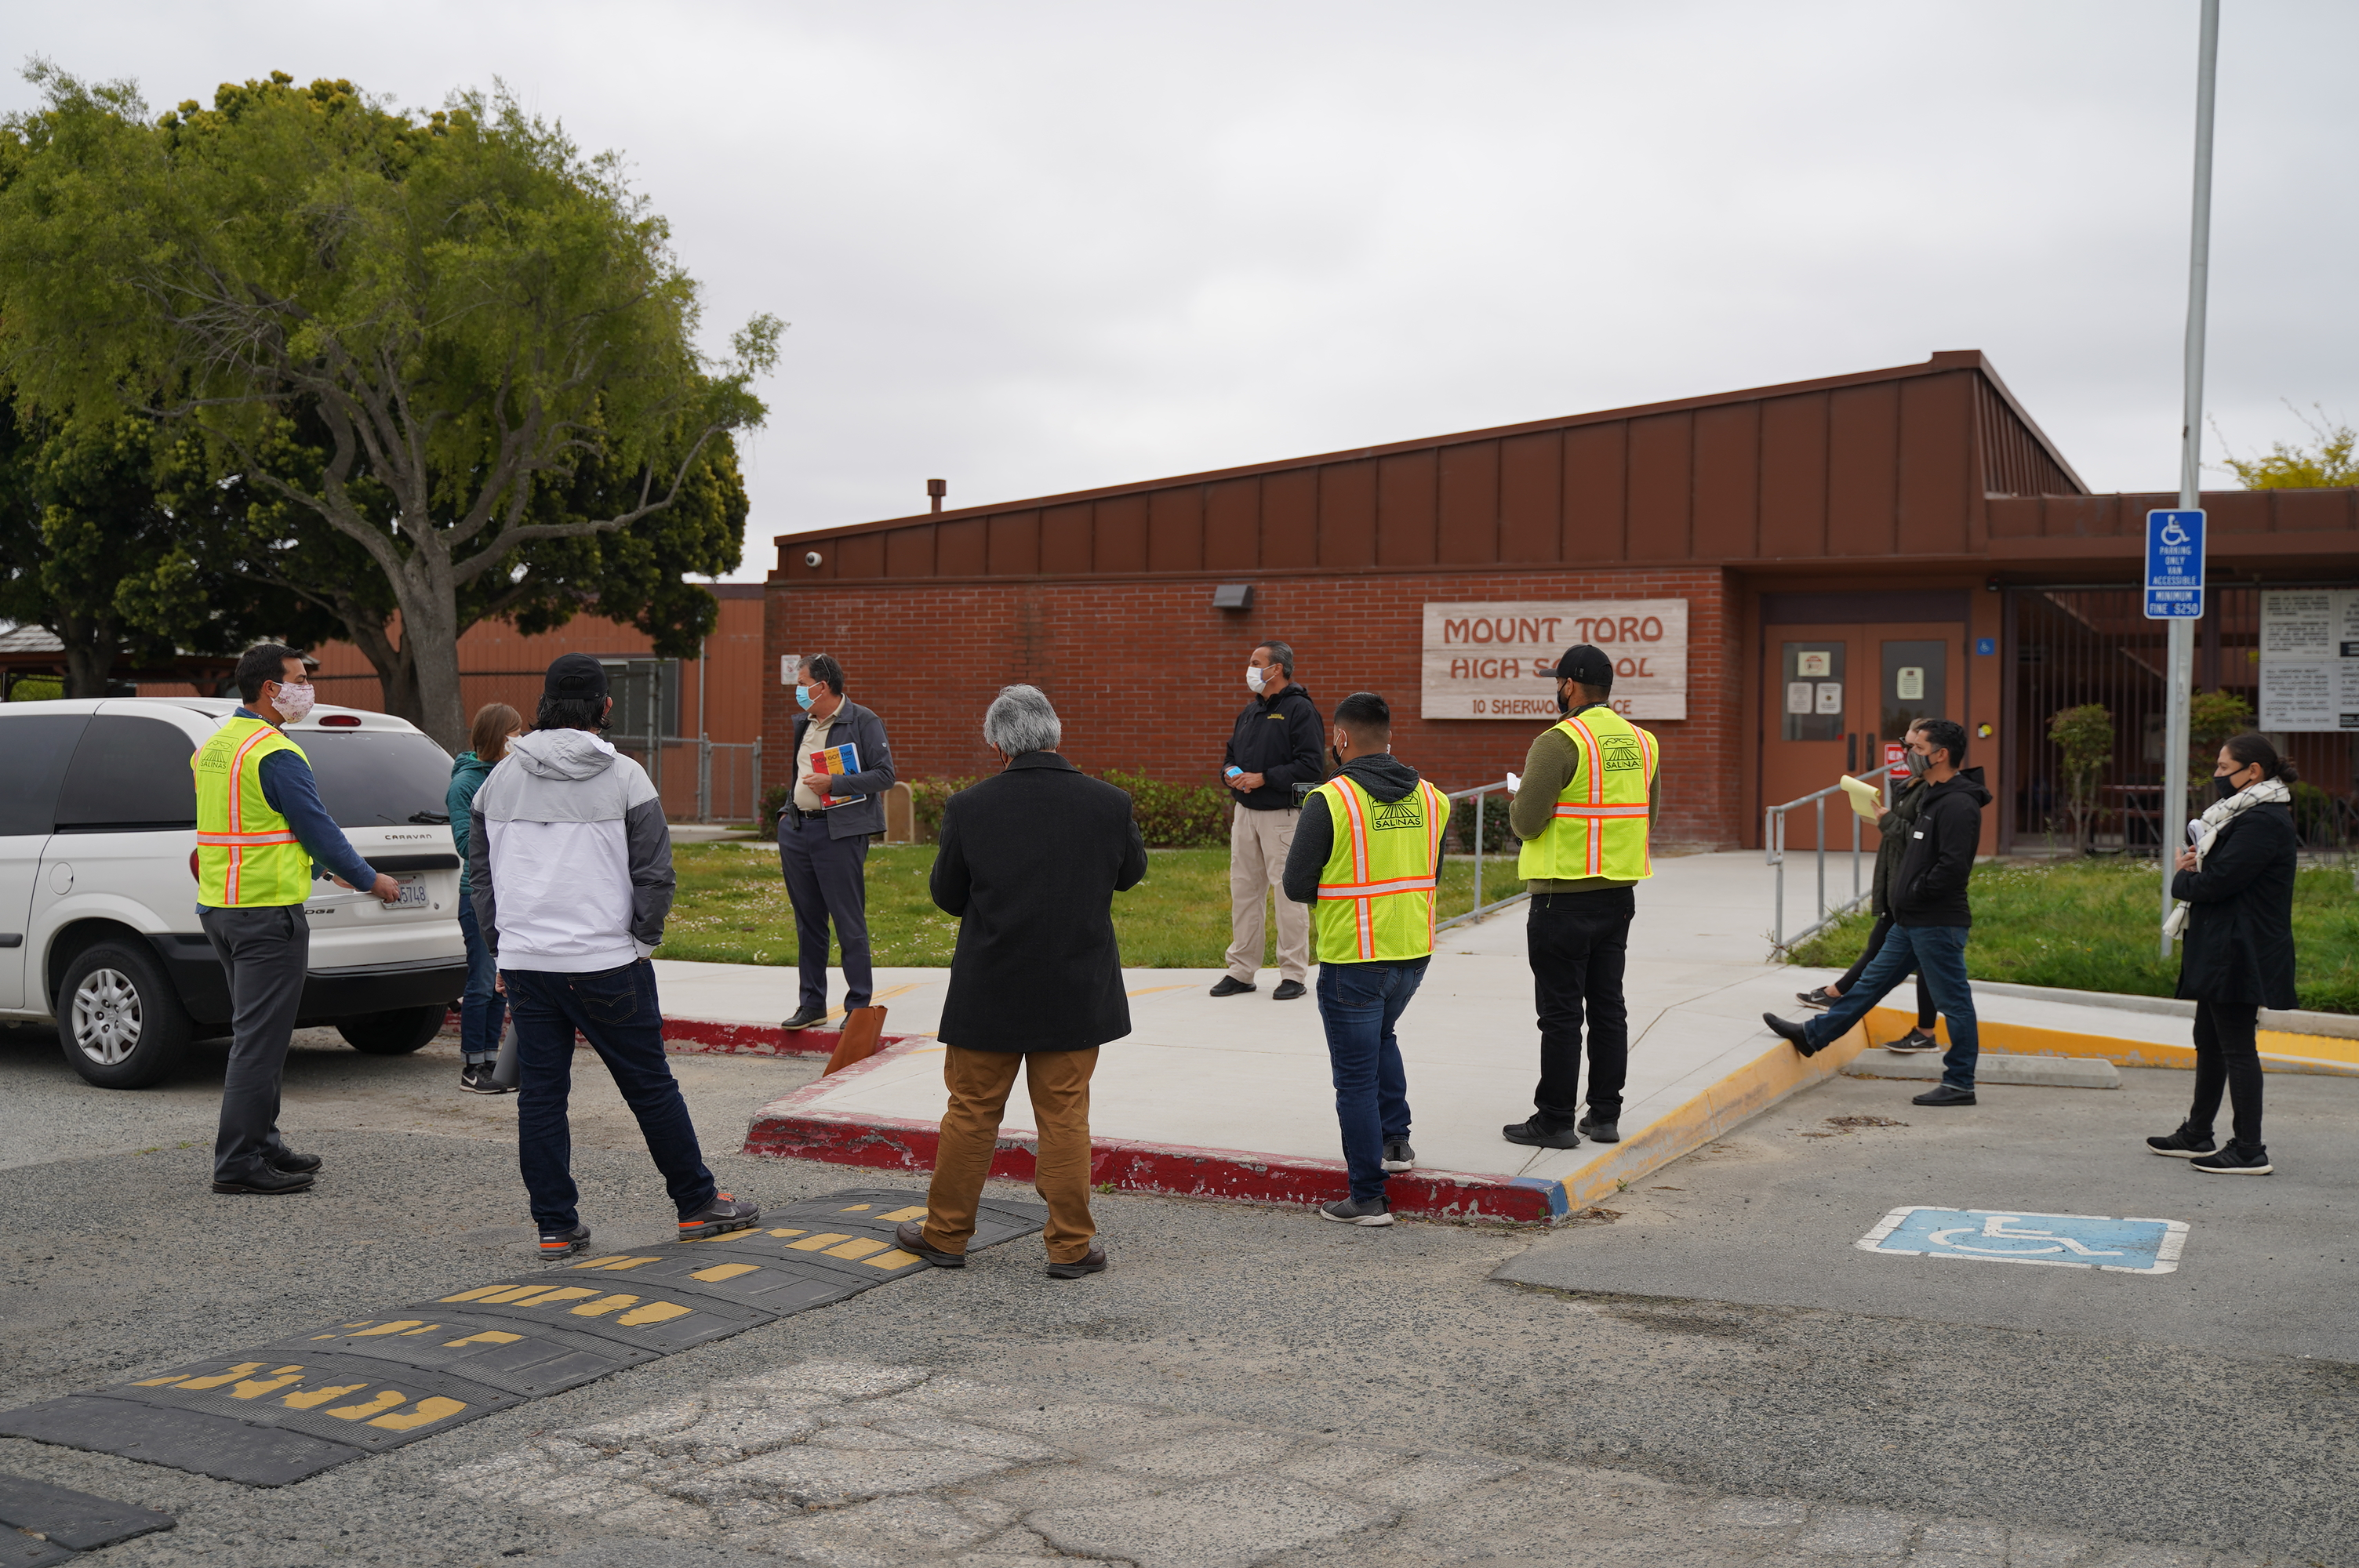
Notes:
The adopted Salinas Safe Routes to School Program provides safety improvement recommendations and educational programming for 45 schools throughout Salinas.

Slide 15
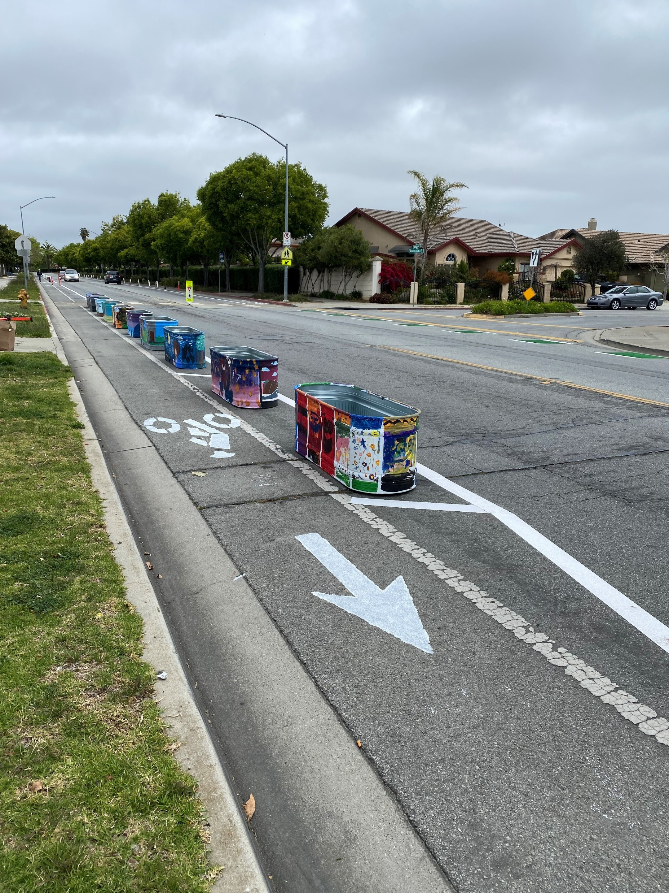
Notes:
Example: Pop-Up Demonstration at McKinnon Middle School in Salinas

Slide 16
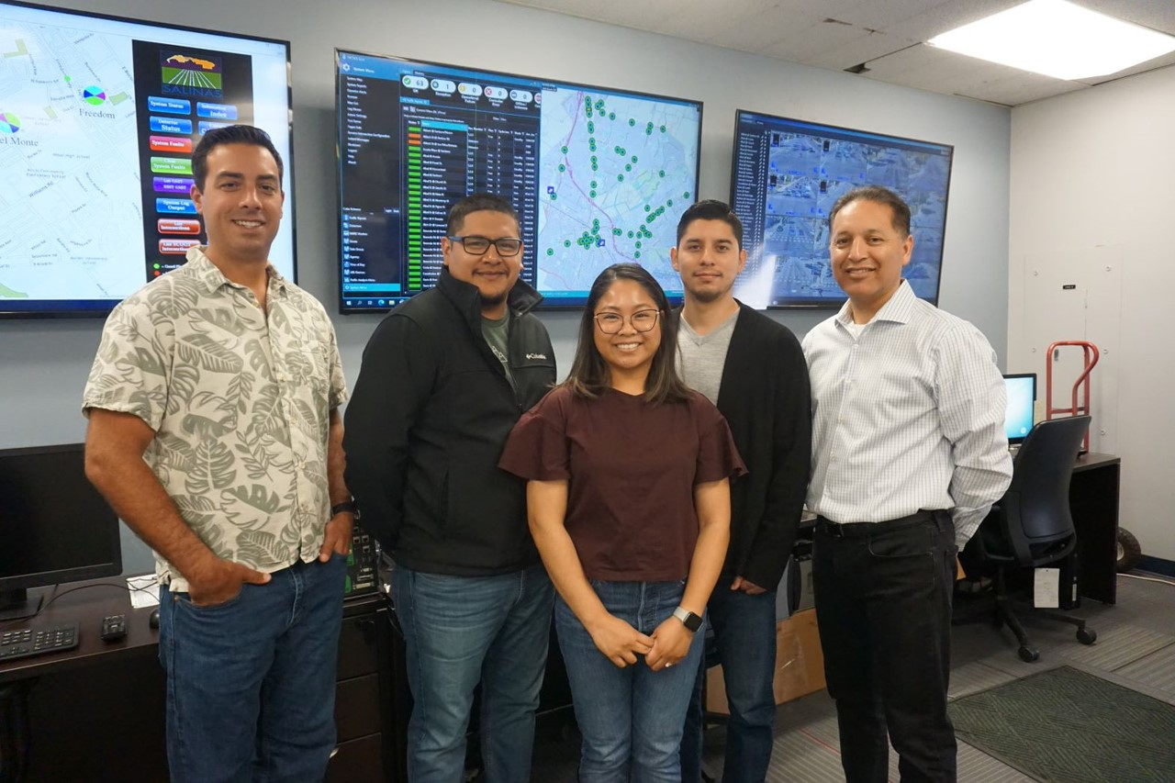
Notes:
With that we recognized, Andrew Easterling, pictured here with his dedicated co-workers for this Transportation Excellence Award.

Slide 17
Congratulations to
2022 Transportation Excellence Awards Honoree, Andrew Easterling!

Slide 18
20th Annual Transportation Excellence Awards
Project Award

Slide 19
20th Annual Transportation Excellence Awards
City of Pacific Grove
Point Pinos Coastal Recreational Trail Project
Notes:
completed in 2022 is a nearly a one mile stretch of coastline in PG known as Point Pinos, on Ocean View Boulevard .

Slide 20
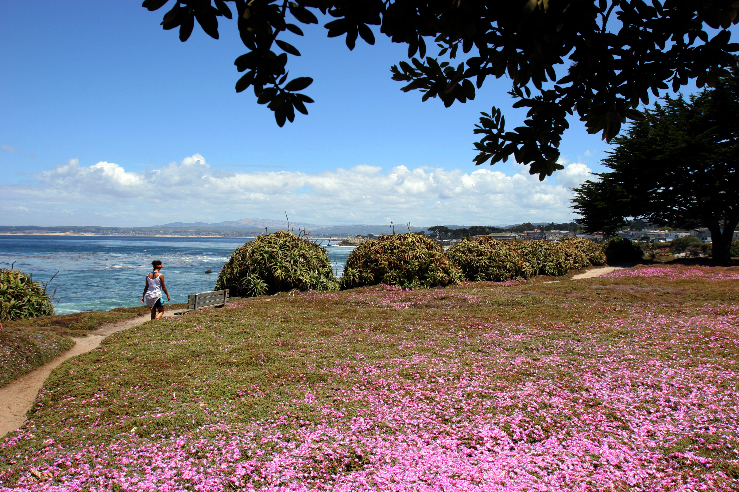
Notes:
The project completed in 2022 is a nearly a one mile stretch of coastline in PG known as Point Pinos, on Ocean View Boulevard .

Slide 21
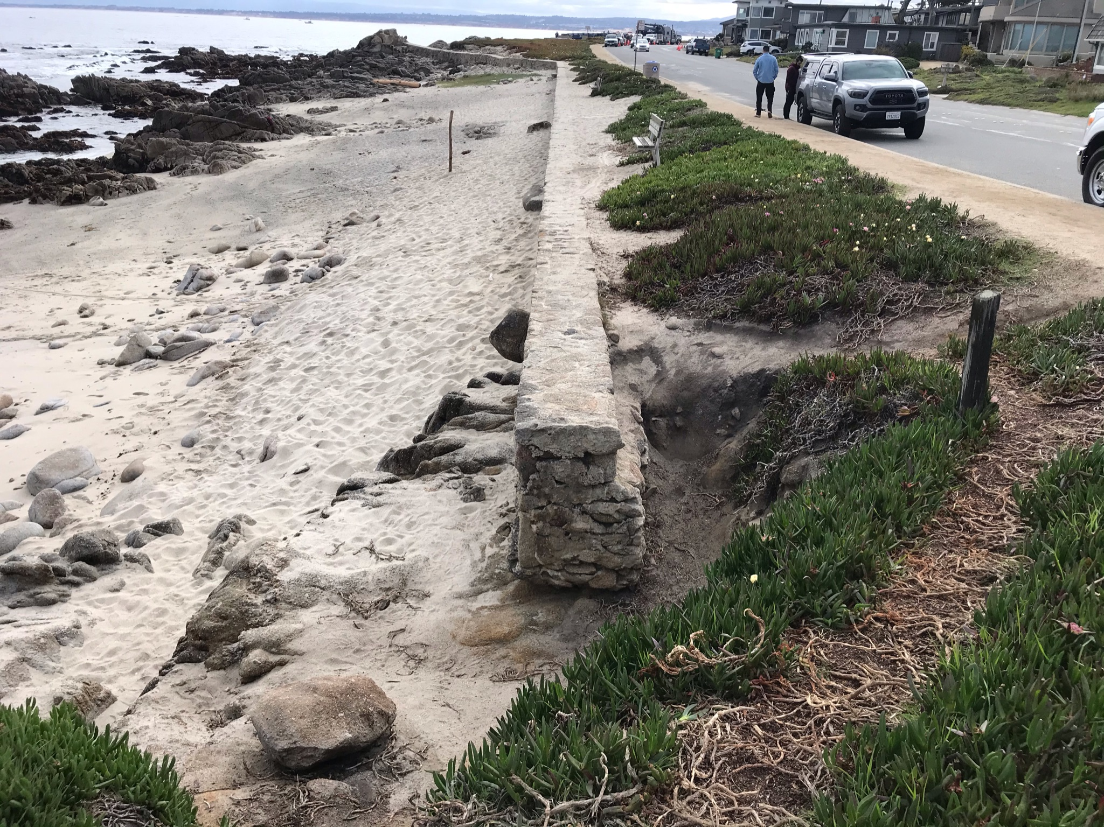
Point Pinos Coastal Recreational Trail
Notes:
BEFORE: NO FORMAL BEACH ACCESS
Prior to this project, Point Pinos had no formal beach access. It lacked formalized, safe, and accessible coastal amenities for its various users-including trails, parking, and coastal access points.

Slide 22
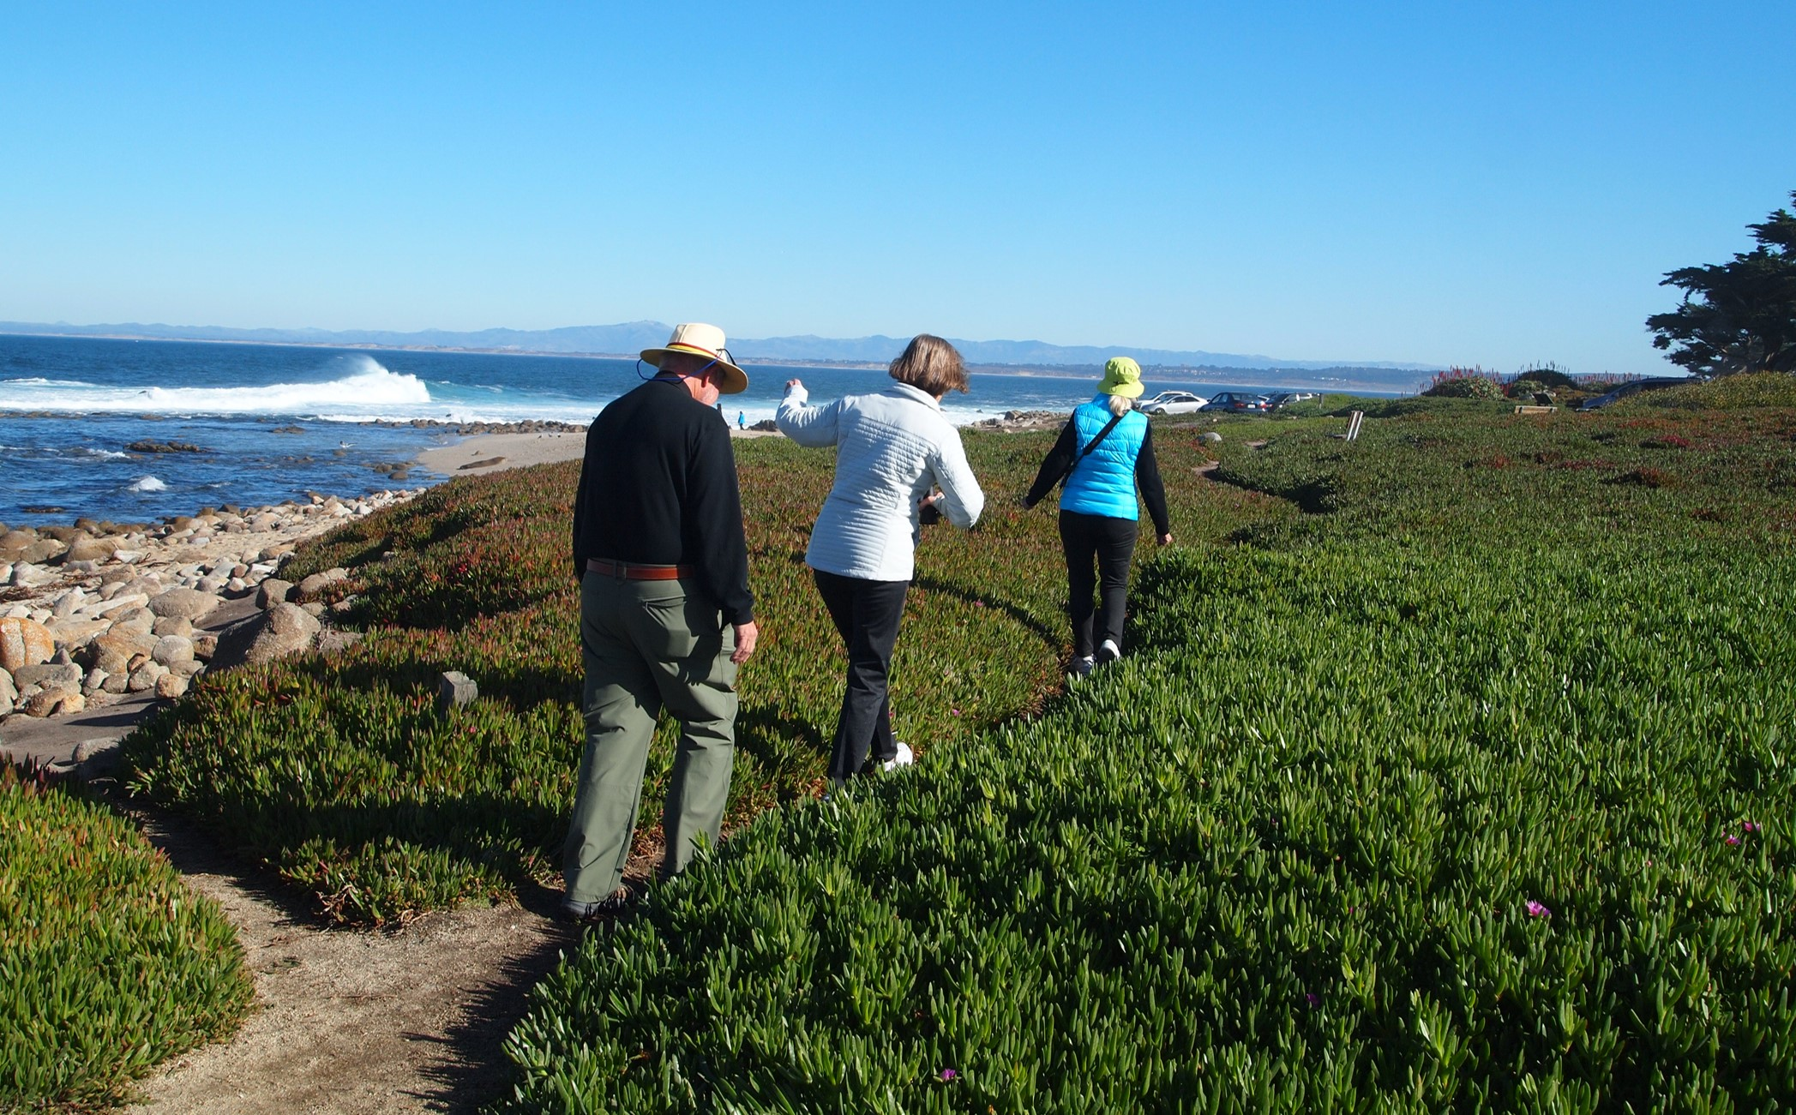
Notes:
Here’s some examples:
An : Informal “goat trail” through the iceplant

Slide 23
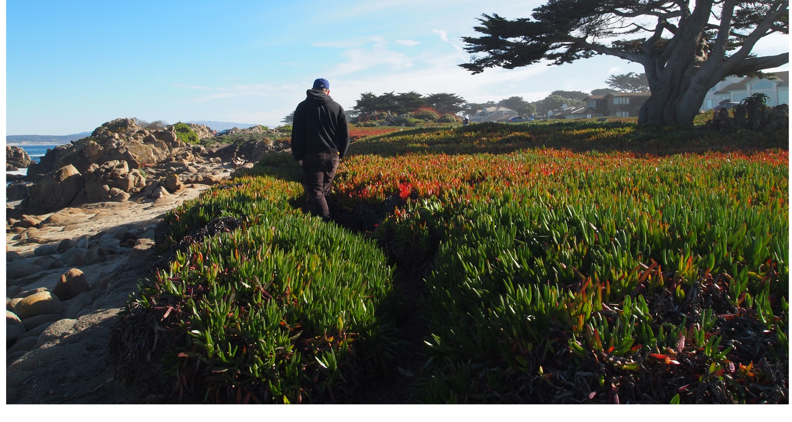
Notes:
And another

Slide 24
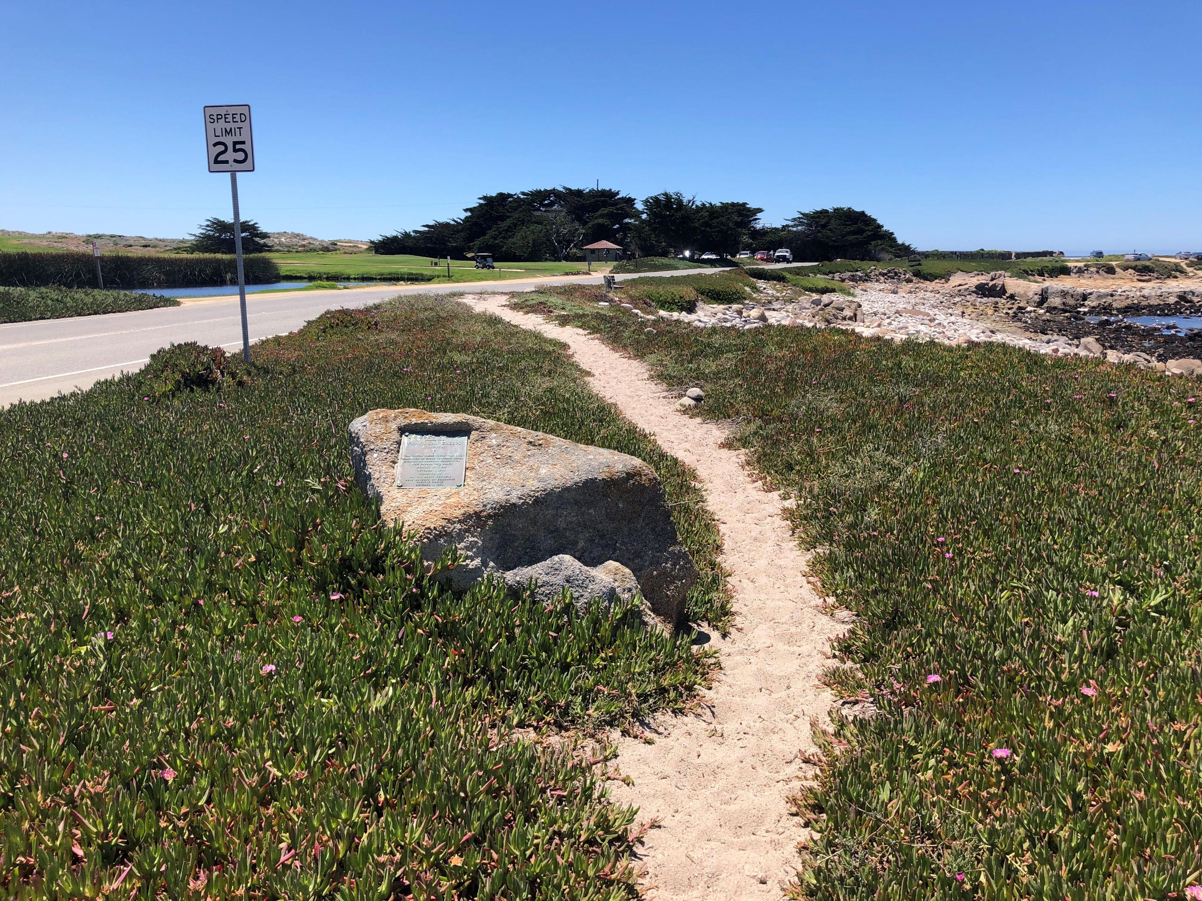
Point Pinos Coastal Recreational Trail
Notes:
BEFORE: INFORMAL, NARROW
SAND PATH
This area also represented the only gap of the California Coastal Trail
between the City of Monterey and the three of four miles of PG Coastline.

Slide 25
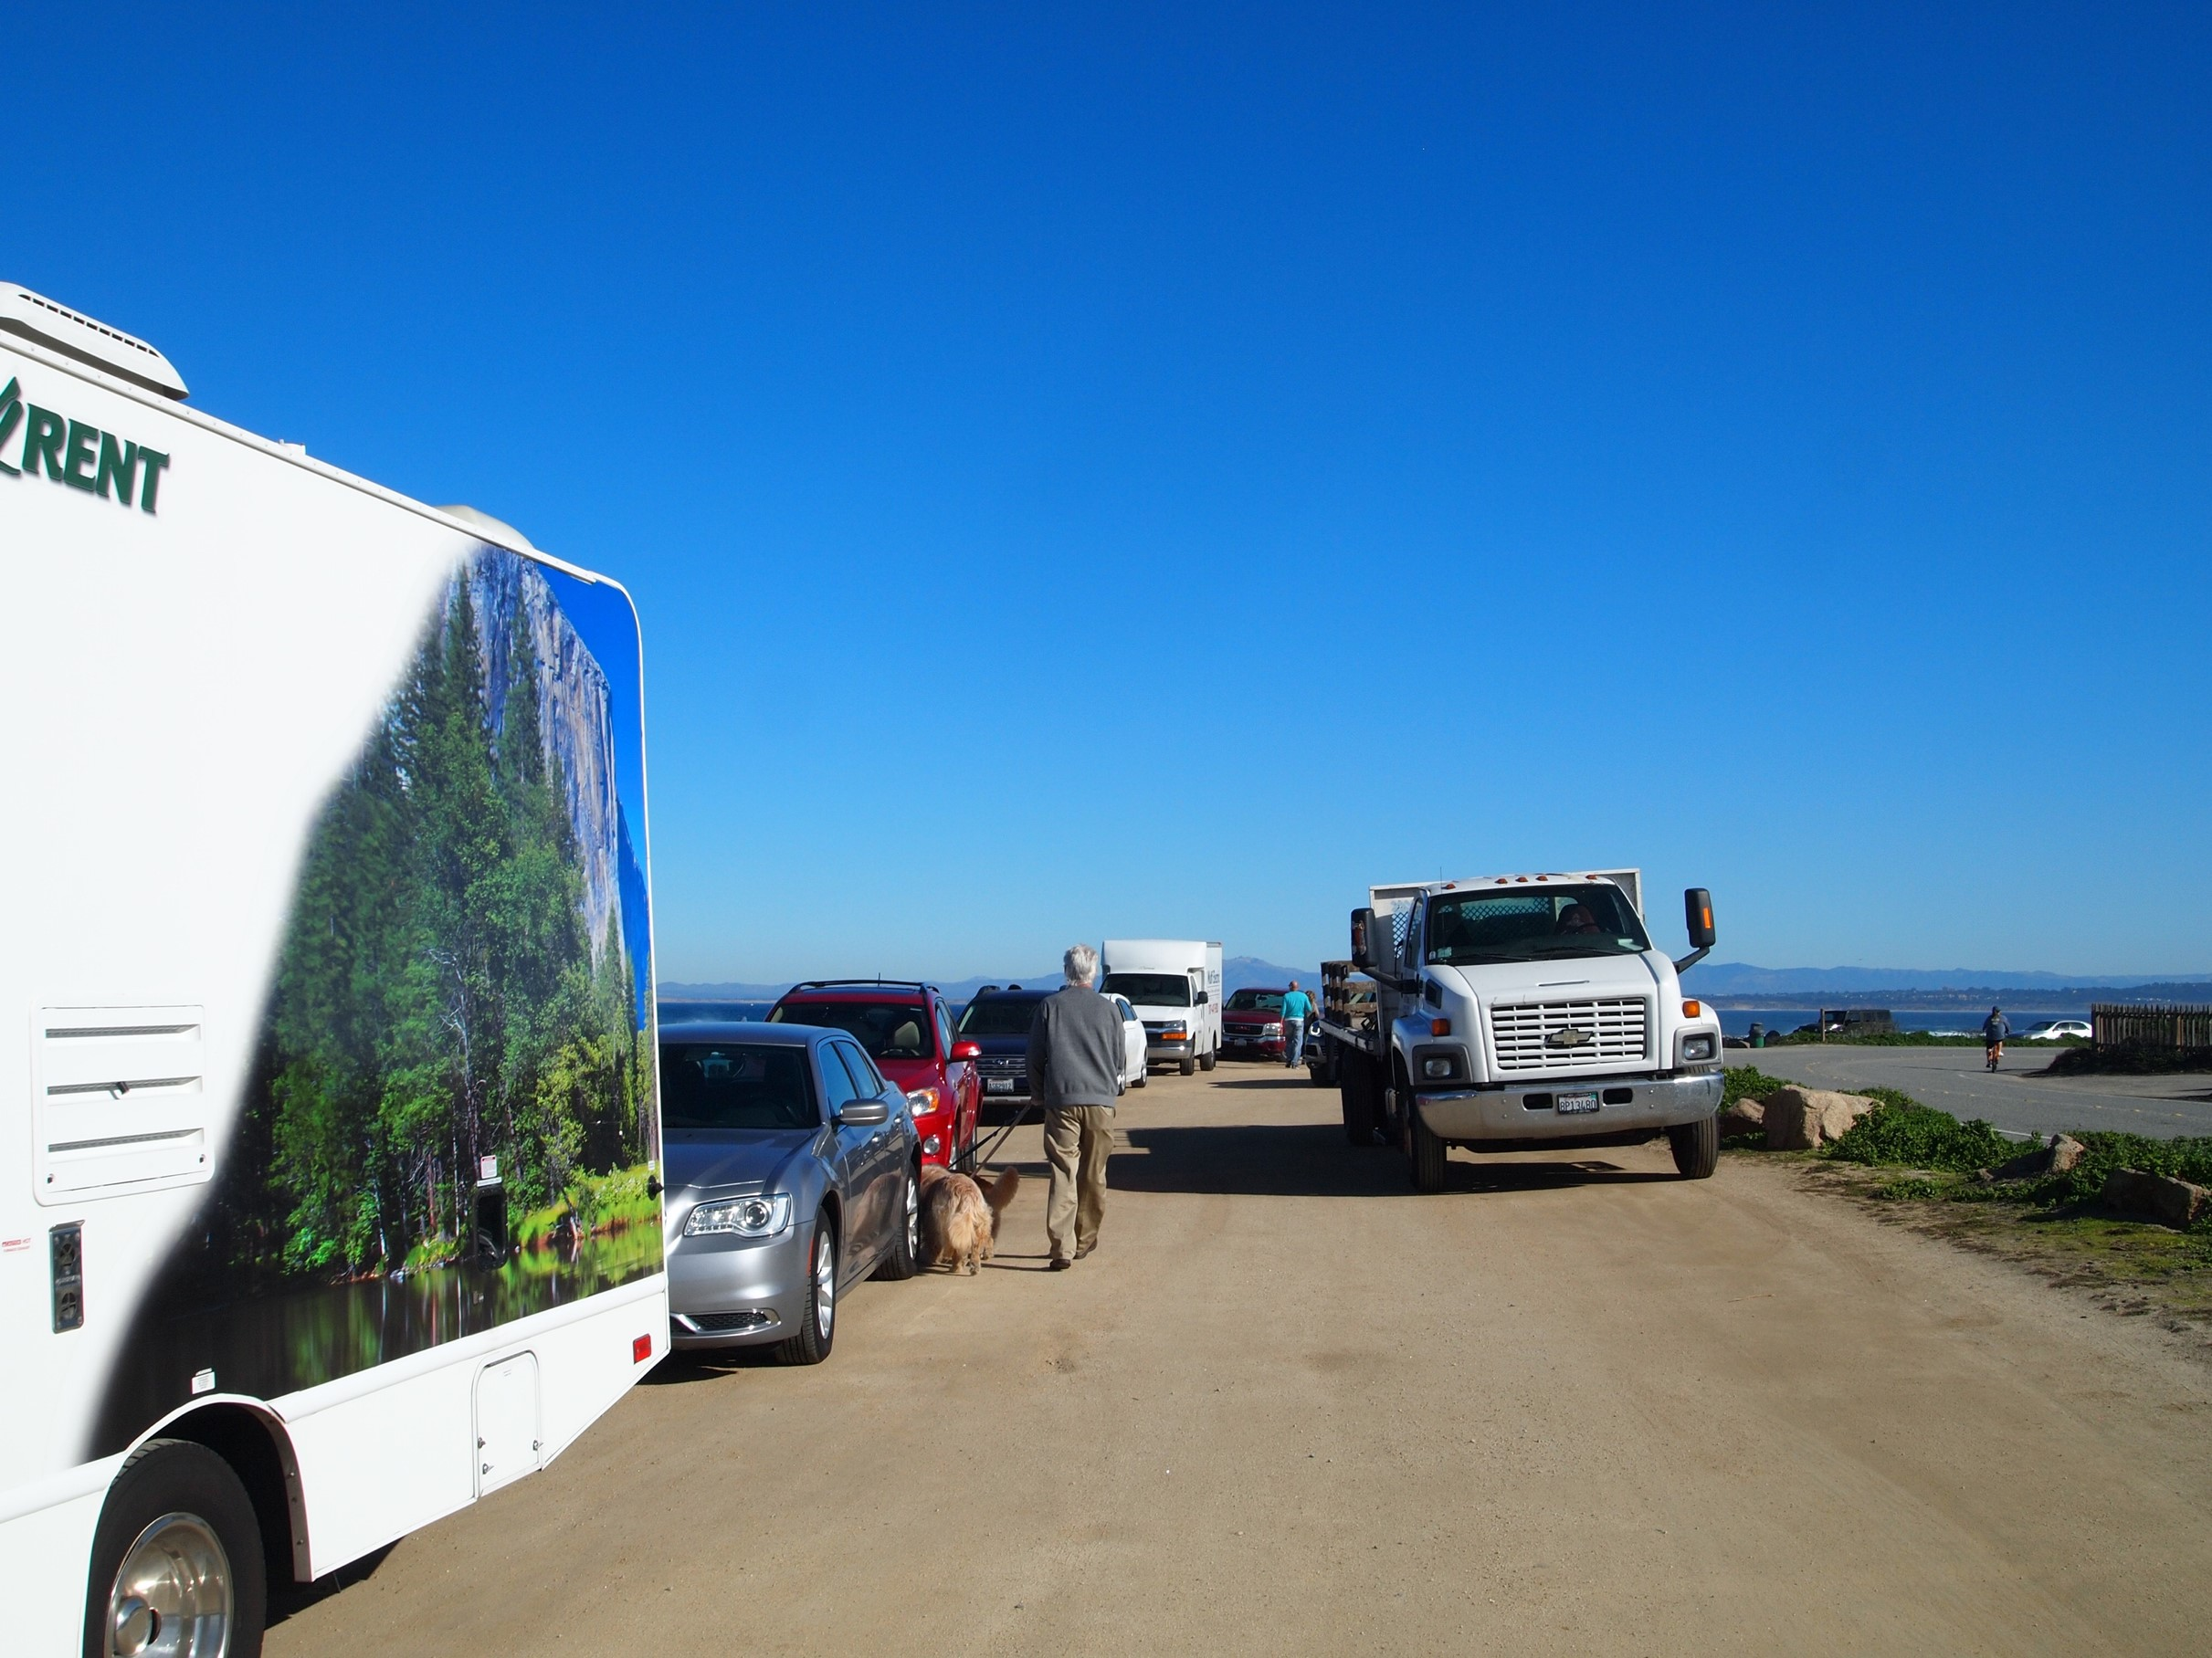
Notes:
Informal parking

Slide 26
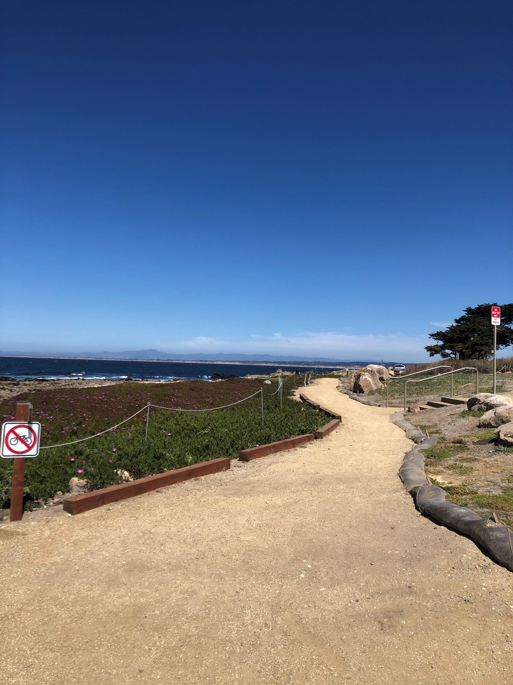
Formal ADA Compliant Trail
Notes:
After: FORMAL, ADA COMPLIANT,
DECOMPOSED GRANITE TRIAL

Slide 27
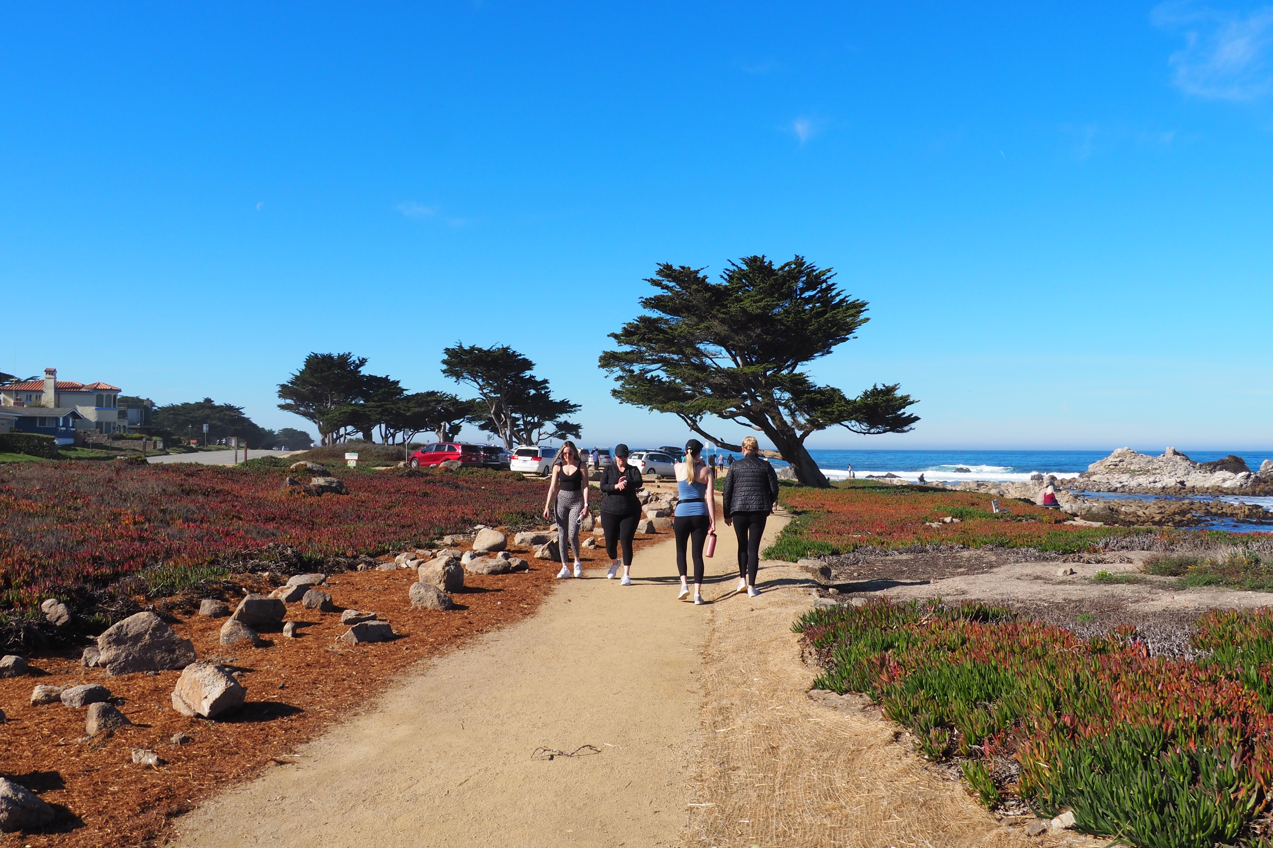
Notes:
AFTER: FORMALIZED, ADA COMPLIANT,
DECOMPOSED GRANITE PATH

Slide 28
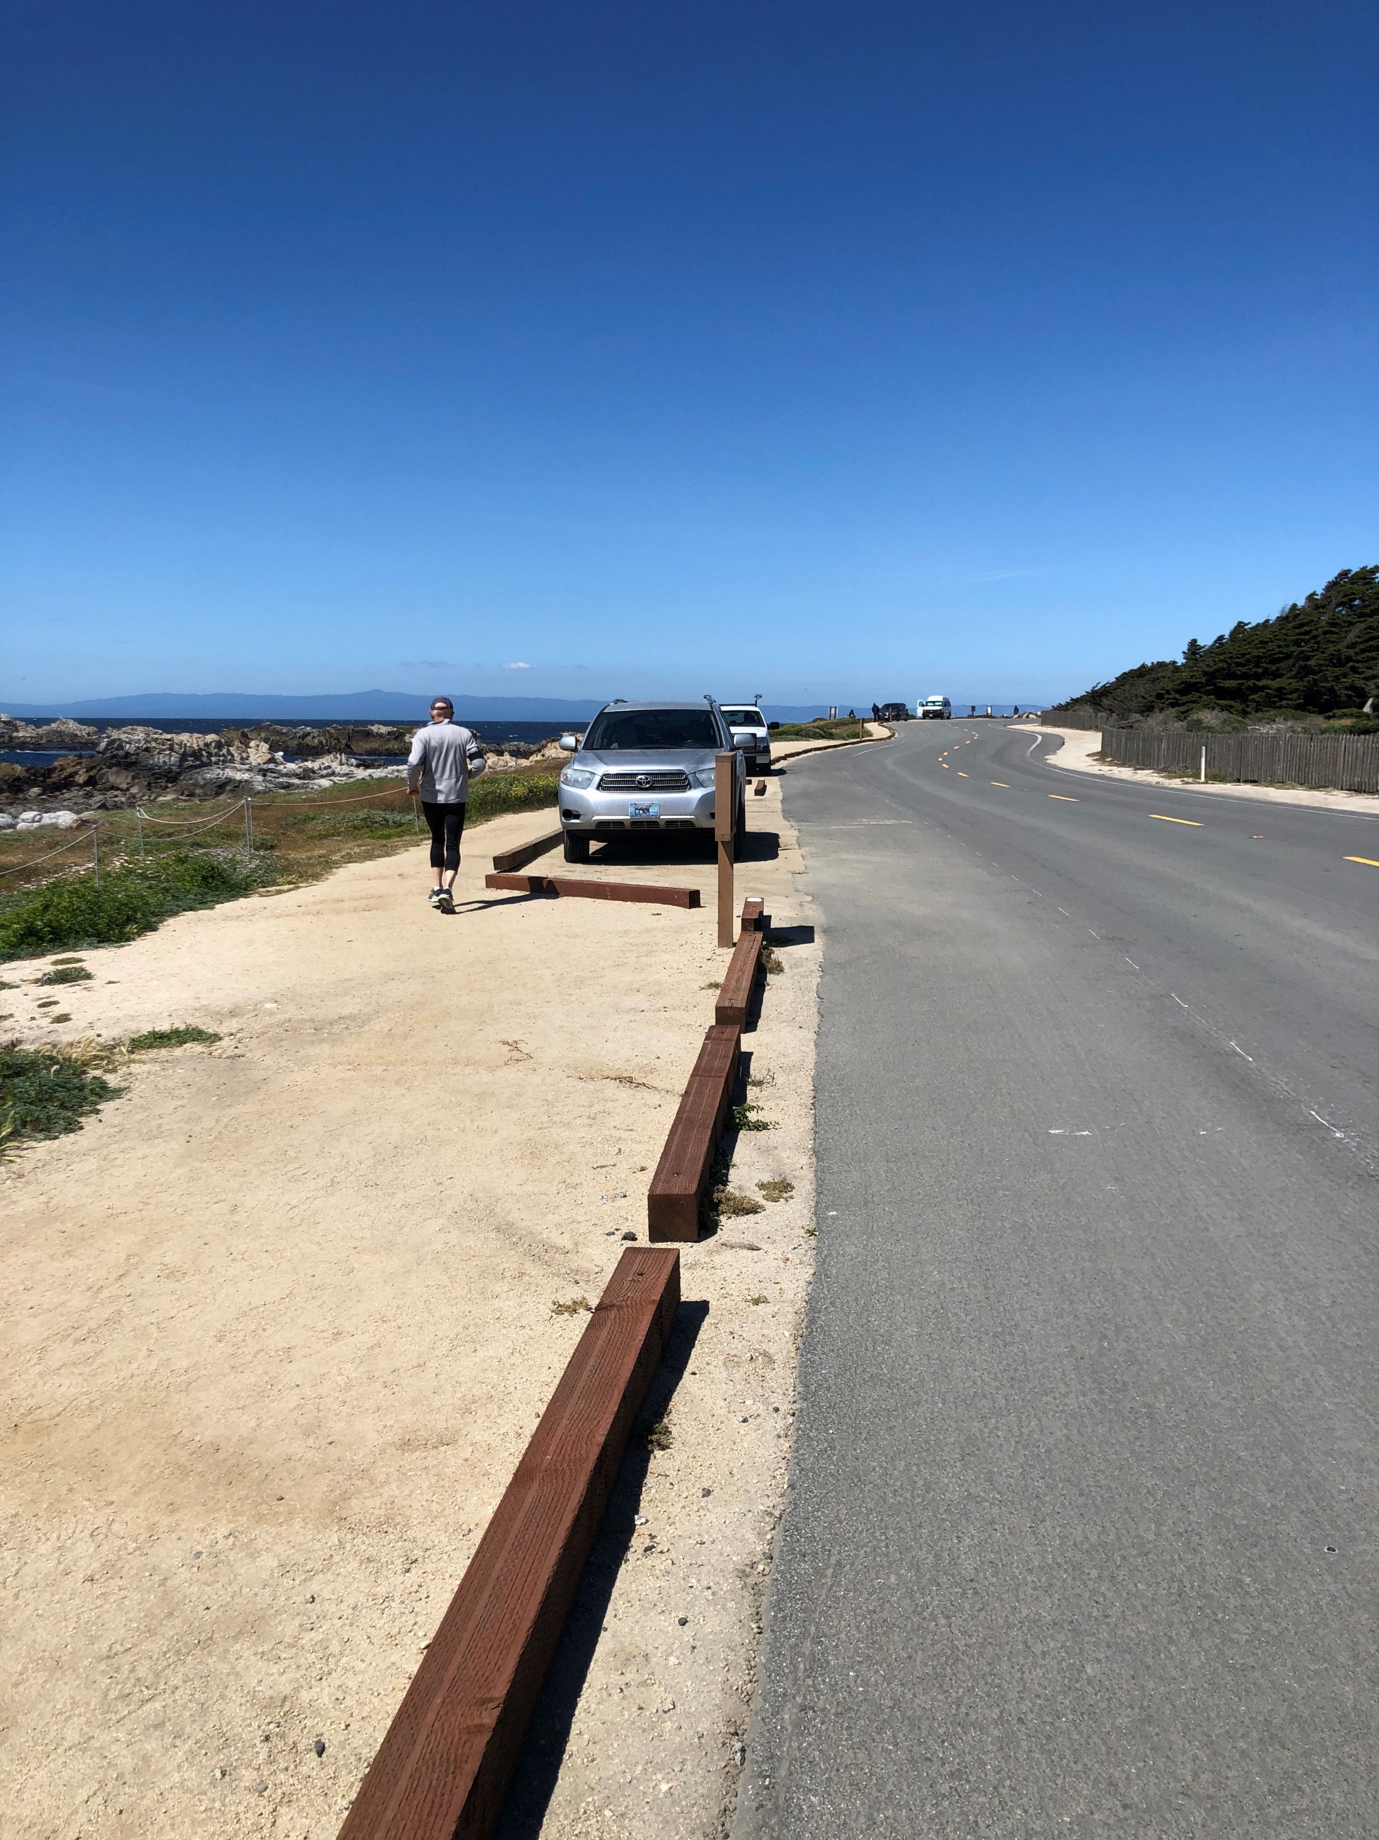
Notes:
AFTER: FORMALIZED PEDESTRIAN PATH &
SEPARATE PARKING AREAS

Slide 29
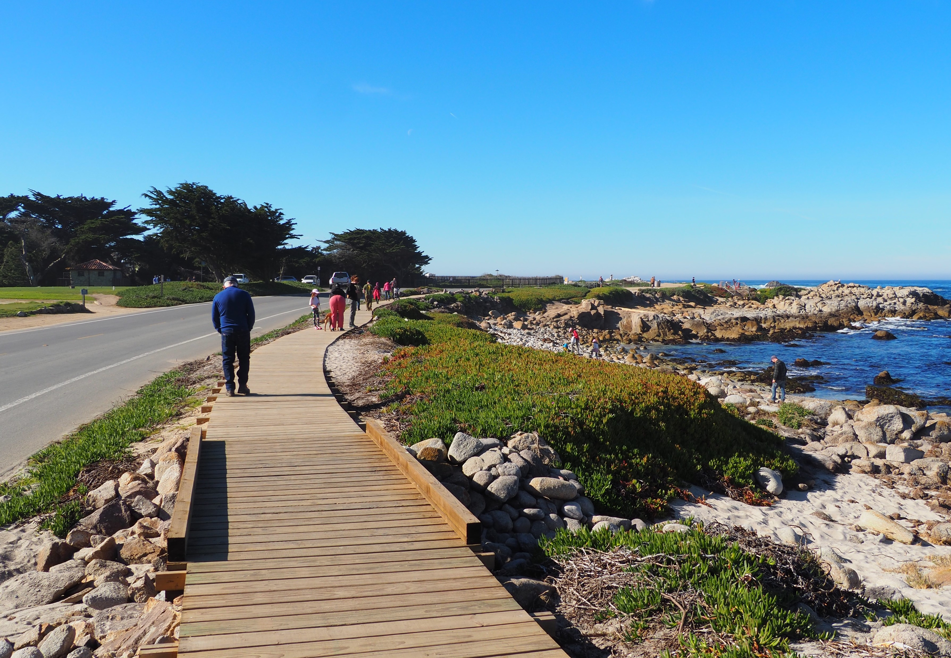
Point Pinos Coastal Recreational Trail
Notes:
AFTER: FORMALIZED BOARDWALK
a formal, ADA compliant, 5-foot-wide trail, boardwalk,

Slide 30
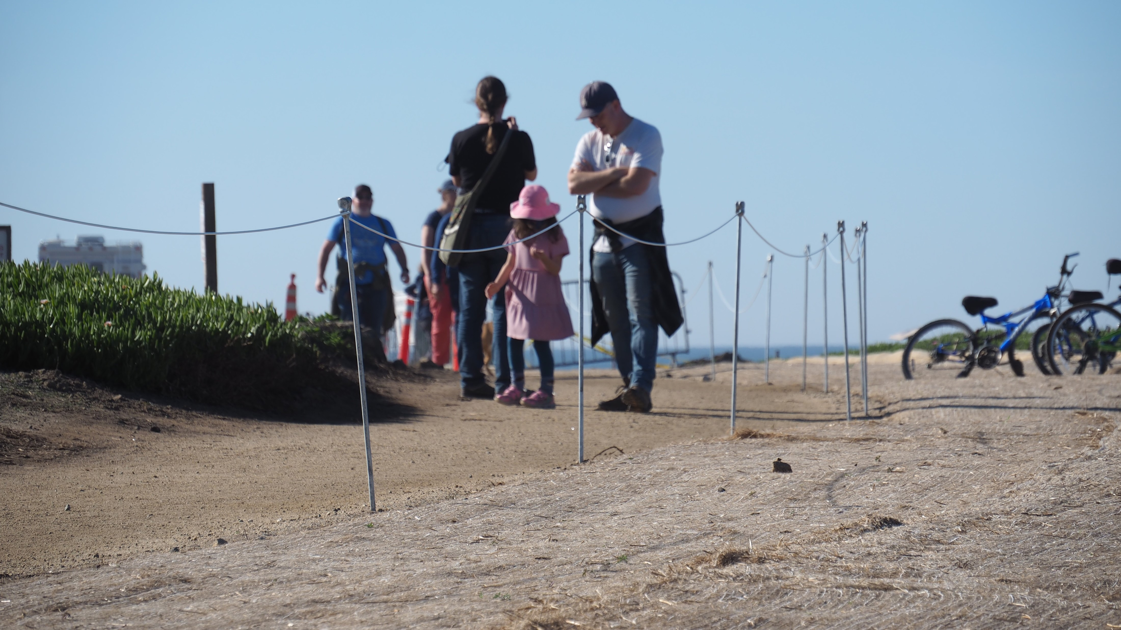
Notes:
AFTER: VEGETATION RESTORATION

Slide 31
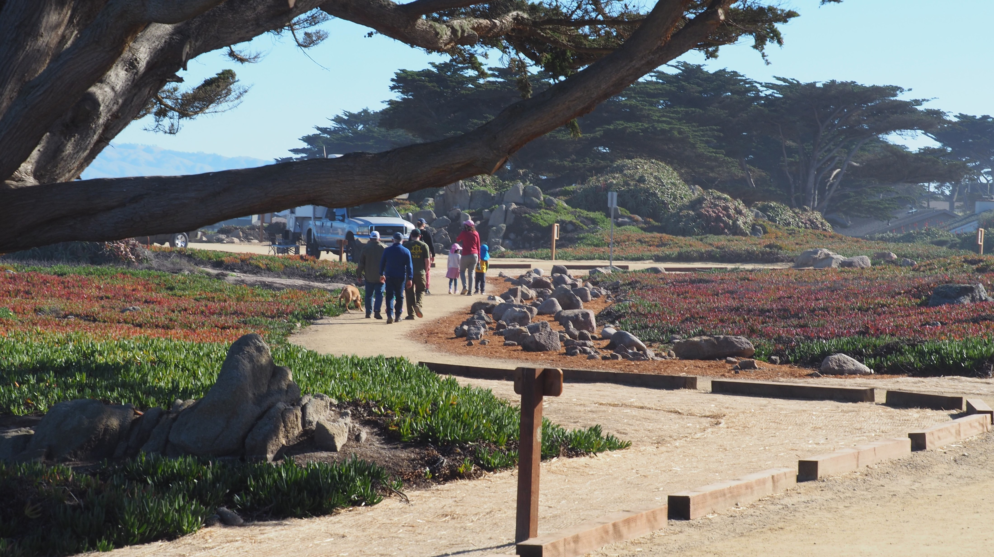
Notes:
The Point Pinos Trail project significantly improved safety, access parking, and stormwater capture. At the completion of the project, the new trail, boardwalk, and parking area served thousands of visitors and residents that come to the City’s beloved coastline; providing all users (pedestrians, bicyclists, motorists,) the opportunity to more safely enjoy this segment of the Coastal Trail and its expansive ocean views, and beaches,

Slide 32
2022 - 2023
Winter Storms
Notes:
And then came the storms! The Point Pinos Coastal Recreational Trail was designed to hold-up under adverse conditions like a winter storm. But who knew in 2022 -2023, we would be hit with an atmospheric river that would dump rain and wind upon us like it did? So the question is , how did the trail fare through the storms?

Slide 33
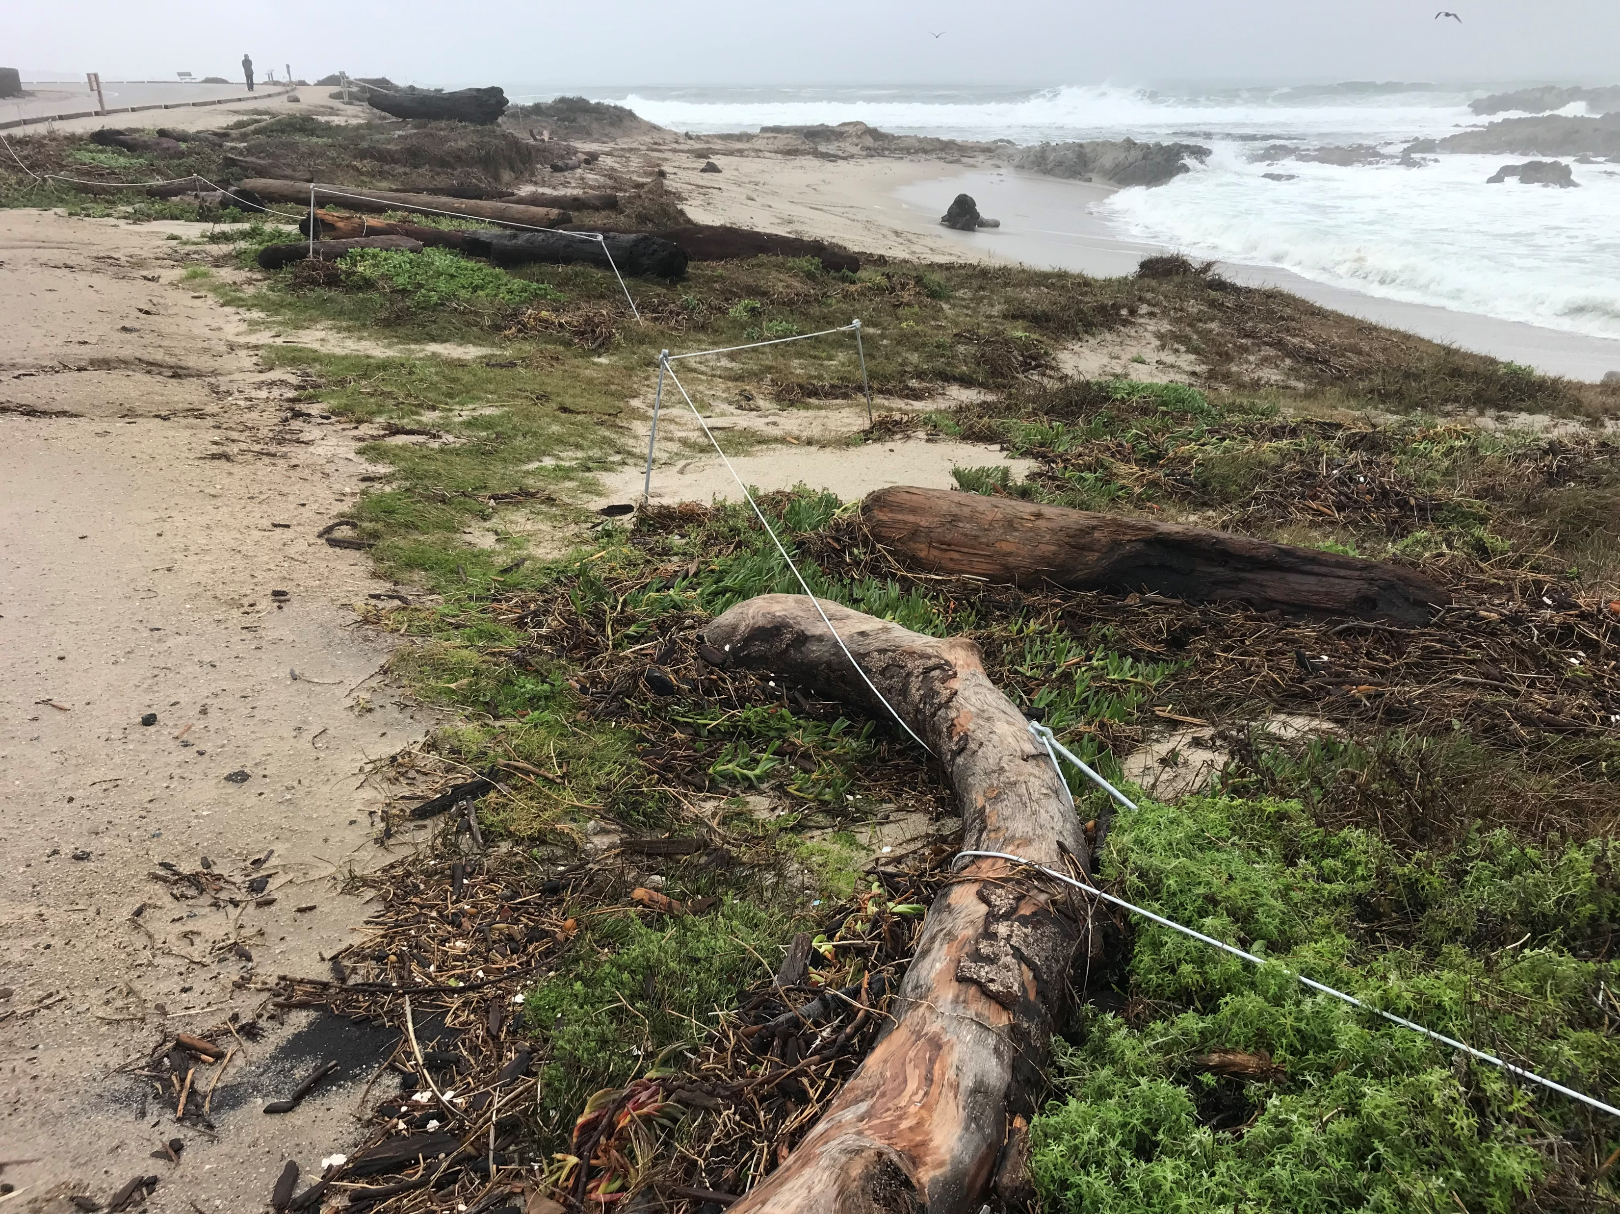
Notes:
The City of Pacific Grove is proud to report that the project held up very well, As you can see, there is a good amount of debris

Slide 34
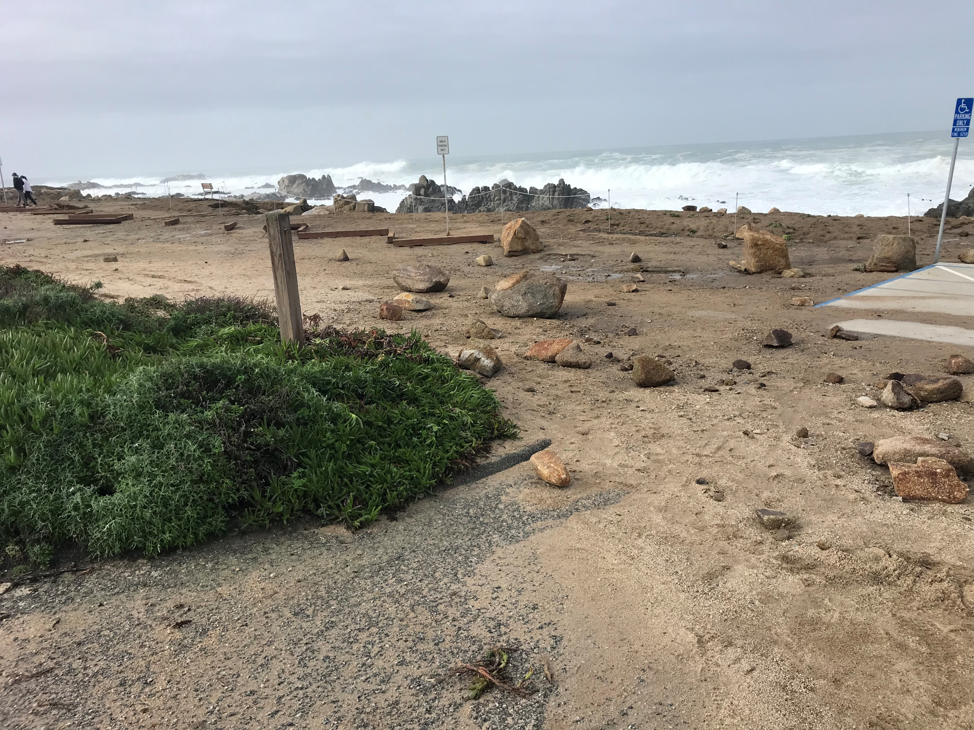
Notes:
and rocks wash up on the parking areas,

Slide 35
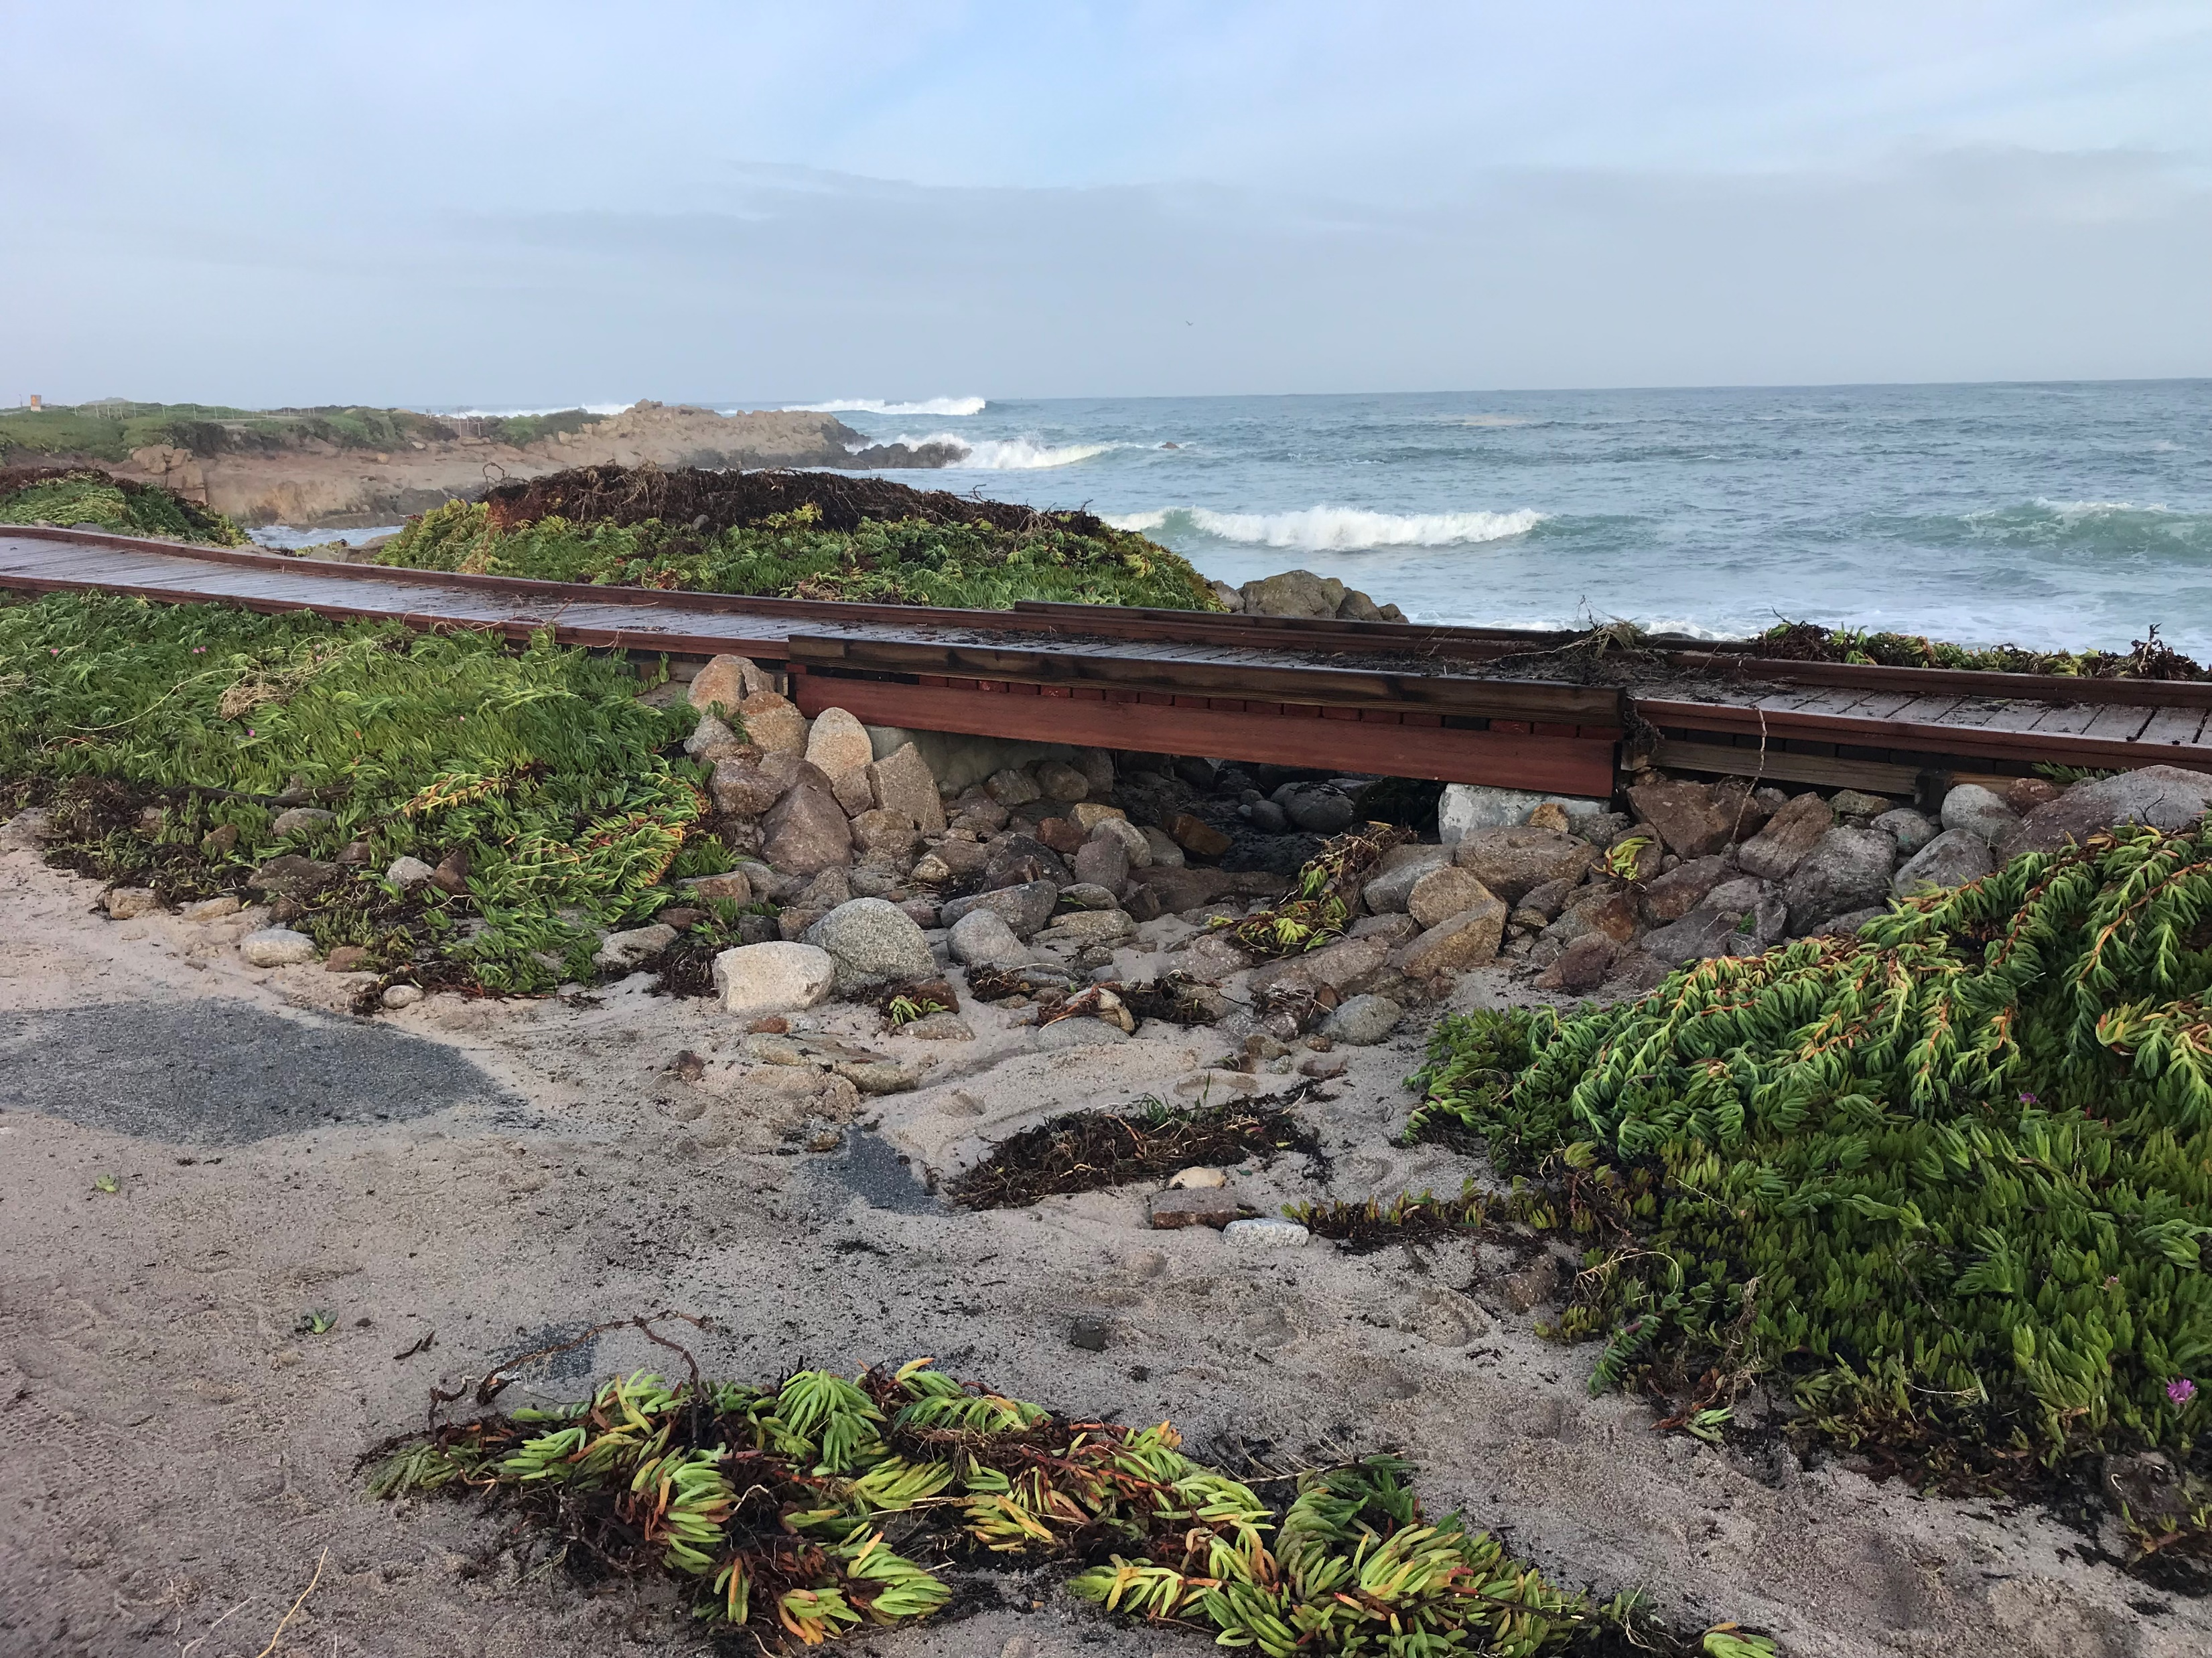
Notes:
but nevertheless, the project held up very well, especially the boardwalk.

Slide 36
Congratulations to:
City of Pacific Grove
2022 Transportation Excellence Awards Honoree !
Notes:
Contractor: Granite Rock Company
o
Designer: Kimley Horn
o
Geotechnical: Parikh Geotech
o
Construction Management: CSG Consultants
o
Quality Assurance: Pacific Crest Engineering

Slide 37
20th Annual Transportation Excellence Awards
TAMC Employee Recognitions
Notes:
We have now arrived at the moment, where we want to recognize a few of our own. So, let me turn this over now, to our Executive Director, Todd Muck, who will present some certificates of appreciation.

Slide 38

TAMC Employee
Certificates of Appreciation
10 Years of Service

Slide 39
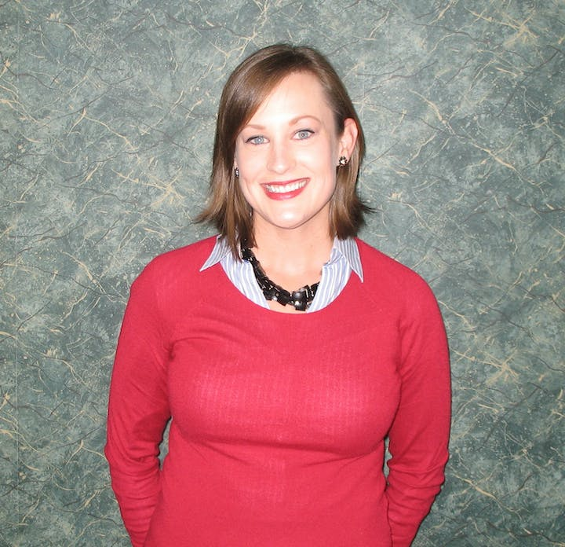
Ariana Green
Principal Transportation Planner

Slide 40
TAMC Employee
Certificates of Appreciation
15 Years of Service

Slide 41
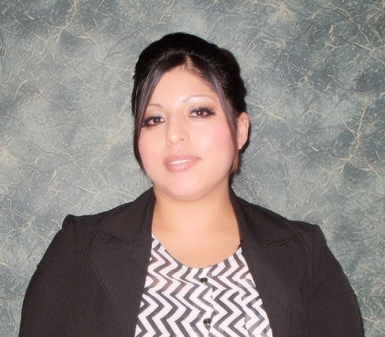
Maria Montiel
Administrative Assistant

Slide 42
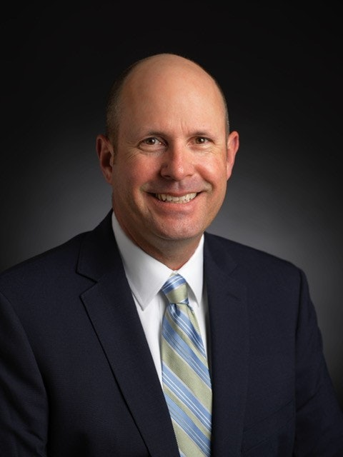
Todd Muck
Executive Director
Notes:
Theresa will ask Chair Mike LeBarre to present Todd’s certificate to him.

Slide 43
20th Annual Transportation Excellence Awards
Outgoing TAMC
Board Chair

Slide 44
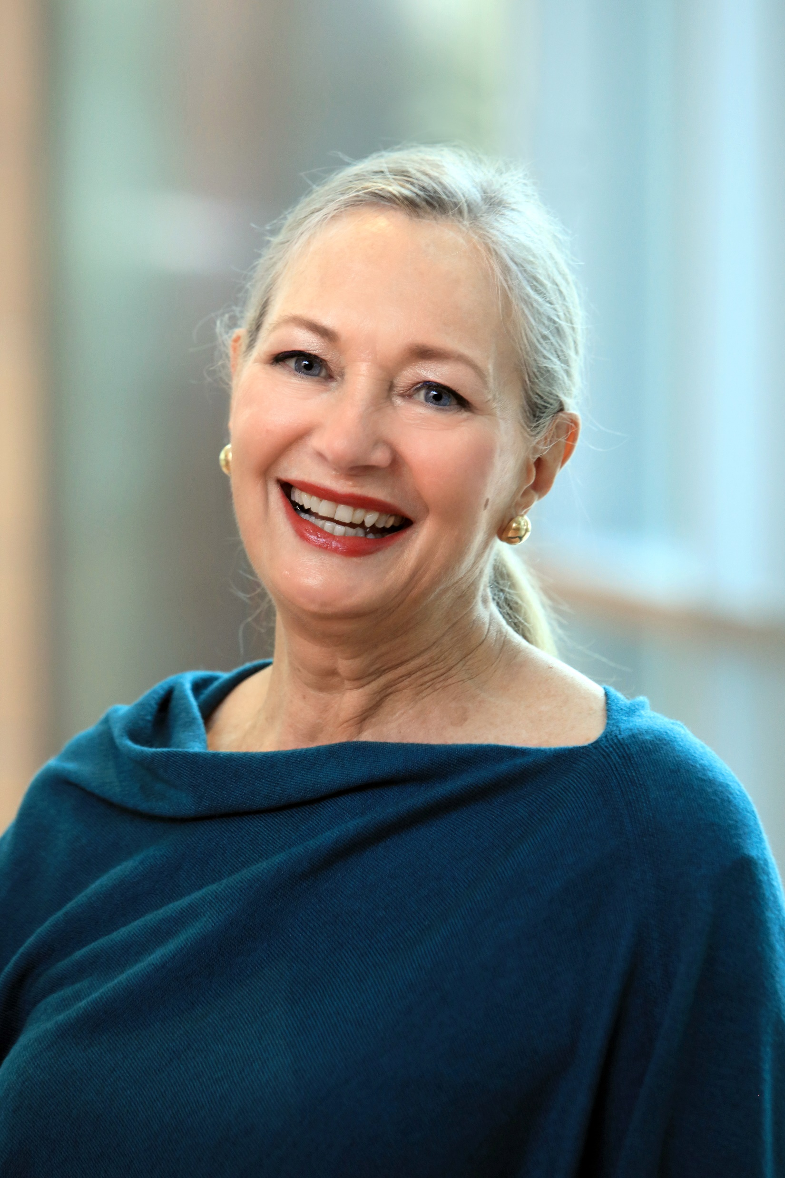
Mary Adams
Supervisor,
District 5

Slide 45
Congratulations to all!
2022 Transportation Excellence Awards
Notes:
As we close, congratulations to all of the recipients. We look forward to celebrating the 20th Anniversary of this award ceremony next year and invite you to join us!

Slide 46
21th Anniversary
Transportation Excellence Awards
Board of Directors Meeting January 24, 2024
Notes:
Plug the 21st and encourage everyone to think about projects or programs that they are working on this year that could be showcased in the 21st awards presentation.

Slide 47
Notes:
After: FORMAL, ADA COMPLIANT,
DECOMPOSED GRANITE TRIAL

