Slide 1
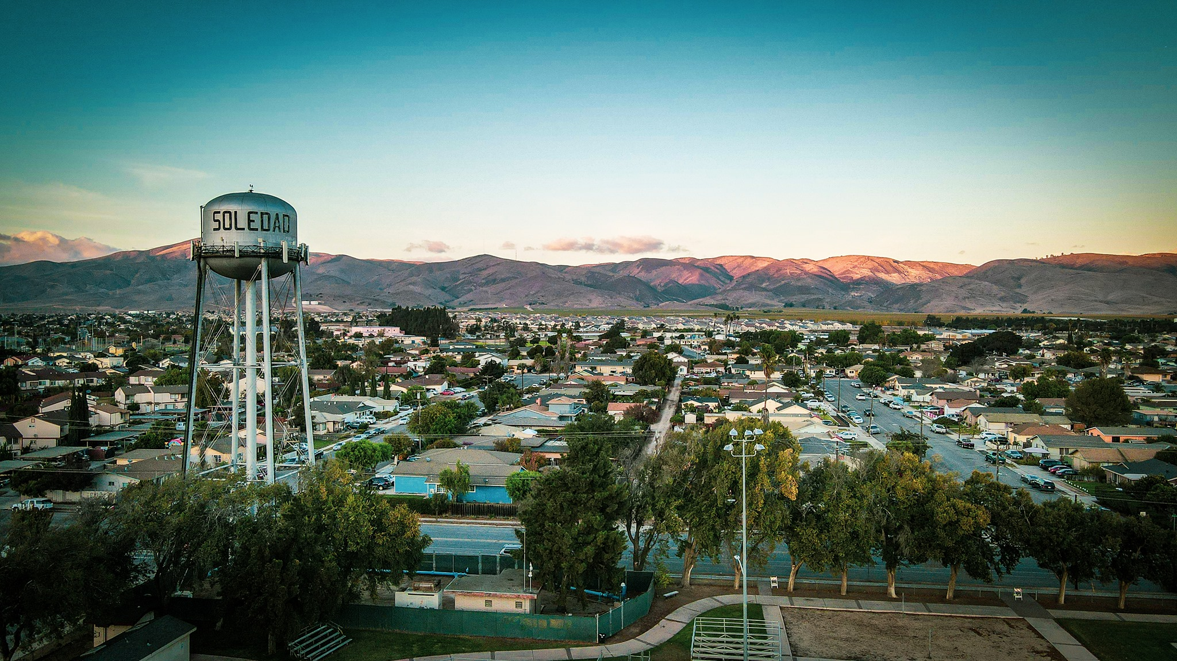
West Street Road Diet
City of Soledad
Public Works Department
Alex C. Ramos
Assistant Engineer

Slide 2
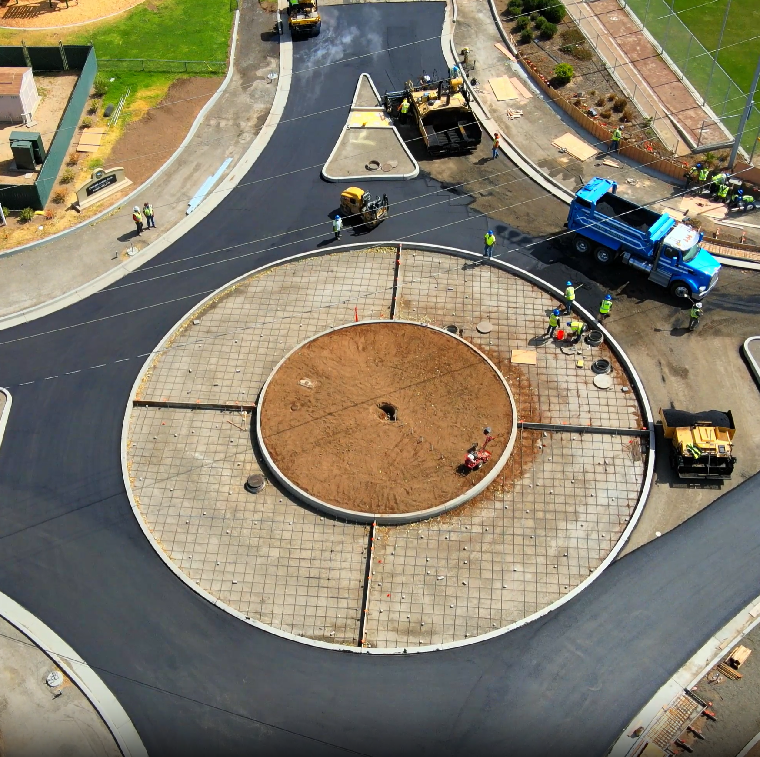
Overview
Background Information
West Street Road Diet
West Street Conceptual Drawings
RSTP Fundings

Slide 3
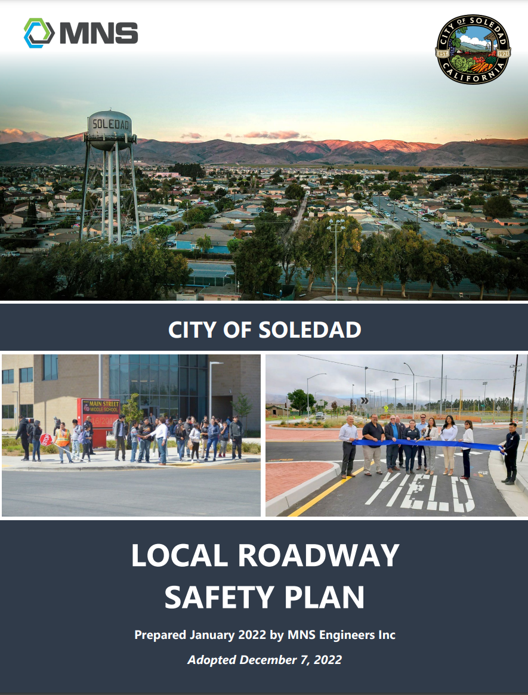
Background Information
Local Road Safety Plan
  Traffic Safety Problems
  Safety Improvement Recommendations
Goals
  Reduce Fatal and Severe Injury Collisions in Soledad
  Implementation of Systemic Countermeasures
  Achieve Effective Roadway Safety Through Education, Engagement, and Enforcement.

Slide 4
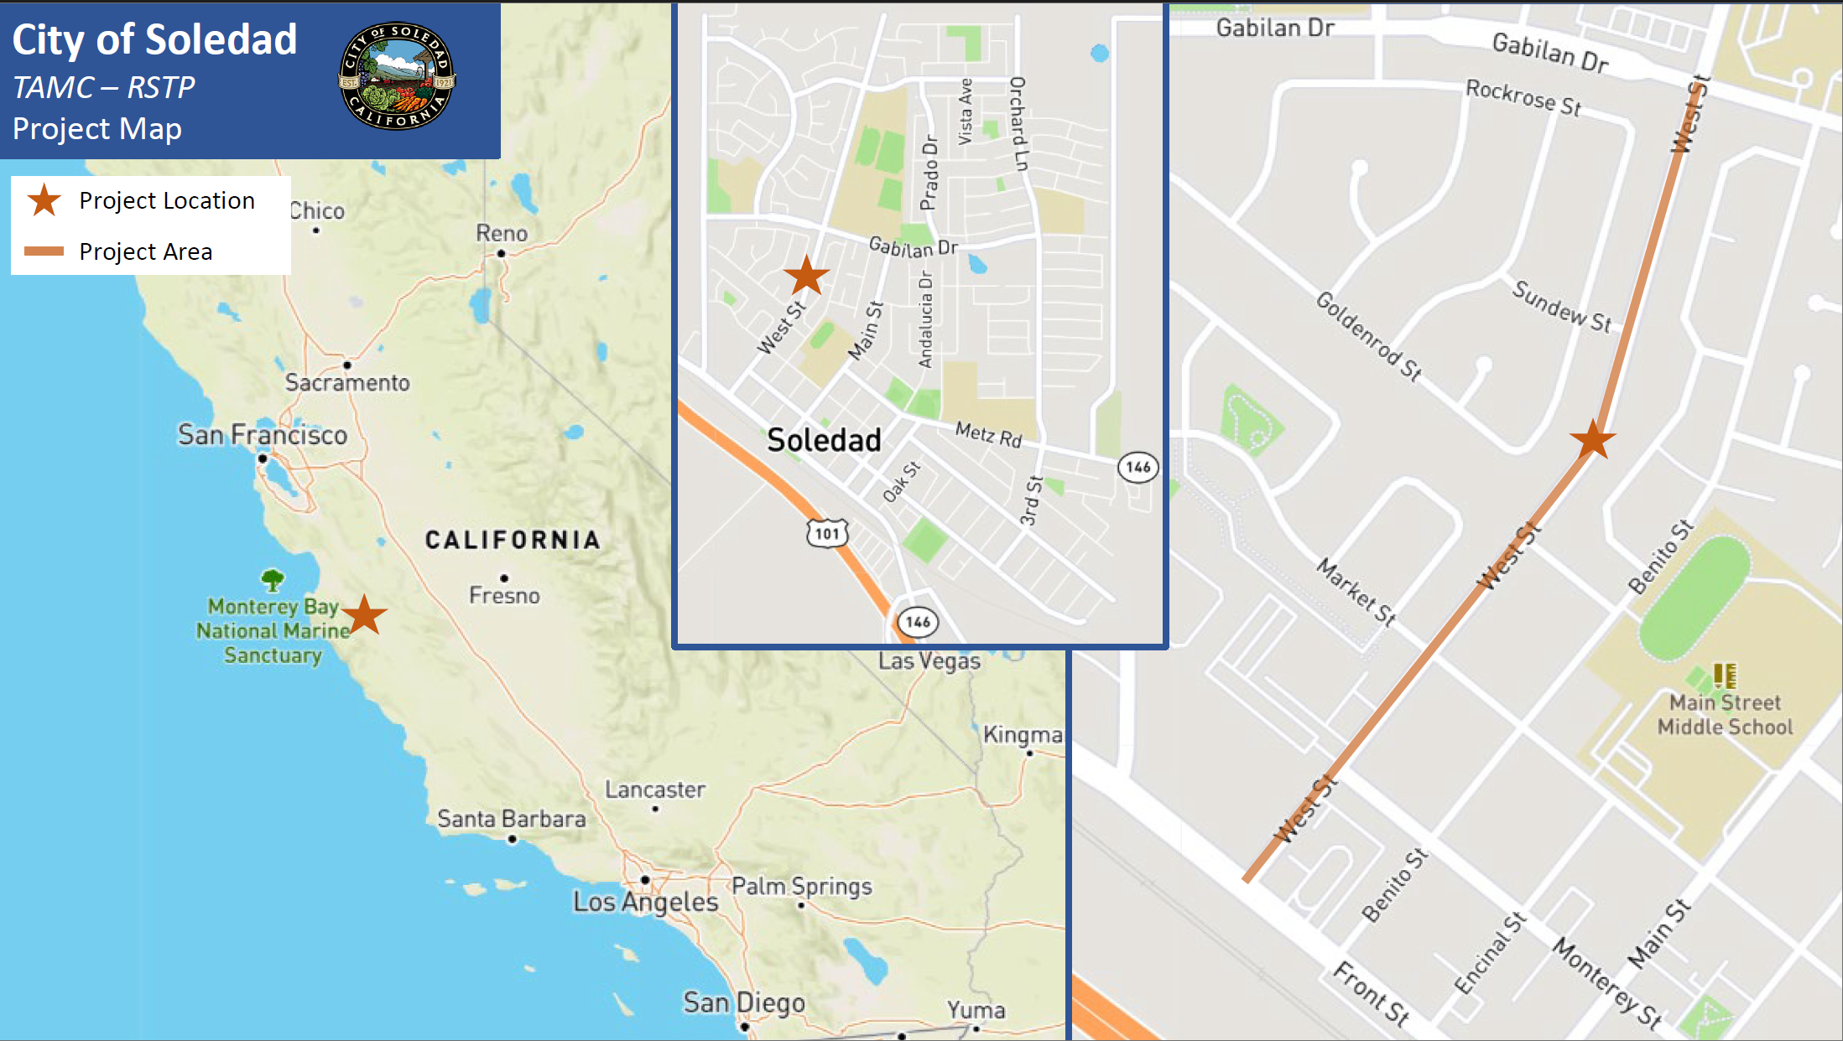
West Street Road Diet
Project Scope
  To improve multimodal mobility, making West St accessible and comfortable for all types of roadway users.
Improvements
  Road Diet – reducing the number of vehicle travel lanes from 4 to 2.
  A two-way left turn
  Painted Bike Lane Buffers
  Pedestrian Crossing at North St.
    With RRFB and Pedestrian Refuge Island
  Road Pavement Reconstruction

Slide 5
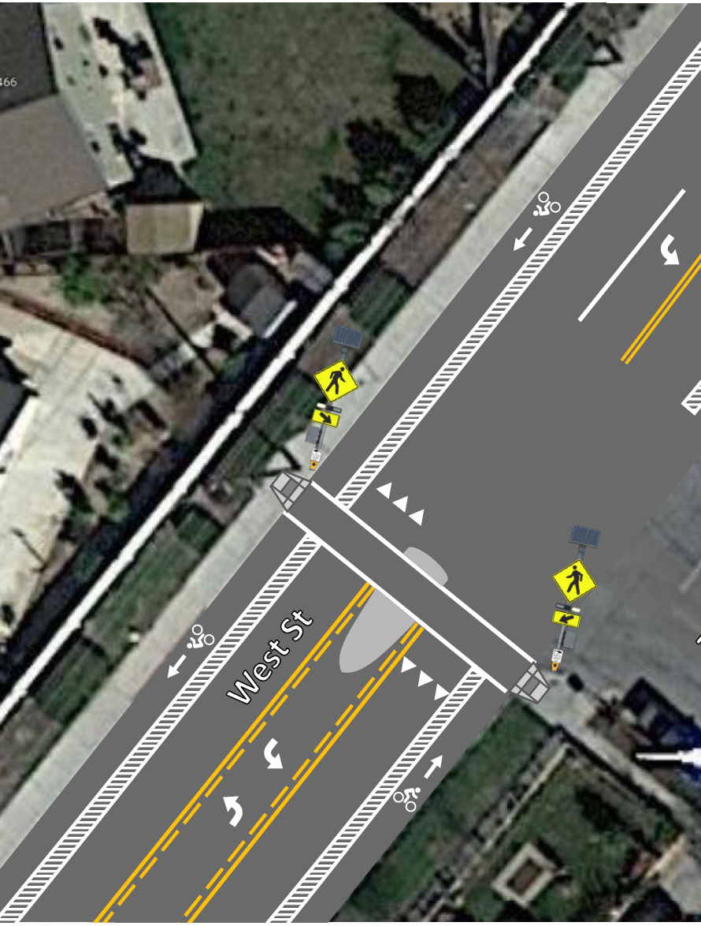
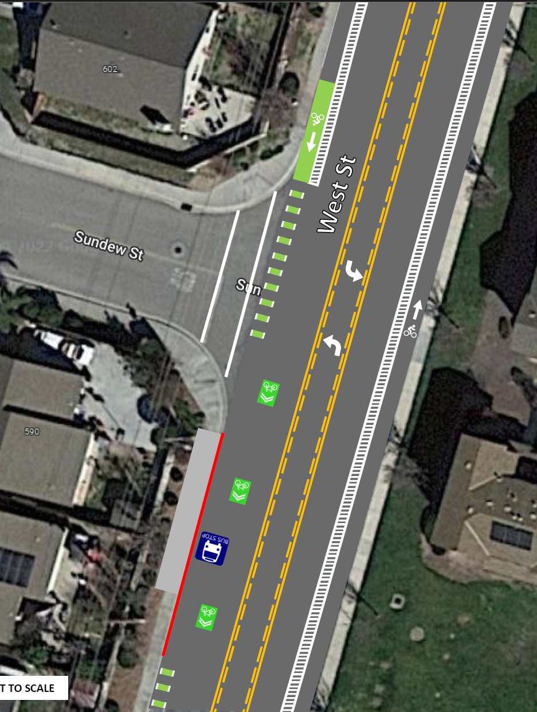
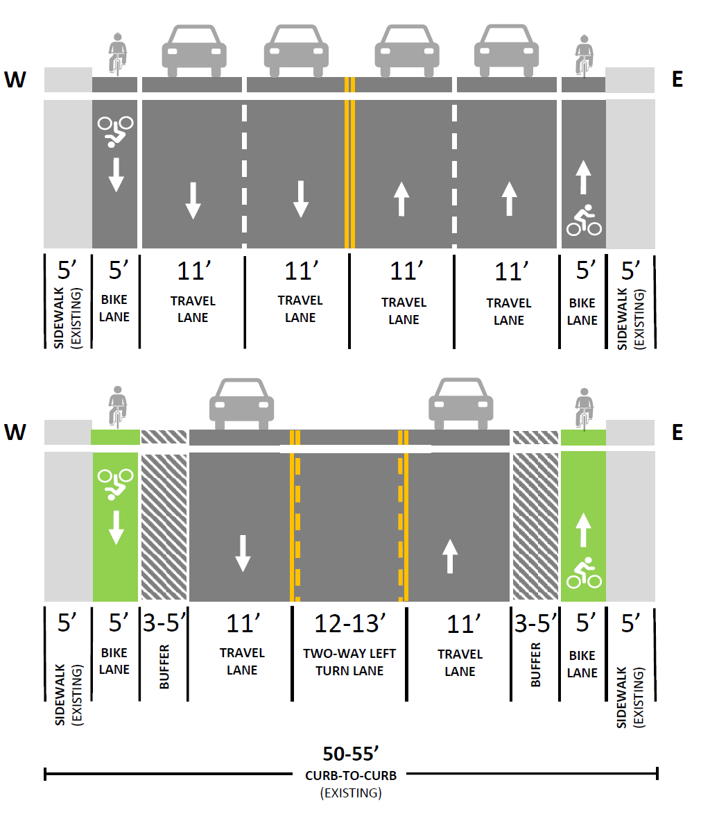
West Street Road Diet (Conceptual Drawings

Slide 6
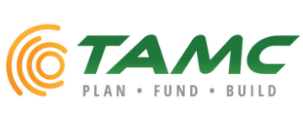
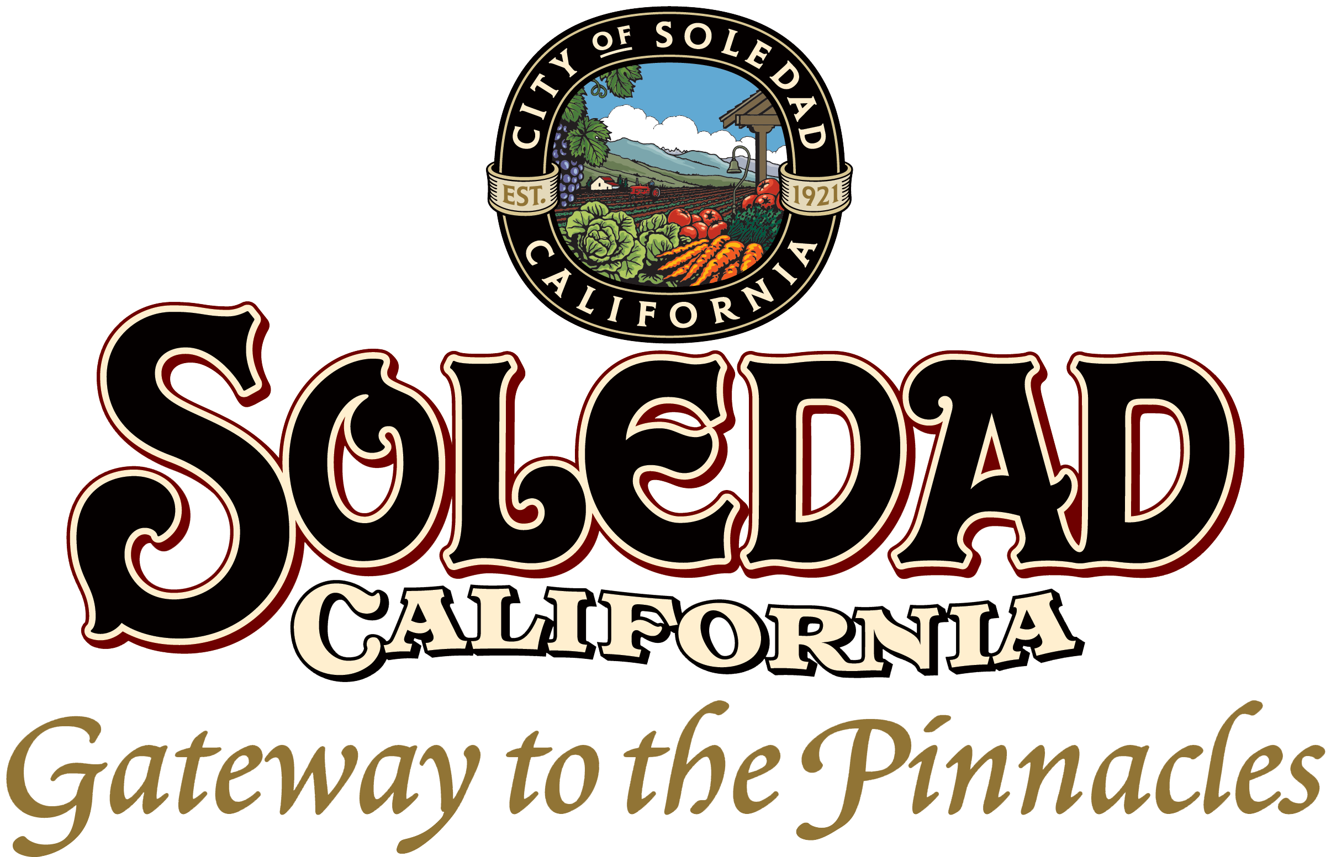
RSTP Funding
Transportation for Monterey County (TAMC) has awarded the City of Soledad with a $2.75M Regional Surface Transportation Program (RSTP) Competitive Grant. Awarded on August 23,2023!
Full funding to accomplish this project!
  Total Project Estimate: $2,758,000
A Huge Thank You to the TAMC Team!

