Slide 1

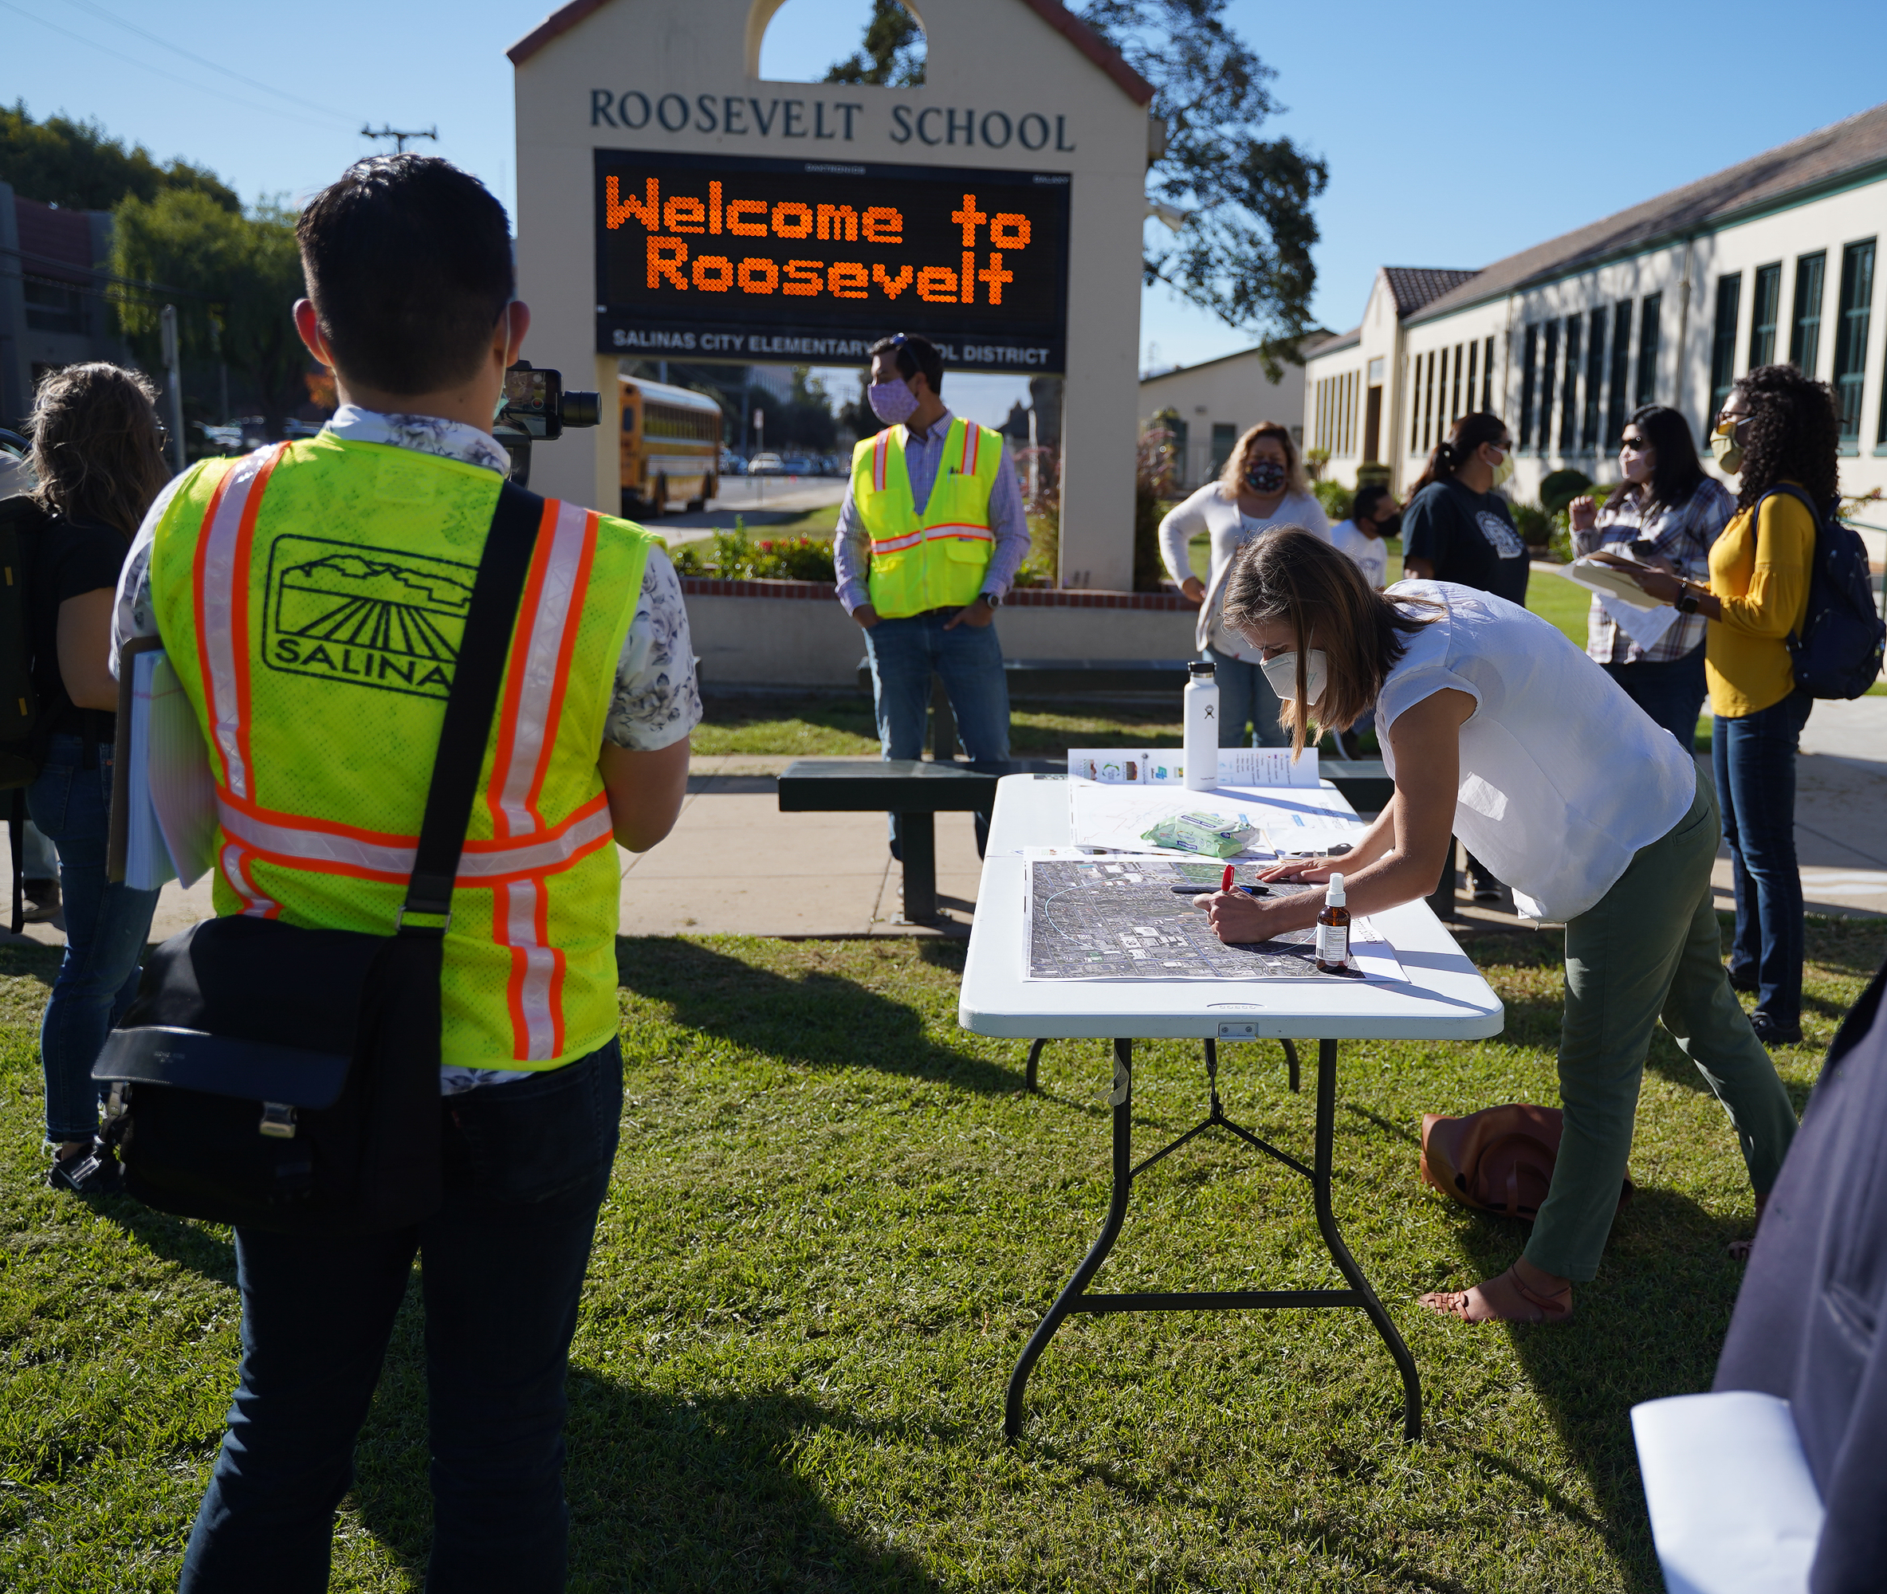









Salinas Safe Routes to Schools Plan
TAMC Board
December 7th, 2022

Slide 2
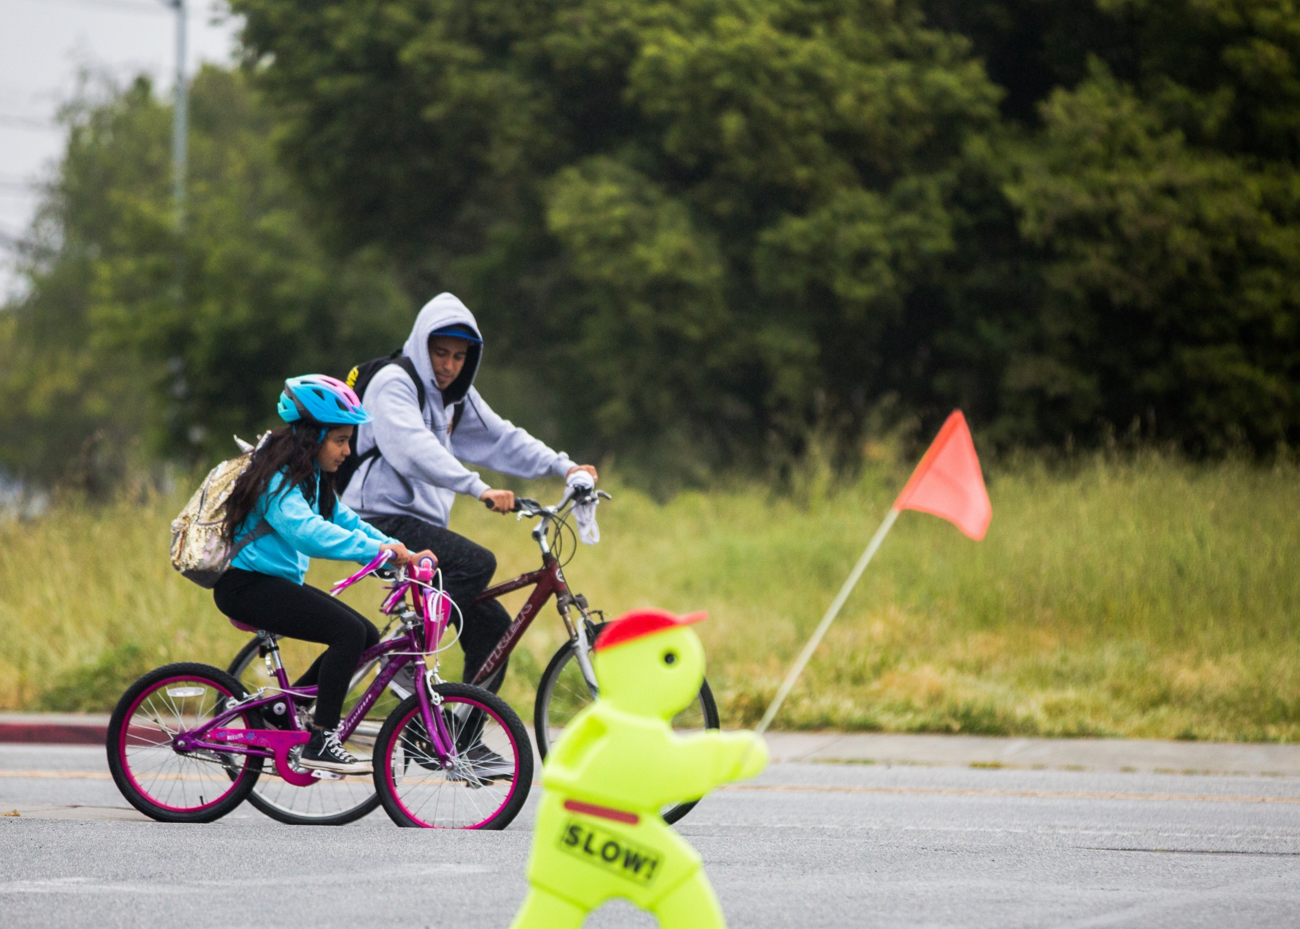

Recommended Action
RECEIVE presentation
ADOPT Resolution 2022-14:
  Adopts the Salinas Safe Routes to School Plan
  Environmental review for Plan is satisfied through the 2045 Metropolitan Transportation Plan/Sustainable Communities Strategy program-level EIR

Slide 3
What We’ll Cover
I. Plan overview
II. Vision and goals
III. Public outreach
IV. Recommendations overview
V. Project evaluation
VI. Plan implementation & next steps
Notes:
Proud of this Plan – today I’ll share some highlights of the Plan and the planning process

Slide 4
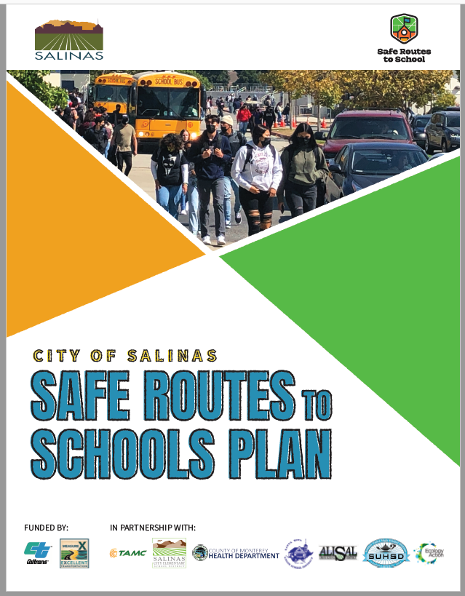
I. Plan Overview
45 schools in Salinas
2020 – 2022
Funded by Caltrans Planning Grant
& Measure X
Partnership between City, TAMC, MCHD, Ecology Action, and 4 school districts
Notes:
HUGE plan

Slide 5
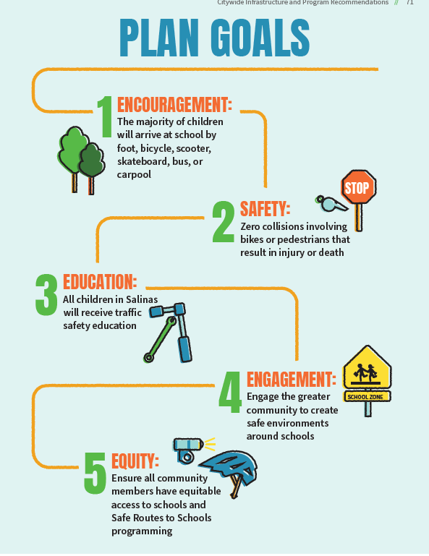
Notes:
Consistent with Countywide SRTS Program Goals
Encourage students to get to school by means other than car
Zero serious or fatal injuries involving bikes and peds
All children will receive traffic safety education
Engage the greater community to support a safer environment around schools
Equitable access to schools and programming

Slide 6
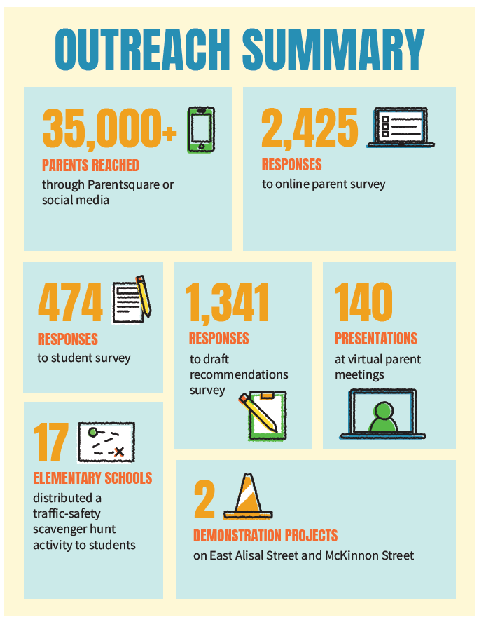
III.Outreach Summary
Notes:
We kicked-off our community outreach in February 2020 and then were shut-down by COVID pandemic. The team found creative ways to get around this and engage with the community including doing a traffic safety scavenger hunt to get input on needed neighborhood improvements.
* Input collected from the community was used to develop project and program recommendations in the Plan
One silver lining that came from the pandemic was that virtual parent/school meetings were better attended than when they were held in-person. So we were able to reach more of the school community and attend more meetings because we saved time and money by not travelling.
Once we had

Slide 7
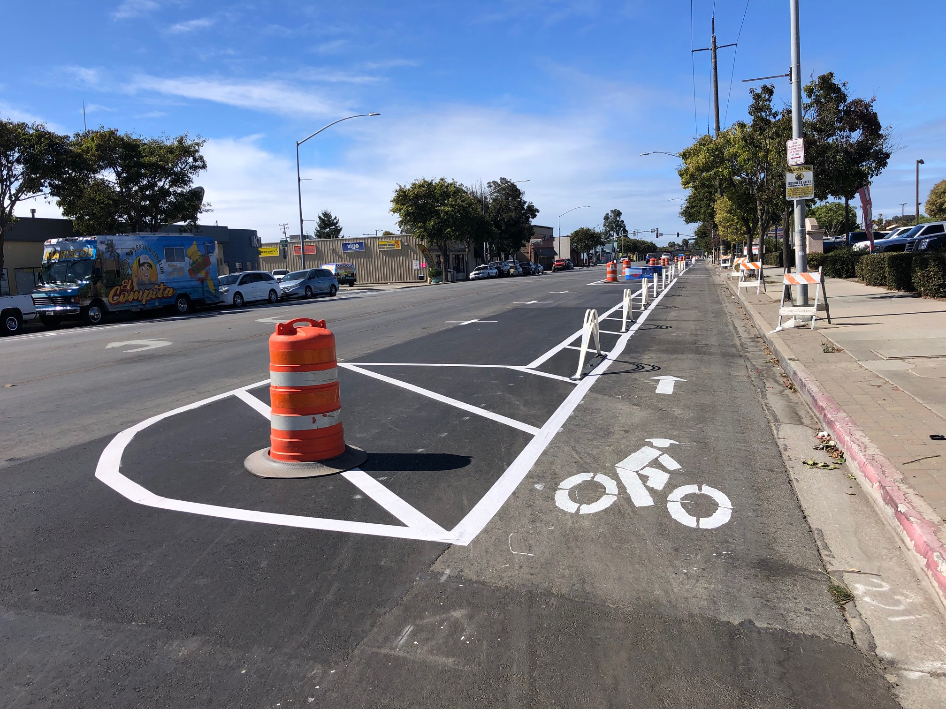
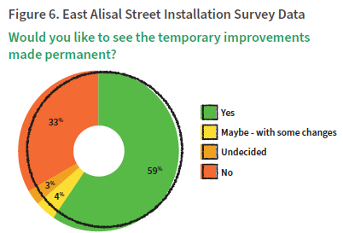
Temporary
Installation: East Alisal Street
Notes:
Effective way to test designs with community members.

Slide 8
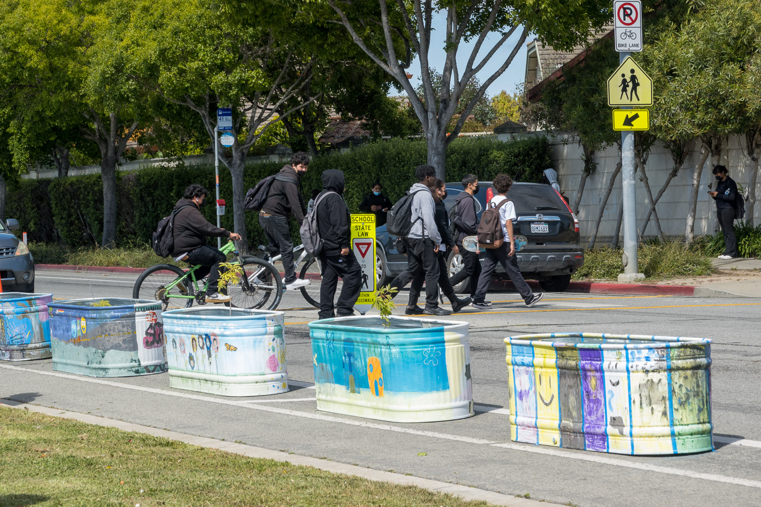
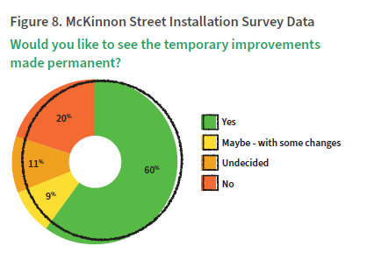
Temporary
Installation: McKinnon Street
Notes:
And if the community wants to make the design permanent – doing these temporary demonstrations give the City an edge when applying for grant funding. In fact this project has been recommended to receive Active Transportation Program grant funding!

Slide 9
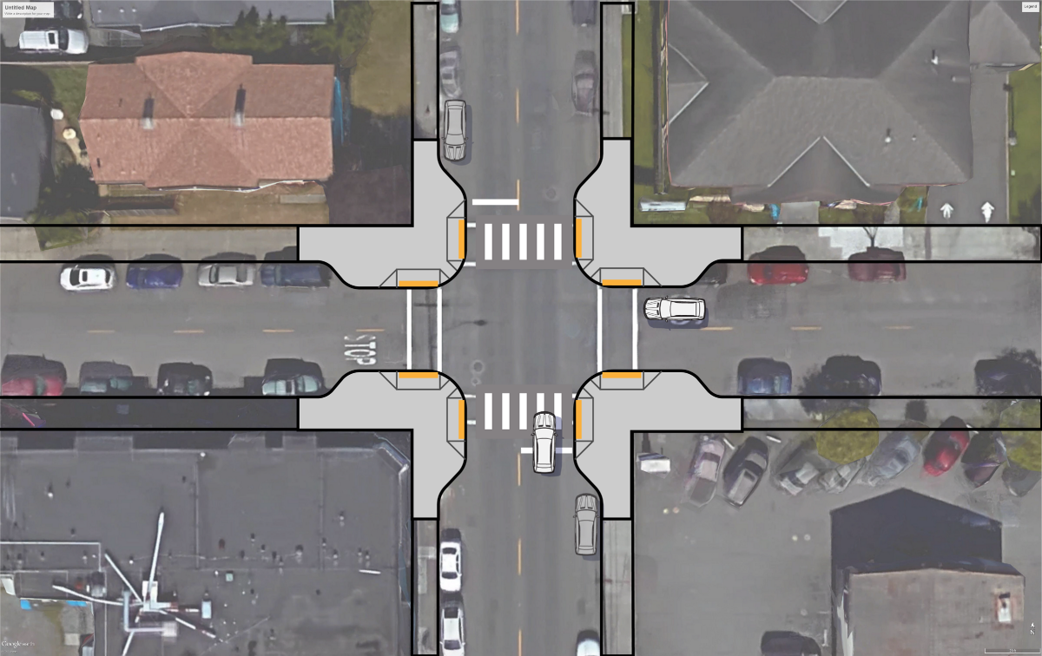
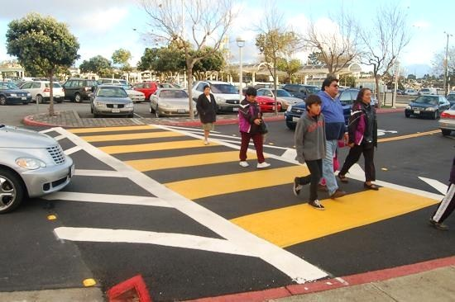
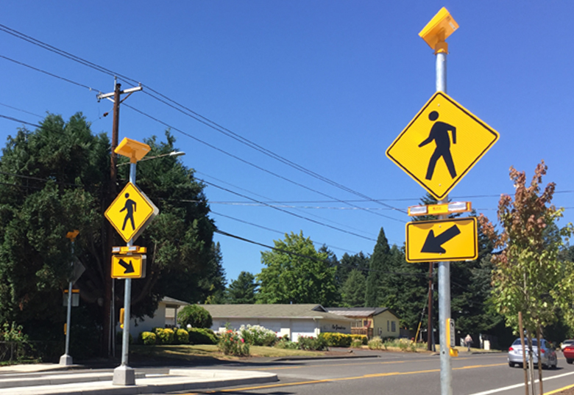
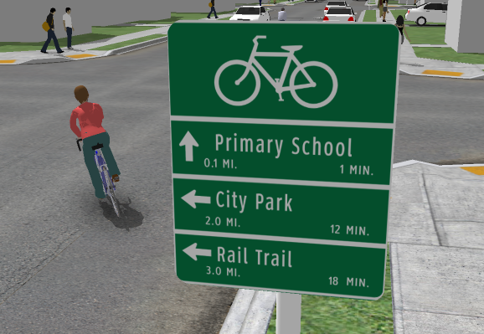
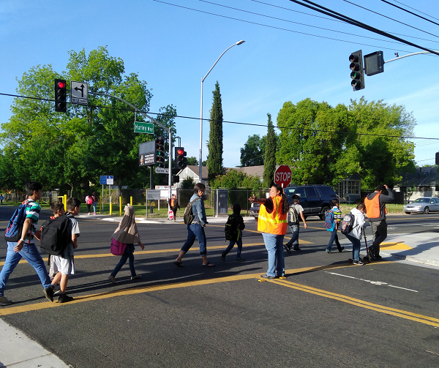
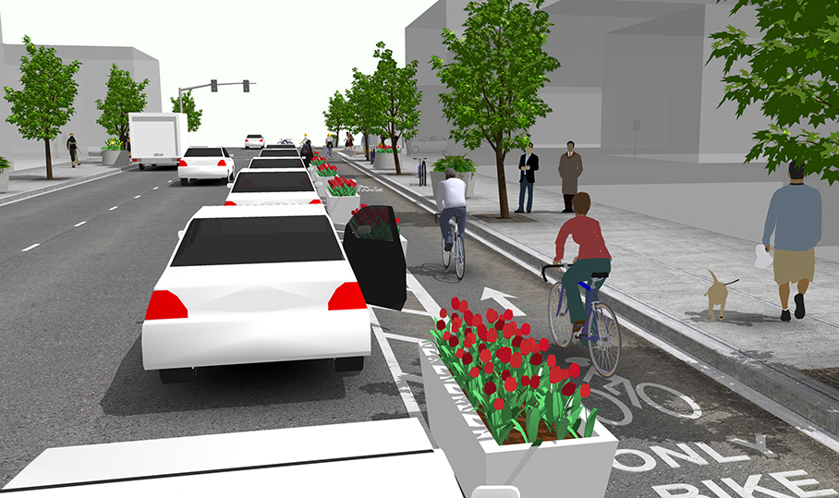
Common Infrastructure Recommendations
Curb Extensions
Raised Crosswalk
Rectangular Rapid Flashing Beacon (RRFB)
Bike Boulevard
Safe Routes to Schools
Corridors
Separated Bikeways/Cycle Tracks
Notes:
Examples of infrastructure recommendations included in the Plan
One of the comments from the TAMC bike & pedestrian committee and community members was to provide physical separation between vehicular traffic and bicyclists and pedestrians like what is shown in the bottom right.
The Plan includes both citywide recommendations and school-specific recommendations

Slide 10
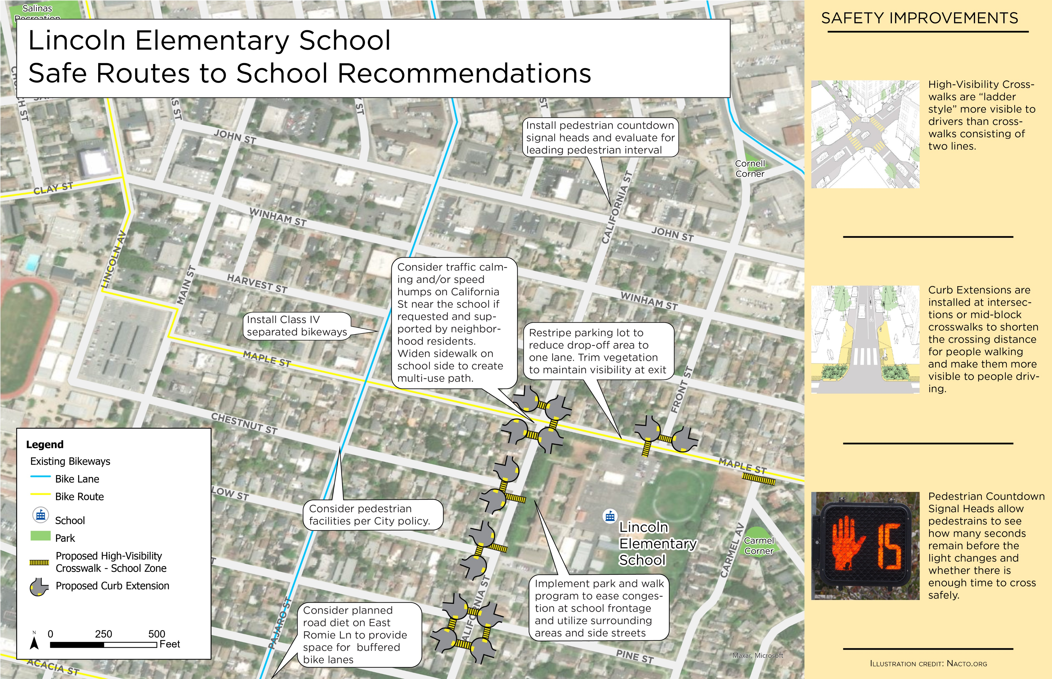
School Recommendations
Notes:
Here’s an example of how the school recommendations are presented within the Plan.
Each of the 45 schools has a page that looks like this to help each school community focus and give detailed input on the recommendations that affect them the most.

Slide 11
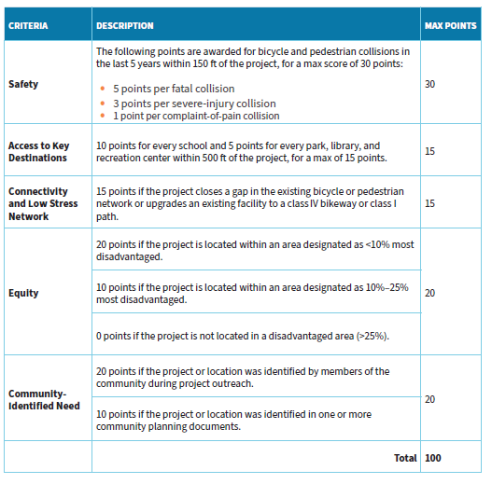
IV. Project Evaluation Criteria
Notes:
Project recommendations were prioritized in the Plan using the following criteria:
Most points given to projects that increase safety
Followed by projects that serve transportation disadvantaged communities and were identified directly by the community through our outreach.

Slide 12
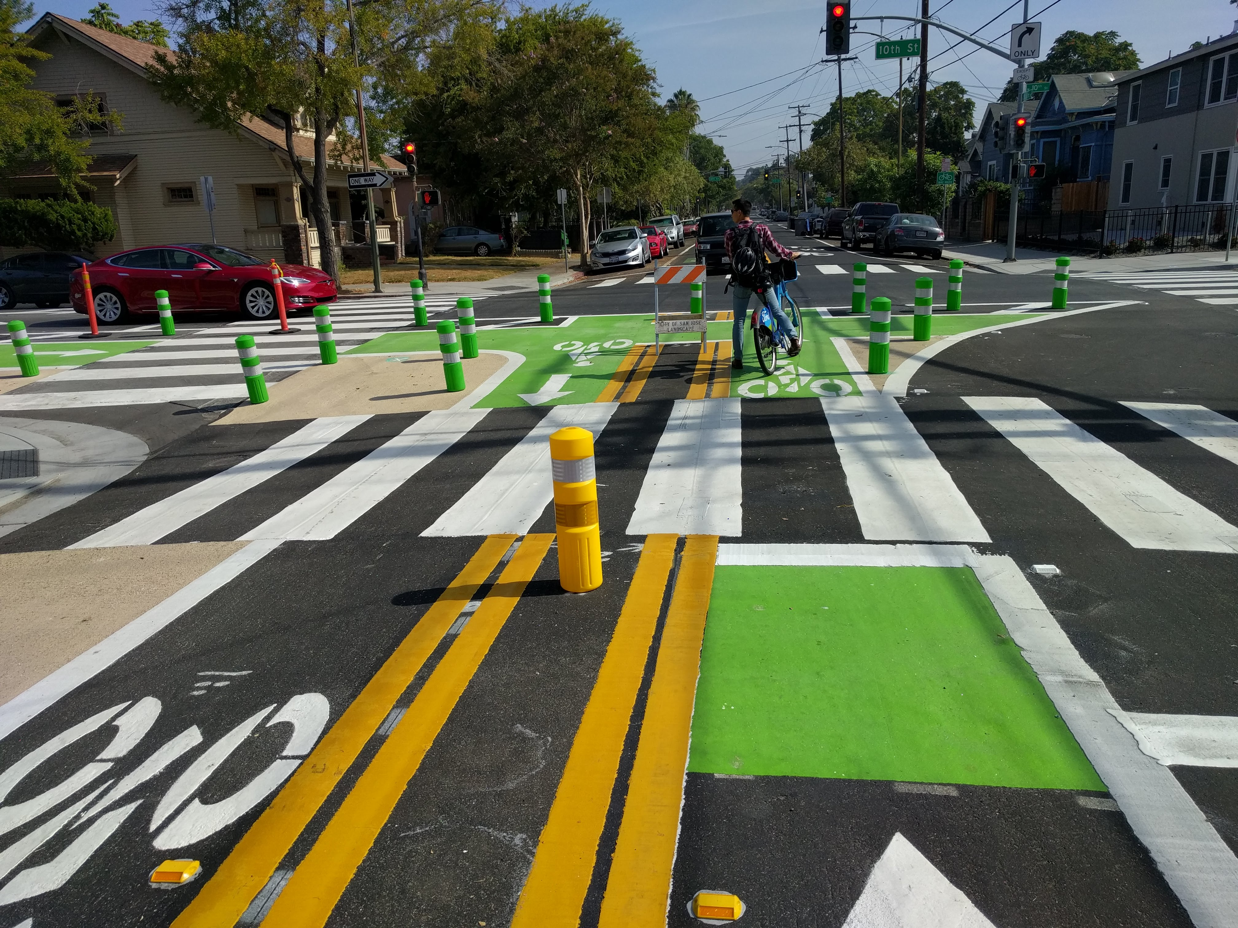
V. Plan Implementation
Projects will be implemented as funding is available
Vision Zero Integrated into Maintenance (VZIM)
Notes:
City has already applied for grants to start implementing the Plan, but also have a really smart way to use their existing funding to do safe routes to school projects:
The VZIM is an innovative program that looks for opportunities to incorporate safety improvements into regular road maintenance. This is a brilliant way to improve safety in a fast and cost-effective way – everyone should be doing this!
Shout-out to Traffic Engineer Andrew Easterling for being particularly proactive about developing the VZIM program and making streets safer in Salinas

Slide 13
Recommended Action
RECEIVE presentation
ADOPT Resolution 2022-14:
  Adopts the Salinas Safe Routes to School Plan
  Environmental review for Plan is satisfied through the 2045 Metropolitan Transportation Plan/Sustainable Communities Strategy program-level EIR

Slide 14
