Slide 1
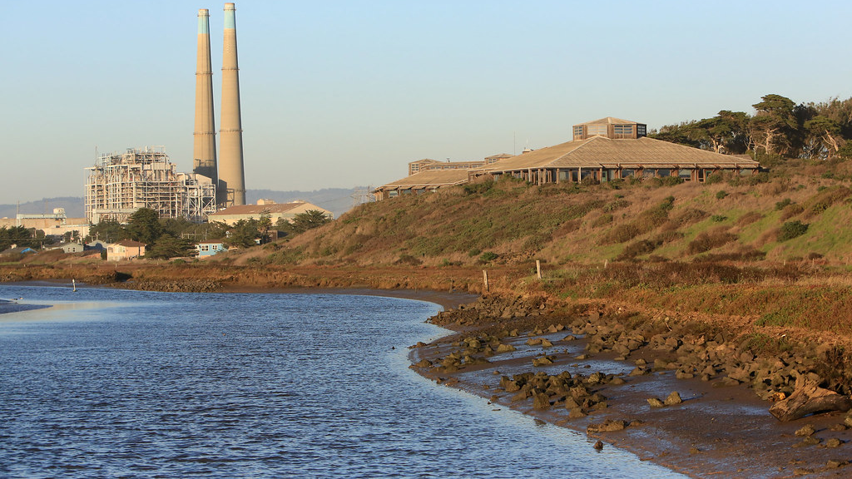
Central Coast Highway 1 Climate Resiliency Study-Planning and Implementation
Transportation Agency for Monterey County
Christina Watson, Alissa Guther, Todd Muck
March 22, 2023
This Photo by Unknown Author is licensed under CC BY-SA
Notes:
[CHRISTINA]
Good morning, Chair LeBarre, Board Members!
This is a group presentation
Introductions…
We’re going to discuss the Central Coast Highway 1 climate resiliency study and discuss next steps for that study

Slide 2

Elkhorn Slough Virtual Reality
Virtual Reality: https://www.virtualplanet.tech/elkhorn-slough
Resiliency Study: https://ambag.org/plans/central-coast-highway-1-climate-resiliency-study
Notes:
[CHRISTINA]
In 2019-20, AMBAG led a study that evaluated the impacts of sea level rise in Elkhorn Slough, looking at the highway 1 corridor, the railroad corridor, and the habitat impacts of sea level rise.
The study was presented to the TAMC Rail Policy Committee on June 1, 2020.
I’m going to show a short version of the video explaining the virtual reality video created for this study.
(1:42 – start at 0:21, end at 1:35)
The links on the slide are for anyone who wants to explore the full VR video or read the resiliency study.

Slide 3
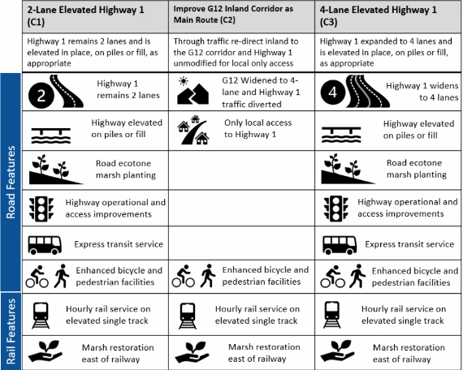
Elkhorn Slough Study Scenarios
Notes:
[CHRISTINA]
This chart shows the 3 alternatives considered, in addition to the no-action alternative.
Elevating Highway 1 as a two-lane highway
Managed retreat (redirecting traffic from a flooded Highway 1 to the G-12 corridor)
Widening Highway 1 to four lanes and elevating it out of the flood zone
This slide is focused on the highway/road traffic.
You’ll notice that every scenario recommends hourly rail service on an elevated single track – this is due to the conclusion from the Network Integration Study, which was happening simultaneously with this study, concluded that there was no need to double-track the mainline tracks through this area.

Slide 4
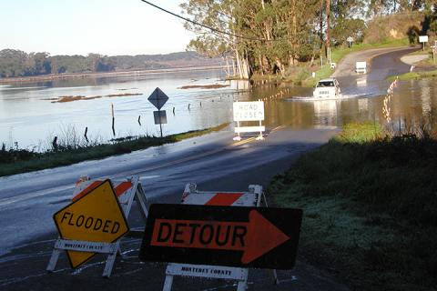
Elkhorn Slough Study Conclusions
No Action: increased congestion and delay; limit access
Recommended action: elevated/4-lane Highway 1
Elevated 2-lane Highway 1 viable alternative but does not solve current congestion
Managed retreat to G-12 corridor limits access, adds traffic to congested route
Image: Kerstin Wasson, Research Coordinator, Elkhorn Slough National Estuarine Research Reserve
Email (831)728-2822 x310
Notes:
[CHRISTINA]
No Action: Allowing Highway 1 to flood would increase congestion and delay in the study area and would limit access to transportation for disadvantaged communities in the area.
Widening Highway 1 to four lanes and elevating it out of the flood zone would provide the greatest relief to congestion and delay, leading to less time spent on the roadway and greater ease of travel
Elevating Highway 1 as a two-lane highway does not provide relief to the demand on Highway 1 that already exists in the study area but does present viable operational improvements that can be implemented to benefit travel time and safety through the corridor.
Managed retreat (redirecting traffic from a flooded Highway 1 to the G-12 corridor) limits access for disadvantaged communities and does worse than the 4-Lane elevated Highway 1 under any transportation metric.
We have been meeting with Caltrans to discuss the next step, which appears to be a Project Study Report or similar document, that will include some conceptual engineering and cost estimates.
Now I’m going to pass the presentation on to Alissa, who will walk through some of the funding options for the next steps on this project.
In addition to the grant opportunities Alissa will detail, there is also the potential for a state budget set-aside which Todd will touch on at the end of our presentation this morning.
[TRANSITION TO ALISSA]

Slide 5

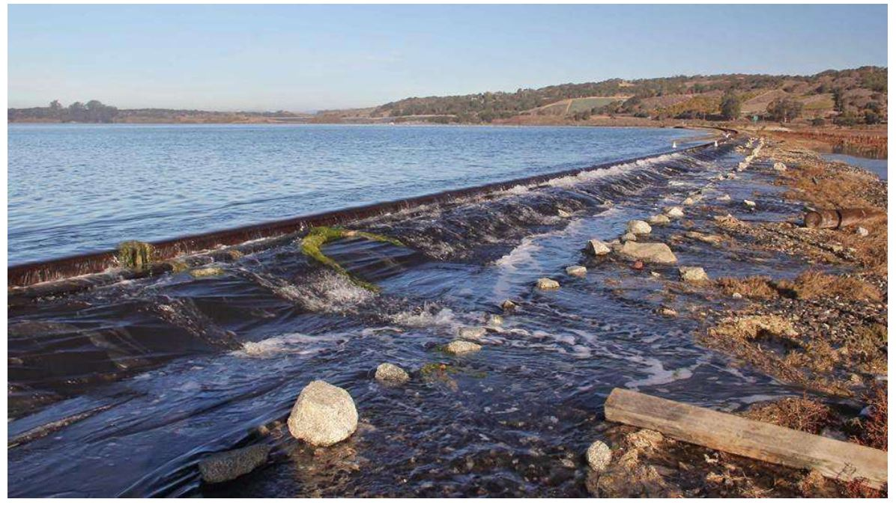
Local Transportation Climate Adaptation Program​
Capital projects adapting local transportation infrastructure to climate change
Total $400 million, first round $50 Million
Applications Due June 28
Notes:
[ALISSA]
provide funding for agencies to develop and implement local transportation infrastructure projects
to adapt to the changing climate and meet federal Justice40 goals
At-Risk Coastal Infrastructure activities that strengthen, stabilize, harden, elevate, relocate or otherwise enhance the resilience of highway and non-rail infrastructure

Slide 6

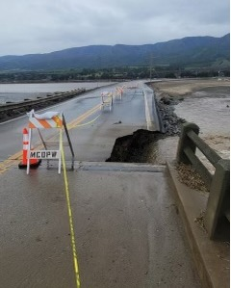
Regional Resilience Grant Program
$250 million/ 3 funding cycles
Regional projects and plans
Climate resilience
Reduce risks from climate impacts
Applications Due July 19
Notes:
[ALISSA]
Regional focus
Collaborative focus
Climate vulnerable projects
Integrate capacity building, vulnerable communities and equitable outcomes
Planning funding will not continue into further rounds

Slide 7
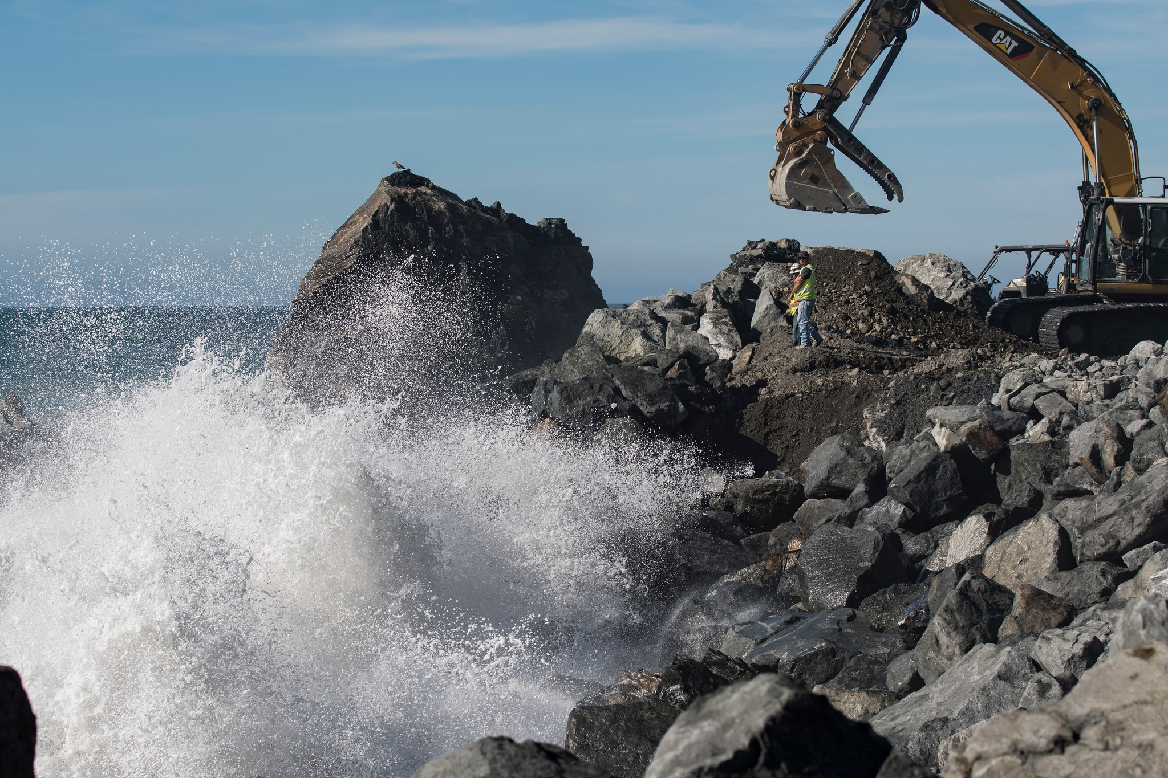
PROTECT Funding
Promoting Resilient Operations for Transformative, Efficient, and Cost-Saving Transportation (PROTECT) Program
Address climate vulnerabilities
Plan transportation improvements
At risk coastal infrastructure grants
Guidelines pending
Notes:
[ALISSA]
The PROTECT program funds are distributed Federally and by formula and by competitive grants. Most of the funds ($7.3B) are to be distributed by formula, while the remainder of the funds ($1.4B) are to be distributed by competitive grant.
Set Aside for Resilience funding
Requires each State to use at least 2% of its PROTECT Formula Program funding each fiscal year for specified types of resilience-related planning activities, such as developing a resilience improvement plan; resilience planning, predesign, or design; technical capacity-building; or evacuation planning and preparation

Slide 8

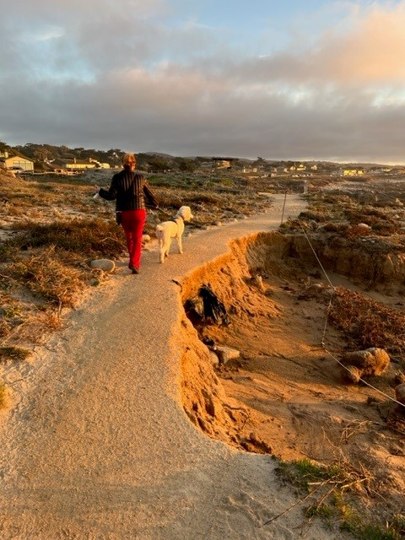
Coastal Conservancy Grant
Focused on Coastal Routes
Highway 1 Coastal Resiliency
~$510 Million for resiliency projects
$150 Million for Coastal Climate Resilience
Rolling applications
Notes:
[ALISSA]
Coastal Resilience Funding
Assess priorities, look at areas that need the most funding
Money is coastal resilience oriented
Strategic plan, project selection criteria
more interested in specific infrastructure planning
Longer term is construction
These funds are newly available, long range project
[TRANSITION TO TODD]

Slide 9
Highway 1 Elkhorn Slough
Next Steps
Seek state budget funds for:
  Caltrans: Project Study Report or similar
  Environmental Review
  Preliminary Engineering
  Cost Estimates
Notes:
[TODD]
Gus tells us there’s ~$3M available potentially in the state budget for members to designate to projects for preconstruction/environmental activities

Slide 10
AUTHORIZE the Executive Director to pursue member designated funding for planning and environmental studies for the Highway 1 Elkhorn Slough resiliency project
This Photo by Unknown Author is licensed under CC BY-SA
Notes:
[TODD]

