Slide 1
2023 Competitive Grants Program of Projects
Transportation Agency for Monterey County
Board of Directors
August 23, 2023

Slide 2
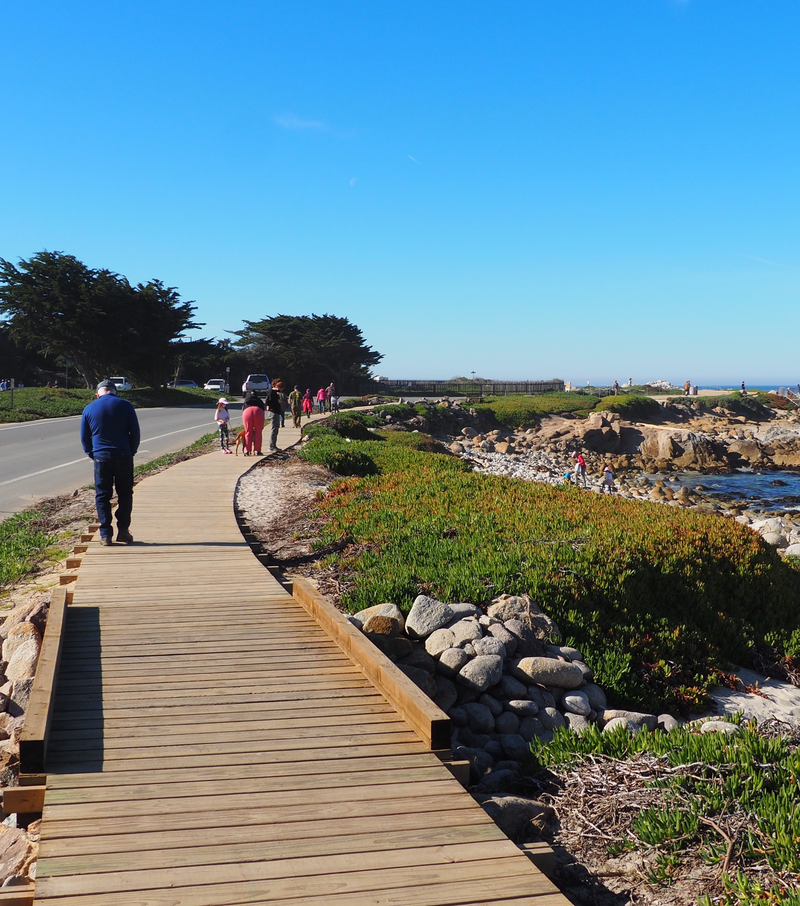
Agenda
Program Overview
Fund Estimate – adopted March 2023
Projects Recommended for Funding
  Competitive Grant Program
  Quick-Build Grant Program
Pacific Grove Point Pinos Trail Project

Slide 3
Program Overview
Fund Source:
Regional Surface Transportation Program
Transportation Development Act 2%
Eligible Uses:
Highways, local streets, bicycle and pedestrian improvements, and limited transit
Fund Cycle:
FY 23/24 – 25/26

Slide 4
Fund Estimate
Regional Surface Transportation Program & Transportation Development Act 2% Fiscal Years 2023/24/25 | $18,000,000 $750,000 $18,750,000
Reserve (10% of the RSTP estimate) | $1,800,000
Salinas Rail Project Set Aside | $2,600,000
Fair Share | $3,600,000
Total Funds in Competitive Grant Program | $10,750,000
Quick-Build Project Pilot Program | $1,000,000
Competitive Grant Funding | $9,750,000

Slide 5
Competitive Grant Application Overview
12 applications submitted
More than $22.7 million requested
Application scores favored projects that:
  Improve regional routes with high traffic volumes
  Include bicycle and pedestrian facilities and safety enhancements
  Benefit disadvantaged communities and people with disabilities
  Have already started environmental review and/or design
  Are sponsored by jurisdictions with a proven track record to deliver projects on time

Slide 6
Recommended Funding
Projects, Ranked Order | Sponsor | Score (100) | Recommended Funding
U.S. Highway 101/Broadway Street at San Antonio Drive Roundabout Improvement Project | King City | 88.9 | $3,519,000
Del Monte Boulevard and Reservation Road Intersection Improvements | Marina | 88.1 | $1,717,500
MST Countywide Bus Stop Project | MST | 83.1 | $425,000
West Street Road Diet and Complete Street Project | Soledad | 79.2 | $2,758,000
Harden Parkway Path and Safe Routes to School Project | Salinas | 73.7 | $1,556,000
Coe Avenue and General Jim Moore Boulevard and Seaside MS Intersection Improvements | Seaside | 71.7 | $0
Old Stage Road and Encinal Road Roundabout | Mon. County | 70.9 | $0
Carmel Valley Road and Laureles Grade Roundabout | Mon. County | 70.3 | $0
Salinas Road and Pajaro Project | Mon. County | 67.3 | $0
Prunedale Roundabout Project | Mon. County | 64.7 | $0
Del Monte Avenue/Washington Street Bicycle and Pedestrian Improvements | Monterey | 63.7 | $0
Carmel Valley Road Safety Improvement and Bicycle Lanes Project | Mon. County | 56.1 | $0
Pop-up at MLK Elementary School, Seaside
6
Competitive Grants Program
August 23, 2023

Slide 7
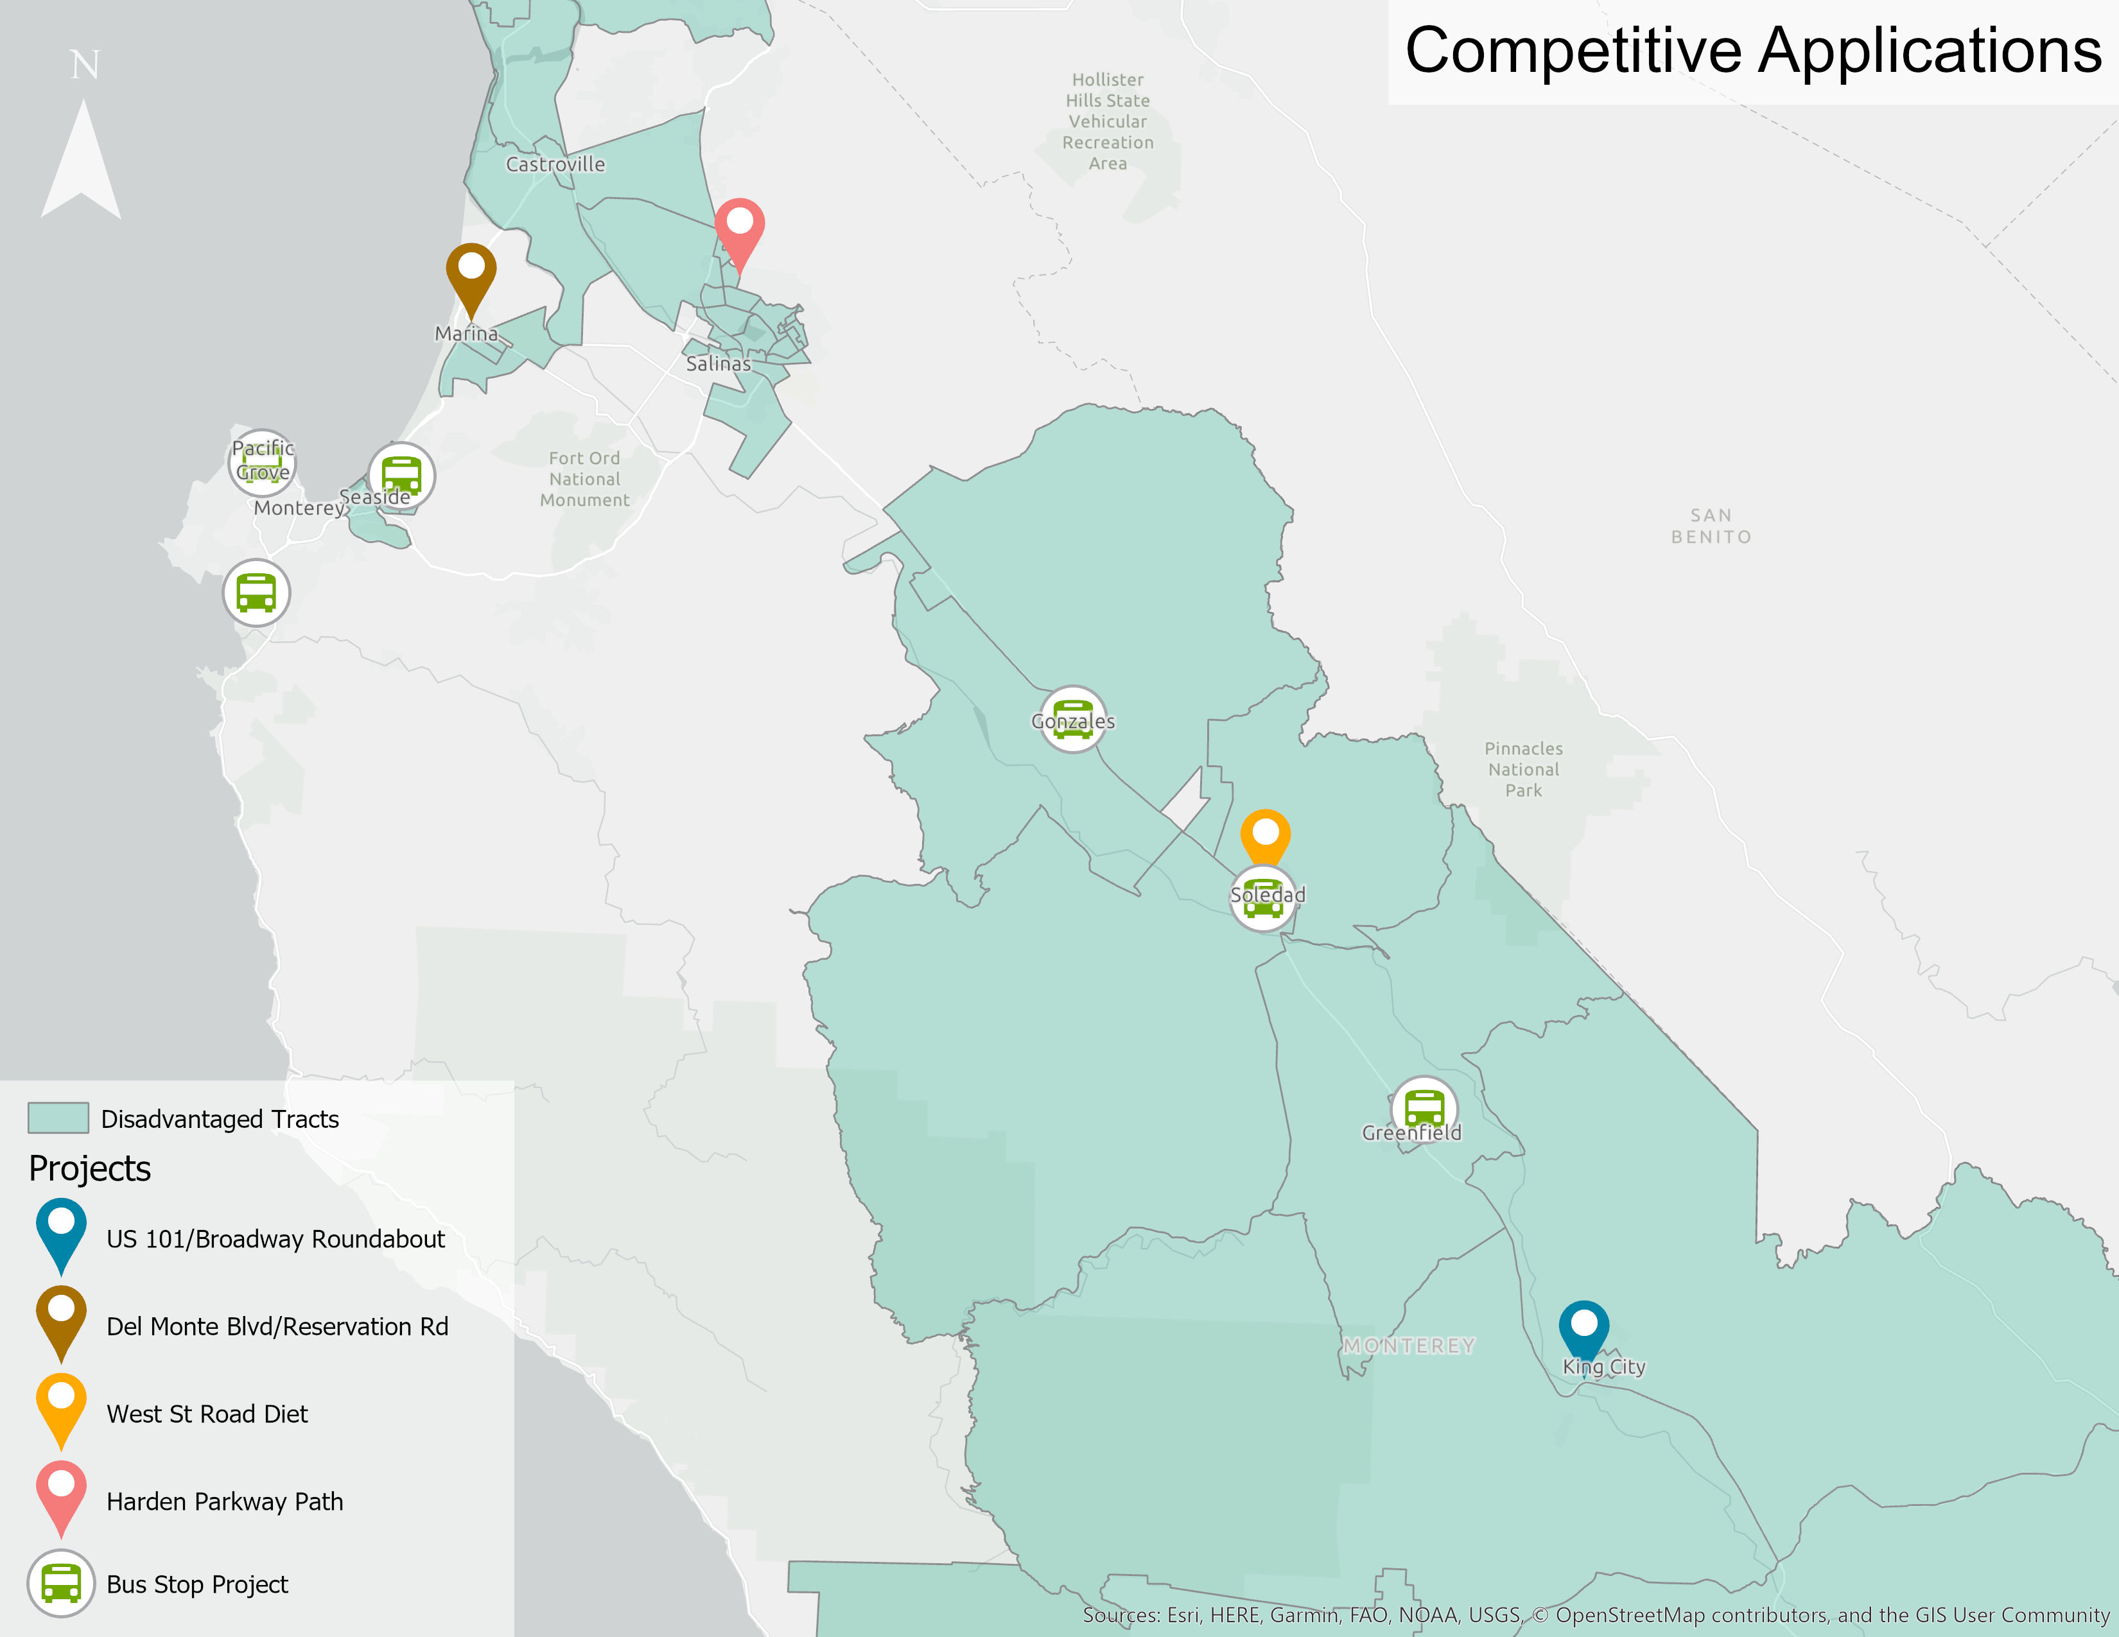
80% of projects recommended for funding within a disadvantaged community (designated by the federal Justice40 Initiative)

Slide 8
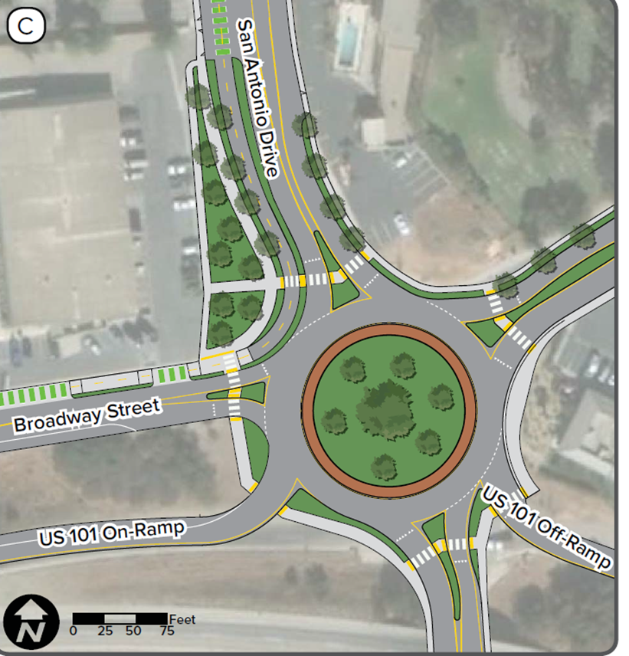
U.S. Highway 101/Broadway Street at San Antonio Drive Roundabout Improvement Project
Project Sponsor
King City
Total Project Cost
$3,922,000
Recommended Funding
$3,519,000
8

Slide 9
U.S. Highway 101/Broadway Street at San Antonio Drive Roundabout Improvement Project
Project Details
Roundabout at the U.S. 101/Broadway St and San Antonio Drive intersection
Simplify complex geometry, slow speeds, and eliminate left-turn conflict points
Pedestrian crosswalks, refuges, and sidewalks
Provides connection to future San Antonio Trail Project
Class II bike lanes within the project limits
9

Slide 10
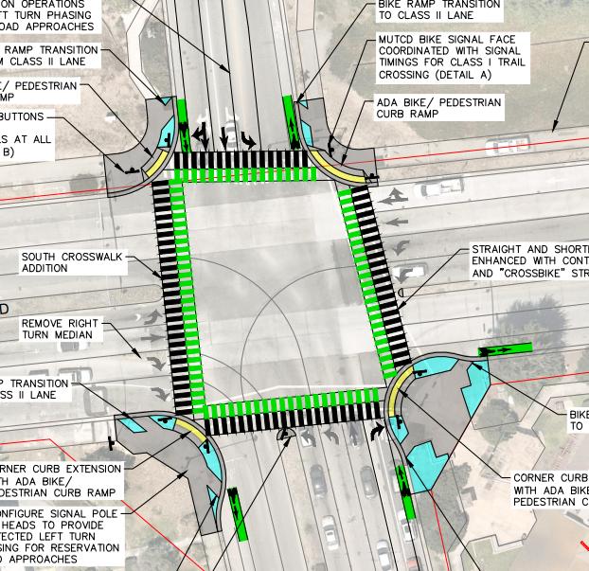
Del Monte Boulevard and Reservation Road Intersection Improvements
Project Sponsor
City of Marina
Total Project Cost
$1,937,500
Recommended Funding
$1,717,500
10

Slide 11
Del Monte Boulevard and Reservation Road Intersection Improvements
Project Details
Enhanced bike and ped visibility and safety at crosswalks and curb bulb out refuge areas
Shortened bike and ped crossing times with realigned crosswalks and ramps
Increased bike and ped protection and separation from vehicles at intersection conflict points
Increased bike and ped connectivity to transit stop, regional trail, commercial and municipal amenities for disadvantaged communities
Improved ADA compliance with audible ped signals, leading ped intervals, and new curb ramps
11

Slide 12
MST Countywide Bus Stop Project
Project Sponsor
Monterey-Salinas Transit
Total Project Cost
$998,800
Recommended Funding
$425,500
12

Slide 13
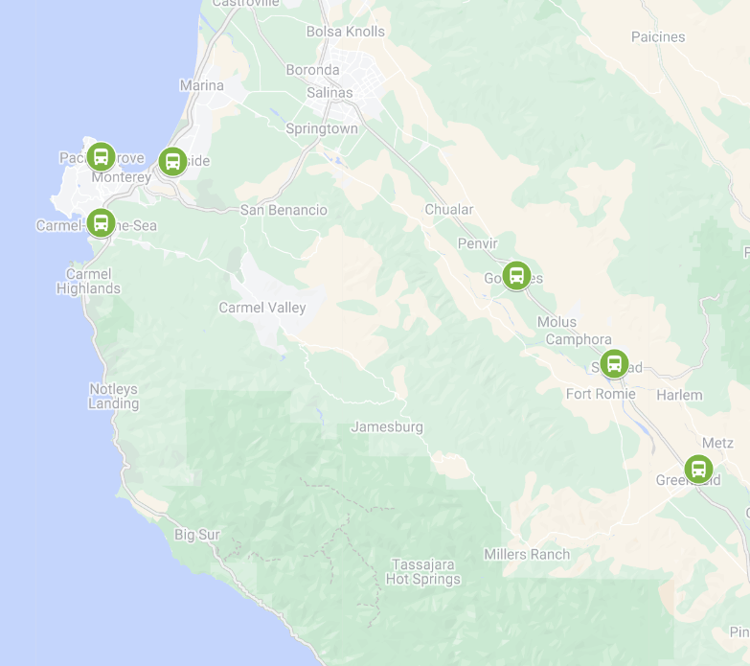
MST Countywide Bus Stop Project
Project Details
49 new ADA-compliant bus stops countywide
Sites were identified through MST’s Better Bus Network, the South County Planning Study, and public comments at Board Meetings
Allows MST to transition its South County service to an individual city focused service that will utilize a main trunk line, Line 23, to connect the intra-city circulator lines.
This service method will increase the frequency of service within these low-income communities
13

Slide 14
West Street Road Diet and Complete Street Project
Project Sponsor
City of Soledad
Total Project Cost
$2,882,000
Recommended Funding
$2,758,000
14

Slide 15
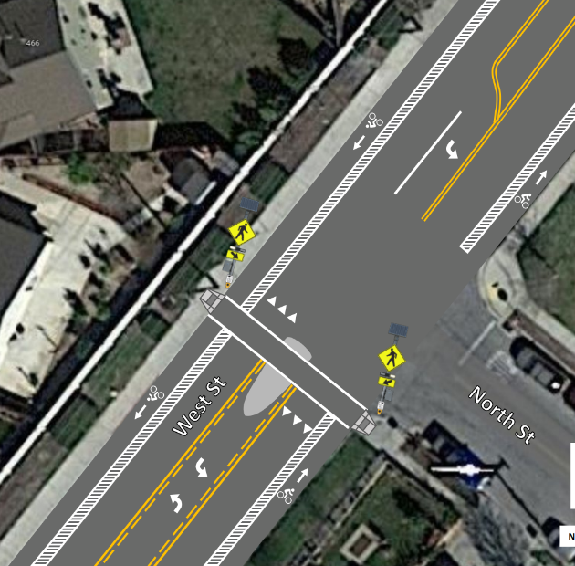
West Street Road Diet and Complete Street Project
Project Details
4-to-2 lane road diet - south of Gabilan Drive restripe as two travel lanes & median
Double striped median from Gabilan Drive to North Street
Two-way left turn lane from North Street to Front Street
Striped 6” bike lane with 3” buffer
Pedestrian crosswalk with RRFB signal and upgraded curb ramps
15

Slide 16
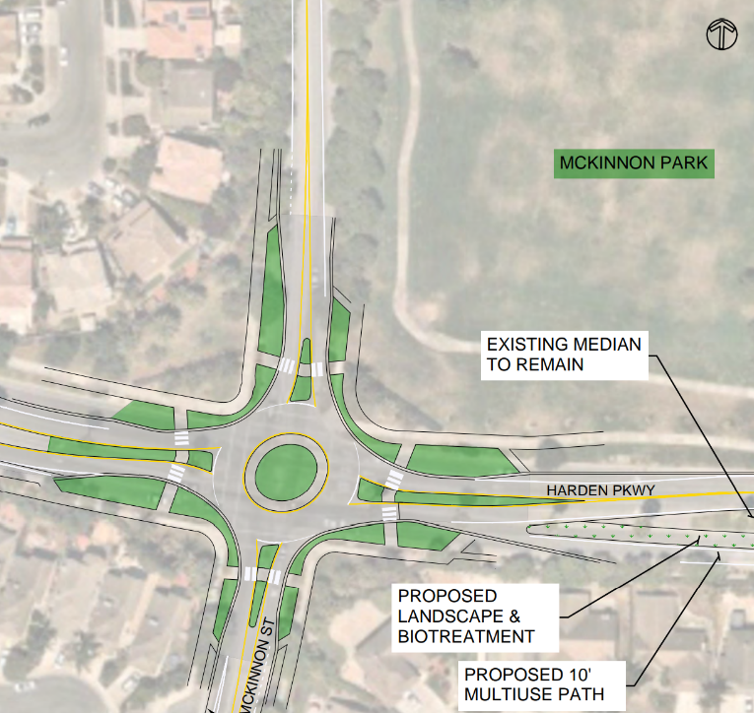
Harden Parkway Path and Safe Routes to School Project
Project Sponsor
City of Salinas
Total Project Cost
$15,562,000
Recommended Funding
$1,556,000
16

Slide 17
Harden Parkway Path and Safe Routes to School Project
Project Details
4-to-2 lane road diet on Harden Parkway with a 2-way separated and protected multiuse path
Stormwater improvements, accessible sidewalks
High visibility crosswalks and curb extensions between McKinnon Street to El Dorado Park
Roundabout at Harden Parkway and McKinnon Street
17

Slide 18
Quick-Build Grant Application Overview
4 applications submitted
More than $732,000 requested
Application scores favored projects that:
  Use semi-permanent materials to test a concept that quickly addresses a safety need
  Continuously engages the community throughout the duration of the project
  Measures progress and performance
  Provides a foundation for potential permanent infrastructure.

Slide 19
Recommended Funding
Projects, Ranked Order | Sponsor | Score (50) | Recommended Funding
East Market Street Cycle Track Quick Build | Salinas | 44.6 | $326,000
Madison/Herrmann/Larkin Traffic Circle | Monterey | 41.6 | $119,120
Division Street Bike Lanes & SRTS Crosswalk Upgrades | King City | 40.4 | $117,380
Countywide Bicycle Facilities - Blanco Road and Inter-garrison Road | Monterey County | 35.8 | $0
Pop-up at MLK Elementary School, Seaside
19

Slide 20
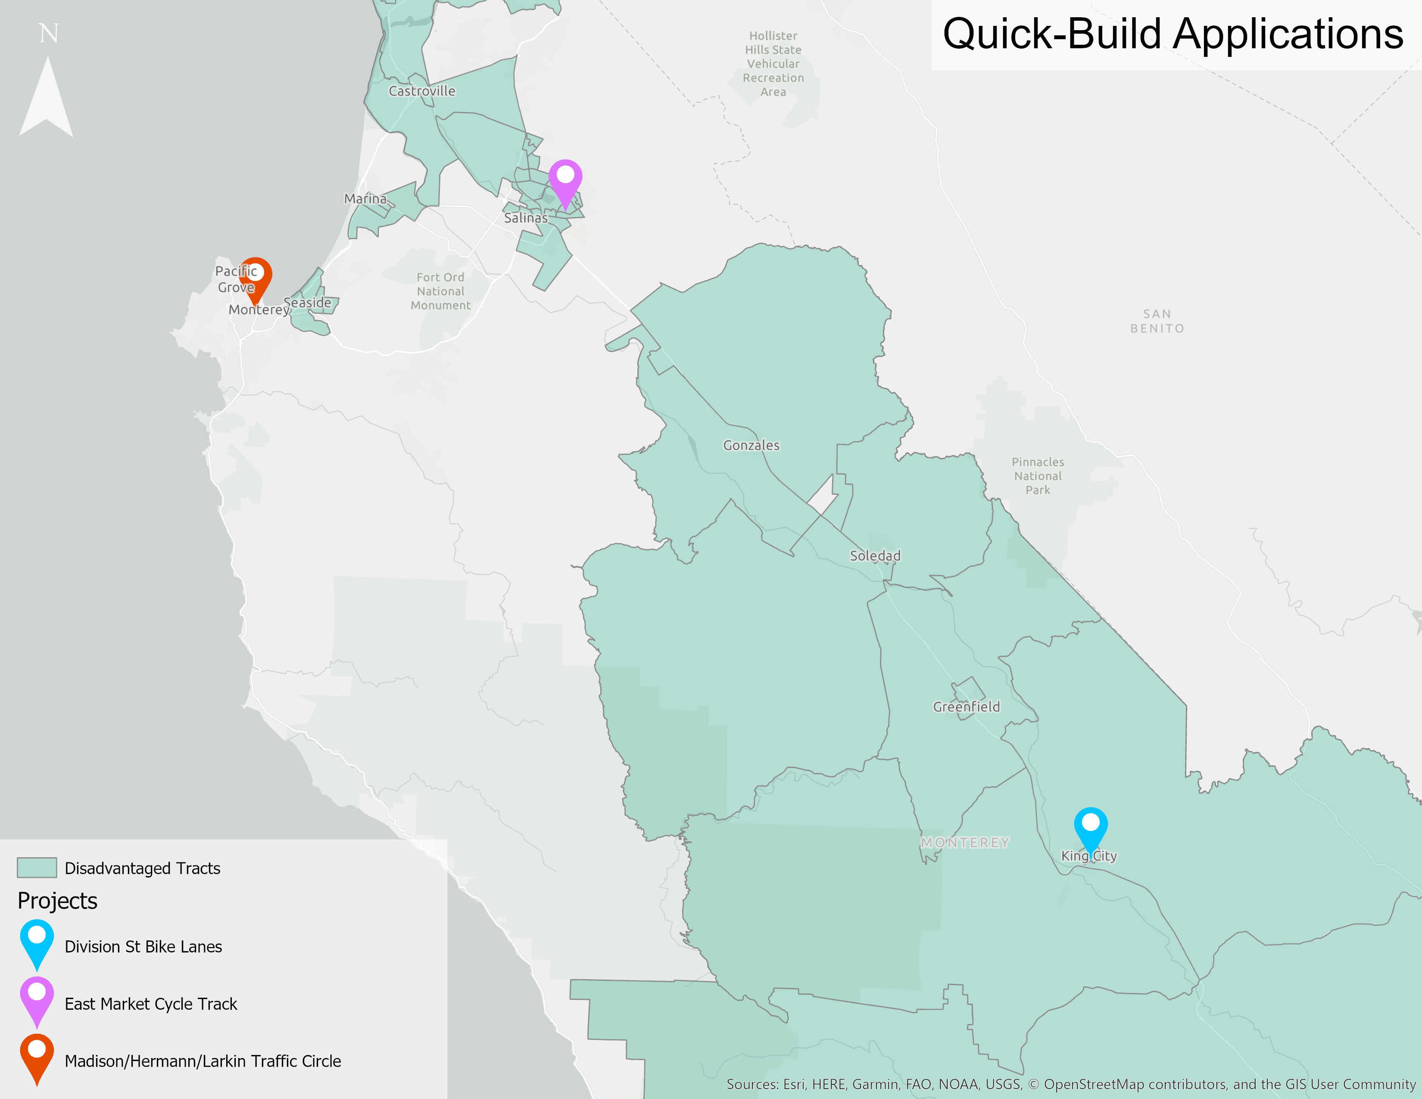
2 of 3 projects recommended for funding are within a disadvantaged community (designated by the federal Justice40 Initiative)

Slide 21
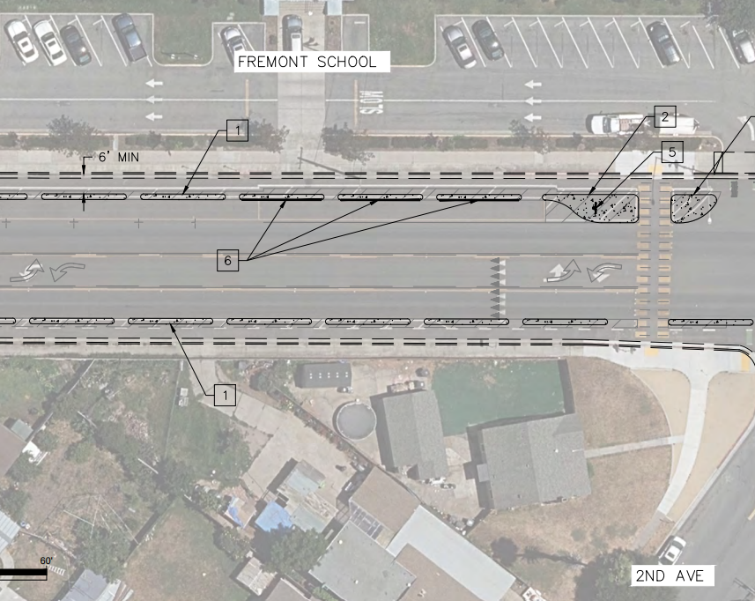
East Market Street Cycle Track Quick Build
Project Sponsor
Recommended Funding
City of Salinas
$326,000
Project Details
Installation of a raised median where a striped buffer currently exists on East Market St from Eucalyptus Dr to Williams Rd
The raised median cycle tracks would serve as a buffer between on-street parking and the bike lanes, protecting bicyclists from the door zone of parked cars
The raised median would prevent drivers from encroaching into or outright blocking the bike lane

Slide 22
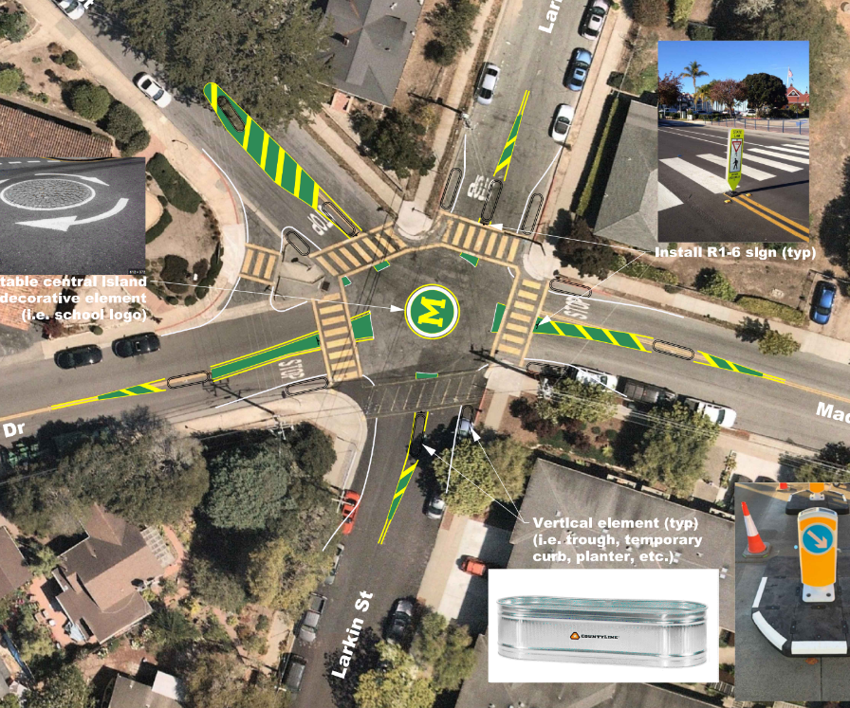
Madison/Herrmann/Larkin Traffic Circle
Project Sponsor
Recommended Funding
City of Monterey
$119,120
Project Details
The addition of a traffic circle and striped medians with vertical elements will:
Reduce vehicle speeds on the intersection approaches
Reduce vehicle speeds through the intersection and at pedestrian crossings on the intersection departures
Provide better visibility of pedestrians
Provide placemaking opportunity for Monterey High School Students and neighbors, reminding drivers of the presence of pedestrians and student drivers

Slide 23
Division Street Bike Lanes & SRTS Crosswalk Upgrades
Project Sponsor
Recommended Funding
City of King
$117,380
Project Details
Division St from Canal St to 1st St and at the intersections of Fairview/Division and Pearl/Russ
Reduce lane widths
Provide high visibility crosswalks and curb ramps
Provide buffered and/or protected bike lanes
The project’s improvements are anticipated to reduce collisions and near misses for motor vehicles, pedestrians, and bicyclists

Slide 24
Staff Recommendation
Budget
Total Competitive Funds Available | $9,750,000
Competitive Program Funding Recommendation | $9,975,500
Balance | -$225,500
Total Quick-Build Funds Available | $1,000,000
Quick-Build Funding Recommendation | $562,500
Balance | $437,500
Total Funding Available | $10,750,000
Total Funding Recommendation | $10,538,000

Slide 25
Update
Federal Earmark Repurposing request due August 25
$1.2 million repurposed funds available
TAMC staff is submitting a request for the Harden Parkway Path and Safe Routes to School Project to receive the funds
$1.4 returned to RSTP Reserve for future programming

Slide 26
Staff Recommendation
APPROVE the 2023 Competitive Grants Program of Projects and program $10.538 million of Regional Surface Transportation Program and TDA 2% program funds to the Program of Projects.

Slide 27
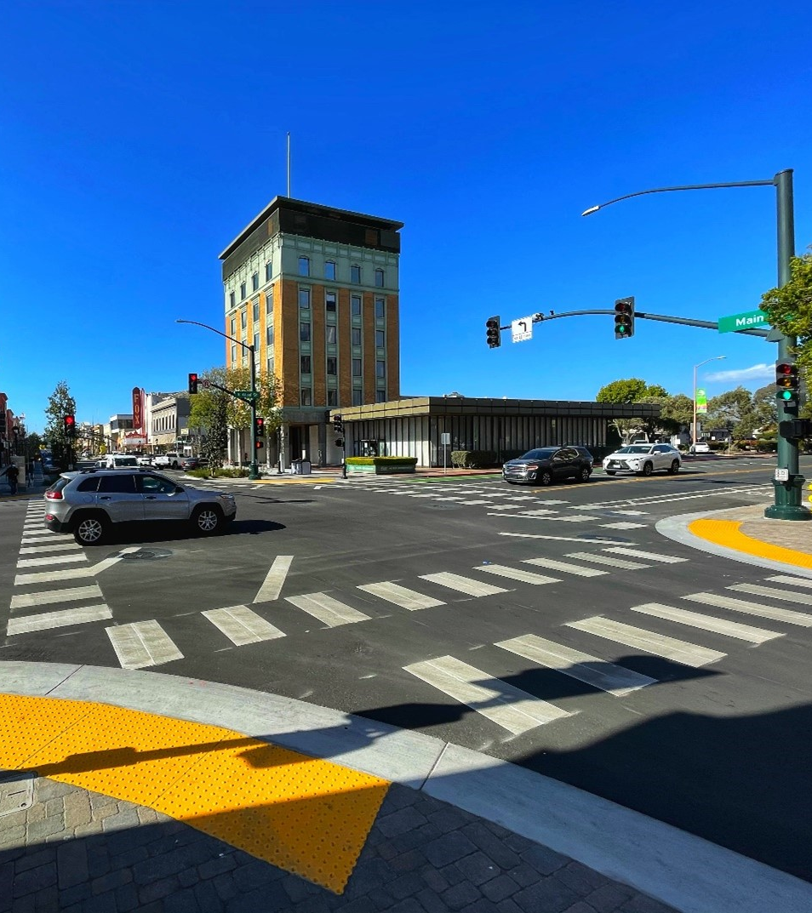
Thank you
Comments or questions?
Janneke Strause
Janneke@tamcmonterey.org
(831) 775-4410
Downtown Salinas Complete Streets Project

