Slide 2
2026 Regional Transportation Plan
TAMC Board Meeting
October 25, 2023
Notes:
Good Morning Mr. Chair, members of the Board.
It is my pleasure to present to you for my first time on the 2026 Regional Transportation Plan.
This is an item that will be coming back to you for discussion and actions at several milestone points between now and June, 2022, when the plan is scheduled for adoption to meet state and federal requirements.
The purpose of this presentation is to provide an overview of the planning process, timeline, and get your input on regional priorities for the 2022 Plan.

Slide 3
Purpose: Long Range Plan
Funding priorities over 20 years
Basis for actions to allocate state and federal funding
Part of a regional collaboration (AMBAG)
Notes:
The Regional Transportation Plan a visionary document that provides a foundation for funding priorities over the next 20 years, and it serves as a basis for allocations of state and federal funding.
Furthermore, it is part of a regional collaboration effort, as our Plan gets combined with San Benito County and Santa Cruz County into the Metropolitan Transportation Plan and Sustainable Communities Strategy produced by AMBAG per federal requirements.

Slide 4
State Funding
Federal Funding
Local Funding
Integrated Funding Plan
20 Year Plans
Metropolitan Transportation Plan / Sustainable Communities Strategy
Regional Transportation Plan
5 Year Plan

Slide 5
Required Elements for the Plan
Policy Element
Financial Element - Budget
Action Element - Projects

Slide 6
Policy Element:
Framework for selecting projects
Goals
Objectives
Performance Measures

Slide 7
2026 Policy Element - Goals
Access & Mobility
Safety & Health
Climate & SustainabilitY
Equity
Economic Vitality
Notes:
Staff has initiated the evolution of goals in building off of our 2018 Plan, while remaining consistent with those identified in the AMBAG’s Metropolitan Transportation Plan and the California Transportation Plan.
Proposed modifications staff is considering includes:
A greater emphasis on geographic equity
The integration of public health/health equity
Reflection on goals to prioritize
Additionally, staff aspires to more directly integrate policy objectives and performance measures reflective of current projects and programs underway at TAMC, including:
Highway Safety projects,
Recreational and active transportation trail system
Transit improvements
Regional rail projects,
Safe Routes to Schools, and
Participatory budgeting program
Near the end of this presentation, I have prepared an interactive activity where we will invite our Board members – and members of the public – to provide input on what you believe should be regional transportation priorities in our 2022 Plan.

Slide 8
Financial Element
Local level projects
Regionally significant projects

Slide 9
Financial Element: Projects
Non-regional/local project costs:
Highways
Local streets and roads
Public Transit
Active transportation
Regionally significant projects
Measure X
Integrated funding plan

Slide 10
Action Element
Identify
Regionally Significant Investments
Research
Alignment with Policy Objectives and Performance Measures
Fund
Prioritize funding list for 20 year horizon of the Plan
Notes:
The Regional Transportation Plan a visionary document that provides a foundation for funding priorities over the next 20 years, and it serves as a basis for allocations of state and federal funding.
Furthermore, it is part of a regional collaboration effort, as our Plan gets combined with San Benito County and Santa Cruz County into the Metropolitan Transportation Plan and Sustainable Communities Strategy produced by AMBAG per federal requirements.

Slide 11
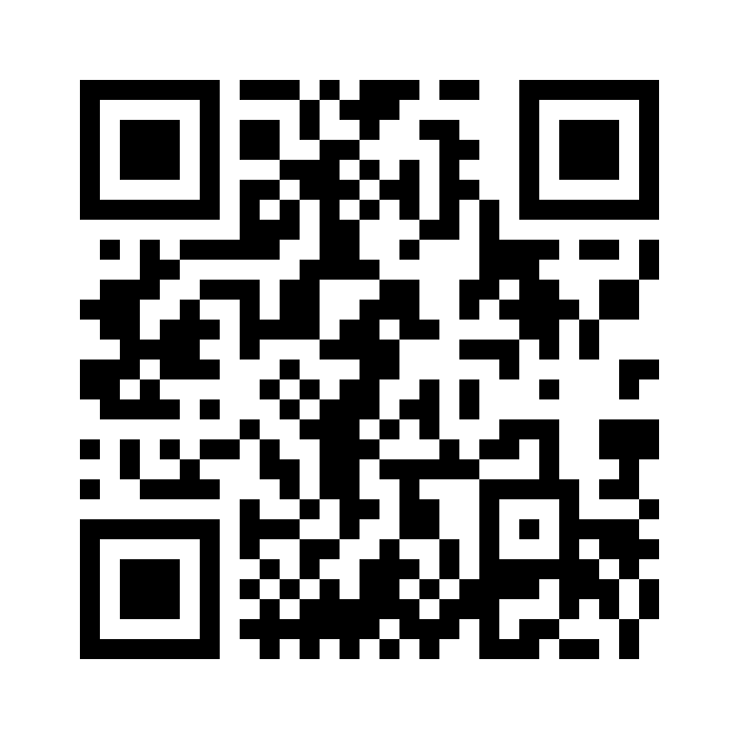
Public Survey: RTP 2026

