Slide 1

2024 Monterey County Bike Map Distribution Plan
By Ariadne Sambrano
Transportation Planner

Slide 2
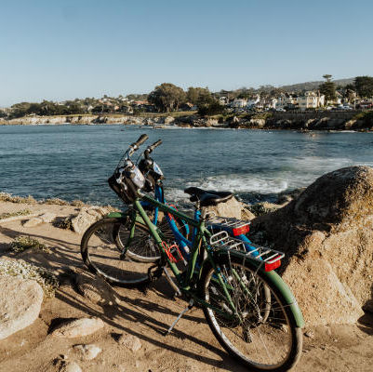
Overview
History
Goals
Schedule of Bike Map Distribution
Review/Input on distribution locations

Slide 3
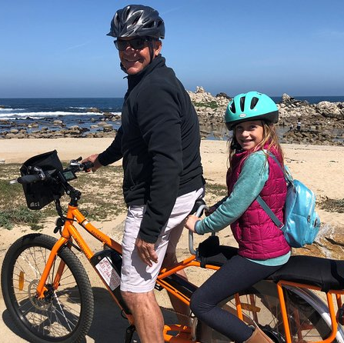
History: Bike & Ped’s Committee Involvement on the Bike Map
Bike Committee has provided vital suggestions and expertise.
Implemented committee-recommended updates to the Bike Map from 2016 and in 2022.
Continuously inspiring a community to be active.

Slide 4

Goals for the Monterey County Bike Map Plan
  Update
  Enhance
  Serve
  Engage
Notes:
Update
Update the bike maps list with new locations and projects added since 2016.
Enhance
Map usability for bicyclists across all of Monterey County

Slide 5
Schedule of Bike Map Distribution
Phase 1- Kick Off:
January 2024
- Review/ Finalize Distribution locations
- Sign-up volunteers
Phase 2 – Planning:
February 2024
Phase 3 - Ongoing
Late February to August 2024
- Finalize logistics and prep materials
- Community Feedback Loop

Slide 6
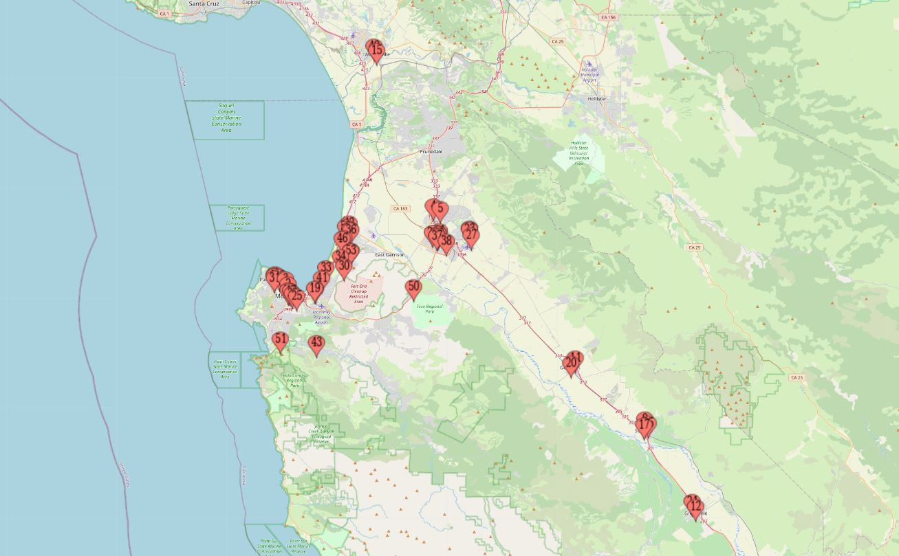
Reviewing Distribution Locations
Distribution Locations Map

Slide 7
Committee Input and Action Requests
Which locations from the list are most important?
Which locations can be eliminated?
Who is willing to commit to being a volunteer and helping to distribute to the Bike Maps to the finalized locations?

Slide 8
Discussion and Questions?

