Slide 1

Scenic Route 68 Corridor Improvement Project
TAMC Board
October 25, 2023

Slide 2
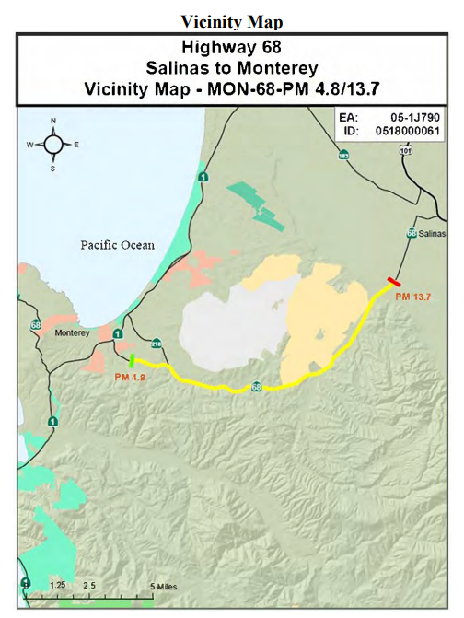
Project Study Area
Scenic Route 68 Corridor Improvement Project

Slide 3
Project Objectives
Address safety concerns
Improve traffic flow
Connect wildlife
Scenic Route 68 Corridor Improvement Project

Slide 4
2 Alternatives Studied
Both alternatives include 3 wildlife crossings
One Alternative converts signals to roundabouts
Second alternative modifies signalized intersections
Scenic Route 68 Corridor Improvement Project

Slide 5
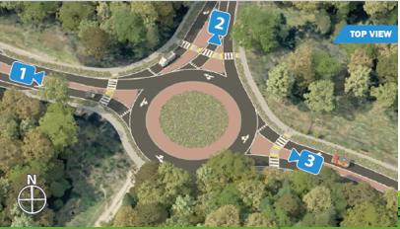
Scenic Route 68 Corridor Improvement Project

Slide 6
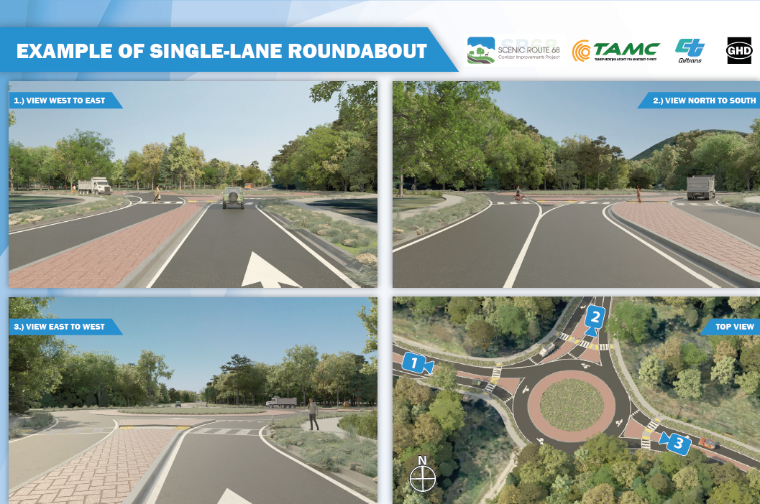
Scenic Route 68 Corridor Improvement Project

Slide 7
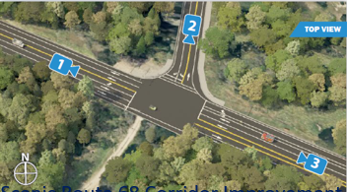
Scenic Route 68 Corridor Improvement Project

Slide 8
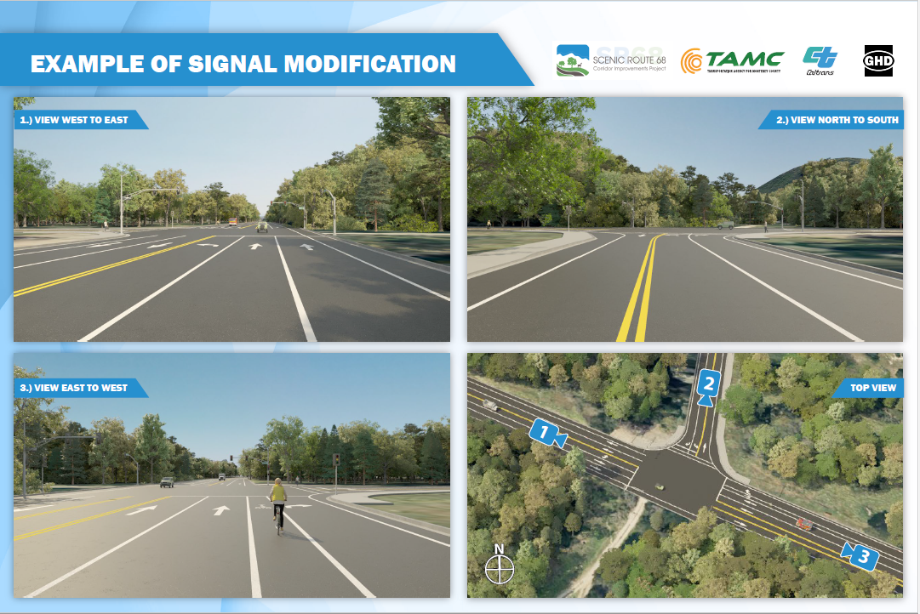
Scenic Route 68 Corridor Improvement Project

Slide 9
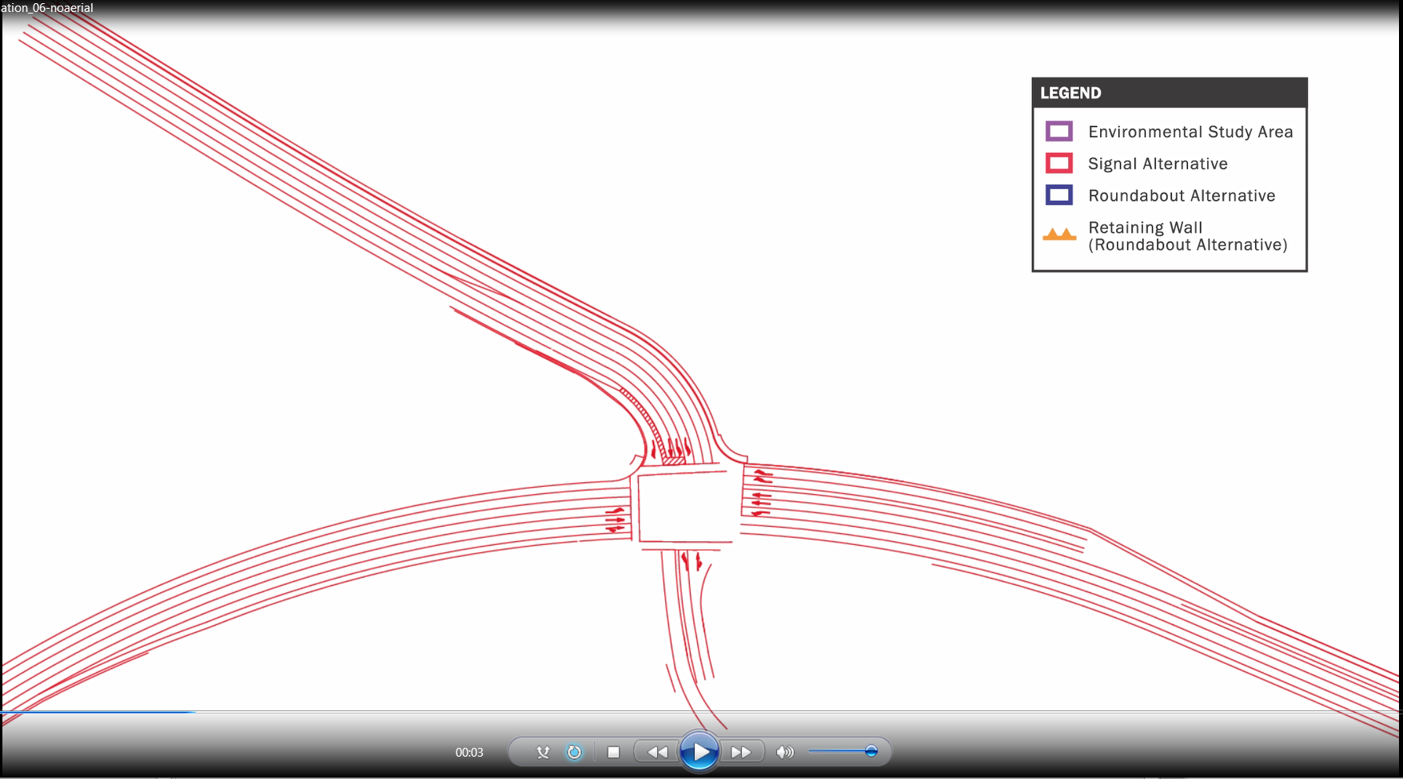
Roundabouts and
Signal Mod
Scenic Route 68 Corridor Improvement Project

Slide 10
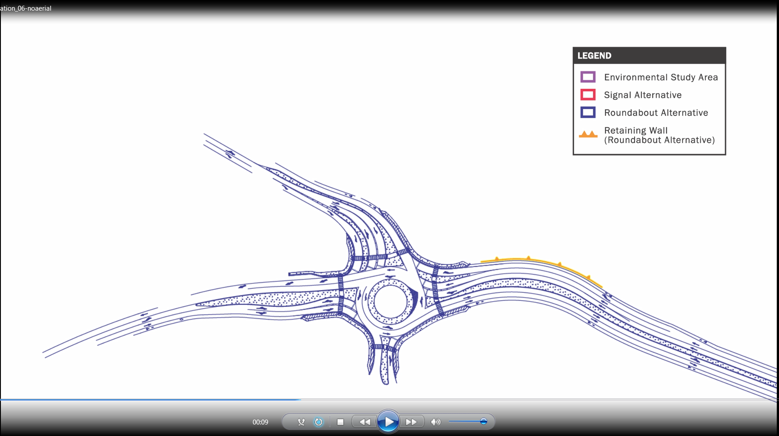
Roundabouts and
Signal Mod
Scenic Route 68 Corridor Improvement Project

Slide 11
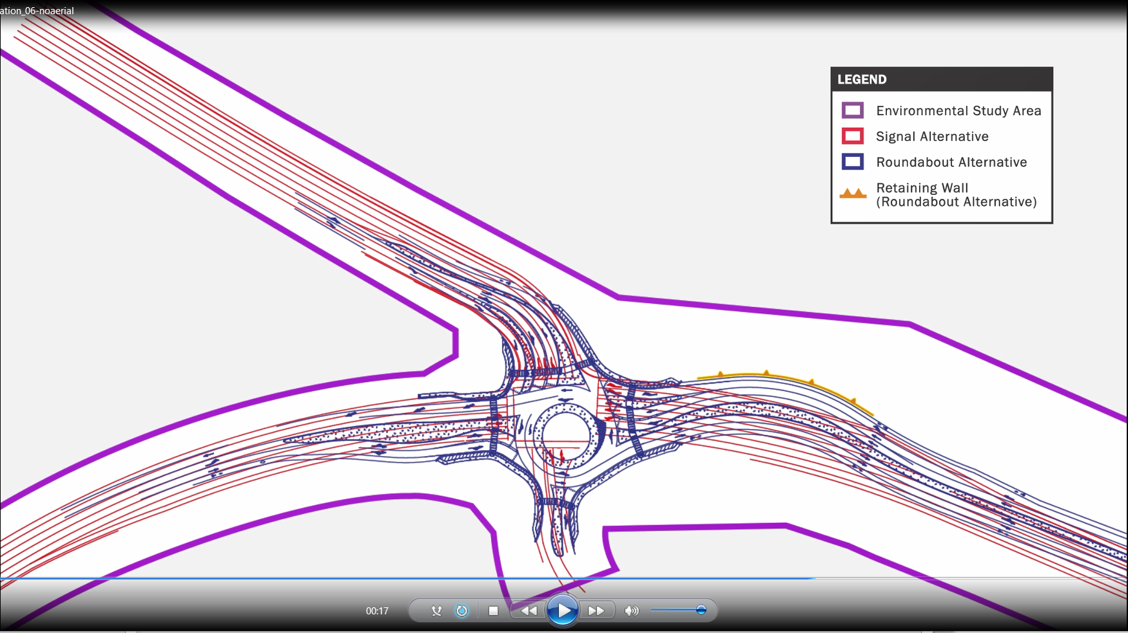
Roundabouts and
Signal Mod
Scenic Route 68 Corridor Improvement Project

Slide 12
Public Hearing Schedule
Wednesday, November 15
  WeatherTech Raceway at Laguna Seca
  3:00-7:00
Thursday, November 16
  Salinas Armory
  4:00-7:00
Wednesday December 6
  Monterey Conference Center
  3:00-7:00
Scenic Route 68 Corridor Improvement Project

Slide 13
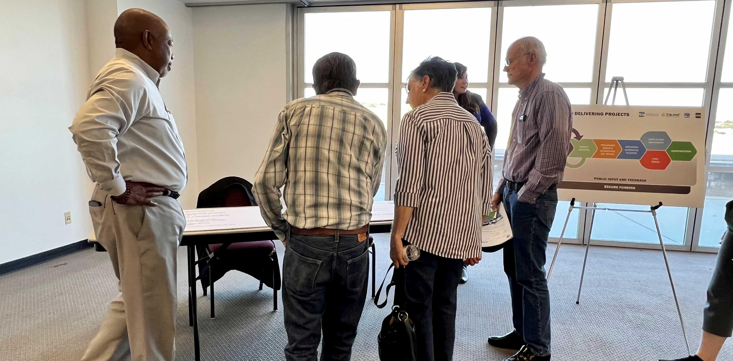
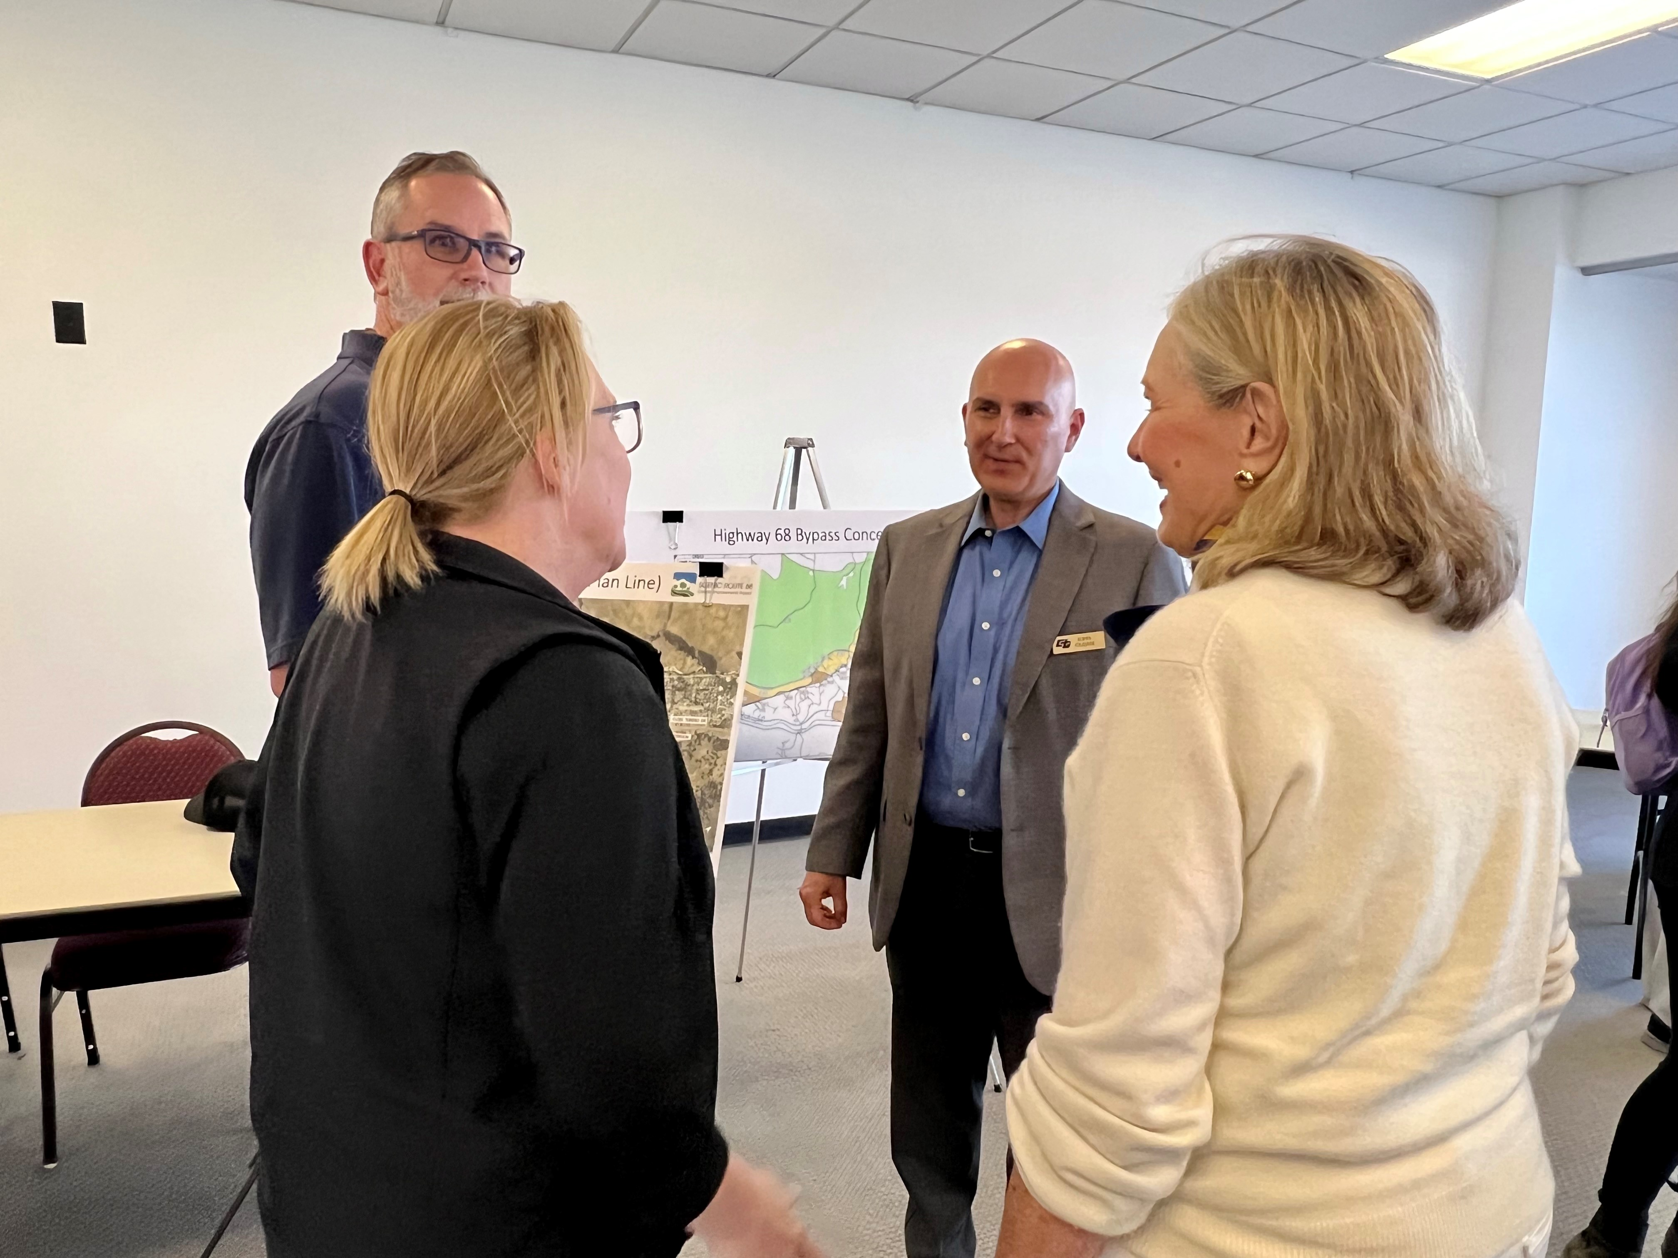
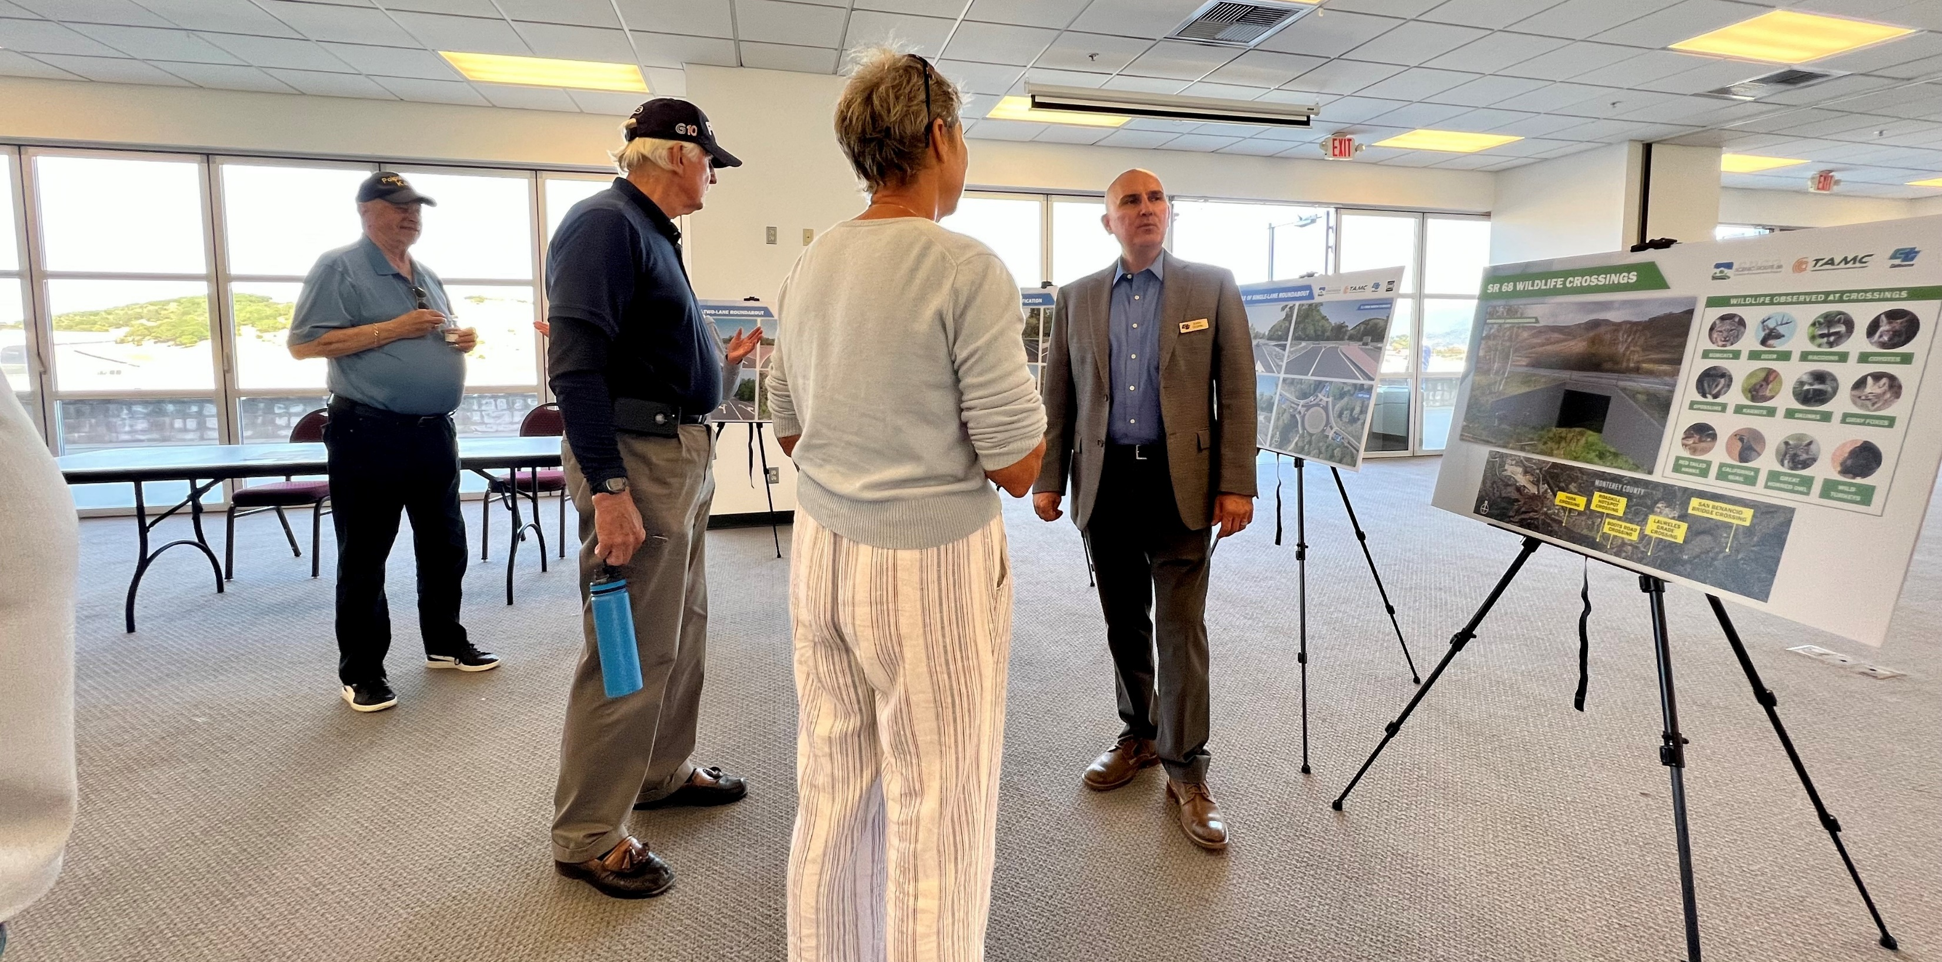
Objectives of Community Outreach Effort
Scenic Route 68 Corridor Improvement Project

Slide 14
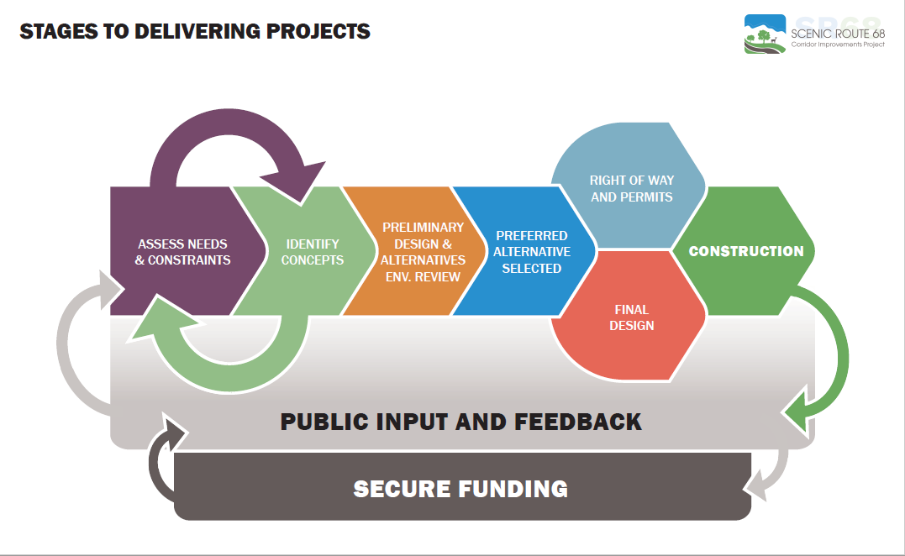
Scenic Route 68 Corridor Improvement Project

Slide 15
Questions
Scenic Route 68 Corridor Improvement Project

Slide 16
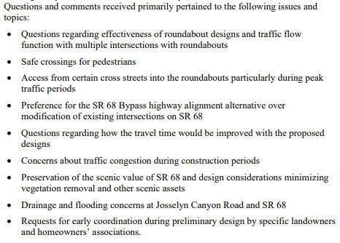
Summary of 2019 Public Outreach
Scenic Route 68 Corridor Improvement Project

Slide 17
Scenic Route 68 Corridor Improvement Project

Slide 18
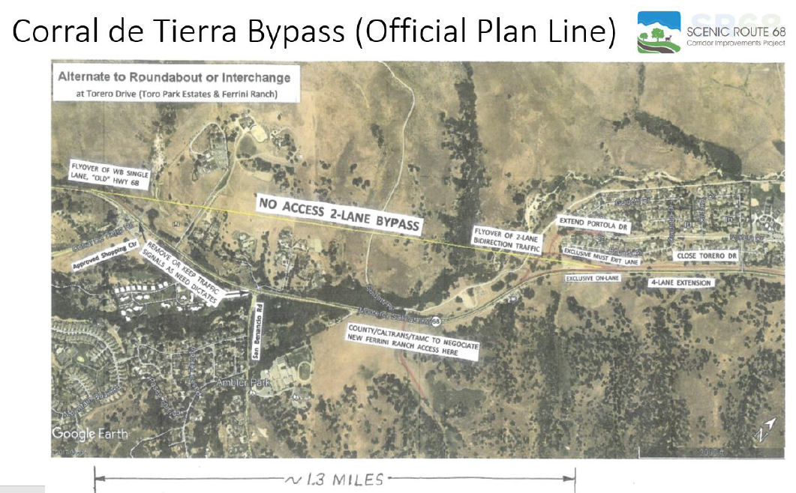
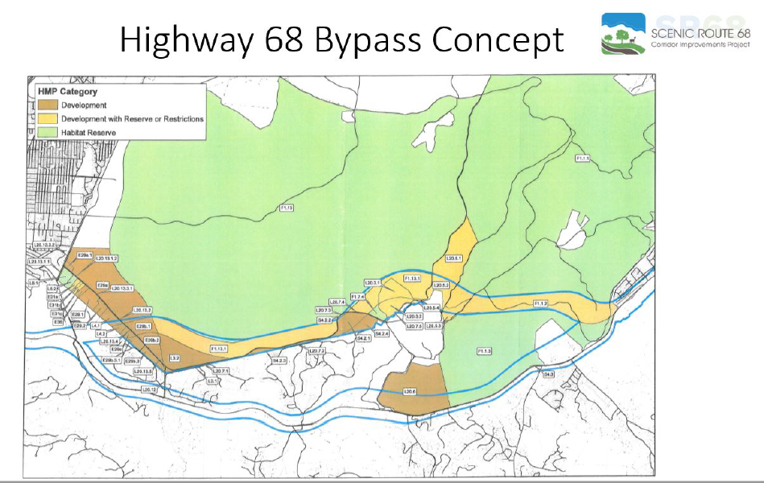
Alternatives Not Considered
Scenic Route 68 Corridor Improvement Project

Slide 19
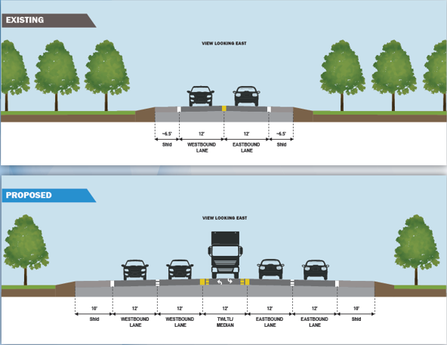
Scenic Route 68 Corridor Improvement Project

