Slide 1



measure x priority projects
CORRIDOR ADVISOR update
26 October 2022

Slide 2

CORRIDOR ADVISOR ROLE
Assess and advise the delivery of priority State highway improvement projects that use Measure X funds:
  State Route 68 Scenic Highway
  US 101 South of Salinas
  State Route 156
Evaluate project delivery schedules and develop implementation and funding strategies.
Coordinate with Caltrans, TAMC, and others to facilitate project implementation and funding.

Slide 3
CORRIDOR ADVISOR APPROACH
Develop Solutions that meet the Project Need and are Implementable
Align Solutions with Existing and Emerging Transportation Values and Policies
Leverage Measure X funding to Obtain State and Federal Funding
Facilitate Community / Stakeholder Engagement throughout the Process
Explore Opportunities to Accelerate Implementation

Slide 4
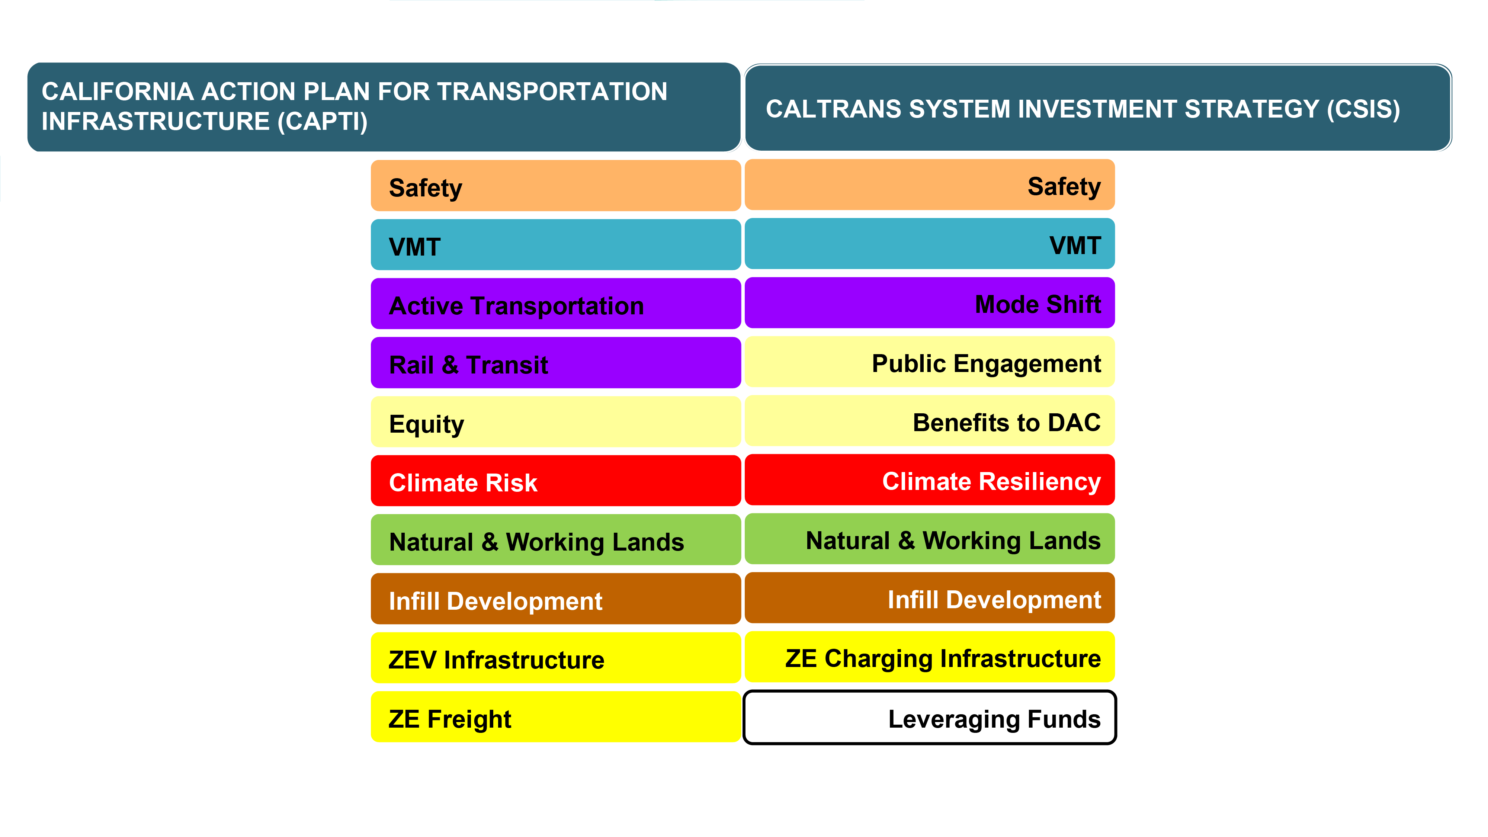
EMERGING TRANSPORTATION POLICY: STATE

Slide 5
SCENIC SR 68 SAFETY & TRAFFIC FLOW PROJECT
STATUS: Environmental Phase
OPPORTUNITIES
Design intersections that improves safety and traffic flow
Create safe passage(s) for wildlife species
Complete Environmental Phase to position project to pursue SB 1 funding in 2024
Facilitate community / stakeholder engagement throughout the process
CHALLENGES
Constrained corridor with limited right-of-way
Minimize permanent impacts to wetlands, streams, and endangered species
Enhance public transit service and improve bicycle and pedestrian facilities
Phasing of improvements

Slide 6
US 101: SOUTH OF SALINAS
STATUS: Environmental Phase
OPPORTUNITIES
Reduce fatalities and severe injuries of all users towards zero
Define alternatives to meet the project’s purpose and need that align with current transportation policies
Develop alternatives to be designed, funded, and constructed as phases, as funding is obtained
Facilitate community / stakeholder engagement throughout the process
CHALLENGES
Complete Environmental Phase to position project to pursue SB 1 funding in 2024
Provide a safe and accessible at-grade roadway system that allows multiple modes including slow moving agricultural equipment, local commuters, freight trains, and complete street elements
Minimize impacts to existing Chualar businesses and avoid reducing production of agricultural land
Identify improvements that can be implemented in the initial phases that enhance safety

Slide 7
SR 156 CORRIDOR
STATUS: (SR 156 Castroville) Design complete
Right-of-Way & Permitting underway
OPPORTUNITIES
Reduce fatalities and severe injuries of all users towards zero in the Corridor
Separate improvements at the US 101 / SR 156 as a US 101 interregional improvement
Phase US 101 / SR 156 interchange improvements with focus on safety and goods movement
Improve traffic flow in an environmentally sensitive area
CHALLENGES
Obtain Coastal Development Permit (CDP) for Castroville Boulevard Interchange project
PG&E utility relocation
Aligning proposed improvements with emerging transportation policies

Slide 8
SUMMARY
During development of projects, focus on:
  Opportunities to Leverage Measure X funding to obtain State and Federal funding
  Identifying opportunities to align with emerging transportation values and policies
  Exploring methods and opportunities to advance implementation
  On-going engagement with community and stakeholders throughout the process

Slide 9
QUESTIONS

