Slide 1


US 101 Business Plan
Transportation agency for Monterey county
January 25th, 2023
Notes:
US 101 Central Coast Coalition formed to raise awareness of US 101 Corridor: transportation/economic asset
need for investment
Follows model of Central Valley’s Route 99 BP, which helped corridor receive $1B in bonds in 2006

Slide 2
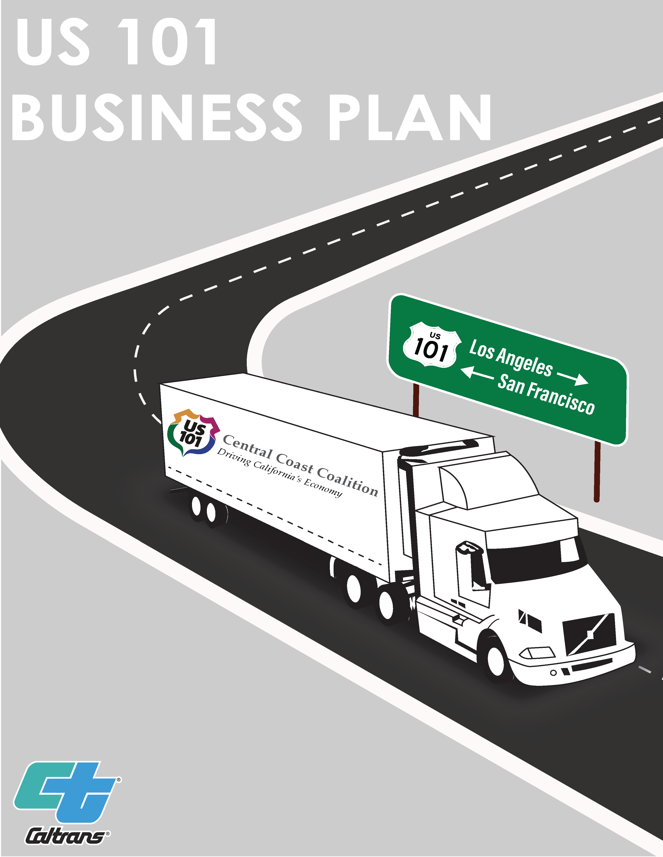

Introduction
What is the US 101 Business Plan?
Approach to achieving the corridor’s goals
Corridor plans build the foundation
Prioritizing investments
Integrated benefits
Financial plan
US 101 Business Plan
Notes:
Difference between BP and traditional CP
BP states the total funding need, funding sources, link priority trans projects to potential funding programs
Follows the SR 99 BP model, US 101 BP provide a medium to communicate to policy makers/partners/public

Slide 3
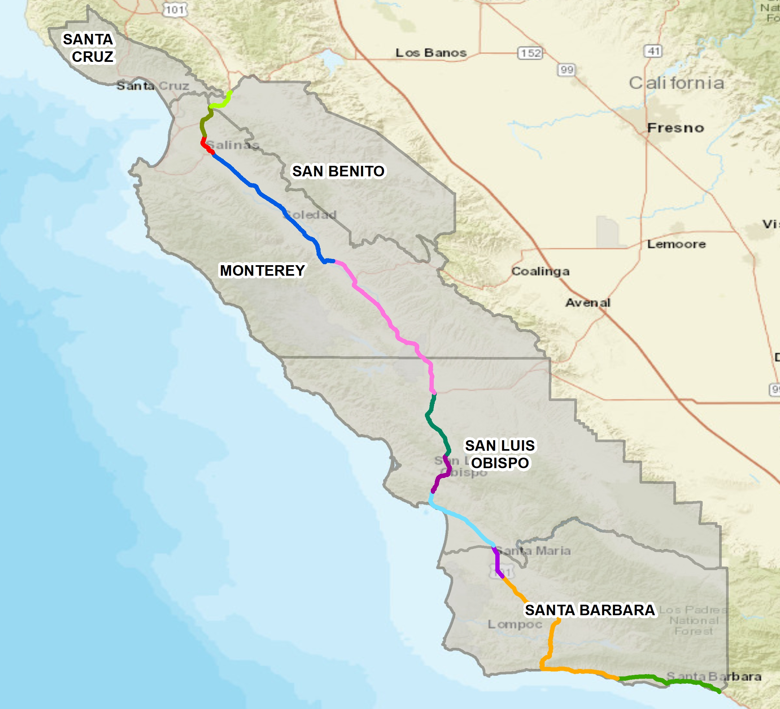
US 101 Business Plan Segments
Segmentation Methodology
- Traffic flow
- Land use
Notes:
-shows counties and US 101 highlighted in different colors
-long stretch – divided stretch into 11 segments based on traffic flow/land use

Slide 4






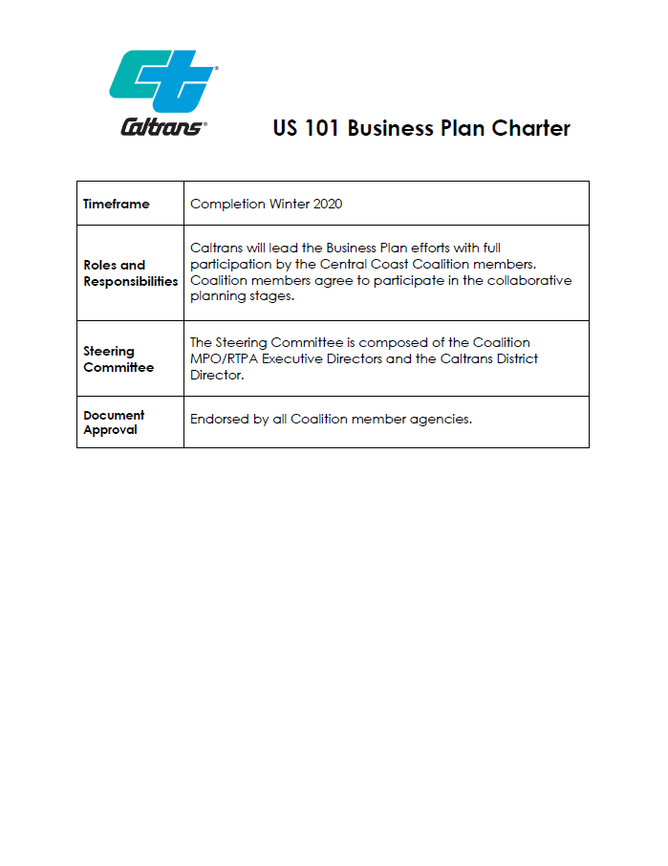
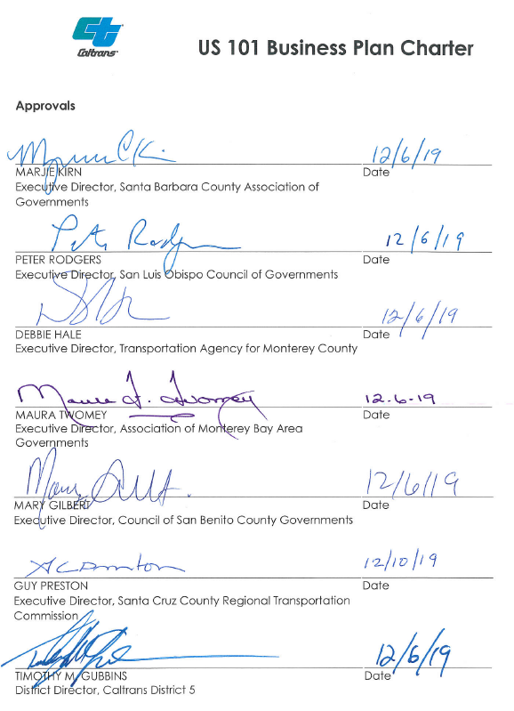
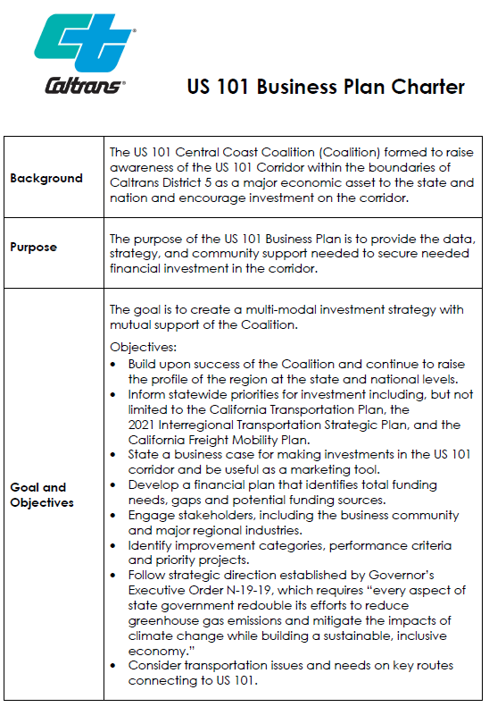
Charter
US 101 Business Plan
Notes:
- partnership effort of the Central Coast Coalition
- Coalition members participate in planning stages
Make use of existing data and plans
Charter established objectives/intended outcomes
Full plan on BP website

Slide 5
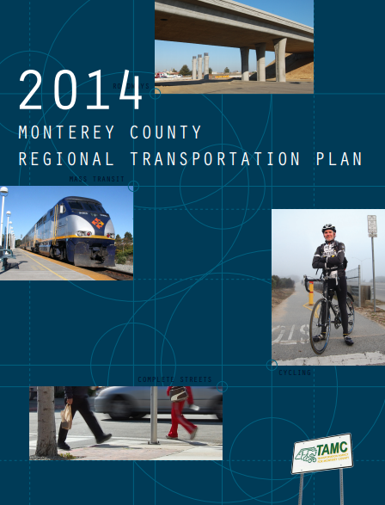
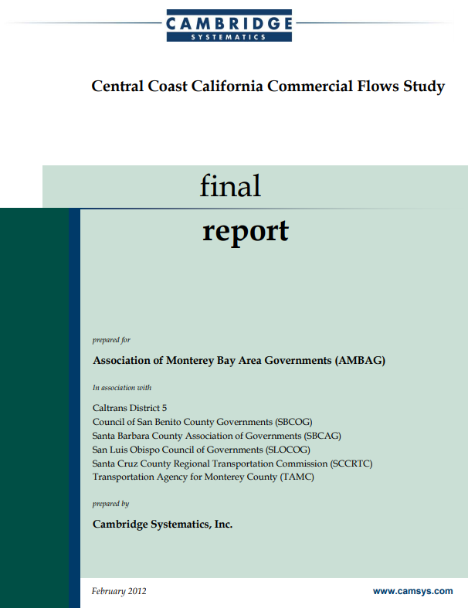
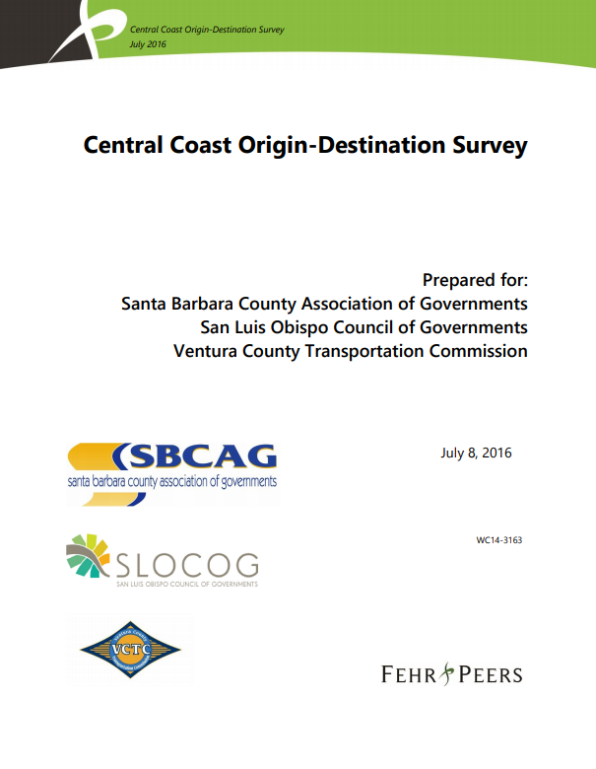
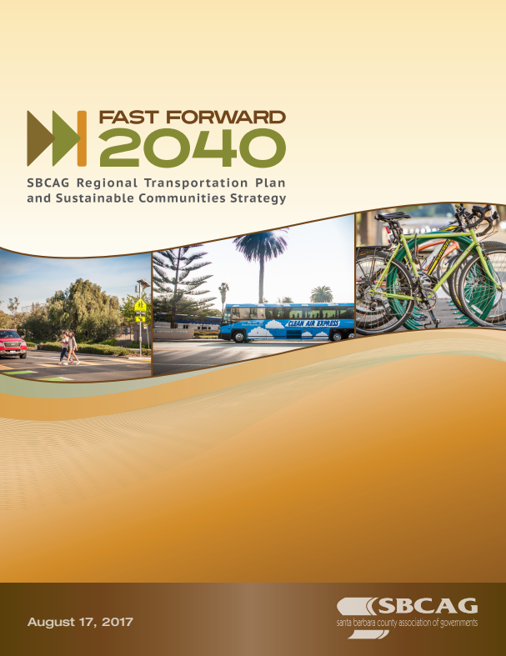
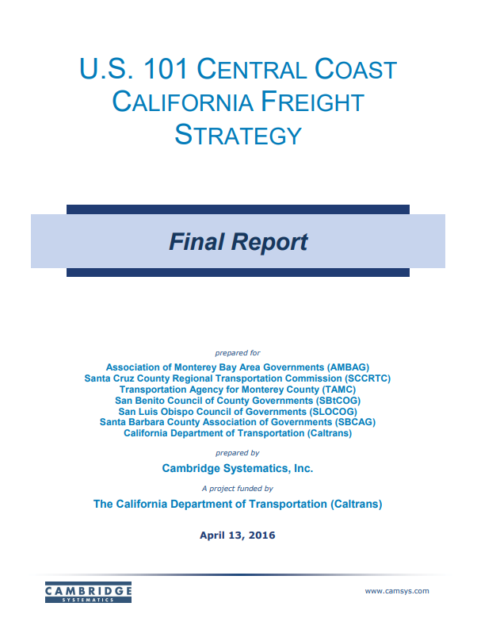
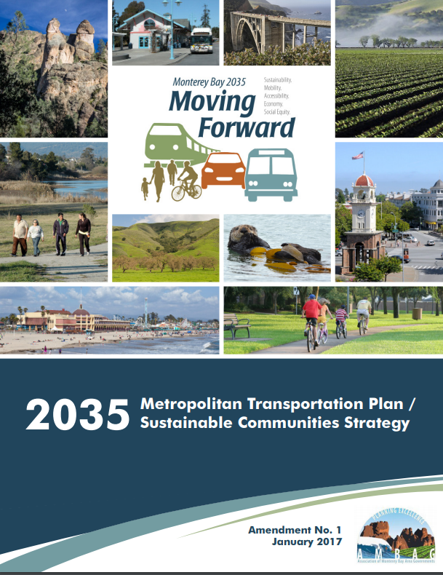
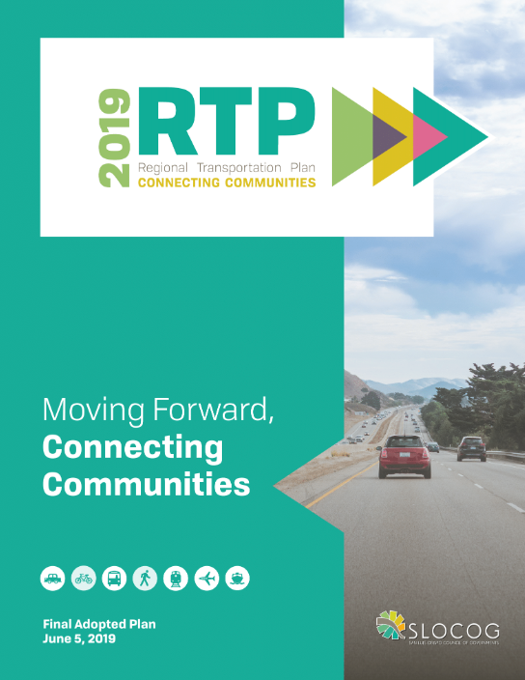
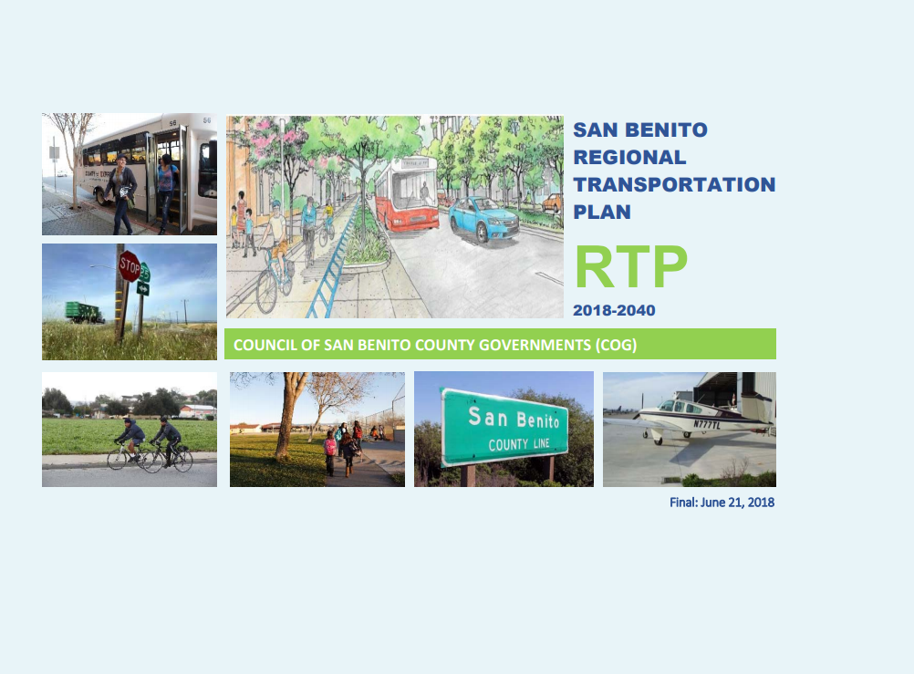
Foundational Documents
US 101 Business Plan
Notes:
- BP builds on existing corridor plans/studies
Plan on building upon previous success of the Coalition
Priorities identified in BP derived from existing local/regional plans

Slide 6
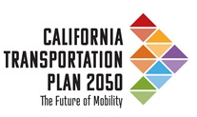
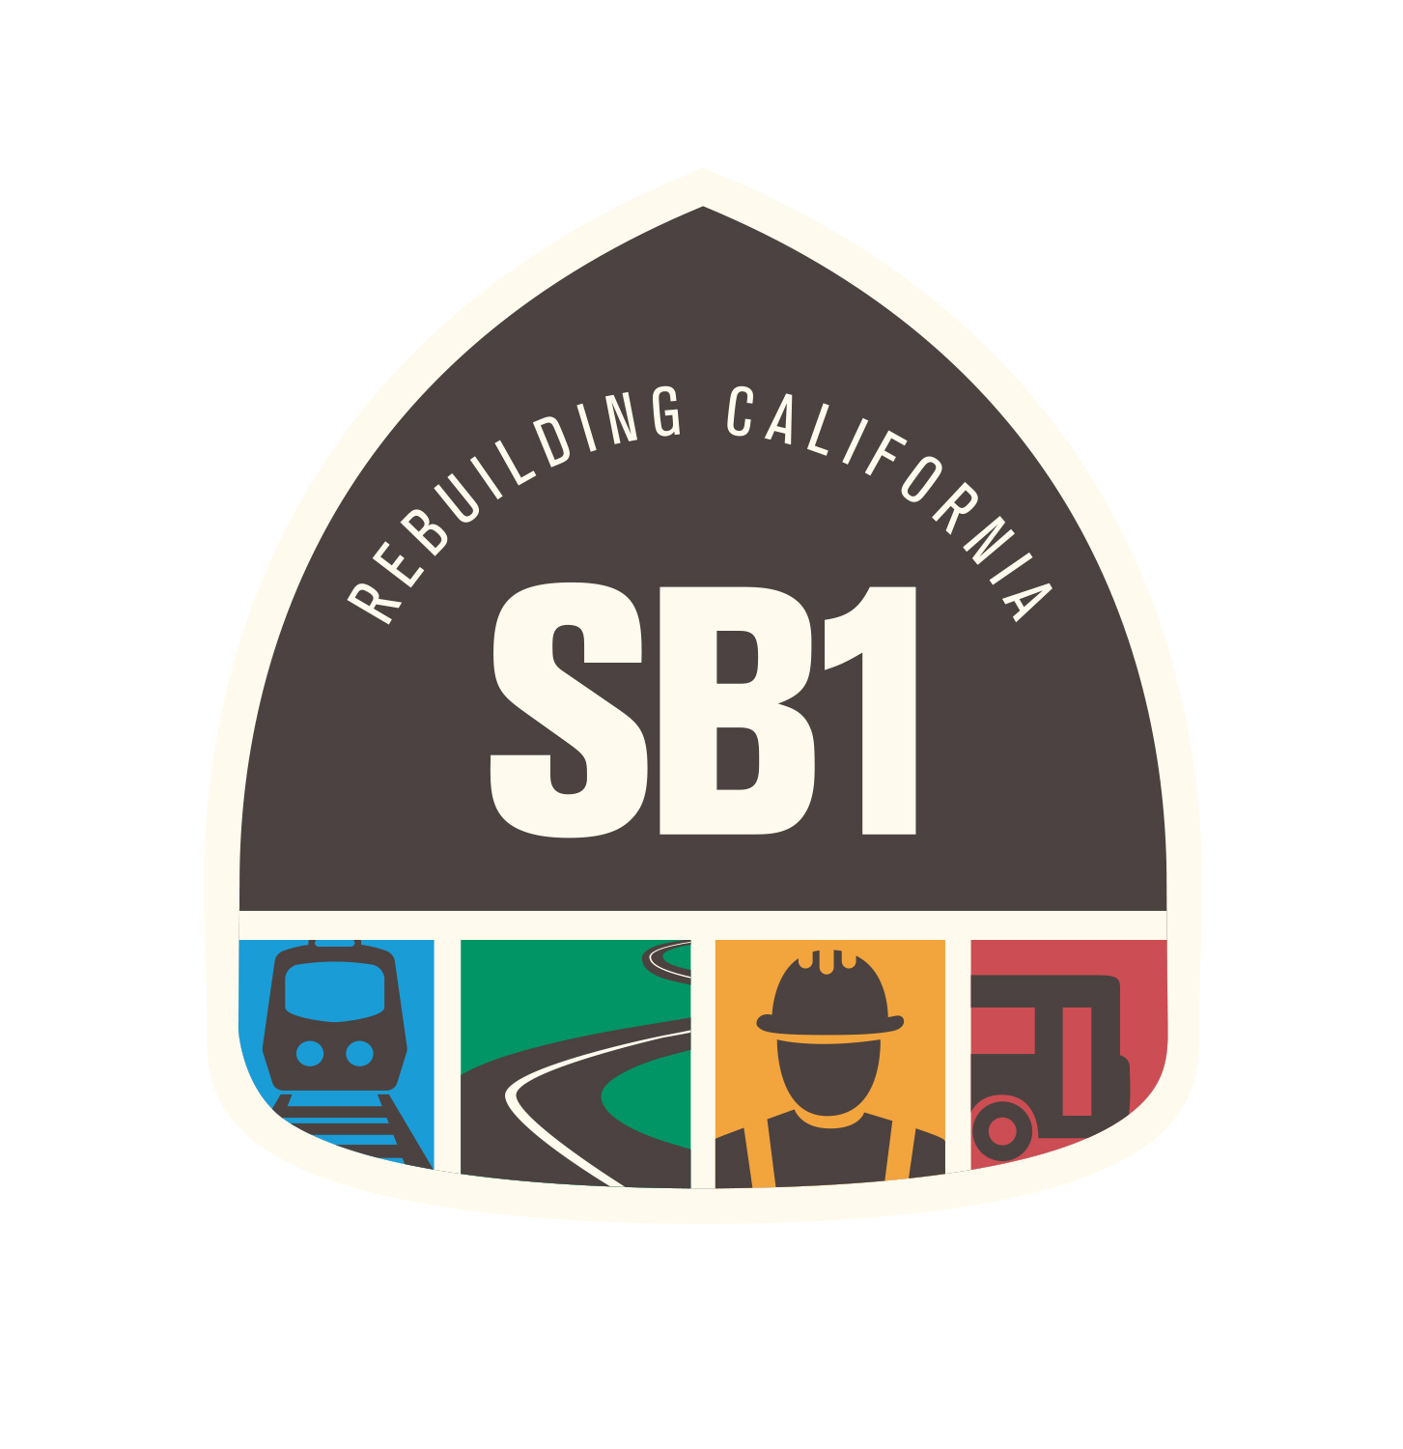

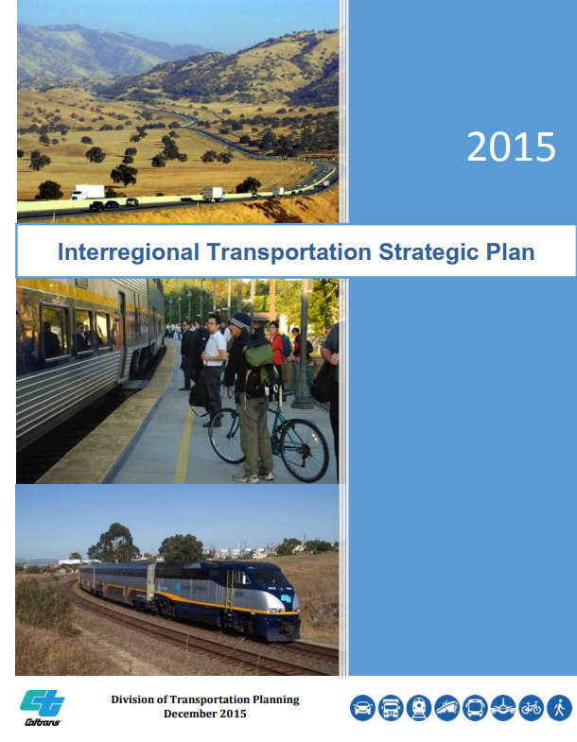
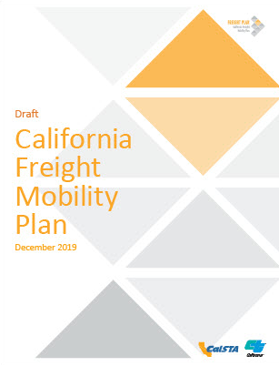

Intended Outcomes
Input to plans
Priority for future Investment
US 101 Business Plan

Slide 7

Intended Outcomes - Project Example
Identifies US 101 South of Salinas Improvement Project
Data Driven Support
Leverage Local/Regional Funds
US 101 Business Plan

Slide 8





Goals
Safety & Health
Provide safety for all users of the transportation system and promote public health.
Sustainability & Climate Change
Practice environmental stewardship, preserve the transportation system, reduce pollution,
and mitigate impacts of climate change.
Economy
Manage the corridor’s assets, support the economy, and enhance the region’s livability.
Mobility
Provide a reliable and efficient transportation system for all people and goods.
Equity
Promote social equity and ensure all socio-economic groups have accessible and equitable
level of transportation services.
US 101 Business Plan
Notes:
Looked at partner’s regional Trans Plans and other Planning documents
5 goal areas
Important to make sure partners/stakeholders can take ownership & align with Exec Order N-19-19 and N-79-20
Supporting climate goals and reduction of greenhouse gas emissions / VMT
Website -> factsheet with goals/objectives

Slide 9
Priority Project Types
Operational Improvements and Conflict Point Reduction Points.
Alternative Fuel Charging Stations and Air Pollutant Reduction Points.
Freight & Goods Movement Improvements.
Freeway Conversion and New Interchanges
Bike, Ped, Transit, Rail, and Park & Ride Improvements.
US 101 Business Plan

Slide 10
US 101 BP Project Considerations (Highway)
Will the project?
  Improve/create a park & ride lot or safety roadside rest area?
  Support bicycle travel/safety (e.g. flashing beacons, shoulder widening, bicycle connection)?
  Be close to infill areas?
  Enhance transit/rail (provide a peak period passenger rail service)?
  Implement TDM/TSM/carpool/vanpool/ITS strategies?
  Include the interchange/ramp/auxiliary lane/operational improvements?
  Accommodate future growth (of US 101 and surrounding areas)?
  Include viable ramp metering?
  Facilitate an integrated, sustainable, and efficient transportation system?
  Convert the roadway to a freeway?
  Facilitate access management improvements?
  Reconfigure interchange strategies?
  Optimize mobility?
  Remove conflict points?
  improve/maintain US 101 pedestrian over/under crossings?
US 101 Business Plan

Slide 11
US 101 BP Project Considerations (Non-Hwy)
Is the project?
    Located on a parallel facility/alternative route to US 101?
    Located in a commercial/industrial area that receives freight products that travel via US 101?
    Improving access to an Alternative Fuel station?
    Improving access to any employment centers?
    Will the project?
      Divert any traffic away from US 101?
      Benefits reach US 101 users?
      Have a portion of users who use US 101 as well?
      Improve the connection to US 101?
US 101 Business Plan

Slide 12
Contact Info
Madilyn Jacobsen
madilyn.jacobsen@dot.ca.gov
(805) 835-6287
Matt Welker
matthew.welker@dot.ca.gov
(805) 556-5464
US 101 Business Plan

