Slide 1

SR 156 / Castroville Boulevard Interchange Project Update
Citizens Oversight Committee
February 20, 2024

Slide 2
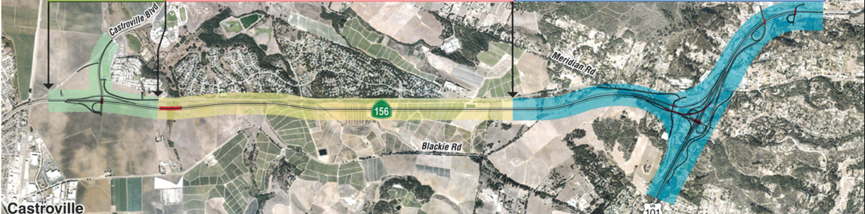
Highway 156 Corridor Projects
Segment 1 Castroville Blvd
$125,800,000
Segment 2
Route 156
$131,000,000
Segment 3
US 101 Interchange
$325,000,000

Slide 3
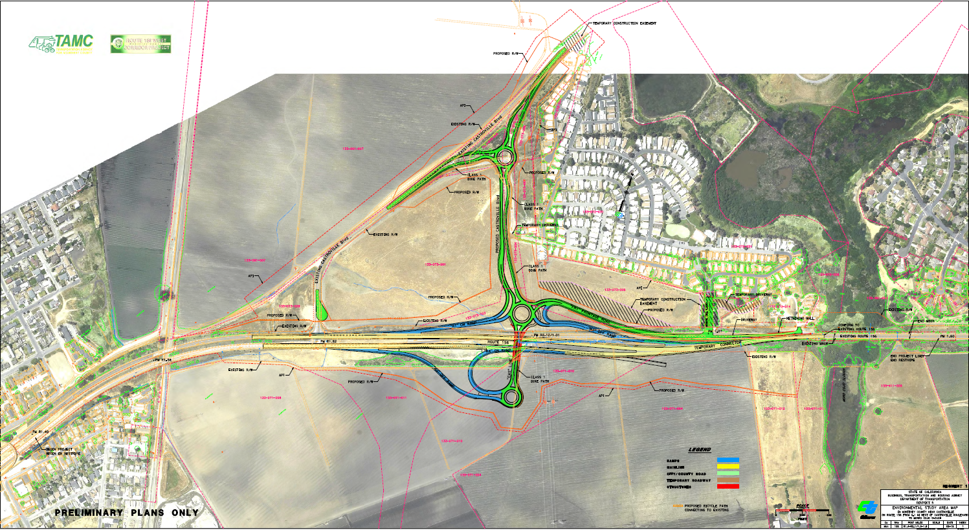
Segment 1: Castroville Boulevard Overview
Notes:
Project Description from the meeting agenda:
Coastal Development Permit to allow three roundabouts as Phase I of the State Route 156 Interchange project to replace the existing Castroville Boulevard signalized intersection. These roundabouts will connect SR 156 with Castroville Boulevard. The project will also provide a new Class 1 mixed use bicycle and pedestrian path, driveways and on and off ramps associated with the three new roundabout structures.
Project Description from the CDP application:
The proposed project will construct a series of three roundabouts to replace the existing Castroville Boulevard signalized intersection. Roundabouts one and two will be connected by an overcrossing above the existing State Route (SR) 156. Roundabouts two and three will be connected by a new road running north/south connecting Castroville Boulevard with SR 156. The project will also work to provide a new Class I mixed use bicycle and pedestrian path, driveways, and on and off ramps associated with the tree new roundabout structures. The project will be constructed in a series of eight stages to ensure there is public access to the high school and community adjacent to the project. The project has the potential to impact Coastal Scrub, riparian habitat, wetlands, California tiger salamander, Santa Cruz long-ted salamander, the California red-legged frog. Removal of eucalyptus, pine, and oak trees is anticipated at two locations on the project site with additional impacts to arroyo willow trees expected near the Santa Cruz long-toed salamander pond. The project also anticipates impacts to approximately 23 acres of farmland. Mitigation plans will be developed to address both coastal agricultural/farmland impacts and coastal biological resource impacts.

Slide 4
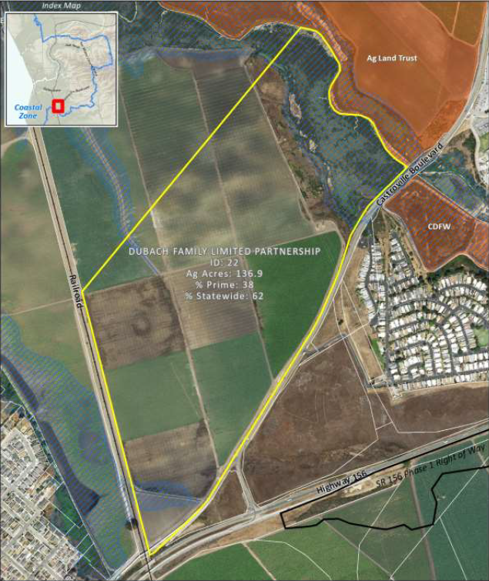
Current Status
Project Plans and Estimate are complete
Coastal Development Permit issued
Army Corp (Wetland impacts) permit issued
Agriculture mitigation property (Dubach) purchased
CDFW permits anticipated in February 2024
Nearing completion of Maintenance Agreement with County
Multiple parcels currently in escrow
60% plans received from utilities for utility relocation

Slide 5
Utility Relocation Timeline and Process
2021
Caltrans initiated contact with all utilities impacted
All utilities responded with exception of PG&E electrical distribution and gas transmission
Early 2022
Late 2022
PG&E gas transmission gives Caltrans an 18-month timeframe to complete relocation plans
March 2023
PG&E electrical distribution assigns project manager for relocation plans
Mid 2023
Mid 2023 to present
Continued challenges with PG&E
60% relocation plans received
First time extension for funding
Second time extension for funding
Notes:
Ongoing communication and meetings with all branches of PG&E and other utilities
60% relocation plans received from all utilities with exception of Charter Communications
Continued challenges with PG&E, exchange of survey information and defining limits of easements needed for their work

Slide 6
Project Costs
Phase | Pre-May 2023 | May 2023 | February 2024
PS&E (Final Design) | $6,200,000 | $6,200,000 | $9,400,000
RW Support | $1,400,000 | $1,400,000 | $2,300,000
RW Capital | $18,100,000 | $18,100,000 | $50,500,000
Construction Support | $5,500,000 | $5,500,000 | $9,100,000
Construction Capital | $27,375,000 | $46,375,000 | $54,500,000
Estimated Total Cost | $58,575,000 | $77,575,000 | $125,800,000
$48,225,000 cost increase

Slide 7
Why So Much?
Project impacted nearly every major utility
Movement and replacement of electrical towers
Relocation of a 12-inch main gas transmission line
Relocation of multiple utilities into distinct alignment
Design
30-foot soil fills on either side of SR 156
Extensive geotechnical
Extensive structures
Environmental
Traverses portion of wetland
Impacts to Santa Cruz Long Toed Salamander
Impacts to Farmland
Within coastal zone
Right of Way
Easements and parcel acquisition associated with utility relocation
Private property parcel acquisition for construction of interchange
Parcel acquisition for amphibian, wetland and farmland mitigation
Notes:
Reasons for major increase in Support Costs:
Increased level of effort in Phases 1 and 2 to facilitate with utility relocations
PG&E
Charter Communications
AT&T
Increased level of effort for Phase 3 support costs
Structures
Geotechnical
Biological monitoring during construction
Reasons for increase in Construction Capital Cost:
Post construction Biological Monitoring requirement increasing from 5 years to 10 years
Increase in unit costs for contract items for landscape planting
Escalation due to estimated RTL pushing into end of FY 23/24 and advertisement and bids due mid FY 24/25
Reasons for major increase in Right of Way Capital Cost:
Increase in utility relocation costs
$24,000,000 of the $26,900,000 increase
$22,000,000 of the $24,000,000 is for relocation of PG&E utilities
Electrical Transmission ($3,000,000)
Electrical Distribution ($6,000,000)
Gas Transmission ($13,000,000)
Increase in environmental mitigation and compliance
Amphibian mitigation, restoration, parcel acquisition and endowment
Wetland mitigation
Farmland mitigation and endowment

Slide 8
Current Risks to Schedule
April 2024: Right of Way Certification and Ready to List (RTL) *
June 2024:
CTC vote for construction allocation
August 2024: Advertise Project
October 2024:
Award Project
Nov 2024: Approve Contract
3rd Quarter
FY 24/25:
Start construction
Notes:
April 2024: Right of Way Certification and Ready to List (RTL)*
June 2024: CTC vote for construction funds allocation*
August 2024: Advertise Project
October 2024: Award Project
November 2024: Approve Contract
Third Quarter FY 24/25: Start construction**
*Right of way certification, RTL and therefore June 2024 CTC vote at significant risk based on current status of delineation, perfection of easements and utility agreements for all branches of PG&E utility relocation
**Actual start of construction dependent on progress of utility relocation by utility companies

Slide 9
Next Steps & Alternatives
Alternatives | Time Delay | Risk
Fund the increased costs | 0 – 6 months | Increased Measure X contribution and potential the project still does not meet funding deadlines.
Reapply for SB1 Cycle 4 | 6 months - 1 year* | Forfeit current grant; Complete ROW and design with local funds, * potential the project is not awarded a future grant.
Value Engineering | 2 – 4 years | Stop the project and forfeit current grant; value engineering results in modest cost improvements.
Reevaluate project | 5 – 7 years | Stop the project and forfeit current grant; most time delay of alternatives; possible that no other alternatives meet State goals.

Slide 10
Thank You.
Questions?

Slide 11

Project Challenges
Legislation needed for take of fully protected Santa Cruz Long Toed Salamander
New Route Adoption and Freeway Agreement needed between Caltrans and the County
Working with Coastal Commission on Coastal Development Permit
Finding properties for Agriculture, Wetland, Species mitigation
Utility relocation and rising costs (ongoing)
Rising construction costs and support needs (ongoing)
Environmental Permits (in process)

Slide 12
Utility Relocation
Seven different Utility Companies have facilities needing to be relocated
  Three of those utilities are PG&E branches: Electric Transmission, Gas Transmission, Electric Distribution
60% relocation plans have been received from all utilities with exception of Charter Communications
PG&E high-pressure gas main

Slide 13
Support Cost Increase = $6,000,000
Reasons for major increase in Support Costs:
  Increased level of effort in Phases 1 and 2 to facilitate with utility relocations
    PG&E
    Charter Communications
    AT&T
  Increased level of effort for Phase 3 support costs
    Structures
    Geotechnical
    Biological monitoring during construction

Slide 14
Construction Capital Increase = $4,000,000
Reasons for increase in Construction Capital Cost:
  Post construction Biological Monitoring requirement increasing from 5 years to 10 years
  Increase in unit costs for contract items for landscape planting
  Escalation due to estimated RTL pushing into end of FY 23/24 and advertisement and bids due mid FY 24/25

Slide 15
Right of Way Capital Increase = $26,900,000
Reasons for major increase in Right of Way Capital Cost:
  Increase in utility relocation costs
    $24,000,000 of the $26,900,000 increase
    $22,000,000 of the $24,000,000 is for relocation of PG&E utilities
      Electrical Transmission ($3,000,000)
      Electrical Distribution ($6,000,000)
      Gas Transmission ($13,000,000)
  Increase in environmental mitigation and compliance
      Amphibian mitigation, restoration, parcel acquisition and endowment
      Wetland mitigation
      Farmland mitigation and endowment

