Slide 1

2024 Transportation Excellence Awards Nominees
TAMC Board of Directors Meeting January 22, 2025
Notes:
Each year, the Transportation Agency presents this Excellence Awards Ceremony to honor individuals, businesses, groups, programs and projects in recognition of their efforts to improve transportation in Monterey County.

Slide 2
23rd Annual Transportation Excellence Awards
Three Award Categories:
Individual Award
Group Award
Program Awards

Slide 3
23rd Annual Transportation Excellence Awards
Individual Award Honoree
Notes:
first award is an individual award

Slide 4
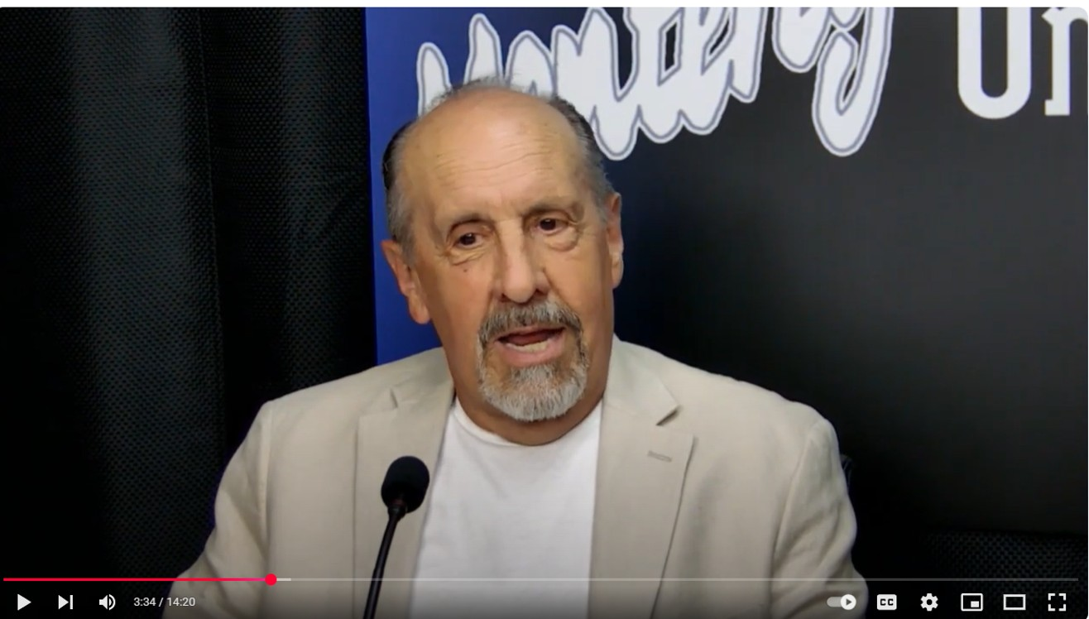
Dwight
Stump
Scenic Highway 68 Corridor Improvement Project
Community
Advocacy & Engagement
Notes:
Dwight Stump has been the leader behind the public campaign to install Adaptive Signal Controls along the 8 miles of the Highway 68 corridor.

Slide 5
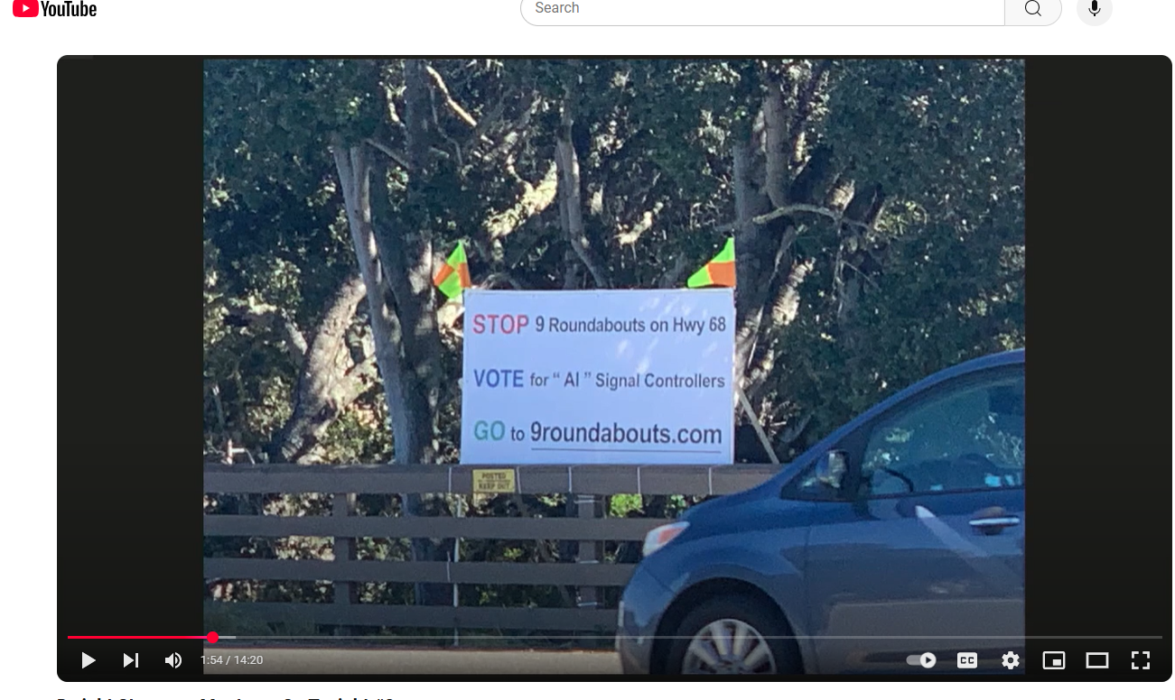
Notes:
He has erected signs at his own expense

Slide 6
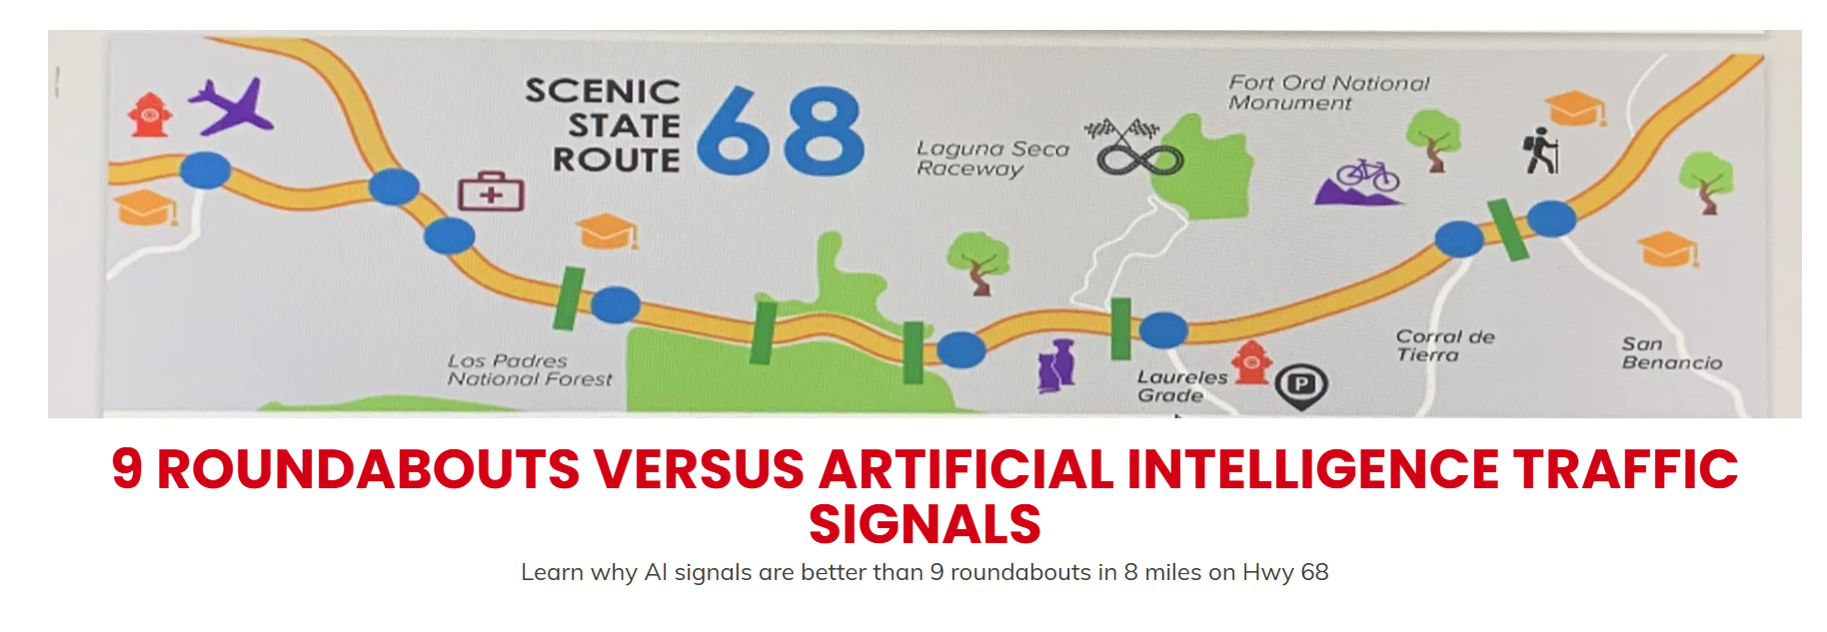
Website
9 roundabouts.com
Notes:
established a website (9roundabouts.com) to inform the public about the benefits of adaptive signal controls, sent numerous letters to the TAMC Board and Caltrans with information on the subject, made numerous public comments at TAMC Board meetings, posted information on the Nextdoor.com by over 20,000 people, has spent extensive time interacting with TAMC staff on the subject.

Slide 7
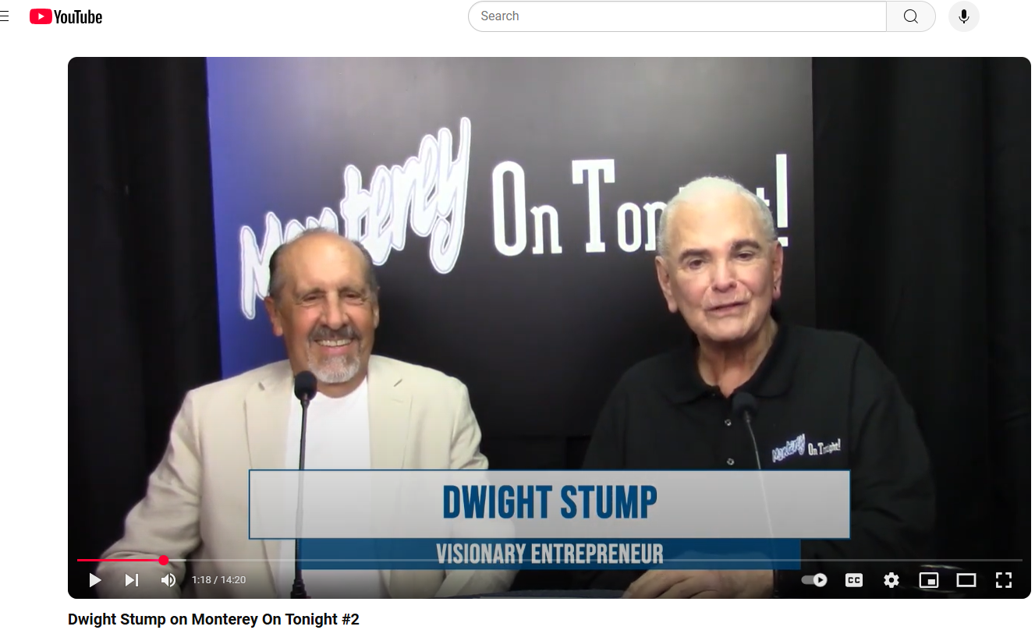
Notes:
Advocating on local talk show

Slide 8
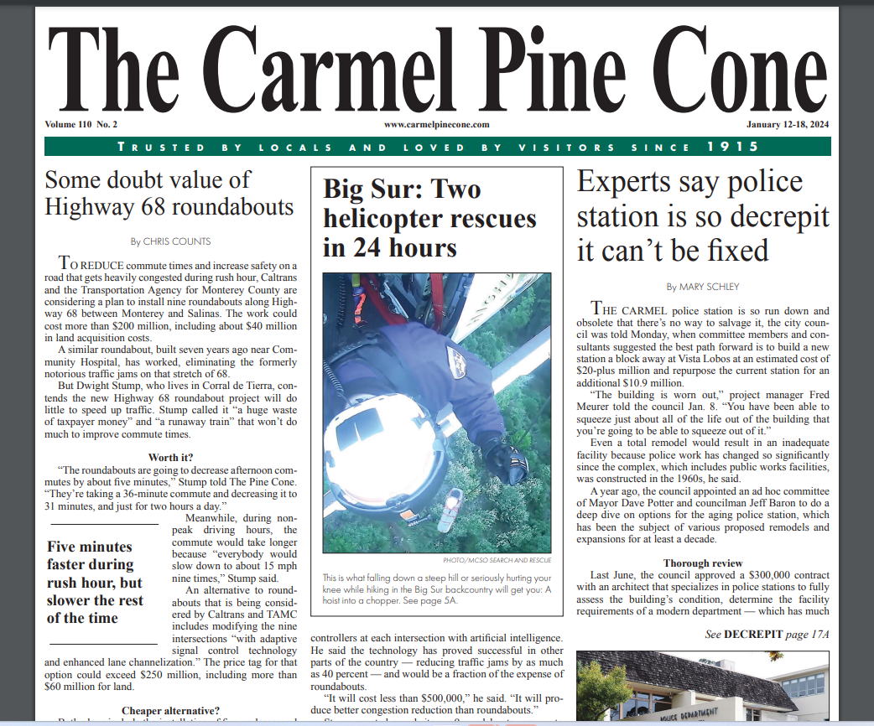
Notes:
Newspaper articles-Pine Cone

Slide 9
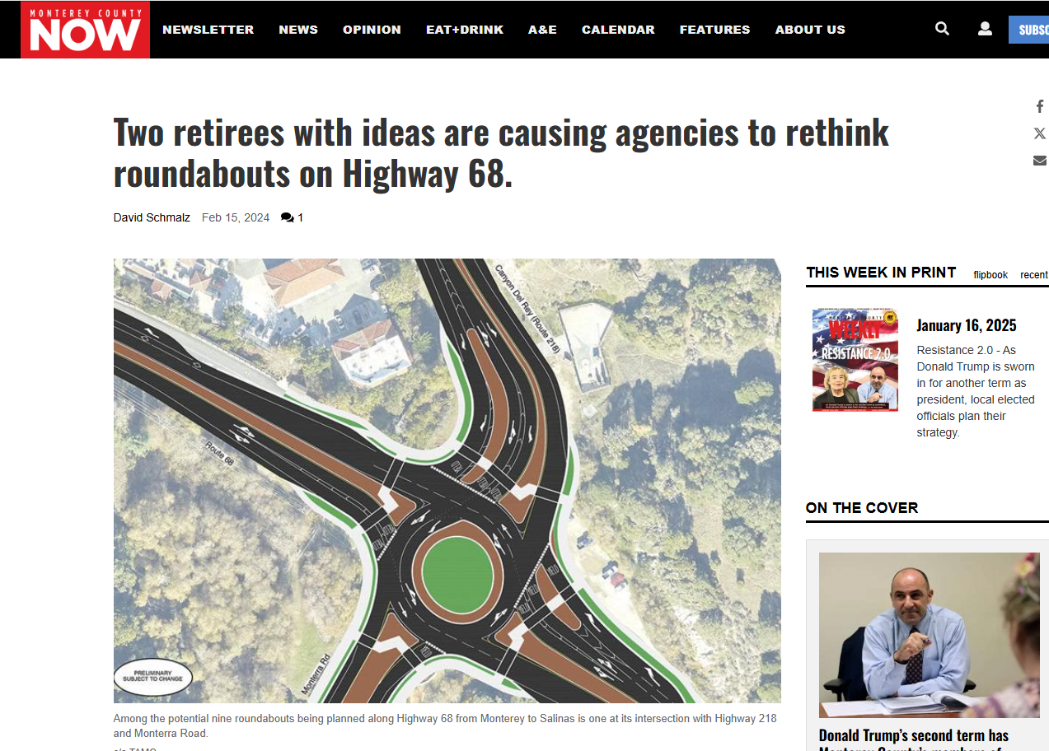
Notes:
Monterey County Weekly

Slide 10
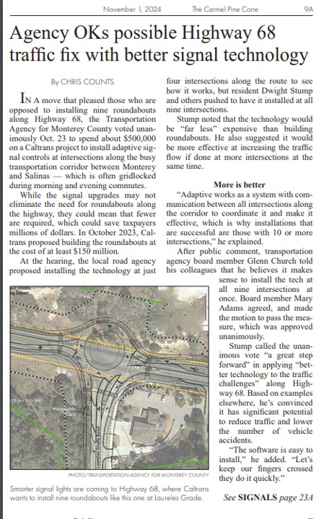
The Carmel Pine Cone
November 1, 2024
Notes:
His persistence led the TAMC Board to vote unanimously to use $500,000 of Measure X funds to install Adaptive Signal Controls at all 9 intersections on Highway 68.
The anticipated results may potentially improve conditions along the heavily congested Highway 68 corridor in advance of the ultimate roundabout project.

Slide 11
Congratulations to:
Dwight Stump
2024 Transportation Excellence Awards Honoree!

Slide 12
23rd Annual Transportation Excellence Awards
Group Award

Slide 13
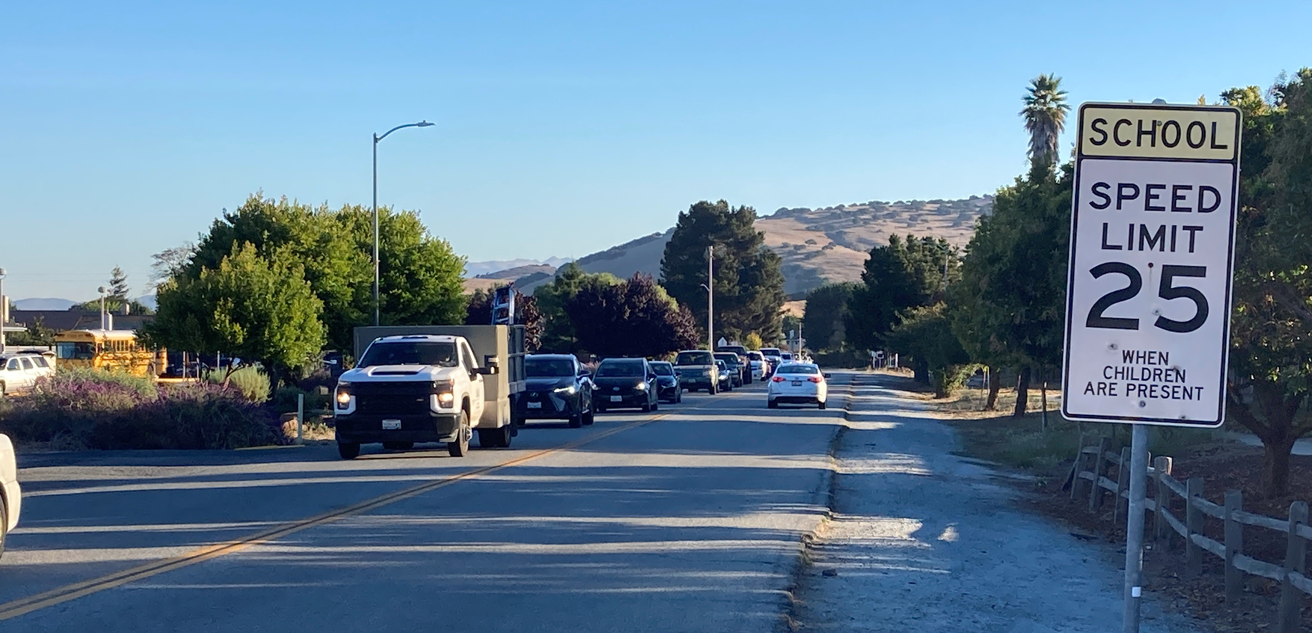
Toro Park and Serra Village Cut Through Traffic Pilot Project Community Group

Slide 14
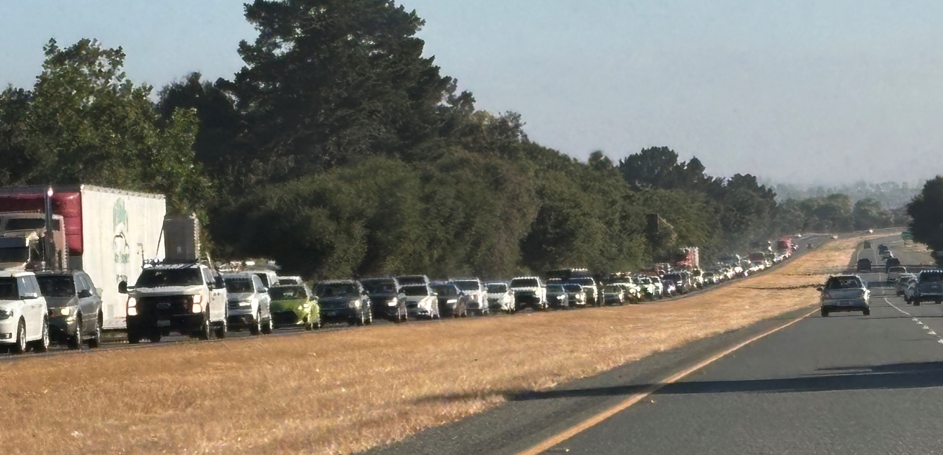
Notes:
The Problem:
Congestion on Highway 68

Slide 15
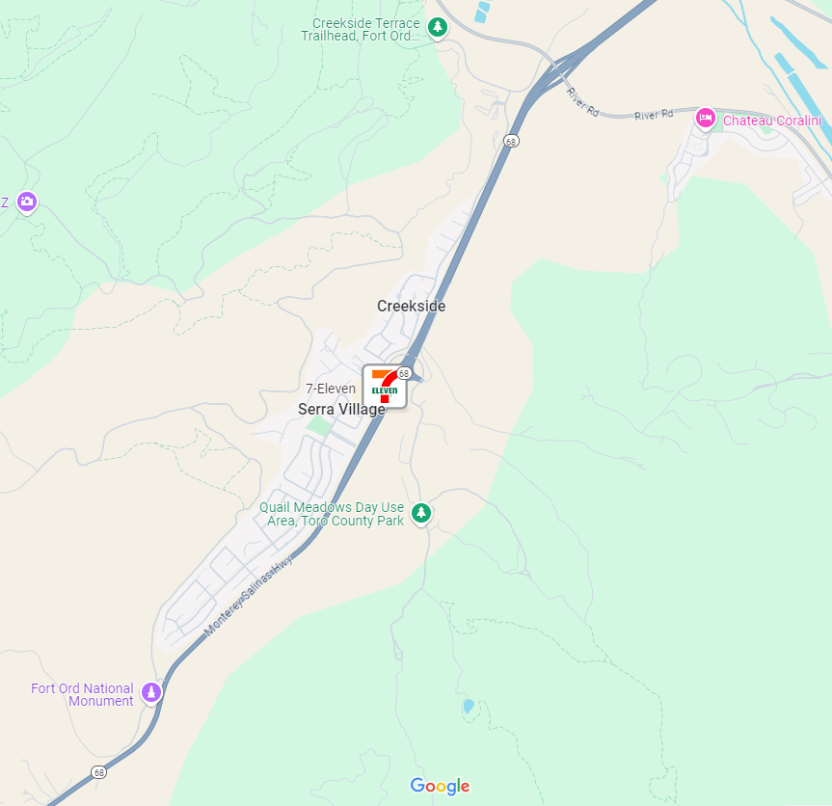
Toro Park Pilot Project
Severe Hwy 68 Congestion=
Cut-Thru Traffic
Notes:
led to aggressive drivers using local streets in the Toro Park/Serra Village neighborhoods to bypass highway traffic.

Slide 16
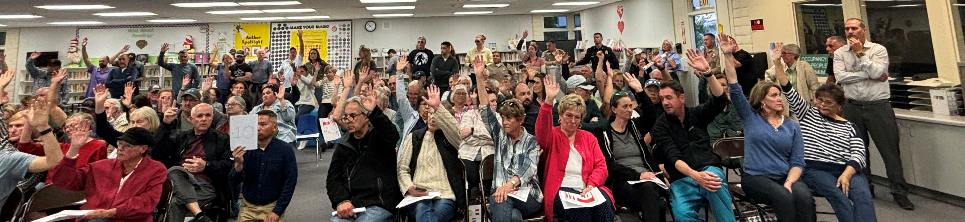
Public Outreach:
Concerns
School Drop-Off Safety (A child has already been hit)
Pedestrian Safety (I don’t feel safe walking anymore)
Aggressive Drivers (Congestion wreaks havoc)
Noise (I don’t need a clock to know when school starts)
Residents Land-Locked (We need to take back our neighborhood)
Traffic is getting worse (Bypass Bypass traffic)
It’s only a few hours (e.g., What about gates closed during school)
Notes:
Residents took action by asking TAMC in March 2024 to head a project to implement a traffic safety project with complete street features,

Slide 17
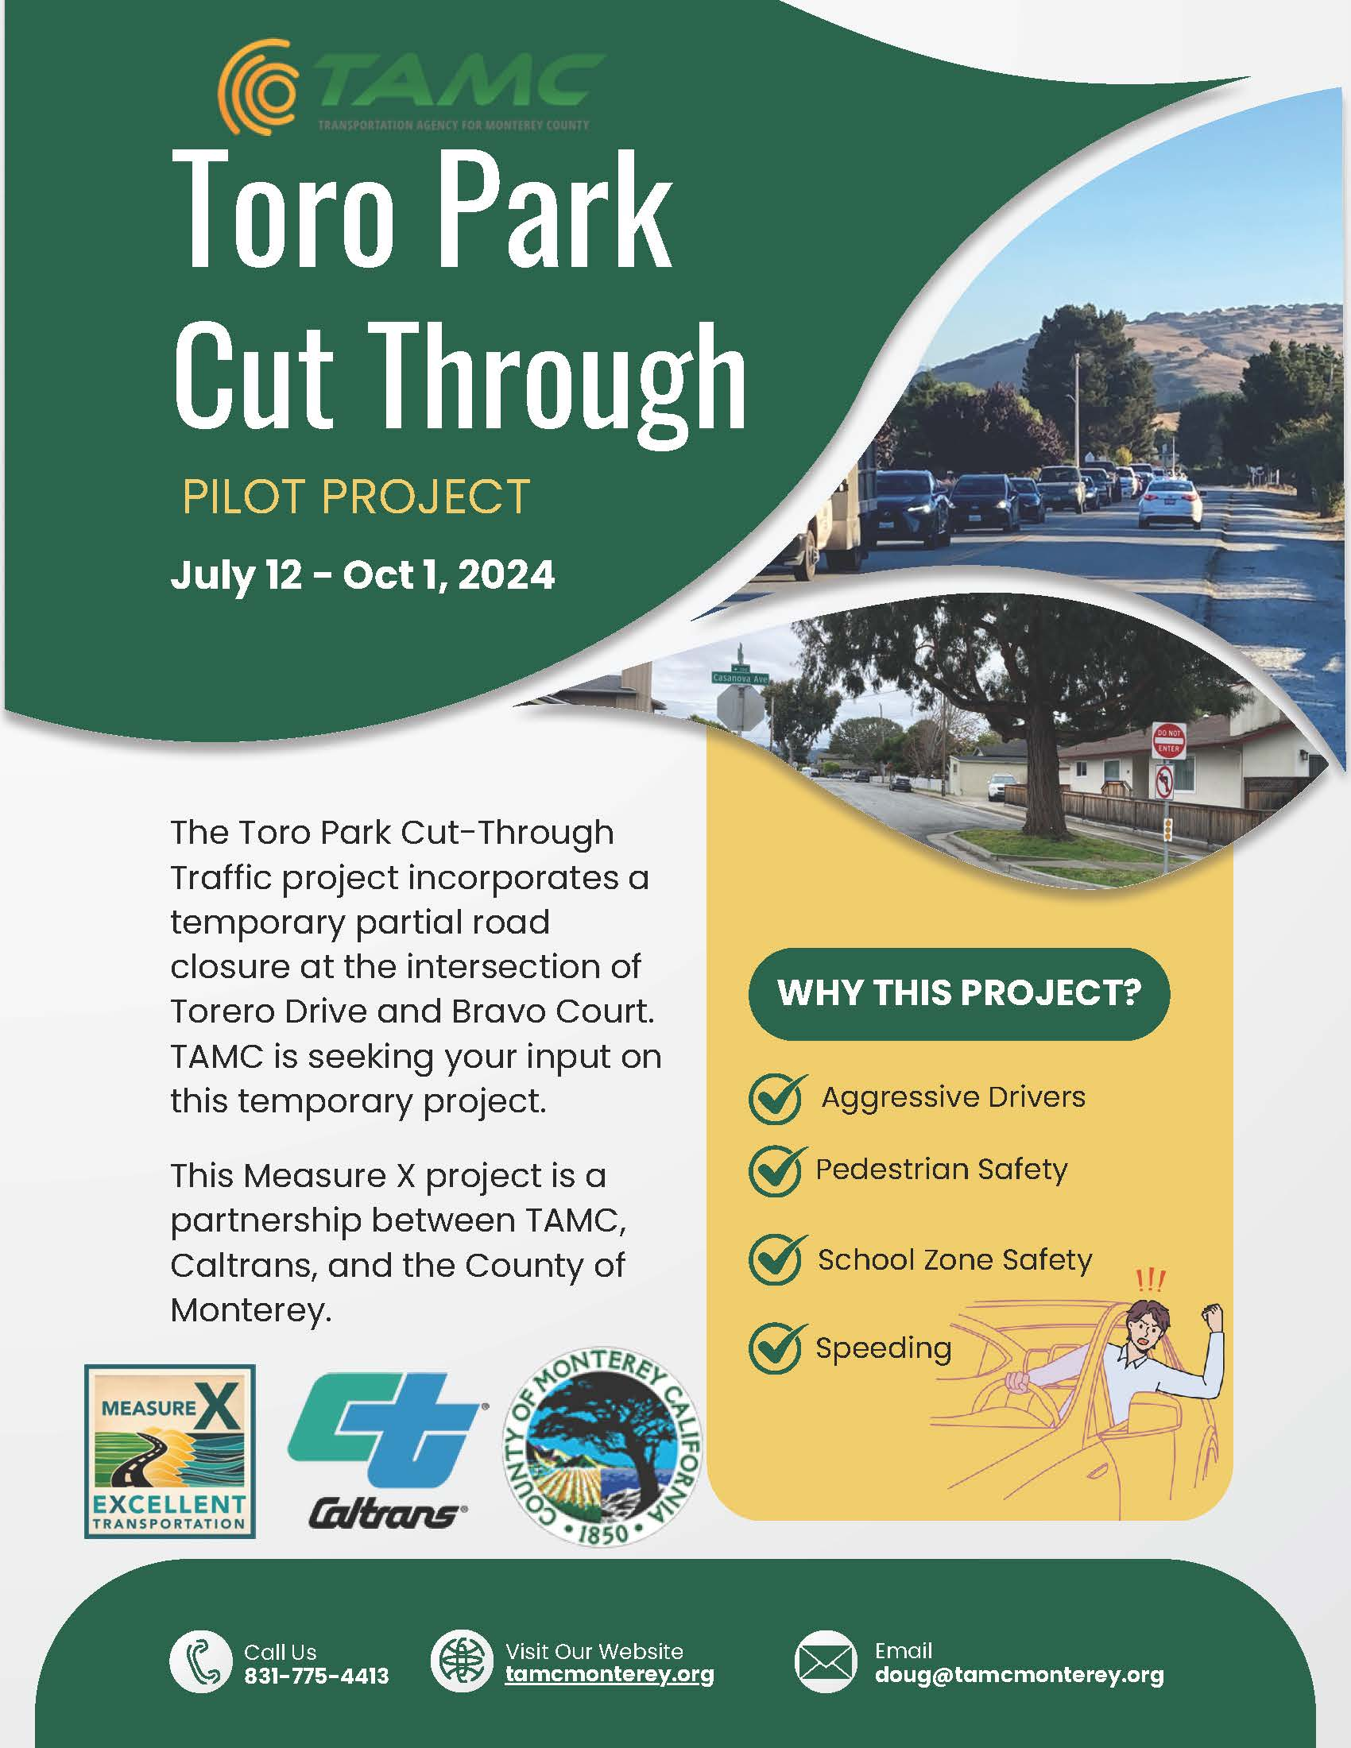
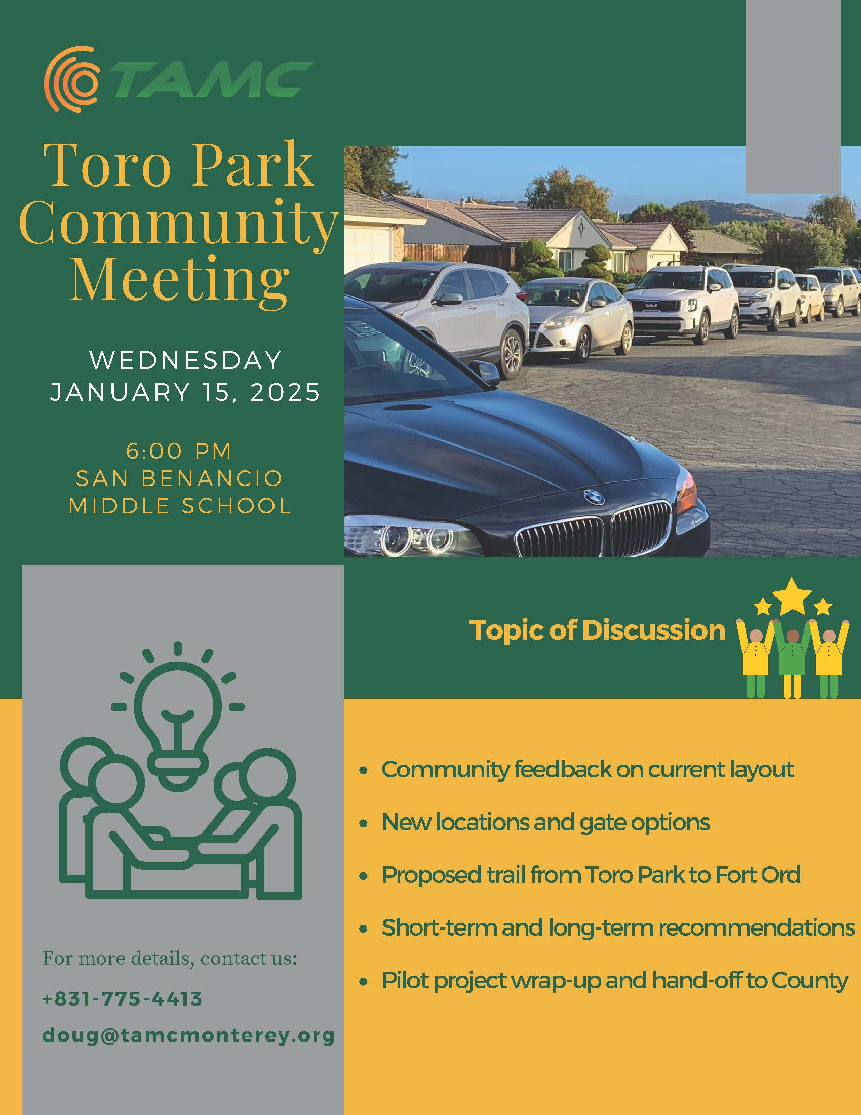
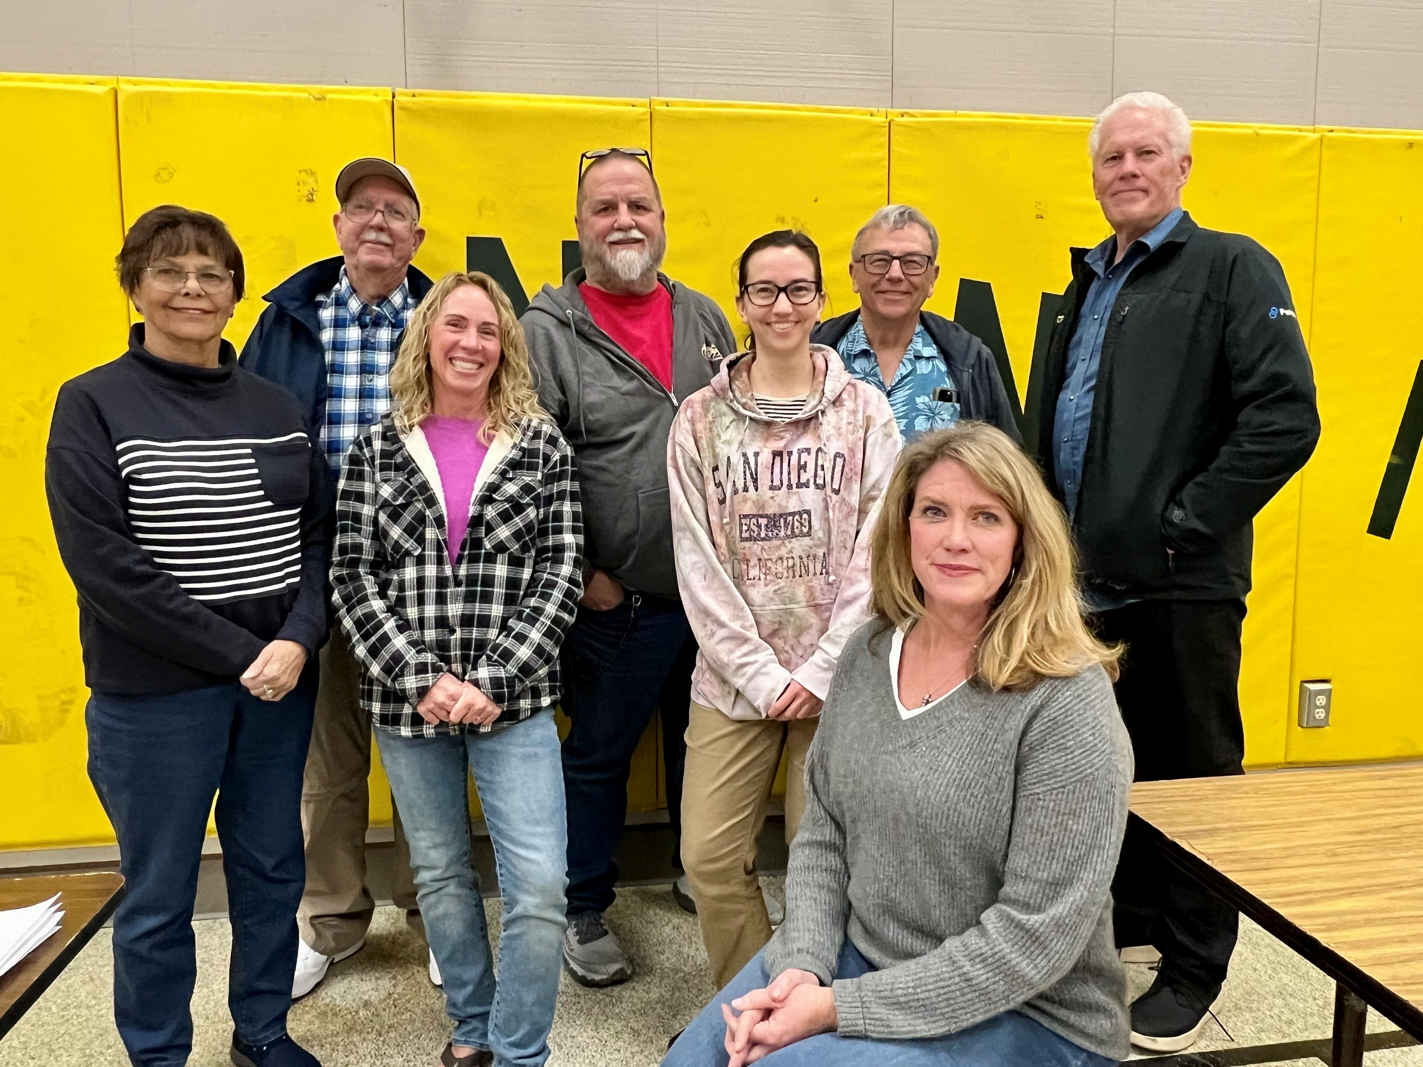
Community Group
Notes:
which became the “Toro Park Cut-Through Traffic Project.”
Through this community driven effort, a committee was set up to guide TAMC and County of Monterey staff in working with residents to reach a consensus on implementing a solution within 6 months of their ask.

Slide 18
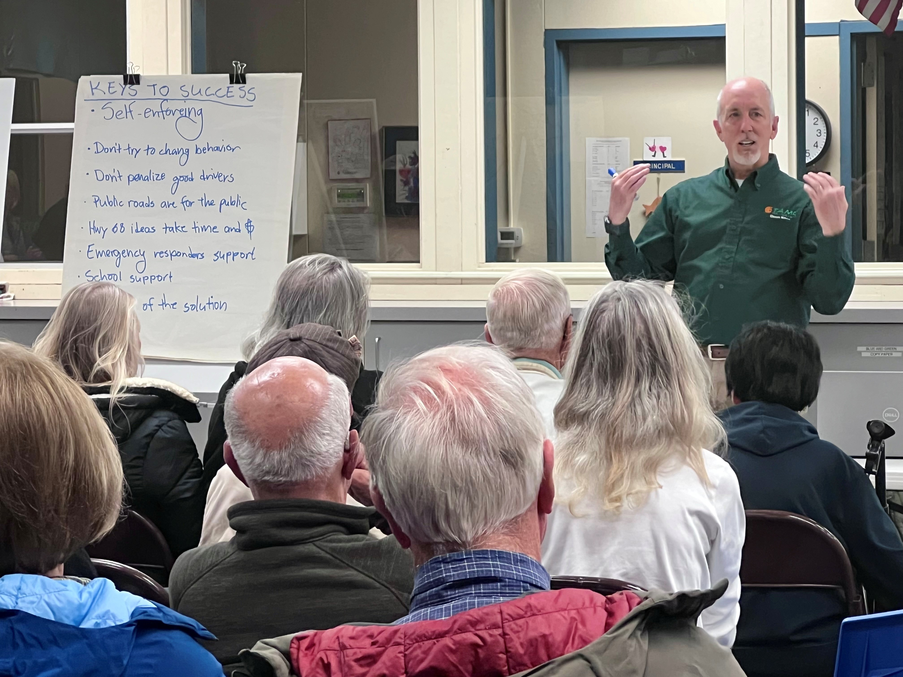
Notes:
The committee helped organize community workshops that built support for the project and kept Toro Park, Serra Village informed of the project progress.

Slide 19
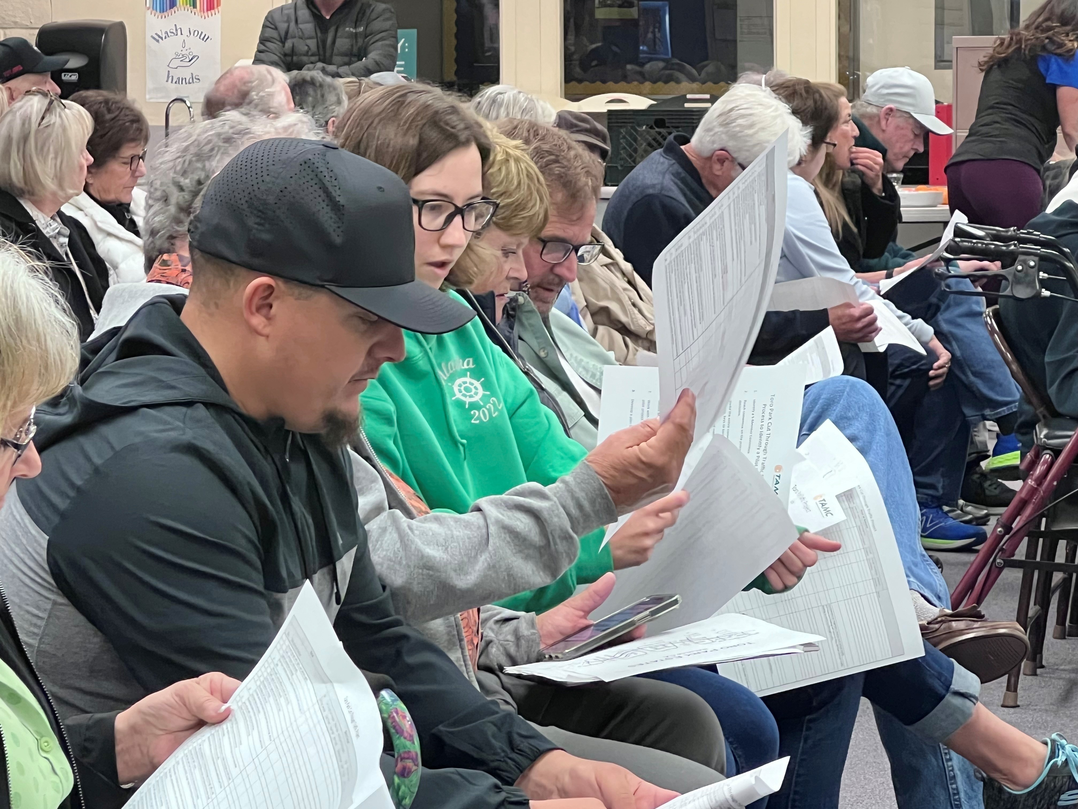
Notes:
Community meetings

Slide 20
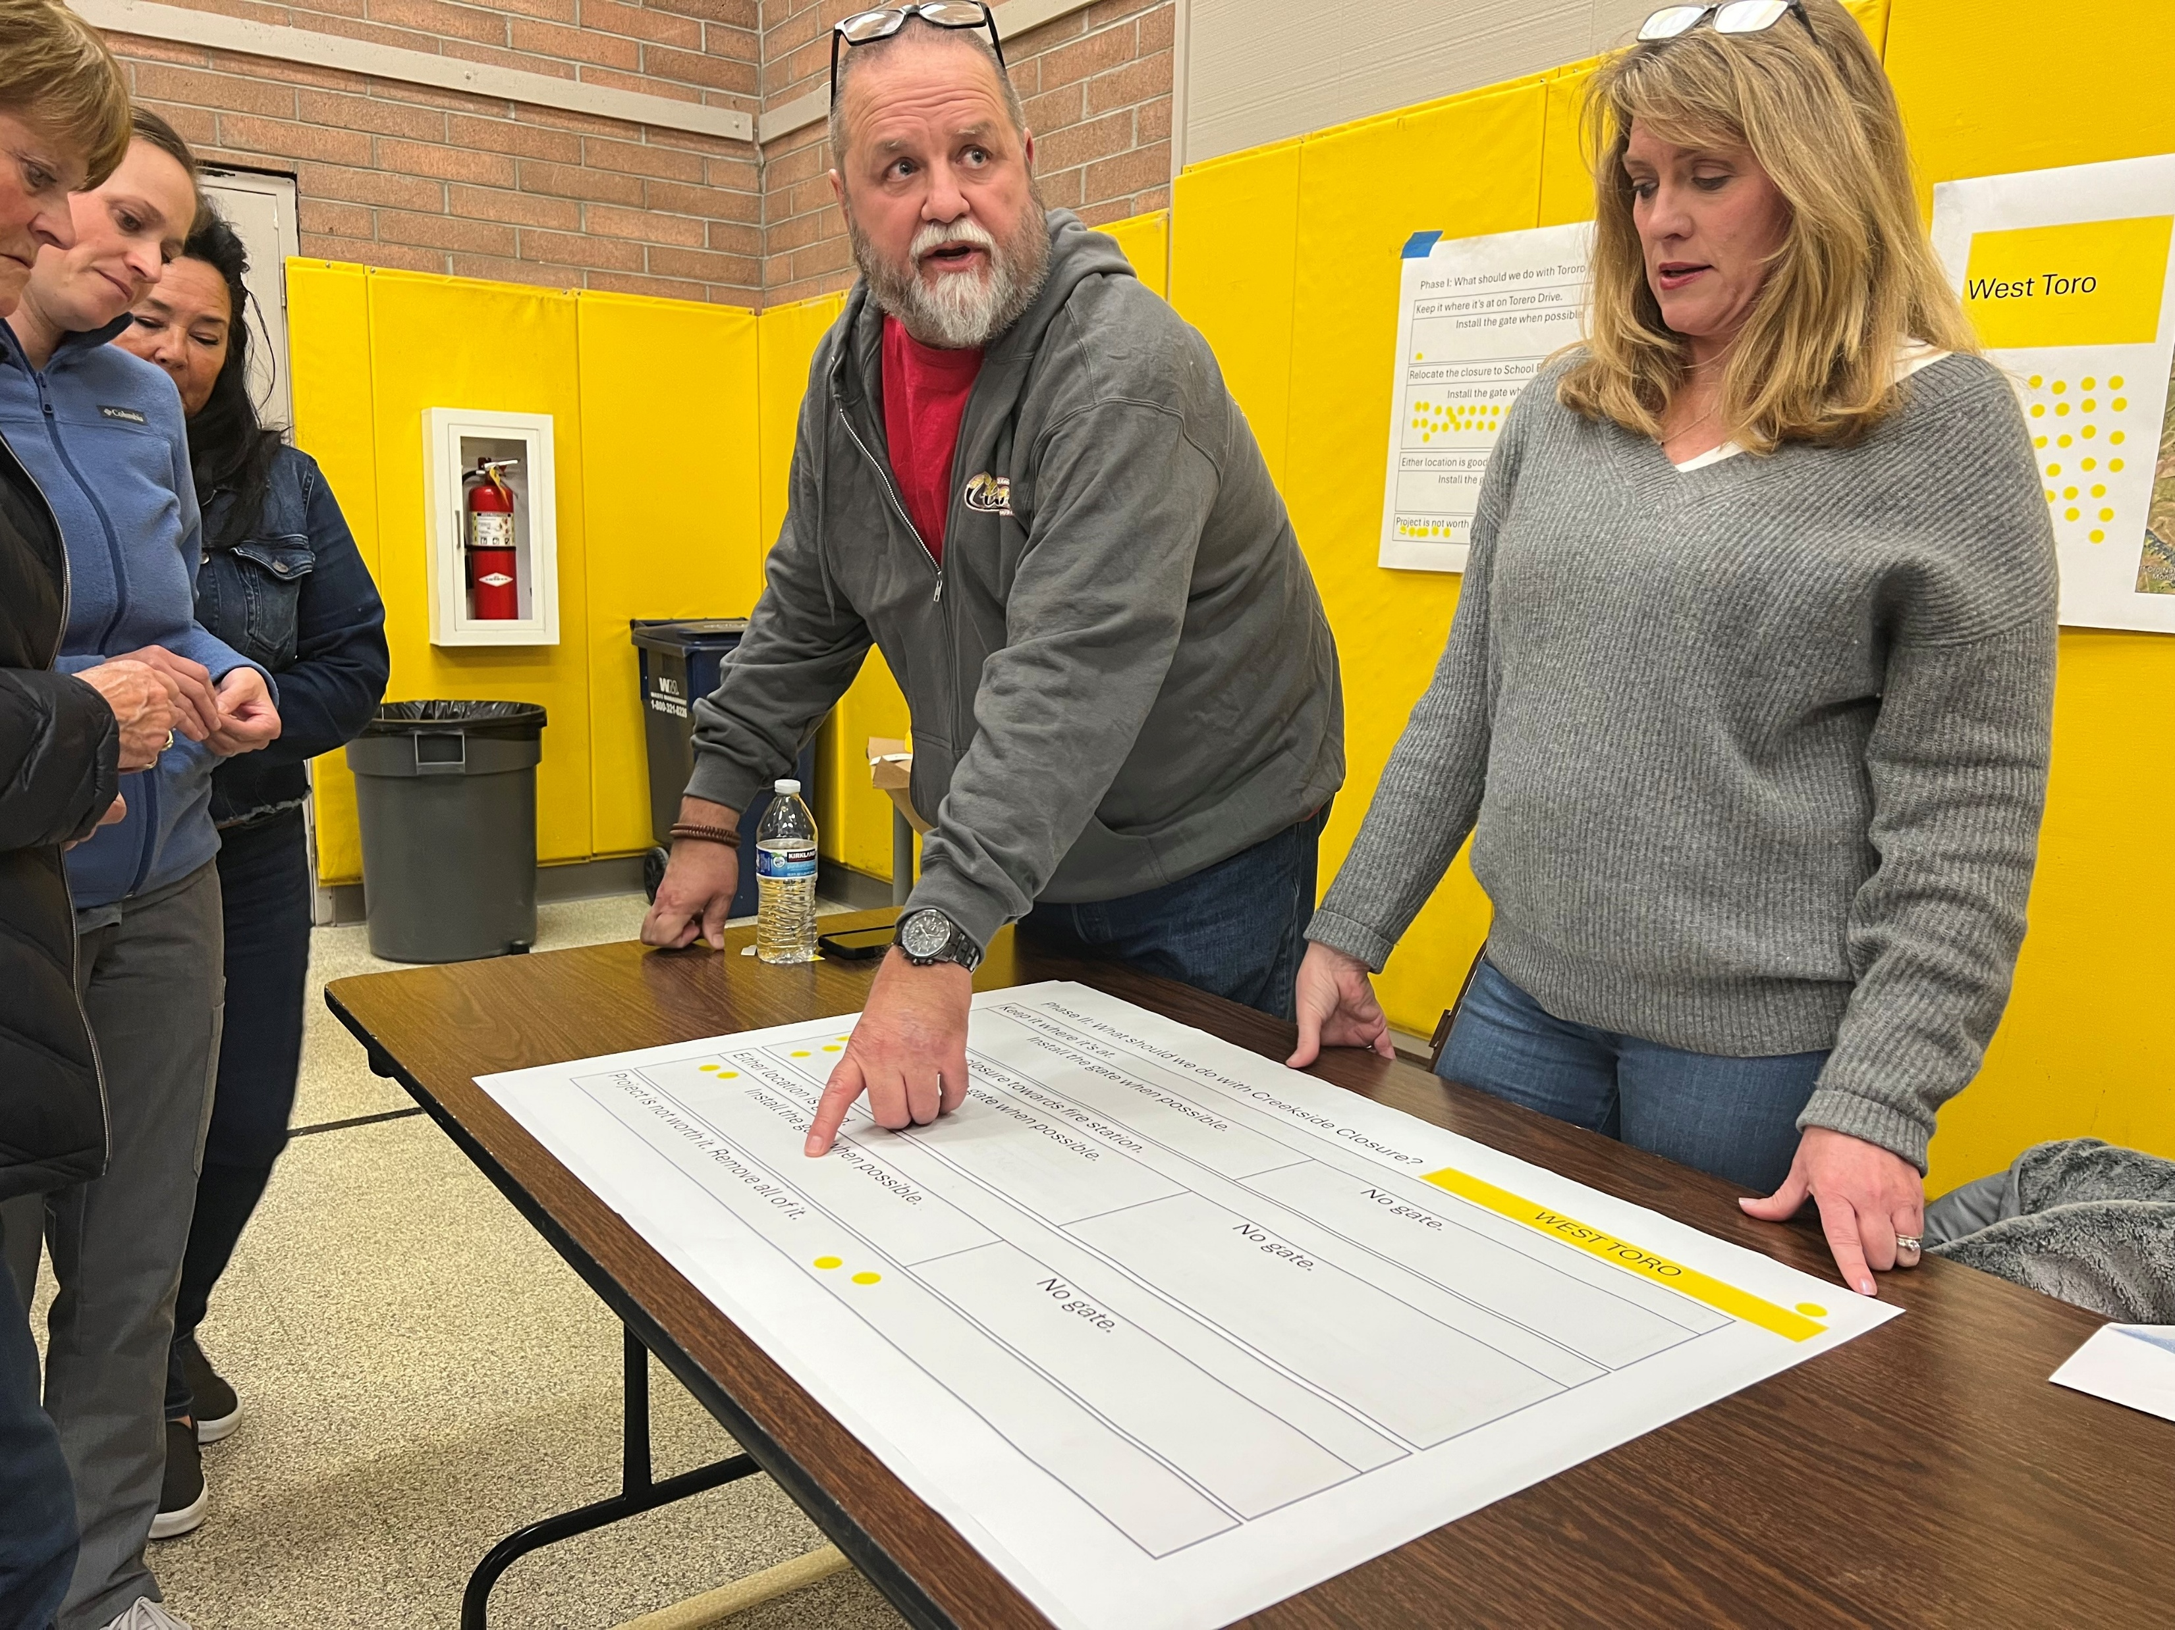
Notes:
Actively engaged: participated in outreach to seek solutions and gather support for through engagement for a solution

Slide 21
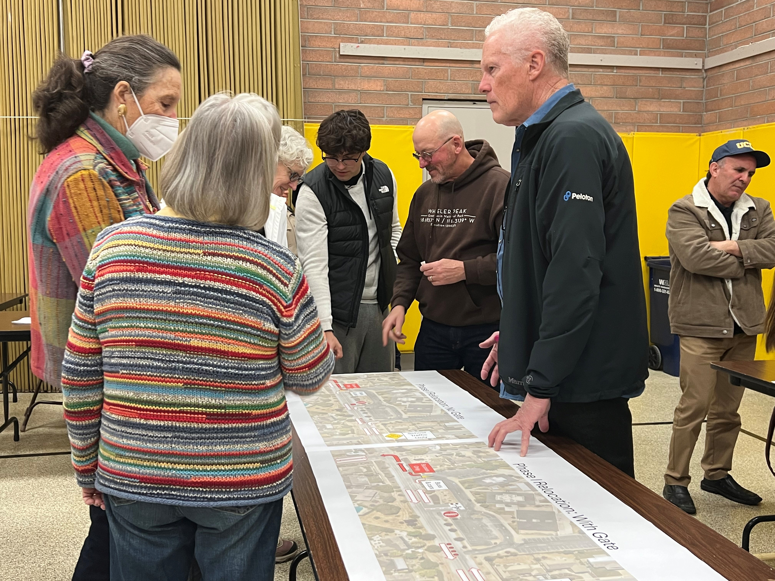
Notes:
Committee members actively engaged:
participated in outreach to seek solutions and gather support for through engagement for a solution

Slide 22
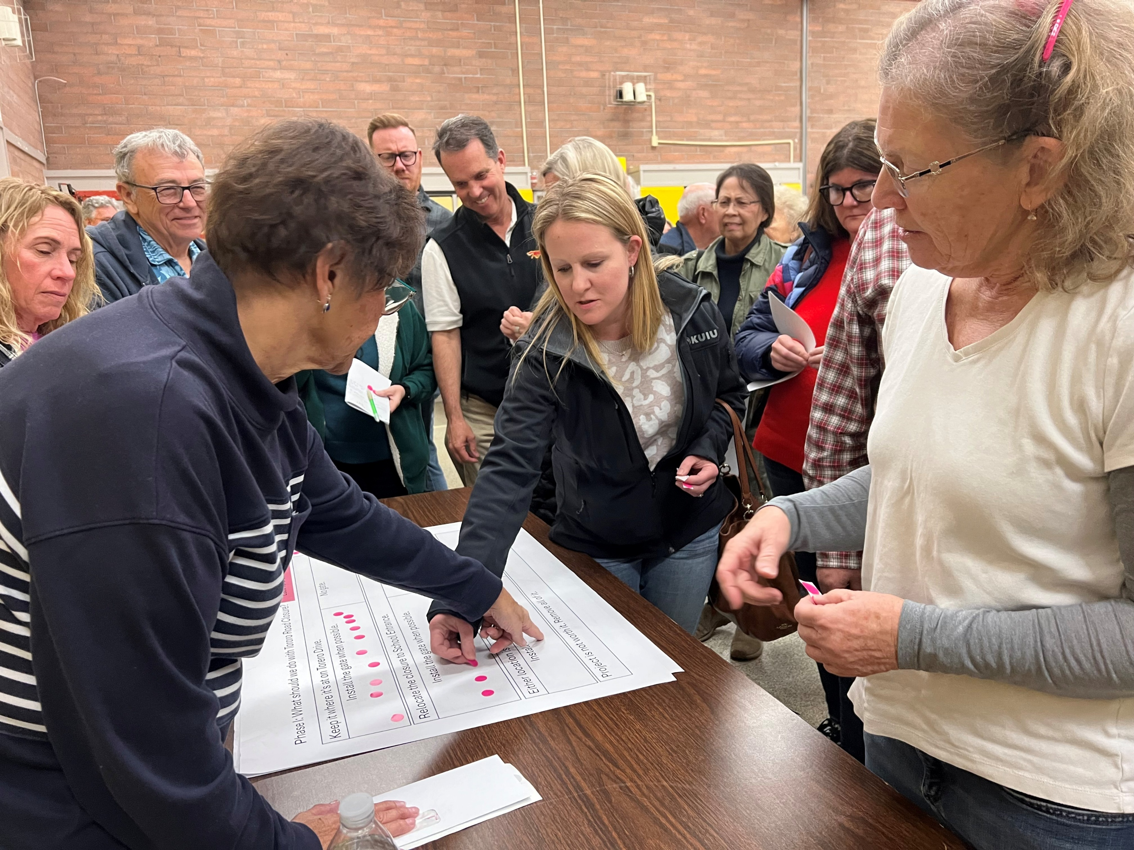
Notes:
Committee members actively engaged:
participated in outreach to seek solutions and gather support for through engagement for a solution

Slide 23
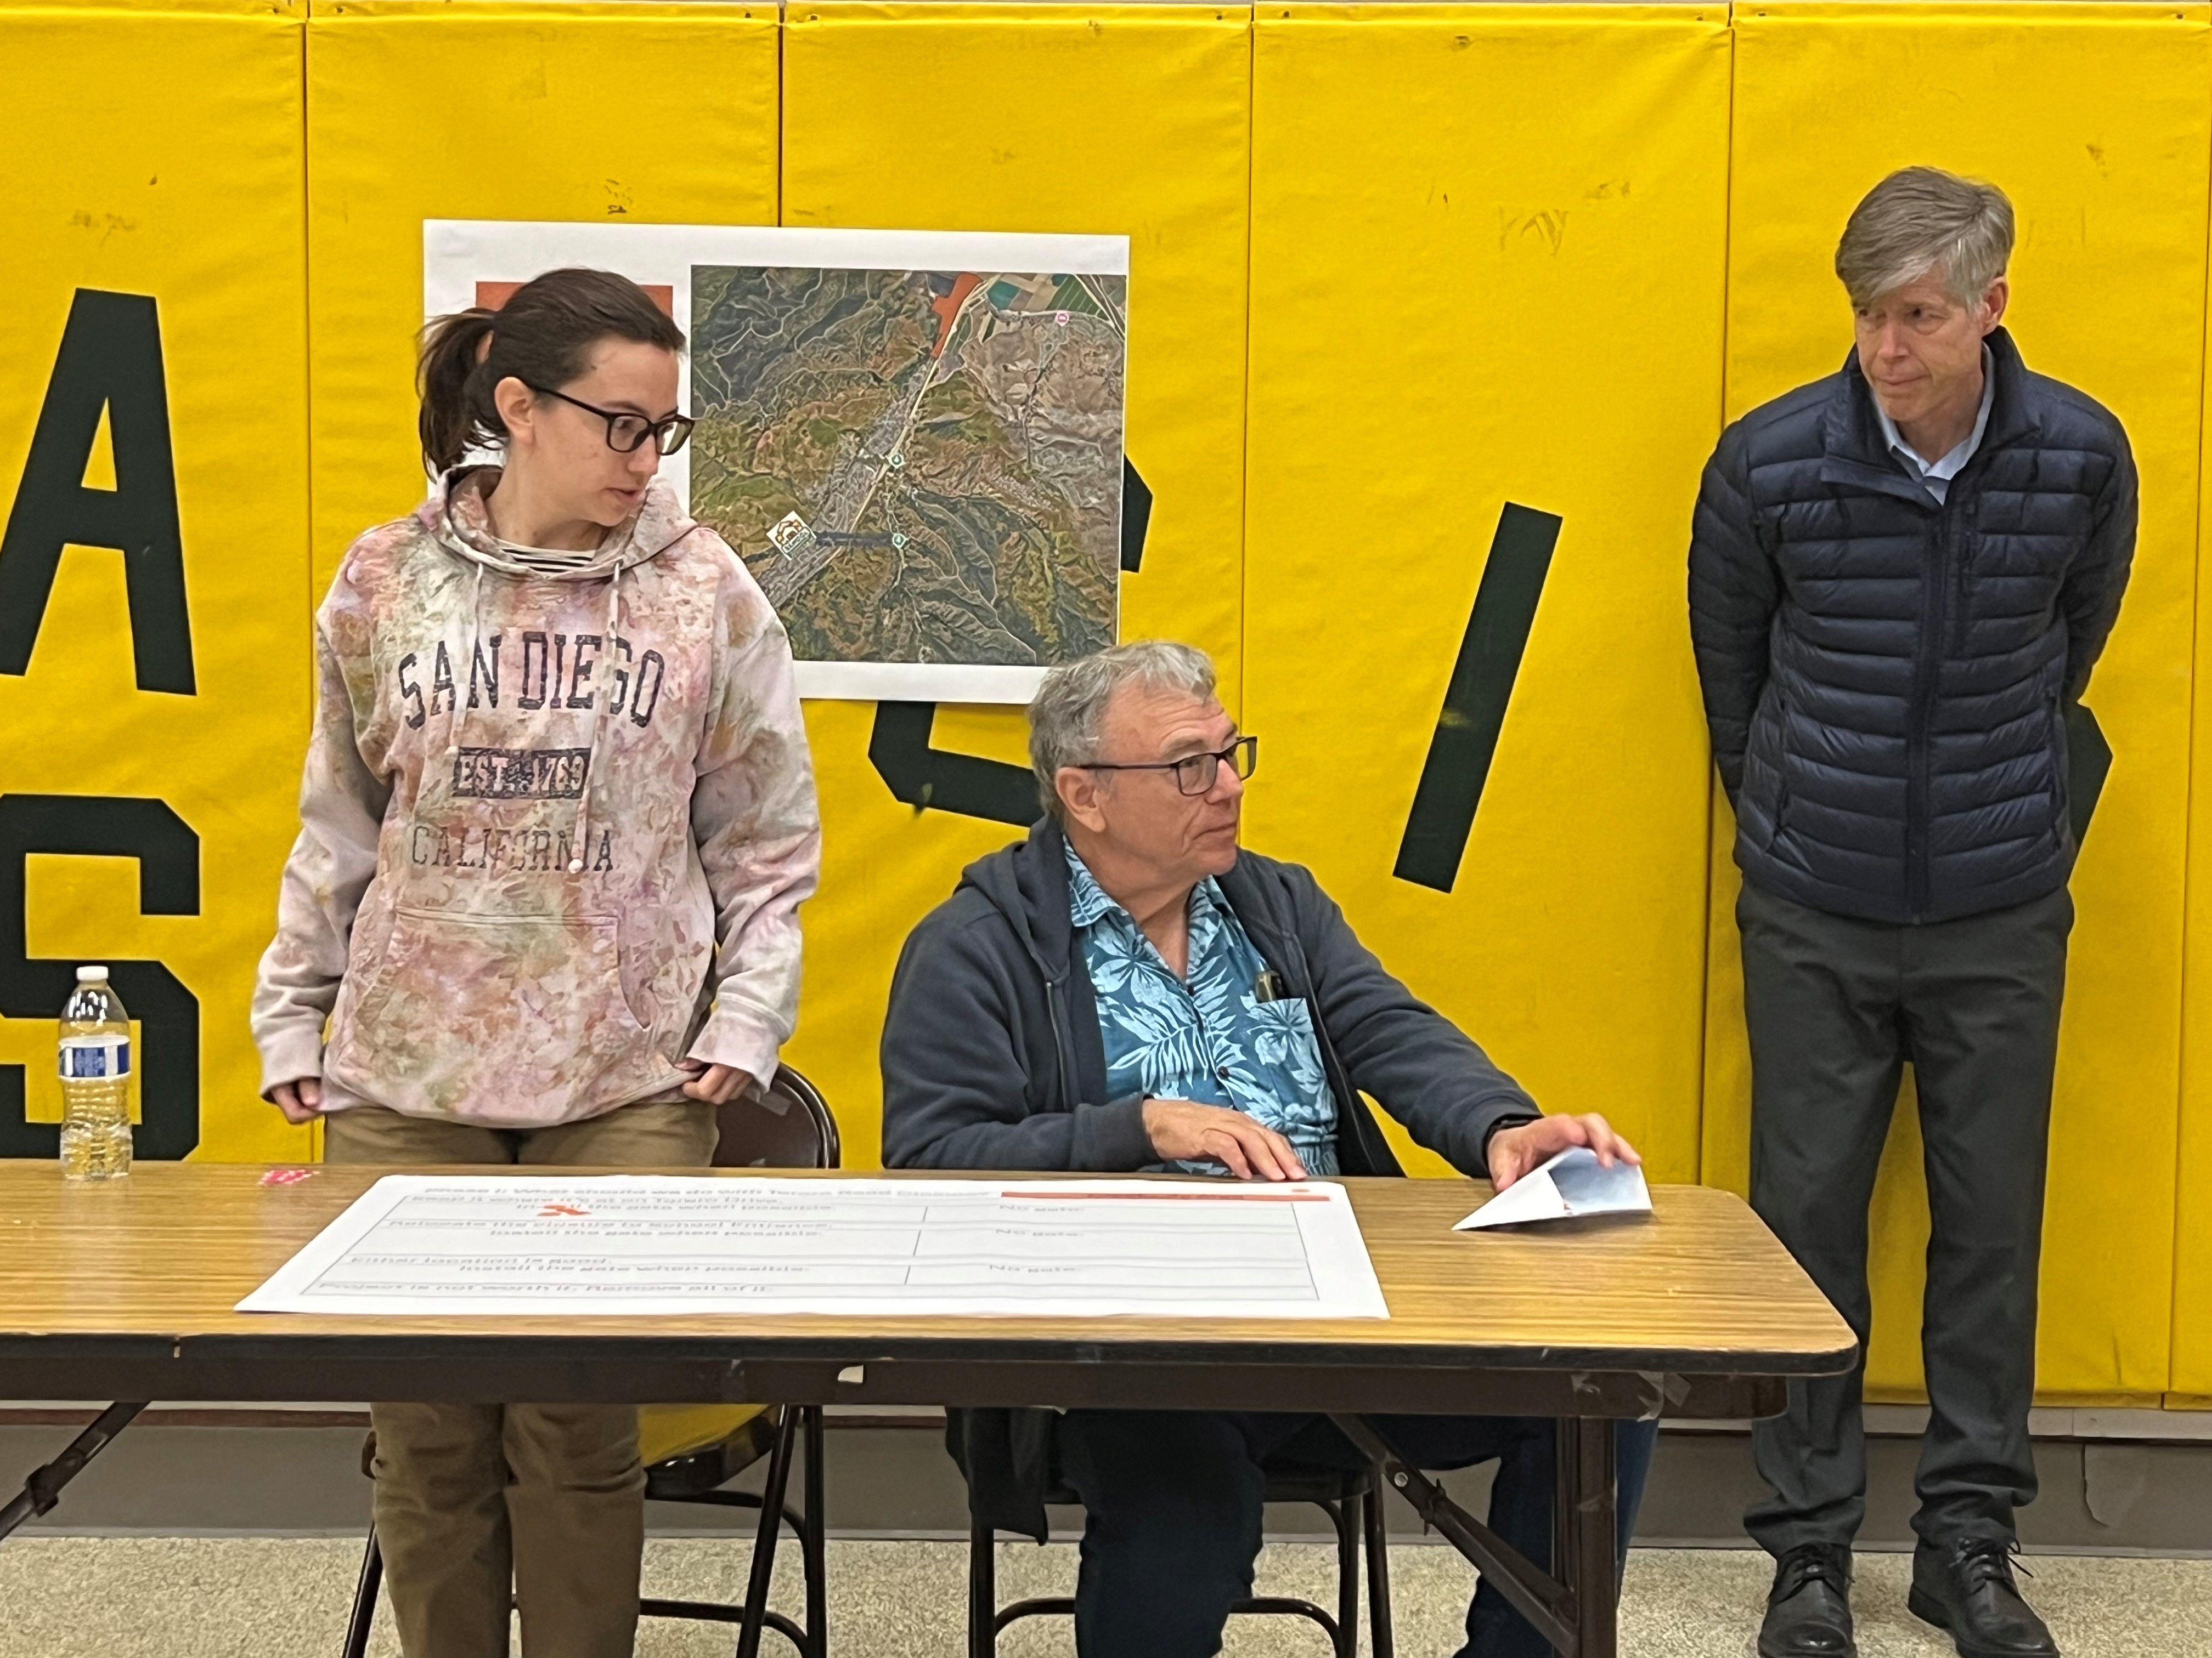
Notes:
Staffing breakout tables at meeting

Slide 24
Notes:
Results:
nearly 500 drivers who had been cutting through the residential neighborhoods and driving in front of an elementary school have been rerouted back onto Highway 68, where the traffic belongs.

Slide 25
Toro Park Cut-through Traffic Pilot Project Community Group
Notes:
The Toro Park Cut-Through Pilot Project is an excellent example of community-based solutions being implemented using public engagement to drive project delivery.
It is a way to show elected officials and the public how a community can be empowered to deliver a project that took over 20 years to find consensus and build trust in public government to address important traffic safety issues.

Slide 26
Congratulations to:
Toro Park Cut-through Traffic Pilot Project Community Group
2024 Transportation Excellence
Awards Honoree !

Slide 27
23rd Annual Transportation Excellence Awards
Program Awards

Slide 28
23rd Annual Transportation Excellence Awards
Safe Routes to School
Salinas Valley Participatory Budgeting Steering Committees

Slide 29
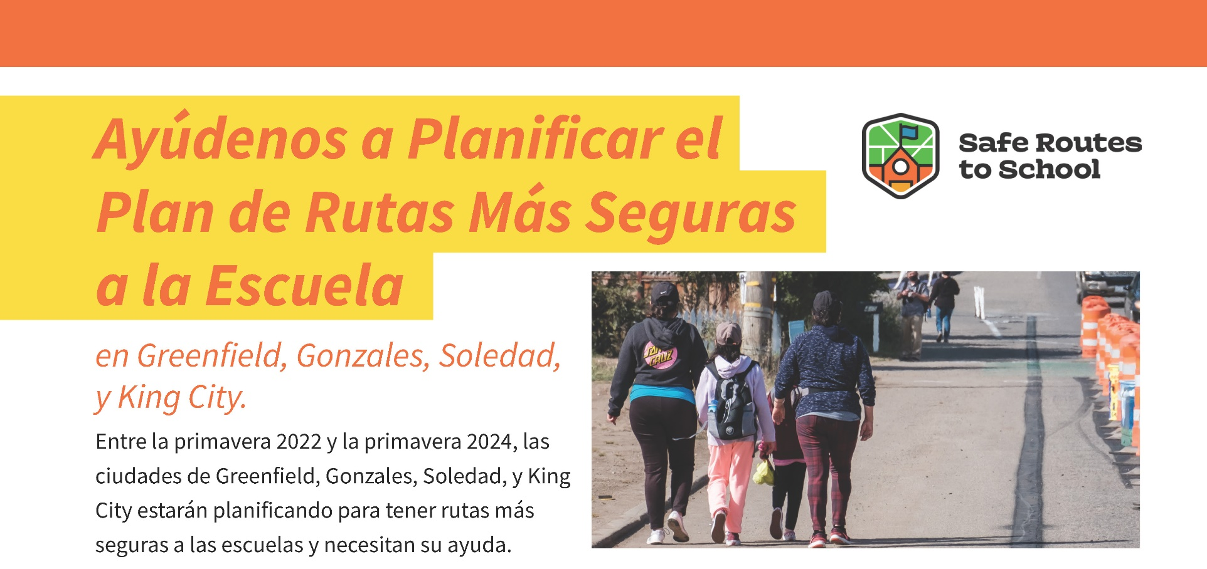
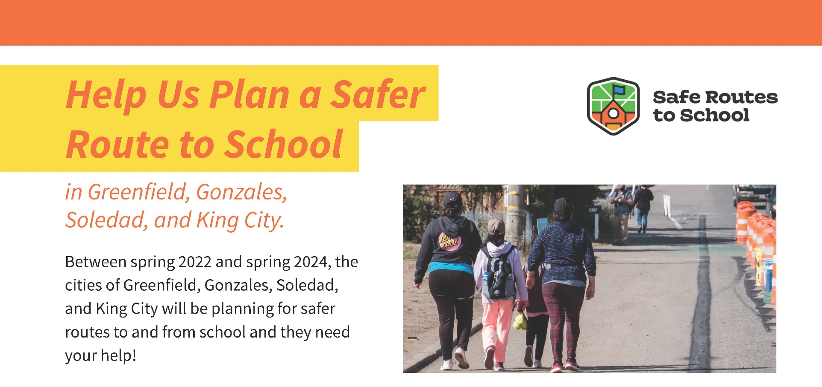
Plan de Rutas Seguras a la Escuela del Valle de Salinas
Salinas Valley Safe Routes to School Plan
Notes:
The Transportation Agency for Monterey County, Monterey County Health Department, Ecology Action, and the cities of Gonzales, Soledad, Greenfield, and King City partnered to develop the Salinas Valley Safe Routes to School Plan ("Plan").
The two-year planning process identified barriers to safe access to 22 public schools in South Monterey County cities and recommended infrastructure and non- infrastructure improvements.

Slide 30
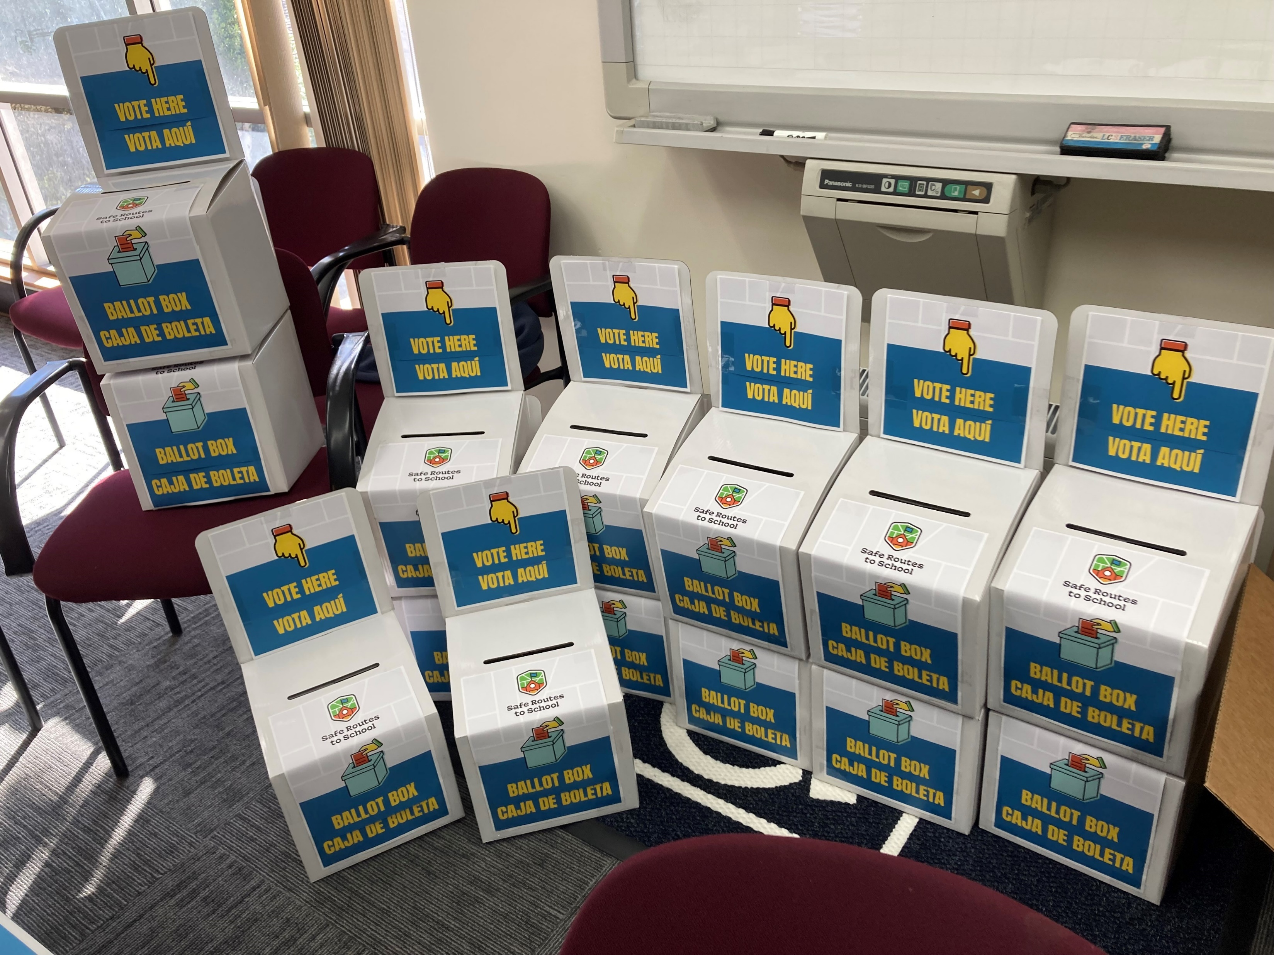
¿Qué es el Presupuesto Participativo?
What is Participatory Budgeting?
Notes:
Participatory Budgeting is a democratic process where community members get to decide how to allocate public funding.
- TAMC is providing $250,000 of Regional Surface Transportation Program funds to King City, Greenfield, Soledad, and Gonzales

Slide 31
¿Qué es el Presupuesto Participativo?
What is Participatory Budgeting?
Diseñar el proceso
Seleccionar proyectos para la boleta electoral
Votar
Proyectos ganadores del fondo
Design the process
Select projects for the ballot
Vote
Fund winning projects
Notes:
Participatory Budgeting in its entirety undergoes these four steps.

Slide 32
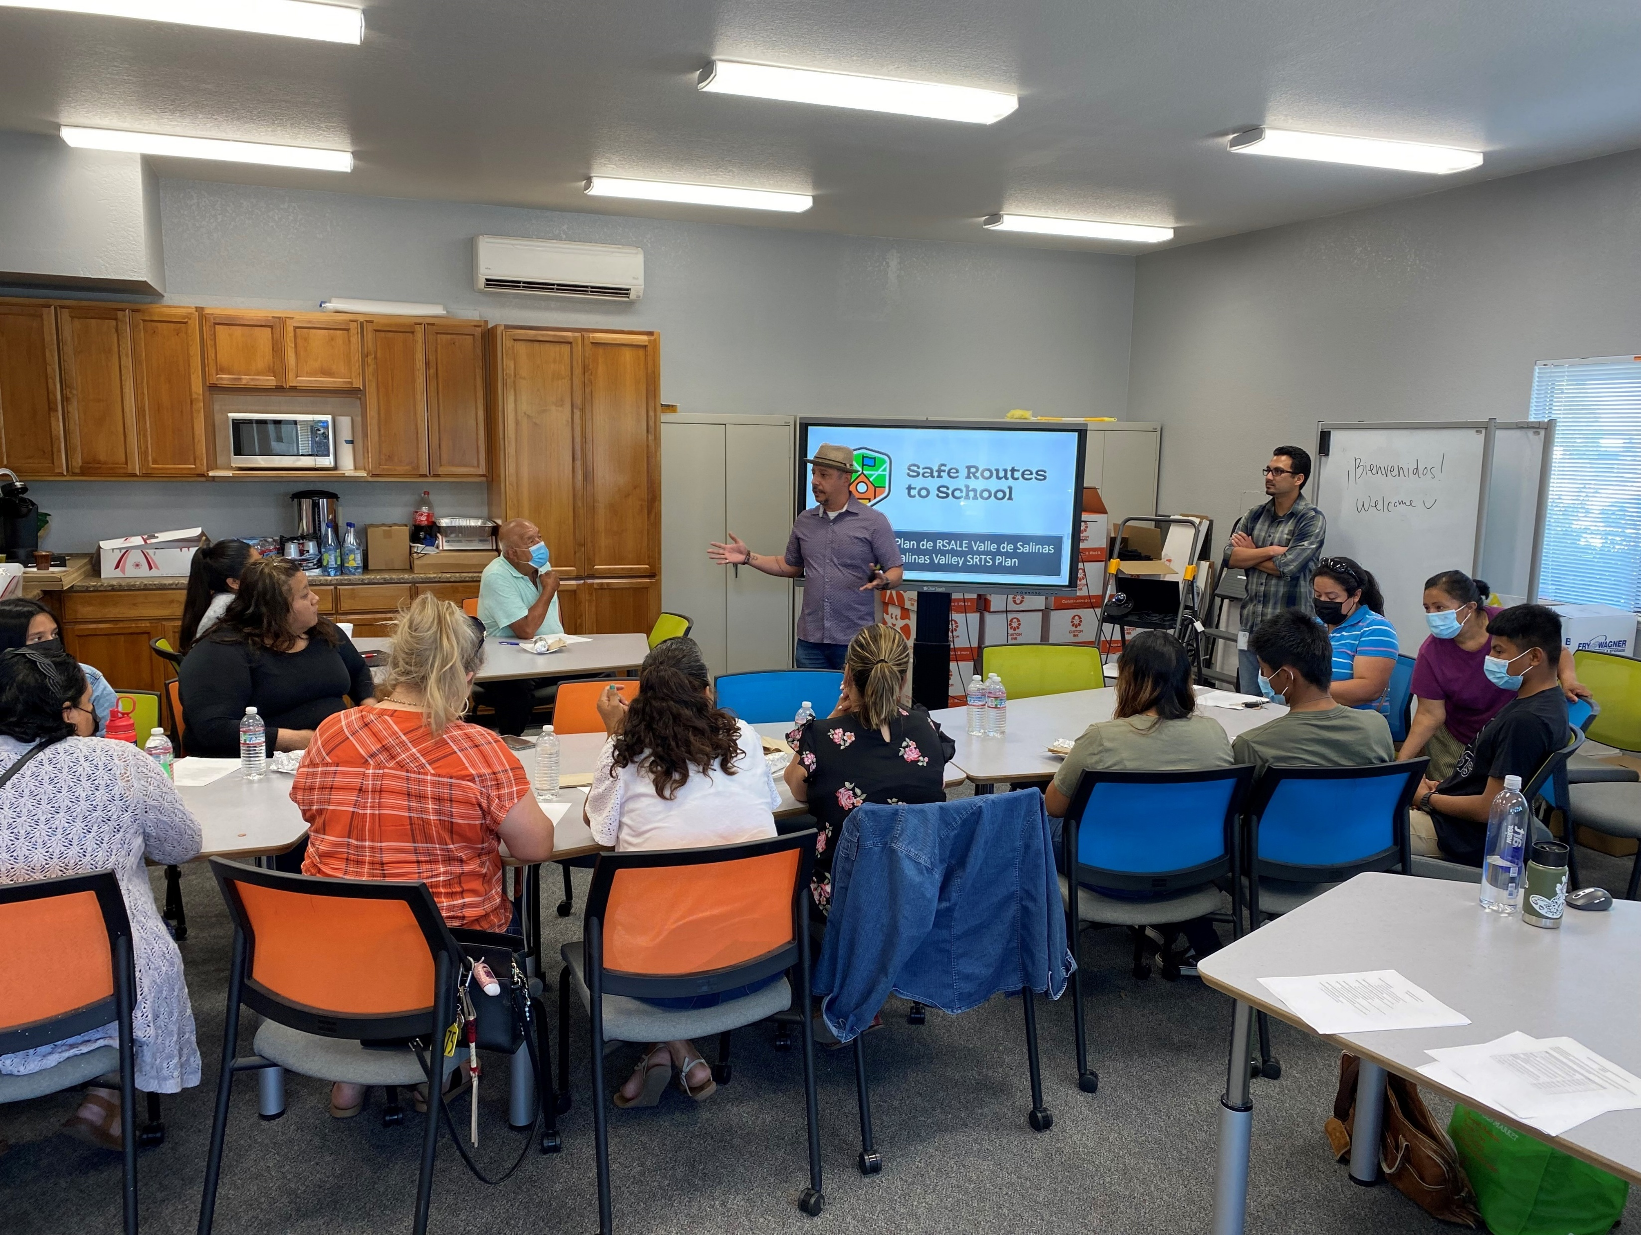
Formación del Comité Directivo
Forming the Steering Committee

Slide 33
Formación del Comité Directivo
Forming the Steering Committee
Divulgación a organizaciones comunitarias
Presentaciones en escuelas
Alcance a través de la red del Departamento de Salud
Outreach to community-based organizations
Presentations at schools
Outreach through Health Department network
Notes:
Able to achieve this with our partnerships with Ecology Action and the Monterey County Health Department, through extensive outreach to recruit steering committee
There were a total of 8 monthly meetings for each committee and each meeting lasted 3 hours.
There were between 10-30 members in each committee.
All meetings were primarily held in Spanish with interpretation to English.
We compensated committee members for their time.

Slide 34
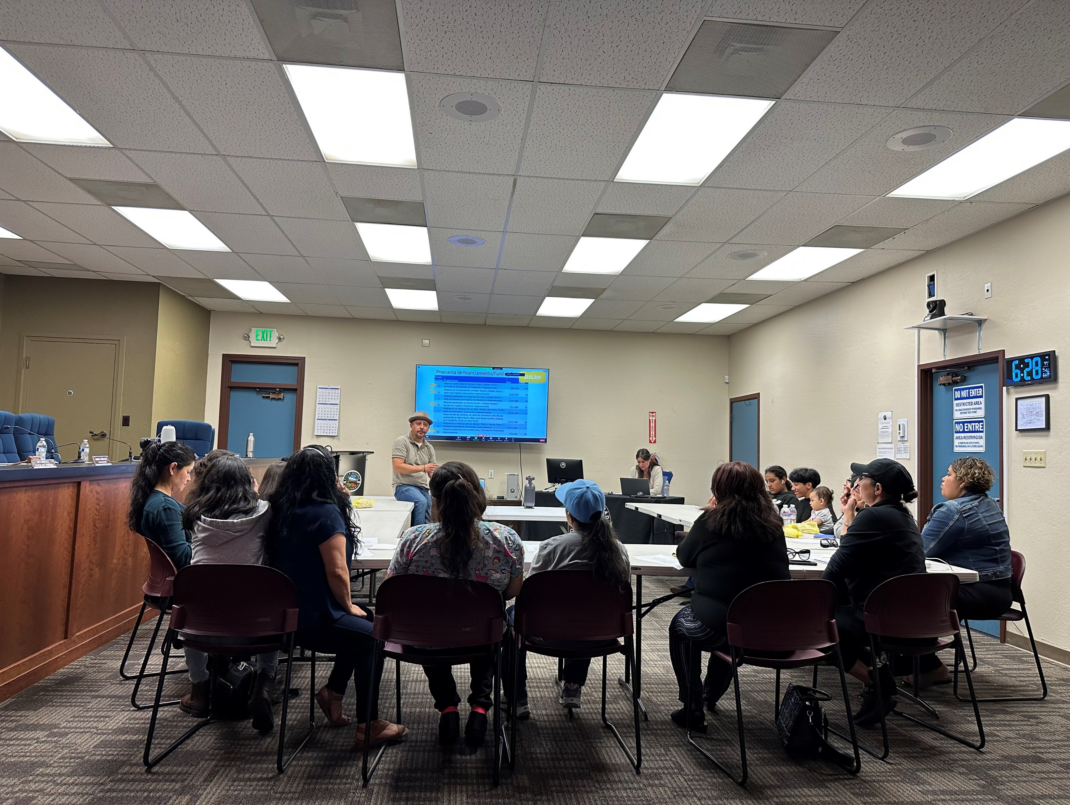
Creación del Proceso
Creating the Process
Notes:
Once the steering committee was formed the project team went over what the members roles were in the participatory budgeting process, with the emphasize that they had the power to drive the process.
The committees began by learning about the projects that will be included in the SV Safe Routes to School Plan and which projects were eligible for PB funding.
The committee began an election planning process where they set up the rules and procedures for a community-wide election.

Slide 35
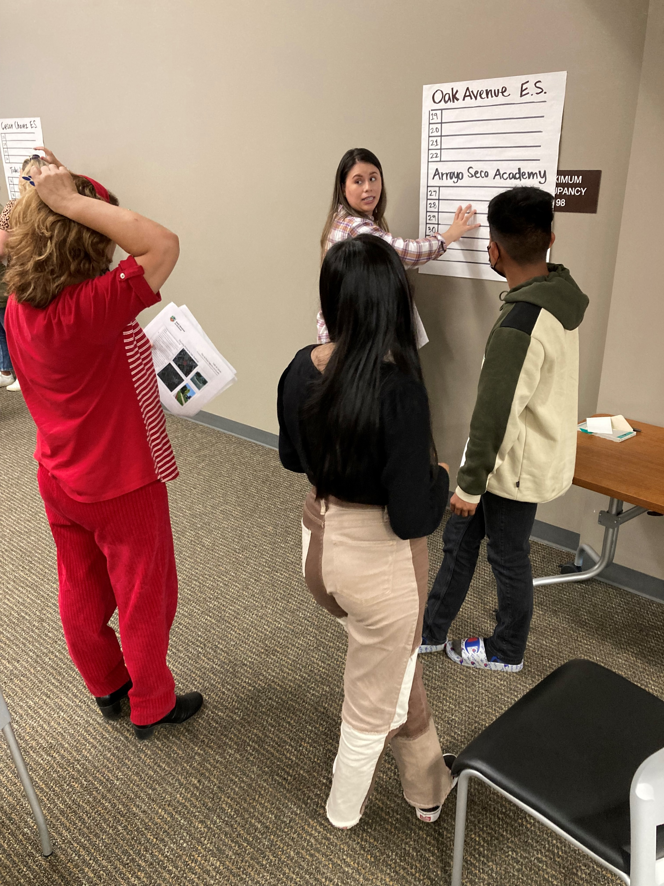
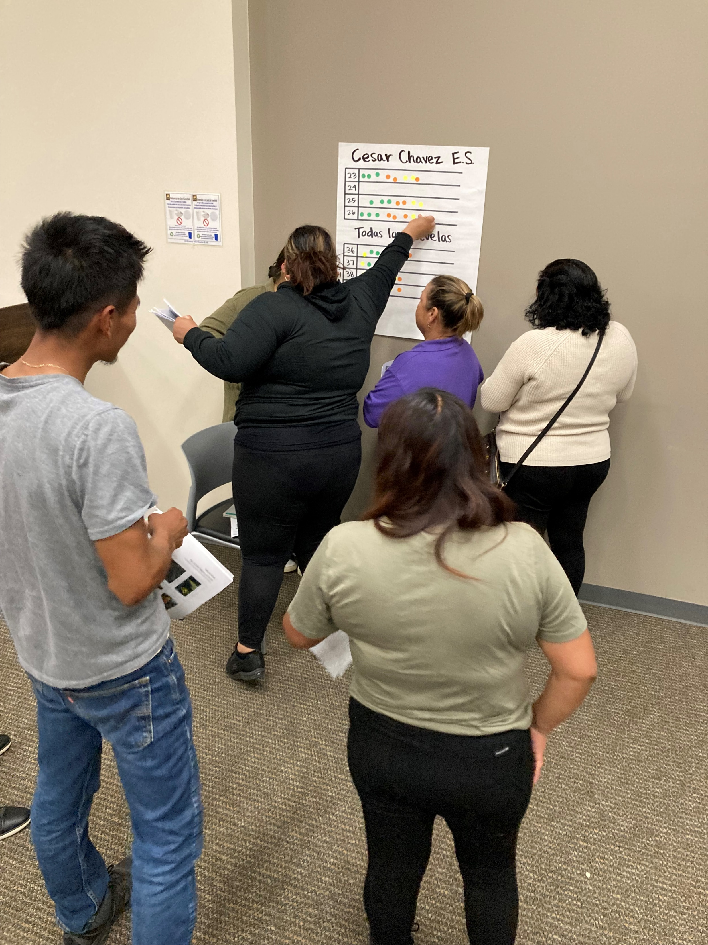
Seleccionar proyectos para la boleta electoral
Select Projects for the Ballot
Notes:
Once the election planning is completed…the committees choose which projects get to go on the final public ballot.
This part of the process required a lot of discussion and important decision making since they had to narrow down a large list of projects.
Each of the committees narrowed the projects to the most important ones, particularly with those that have a direct connection to a school.

Slide 36
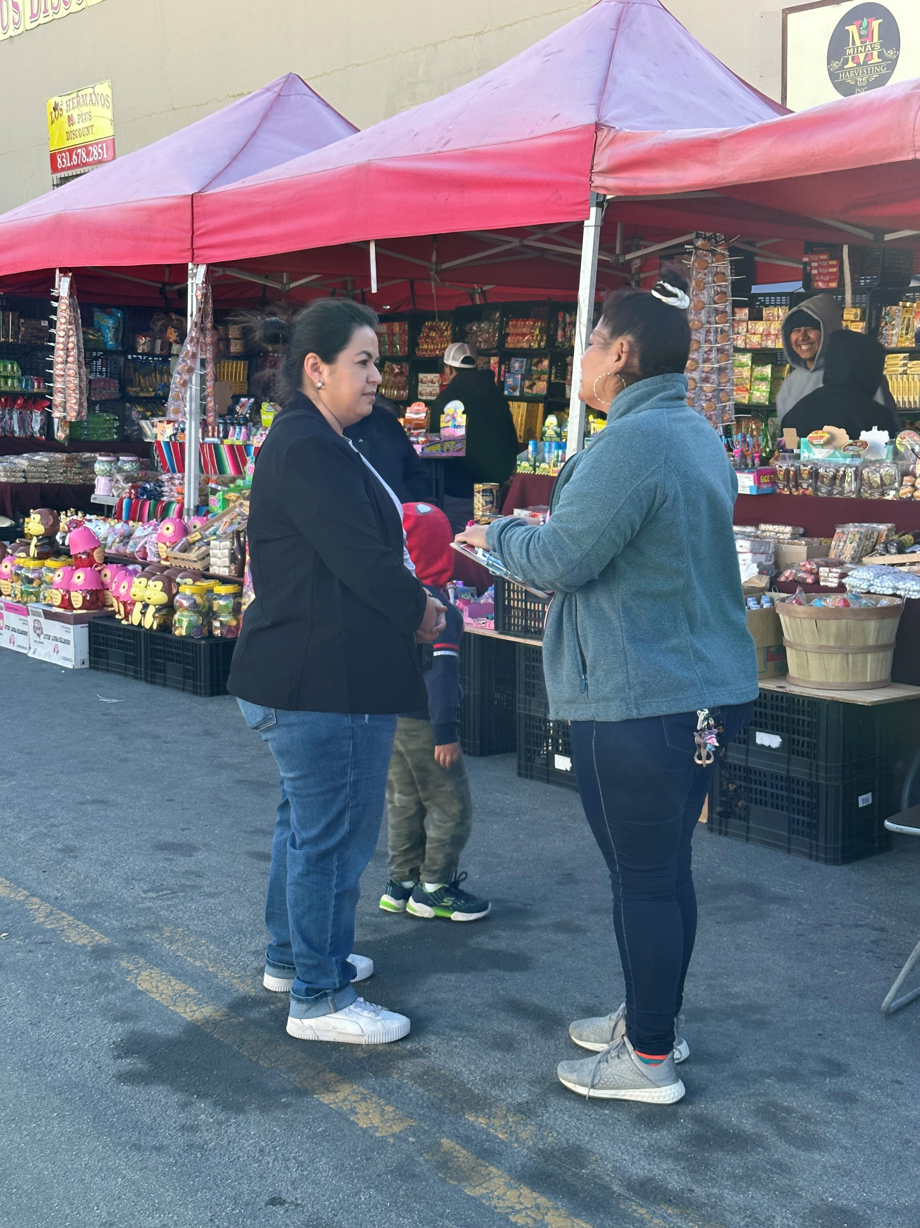
Notes:
Then the teams really went to work!

Slide 37
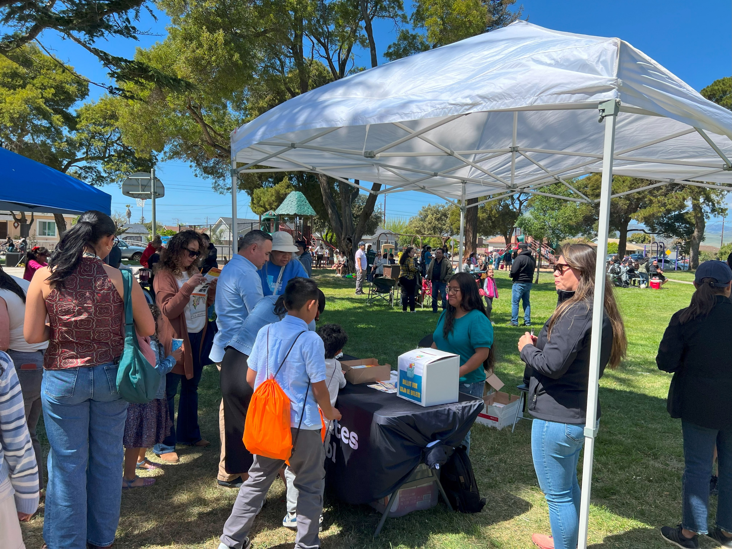

Slide 38
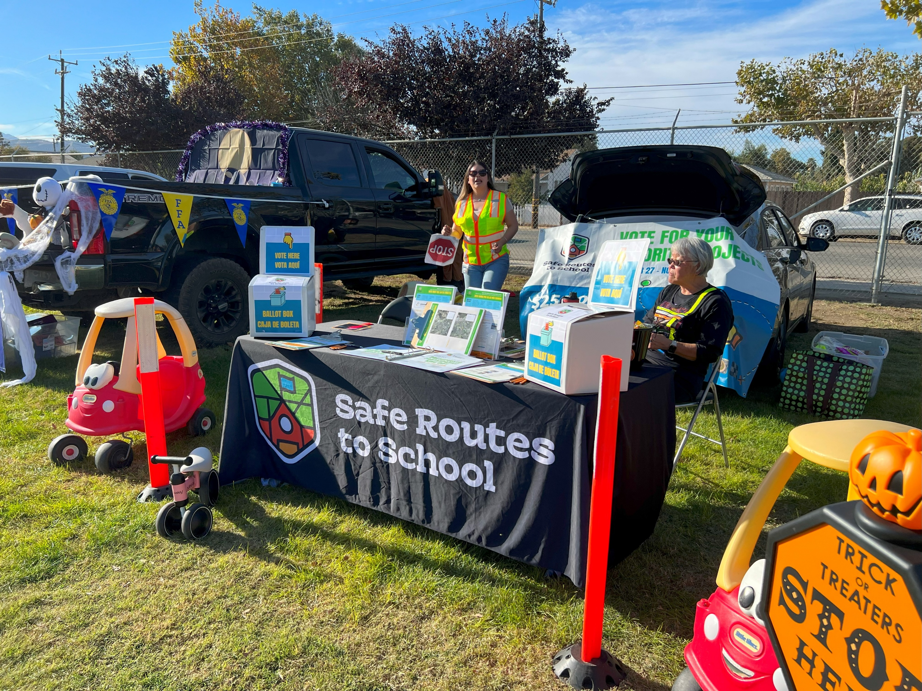
Notes:
Halloween Event in King City

Slide 39
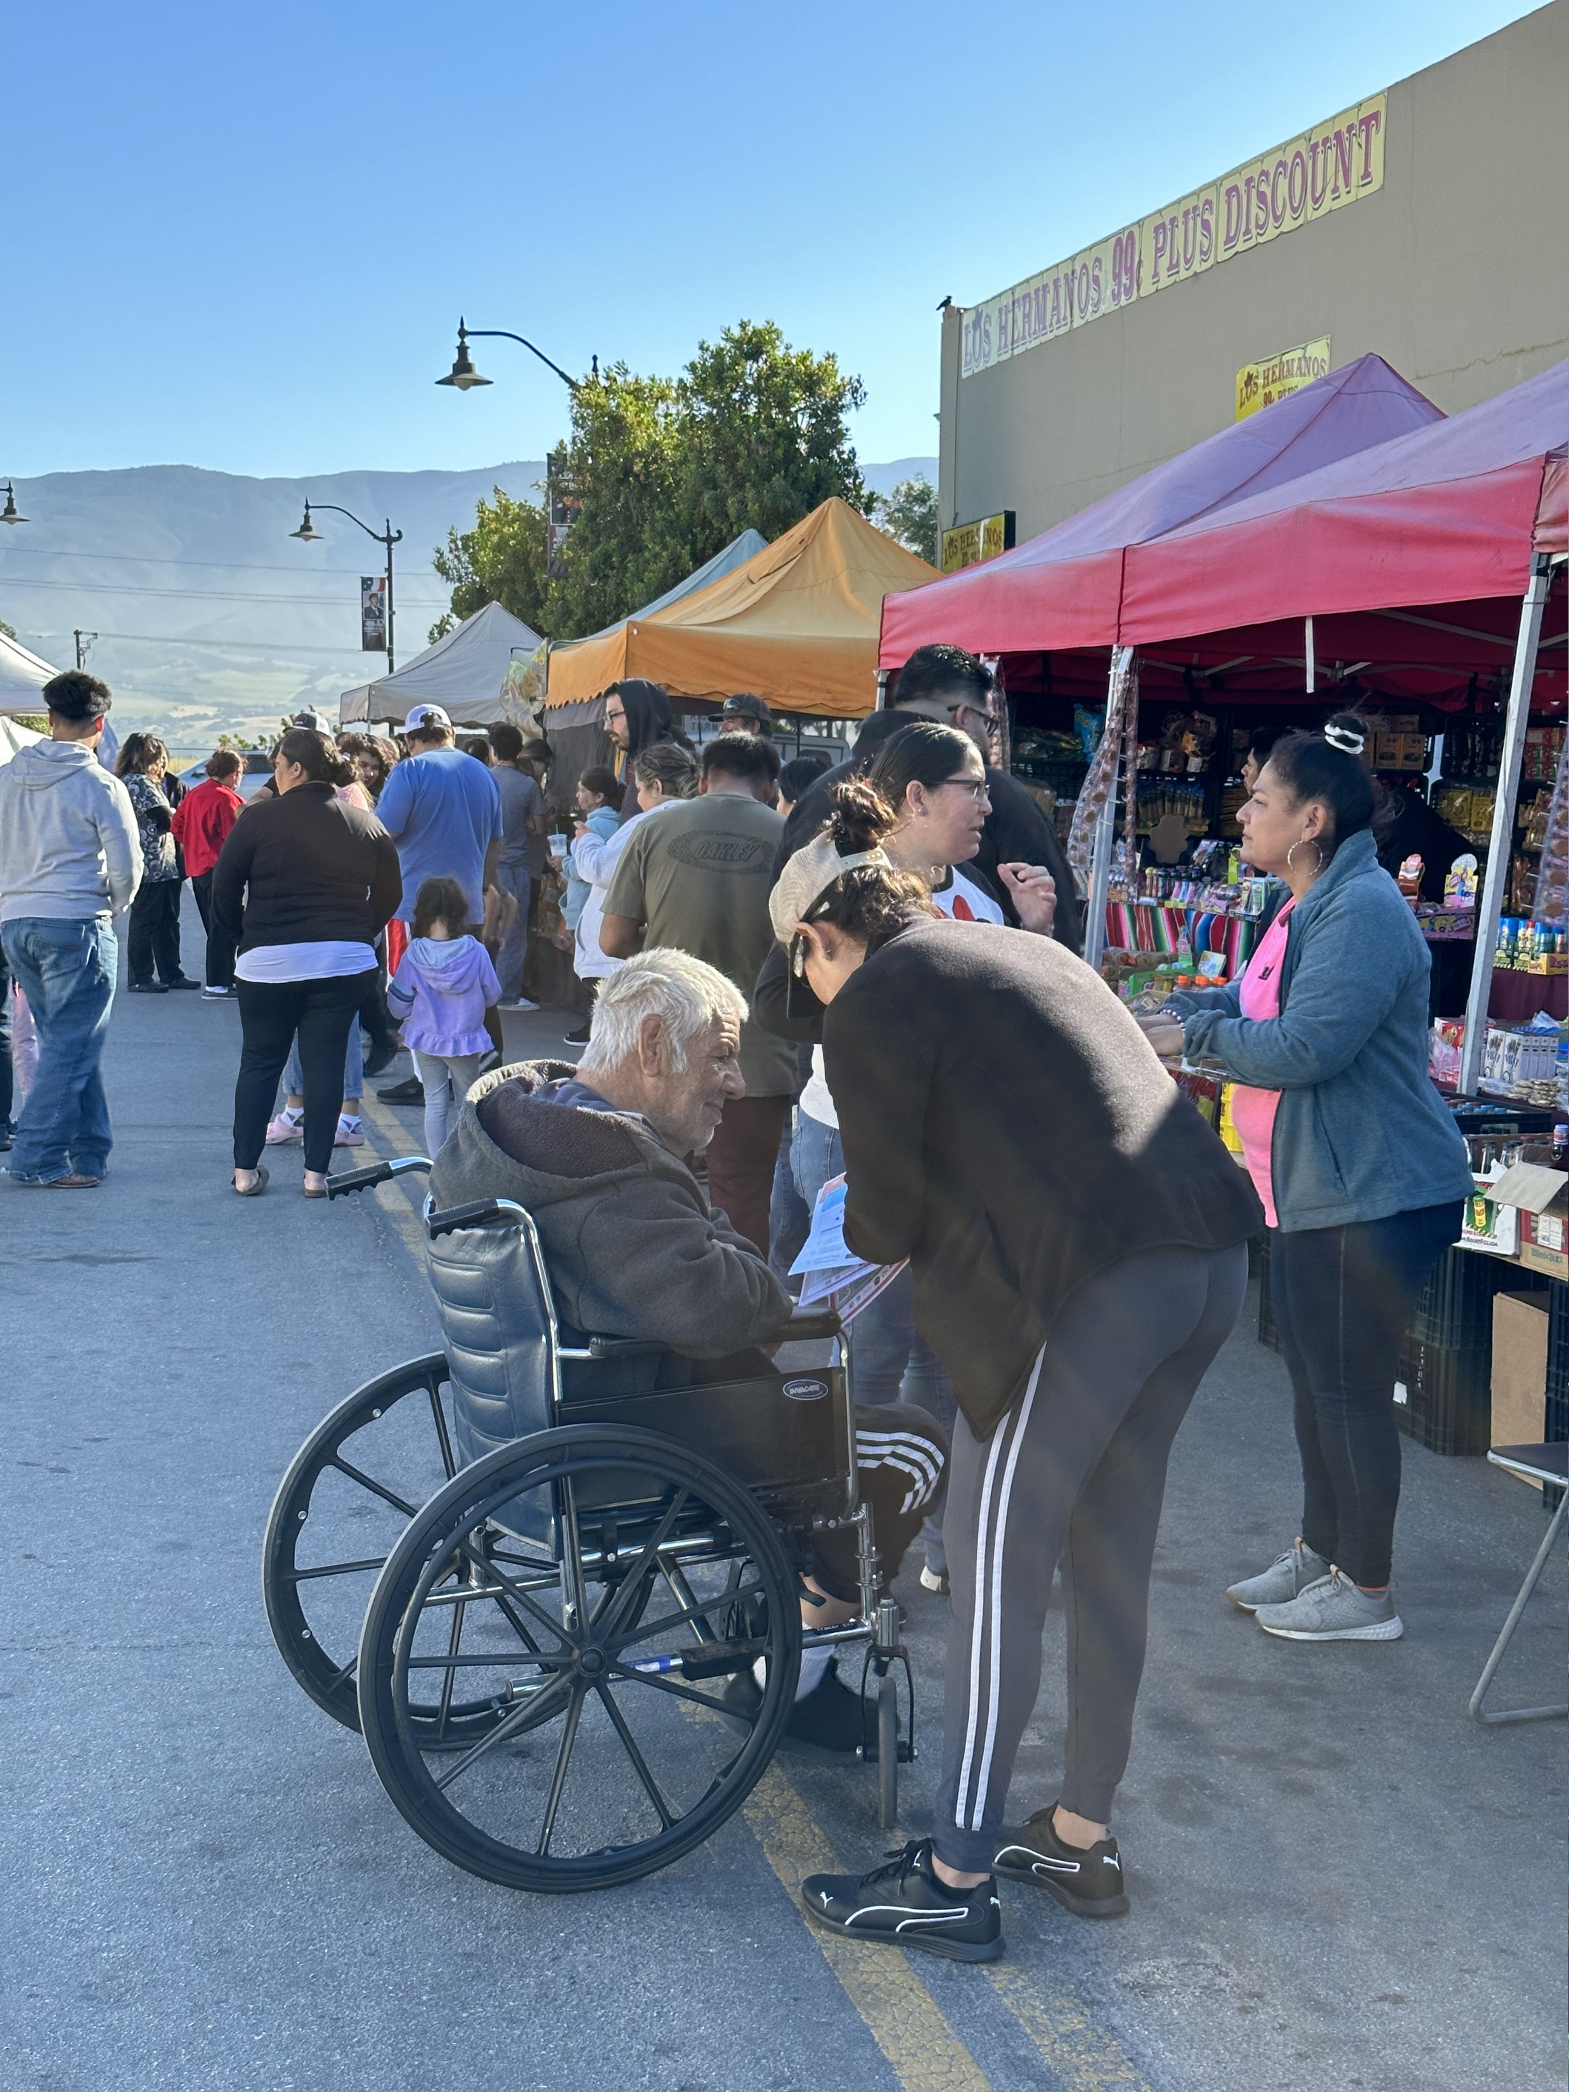
Farmers Market
Notes:
Soledad Farmers Market

Slide 40
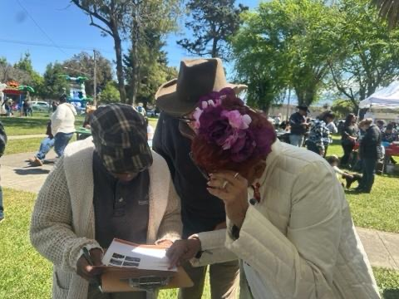
Notes:
Each committee had an election kickoff event where the public could learn more about projects and ask questions

Slide 41
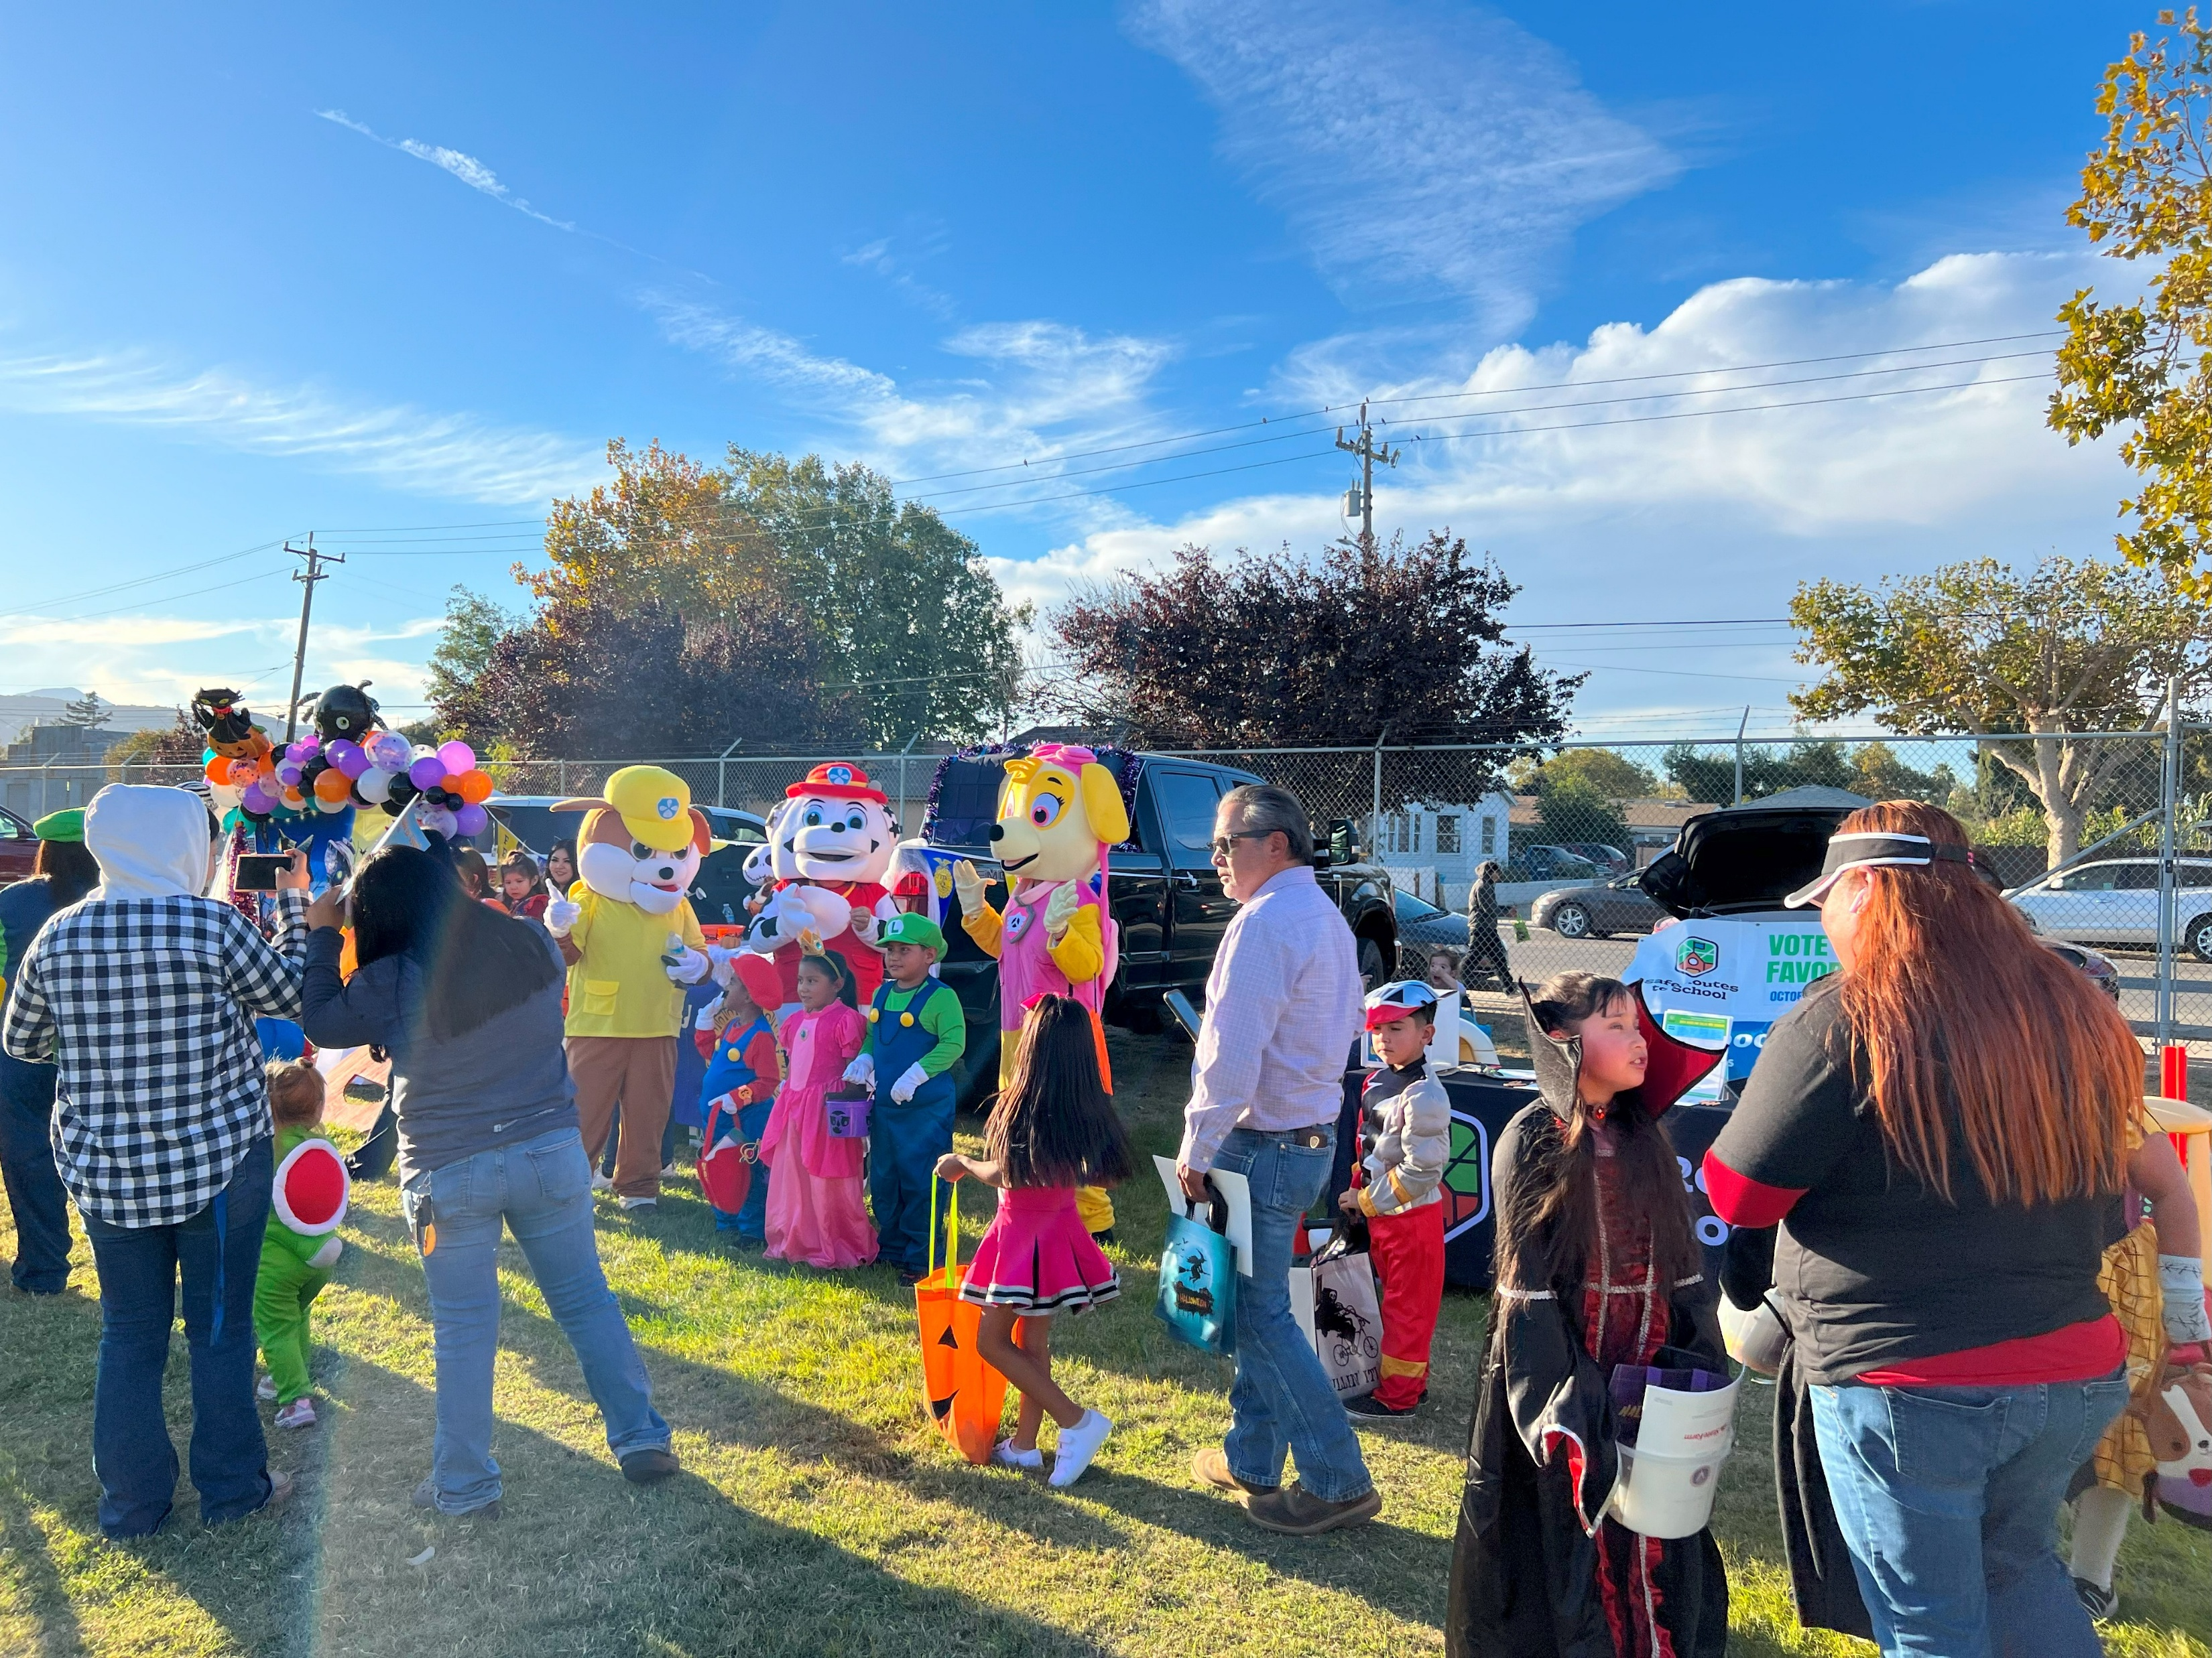

Slide 42
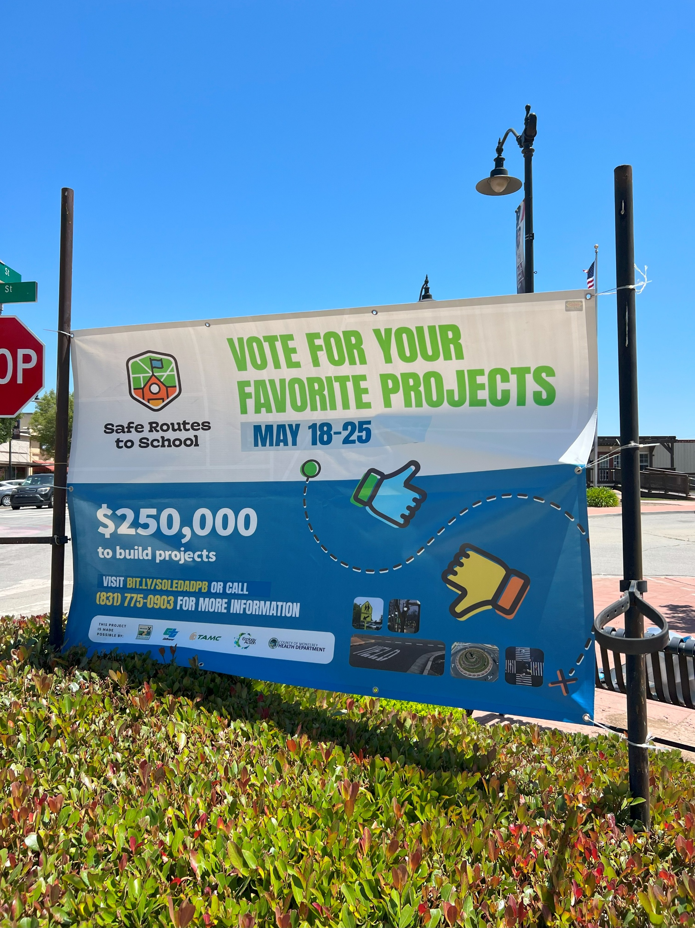
Banner on Front Street, Soledad
Notes:
Placing voting banners throughout the community
Voting periods range from 1-4 weeks.

Slide 43
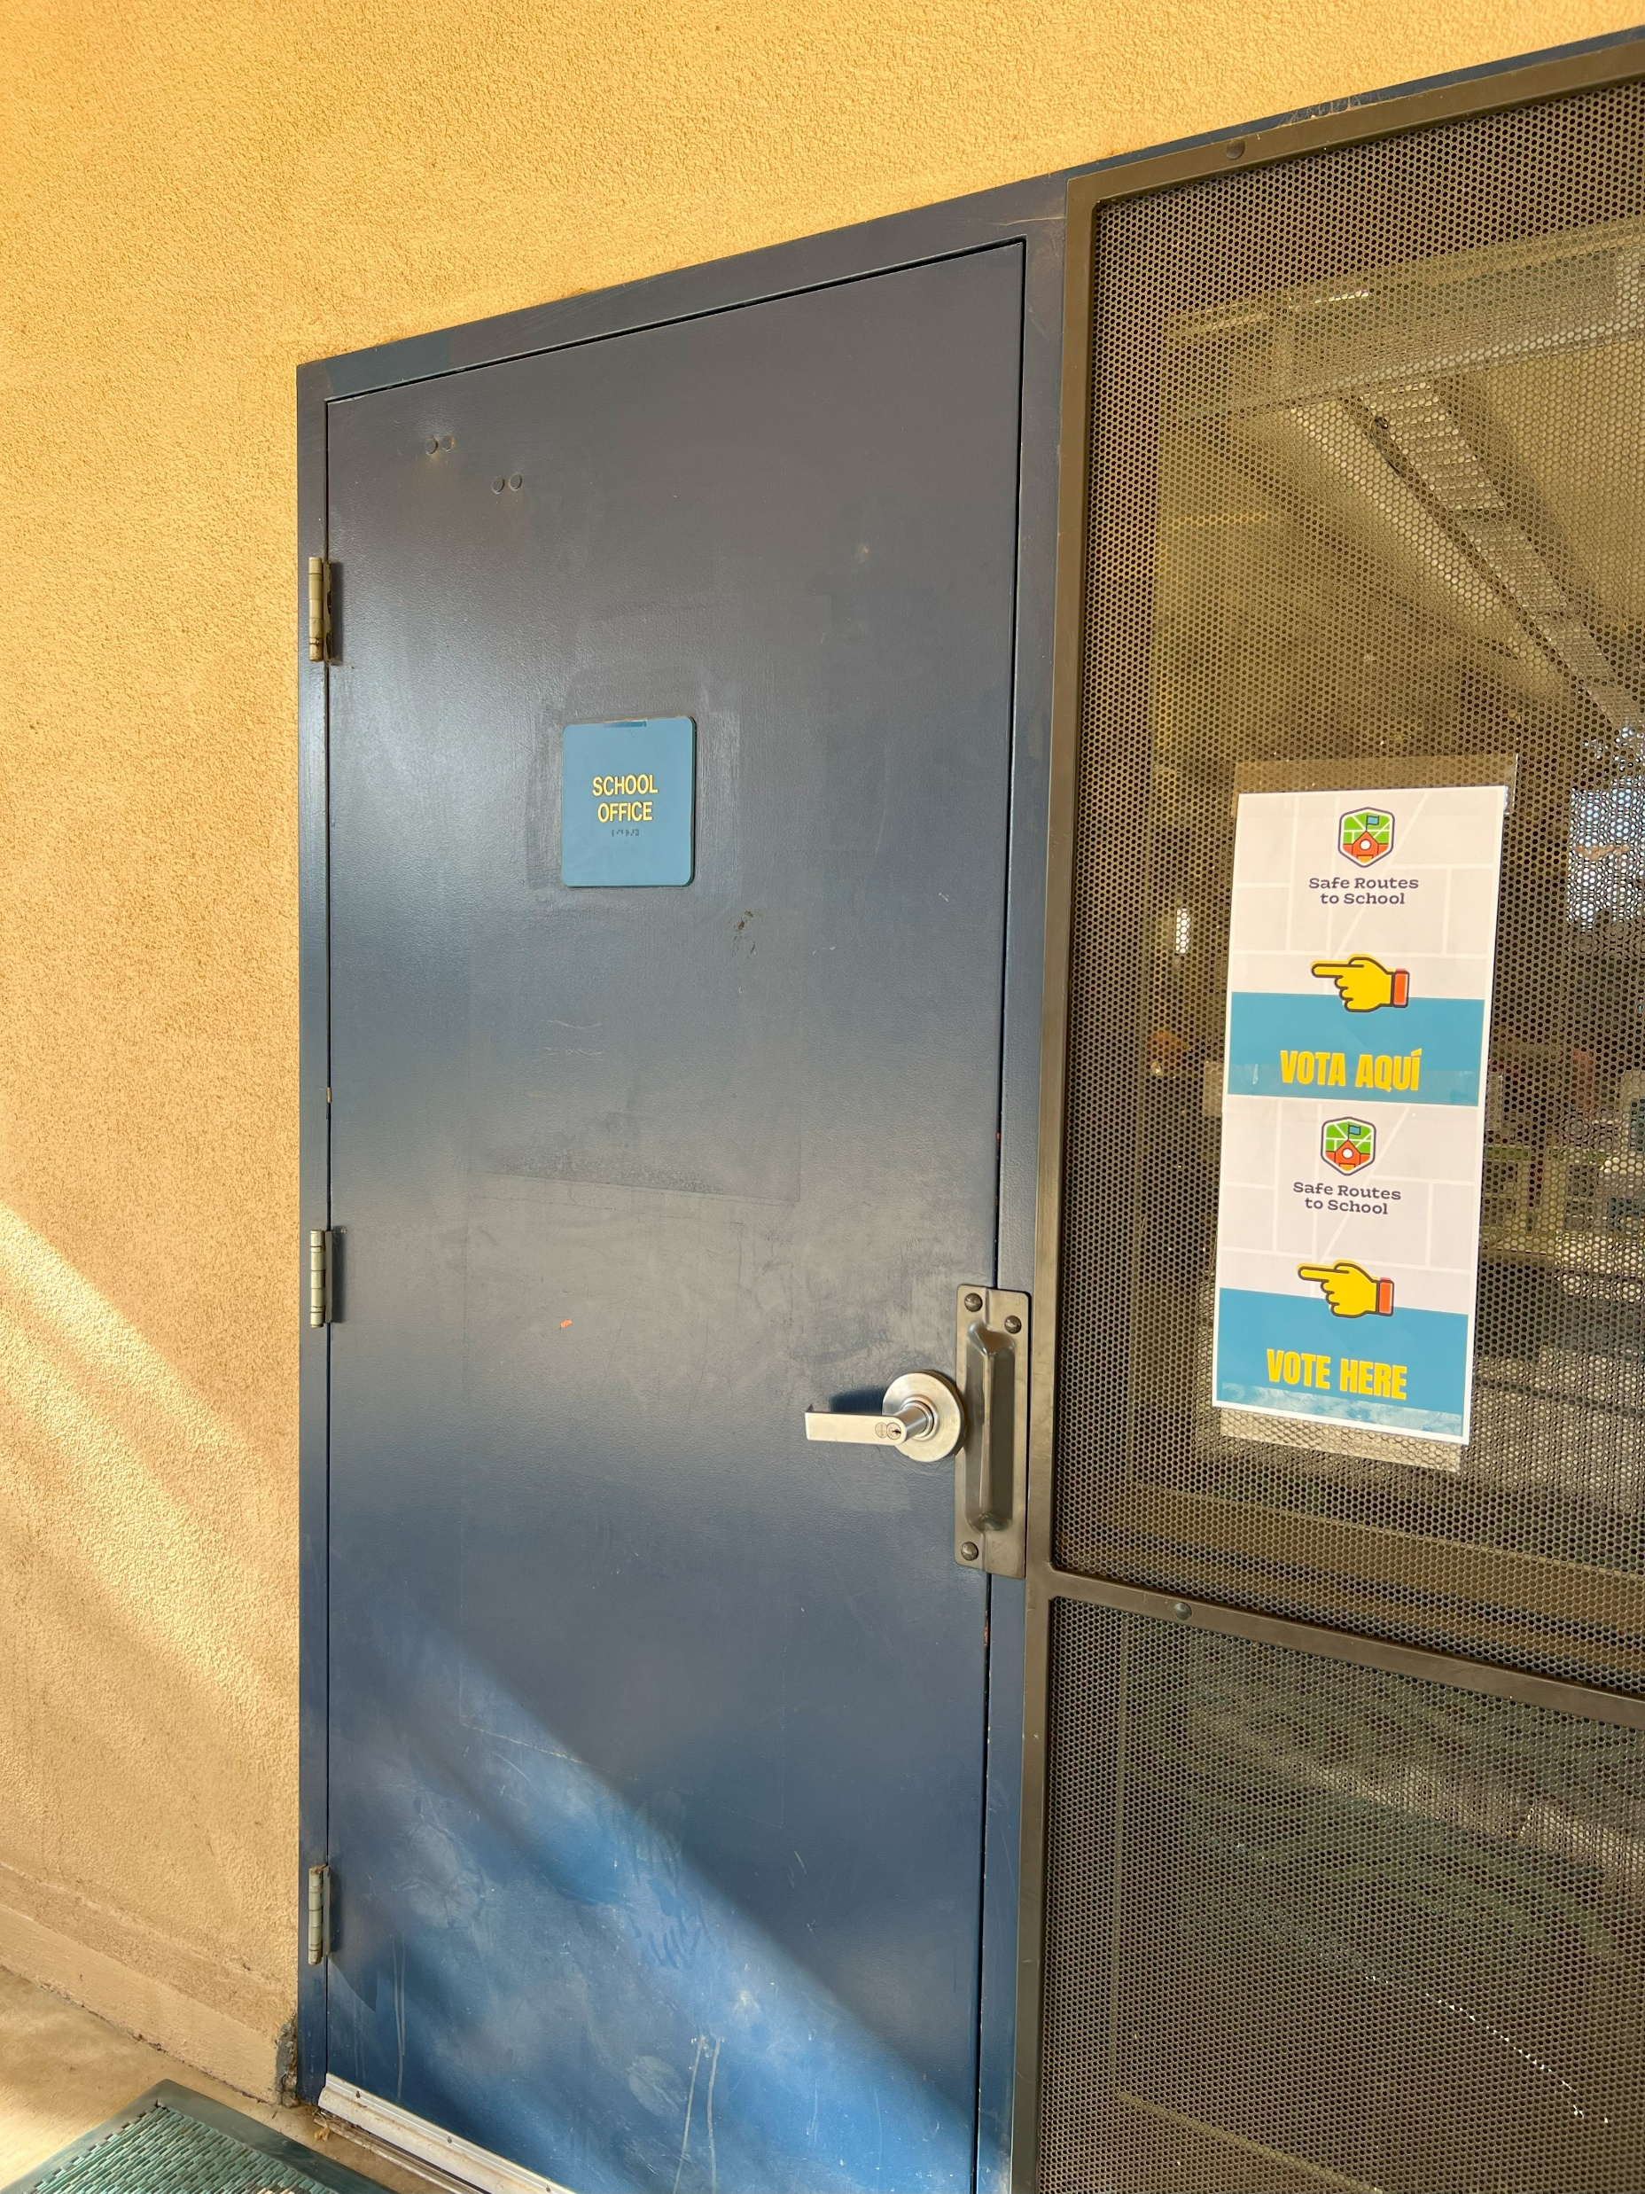
Notes:
Signage at voting locations throughout the community

Slide 44
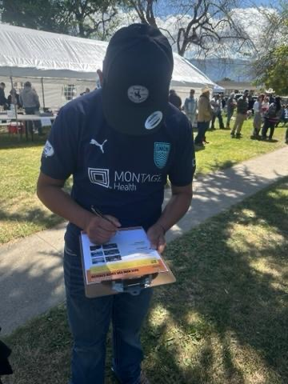
Community Vote
Notes:
Aside from the kick event, the committees tasked themselves to do even more to promote the election, such as flyer distribution at food banks, schools and churches, radio announcements, and tabling at other community events.

Slide 45
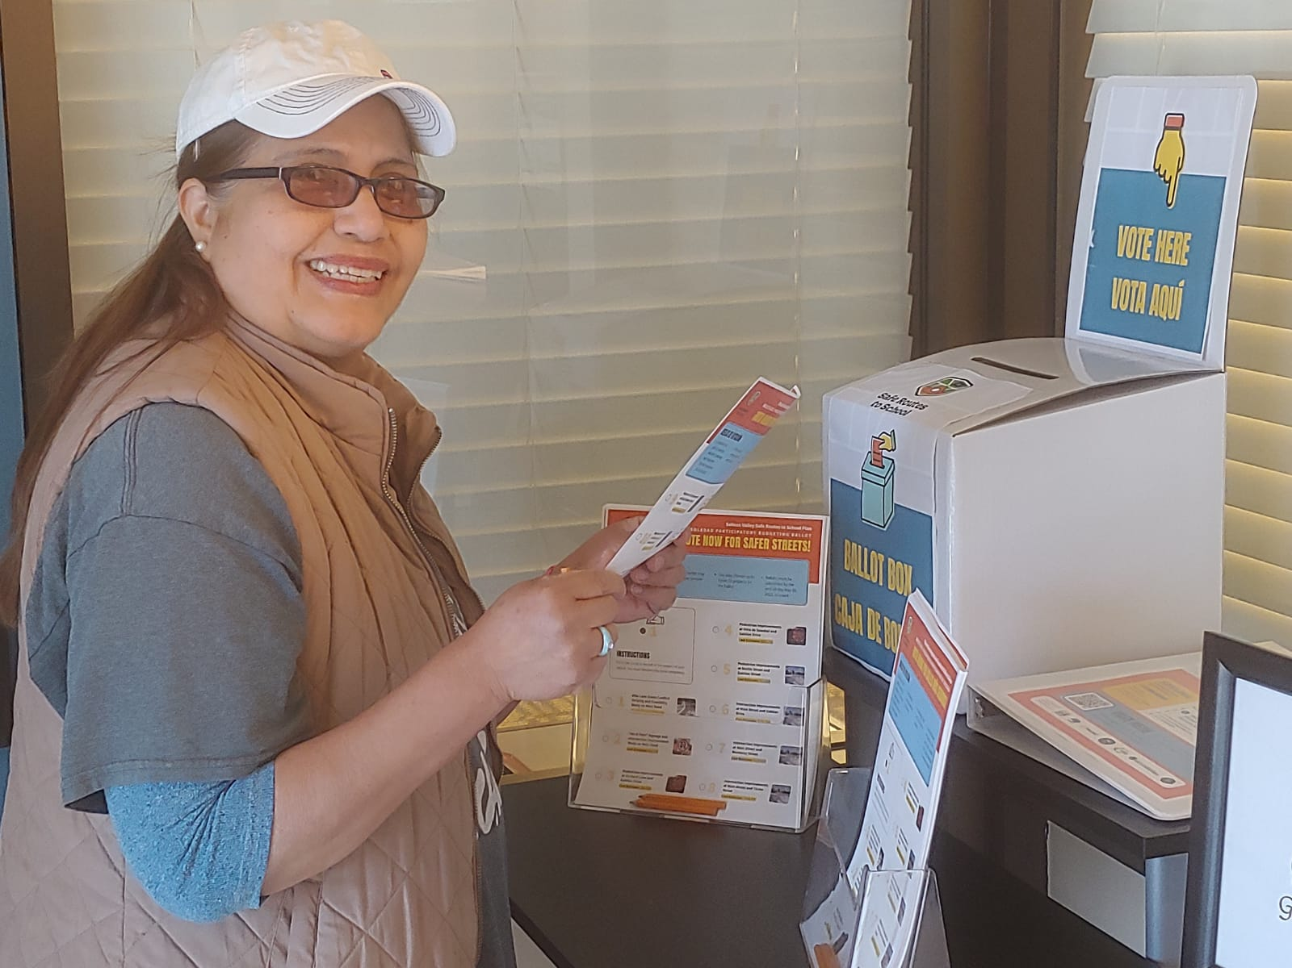
Votar
Vote
Notes:
- Once the projects were finalized for the ballot, staff gathered all materials necessary to prepare for the community election.
.

Slide 46
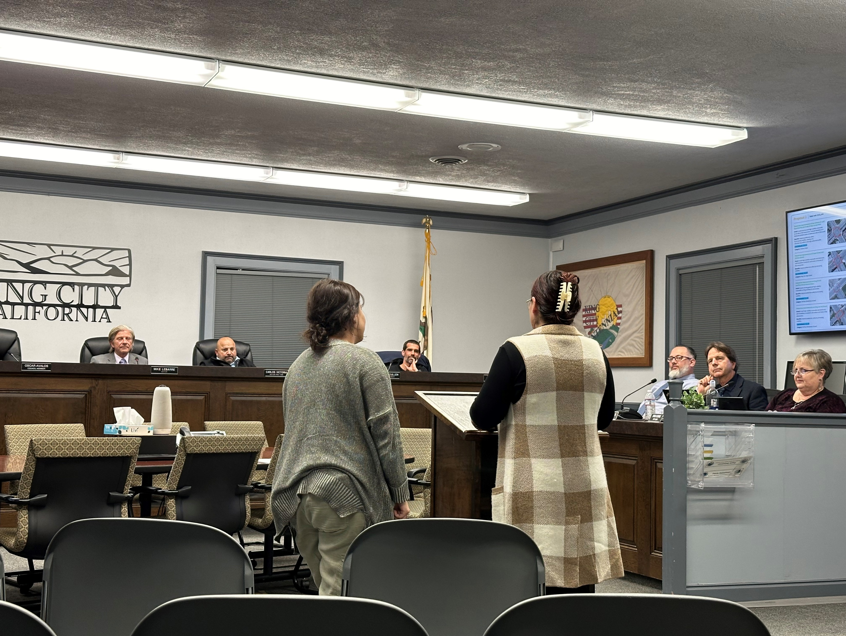
Proyectos ganadores del fondo
Fund Winning Projects
Notes:
After the election, the physical and electronic ballots are counted.
- The committees view the final results and formed a recommendation to present to their city council to approve the projects.

Slide 47
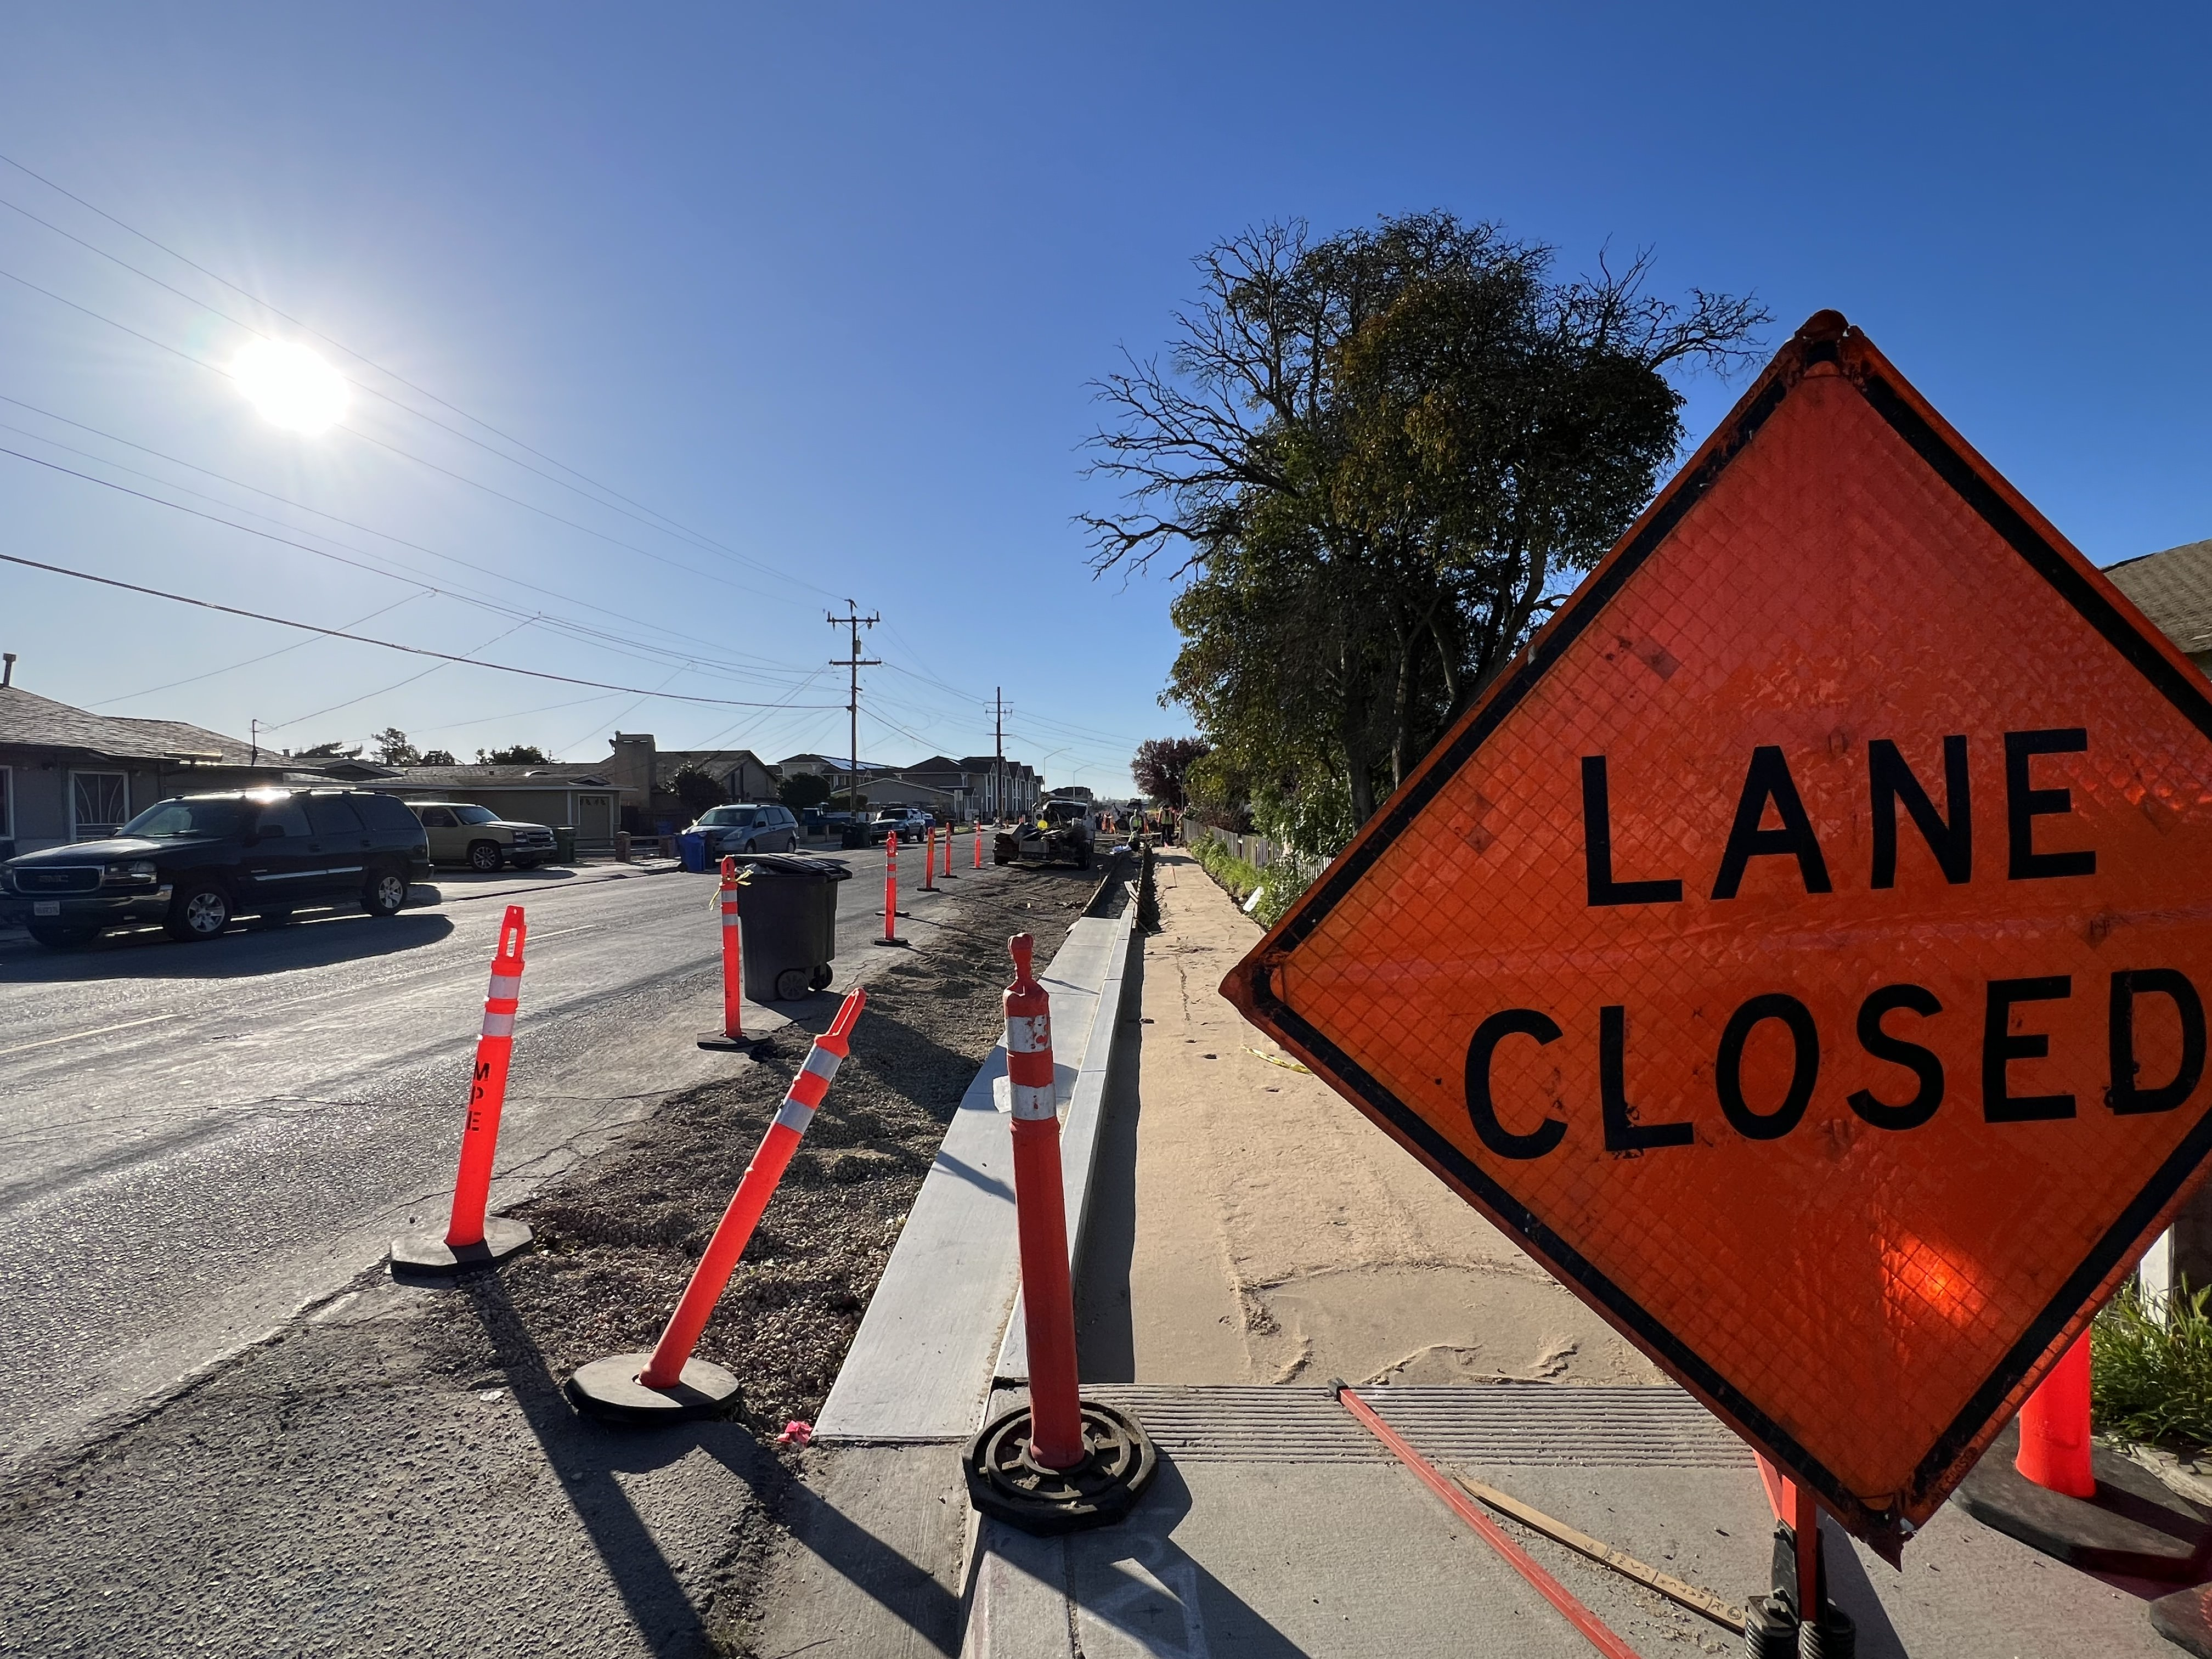
Proyectos ganadores del fondo
Fund Winning Projects
Notes:
Once the city approved the steering committee’s recommendation, the TAMC Board approved the $250,000, so that the city can start implementation of the projects.
Pictured here is the first PB project which was the top voted project in Greenfield is to build a sidewalk on the west side of 12th St that would connect Oak Elementary School and Vista Verde Middle School..

Slide 48
23rd Annual Transportation Excellence Awards
Award Honorees

Slide 49
23rd Annual Transportation Excellence Awards
Program Partners:
Ecology Action, Monterey County Health Department, Greenfield, Gonzales, King City and Soledad Steering Committees

Slide 50
23rd Annual Transportation Excellence Awards
Program Partners:
Ecology Action, Monterey County Health Department, Greenfield, Gonzales, King City and Soledad Steering Committees

Slide 51
23rd Annual Transportation Excellence Awards
Ecology Action

Slide 52
23rd Annual Transportation Excellence Awards
Monterey County Health Department

Slide 53
23rd Annual Transportation Excellence Awards
Greenfield
Steering Committee

Slide 54
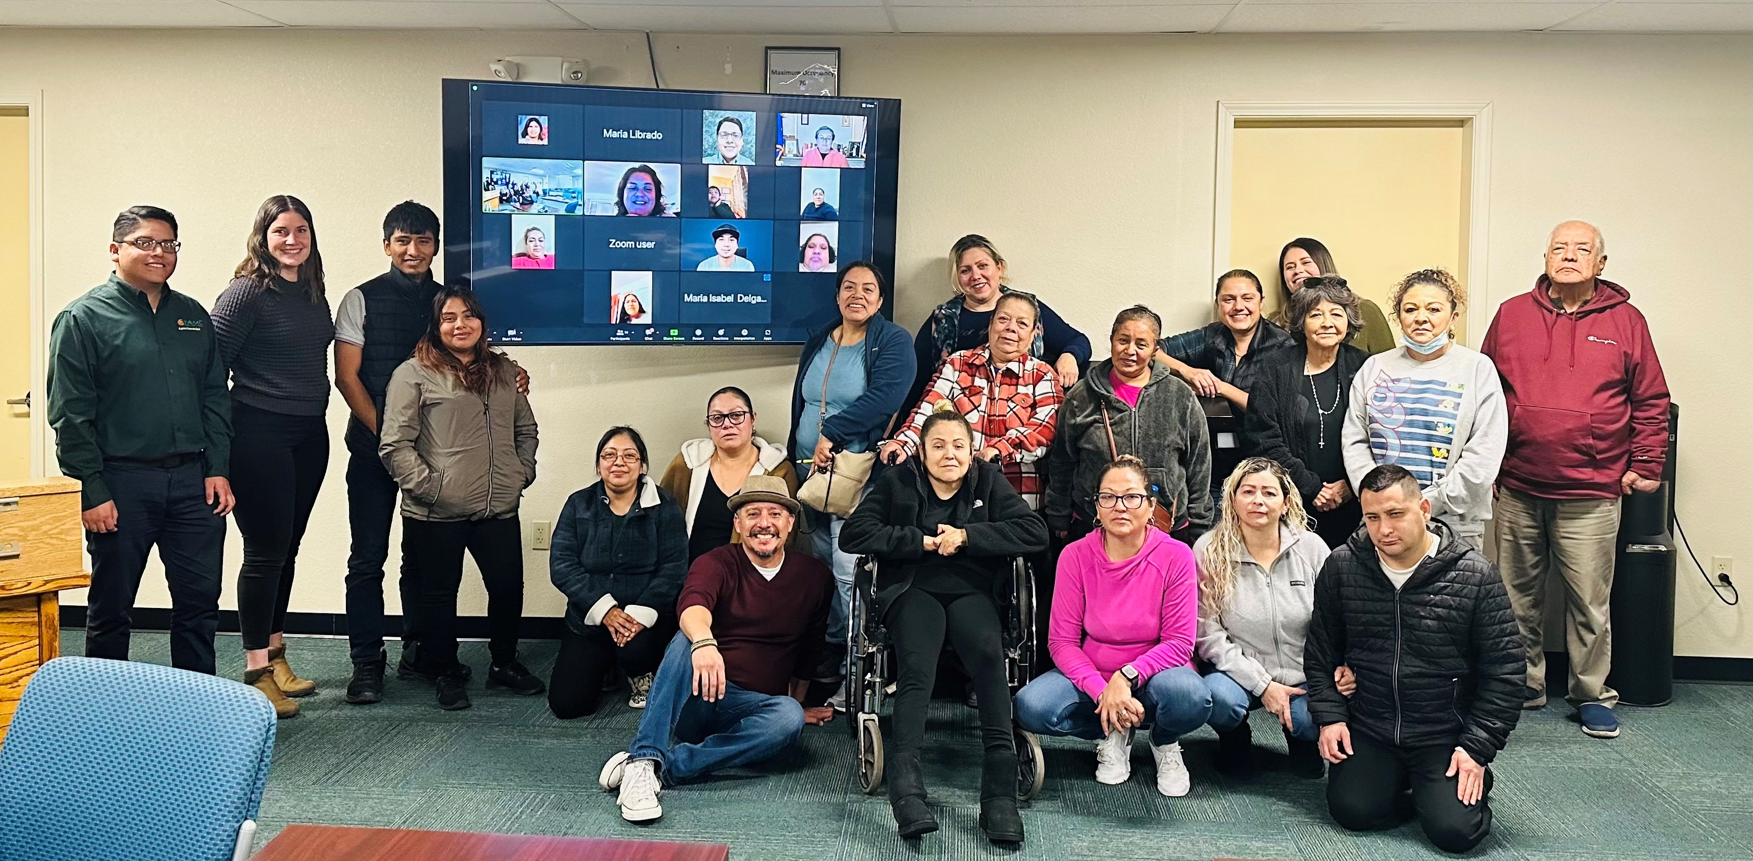
Greenfield Steering Committee
Notes:
Greenfield Steering Committee

Slide 55
23rd Annual Transportation Excellence Awards
Gonzales
Steering Committee

Slide 56
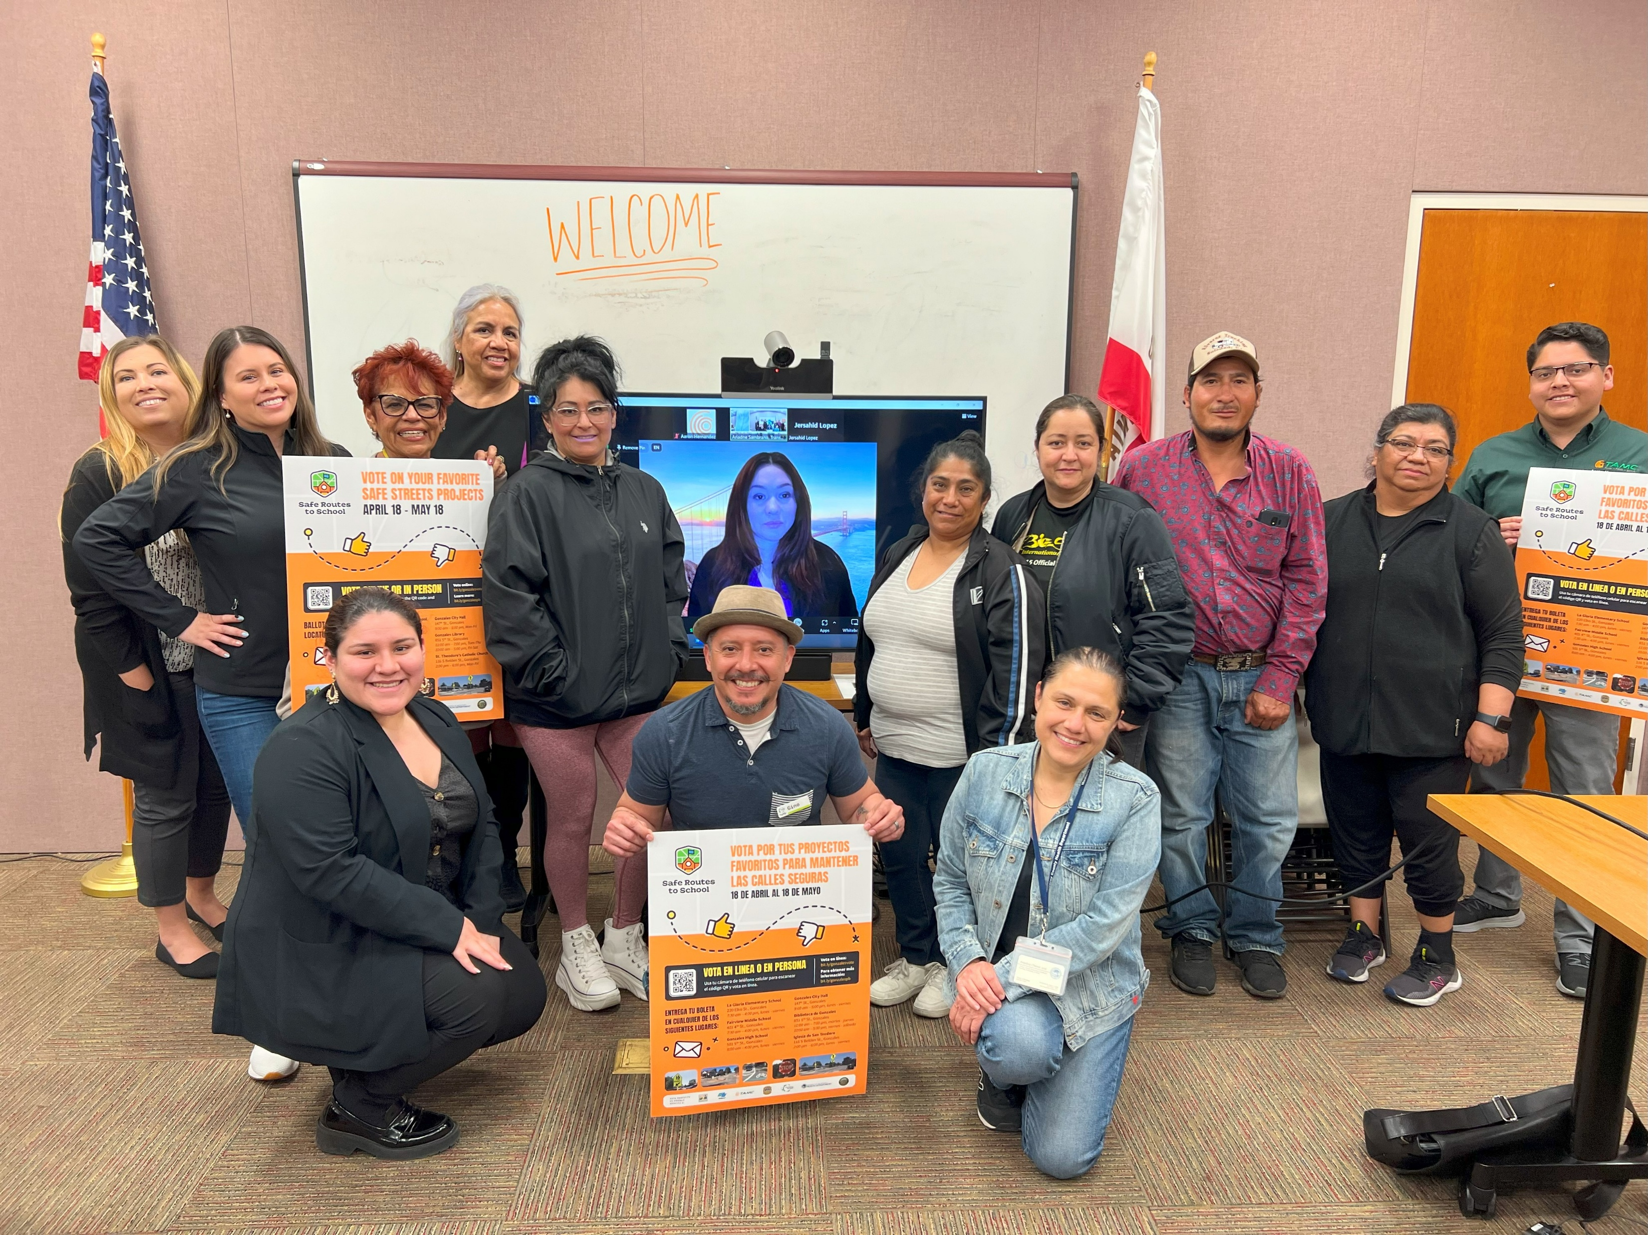
Notes:
Gonzales Steering Committee

Slide 57
23rd Annual Transportation Excellence Awards
King City
Steering Committee

Slide 58
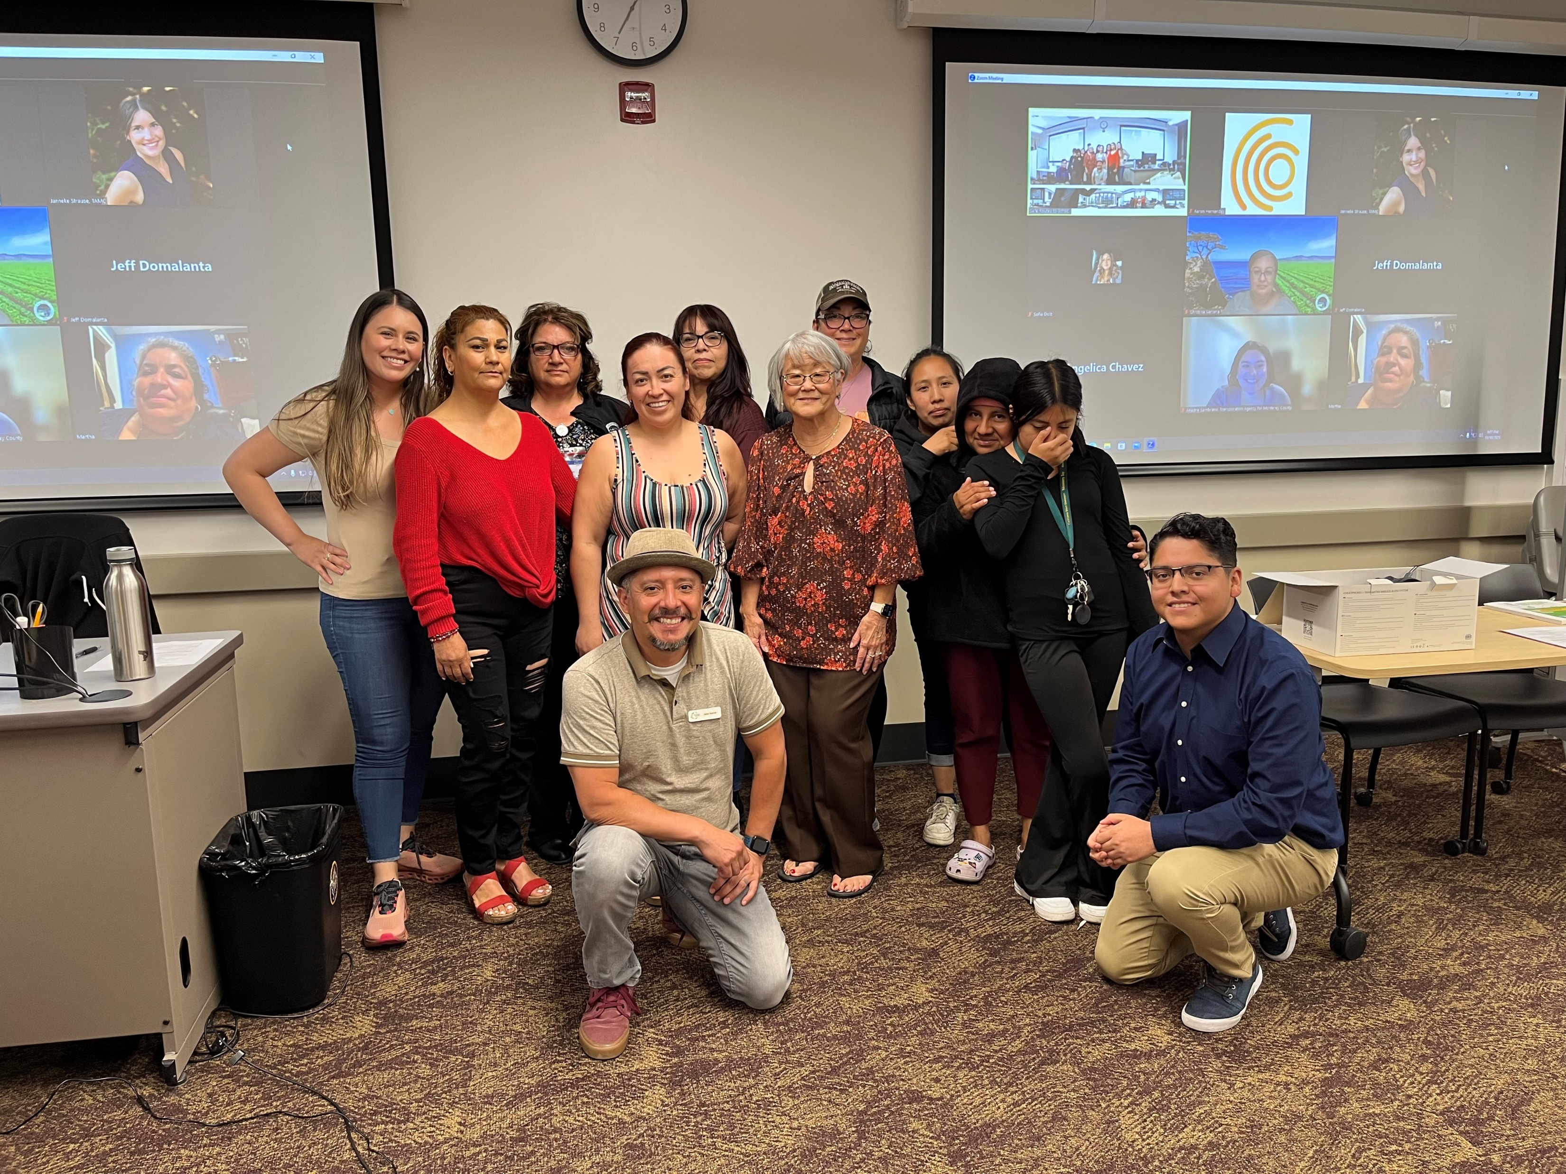
King City Steering Committee
Notes:
King City Steering Committee

Slide 59
23rd Annual Transportation Excellence Awards
Soledad
Steering Committee

Slide 60
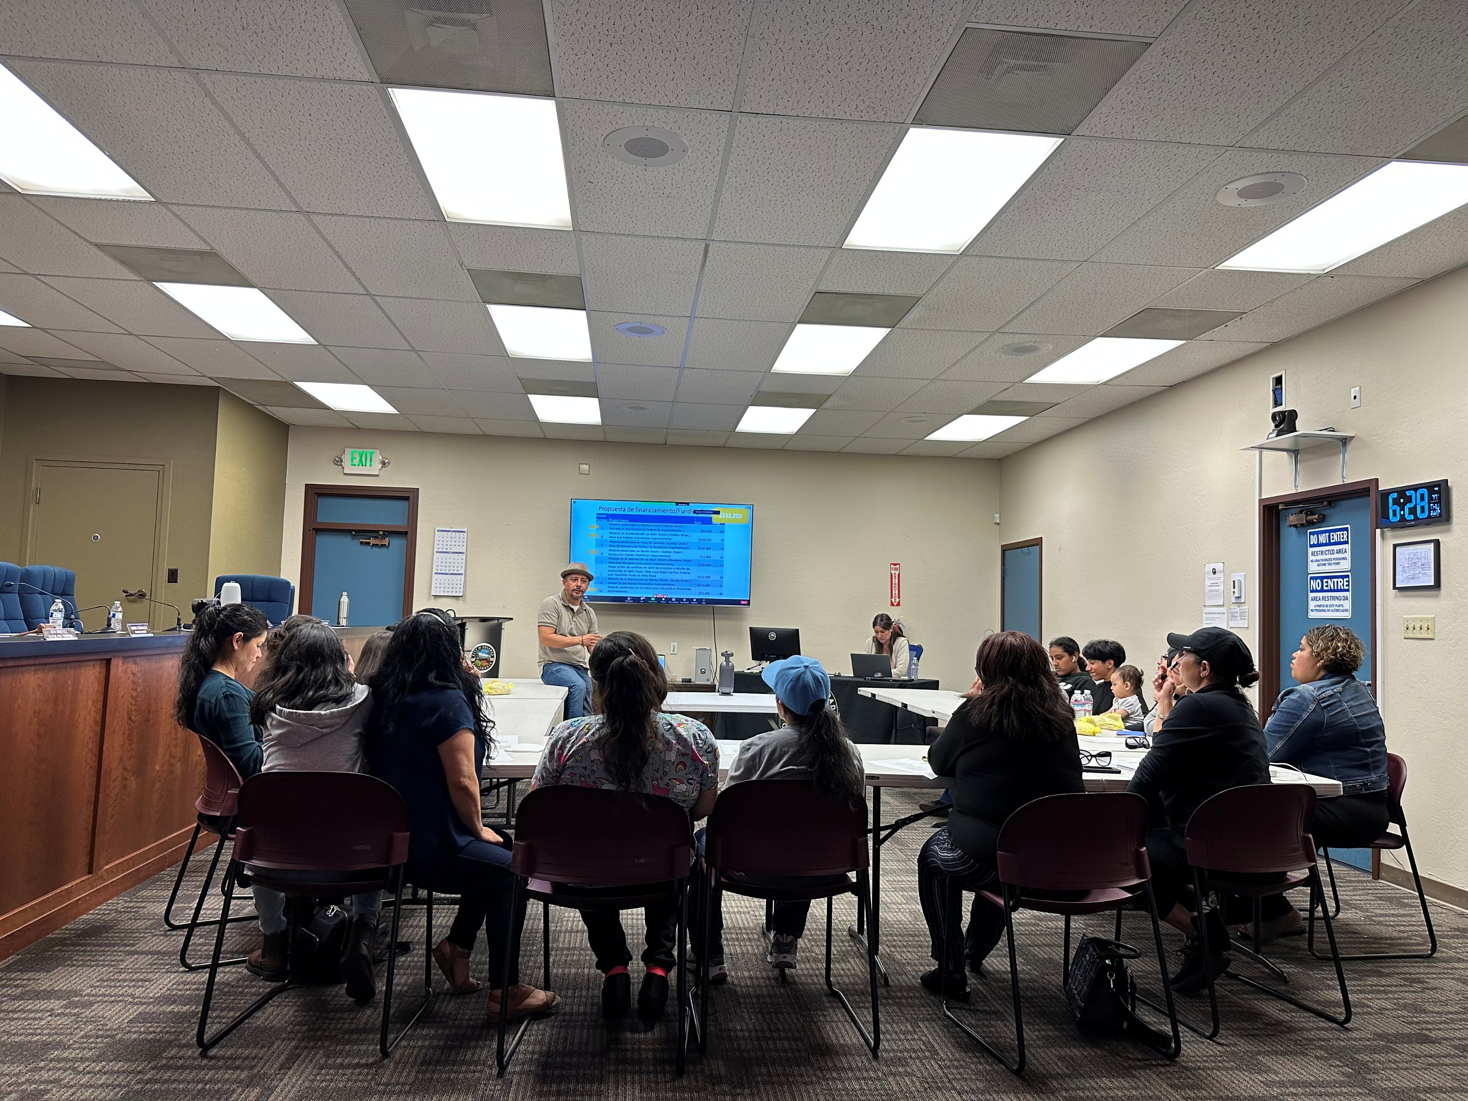
Soledad Steering Committee
Notes:
Soledad Steering Committee

Slide 61
Congratulations to:
Ecology Action, Monterey County Health Department, Greenfield, Gonzales, King City and Soledad Steering Committees
2024 Transportation Excellence Awards Honorees !

Slide 62
23rd Annual Transportation Excellence Awards
Monterey-Salinas Transit
“Commute with Enterprise Vanpool Program”

Slide 63
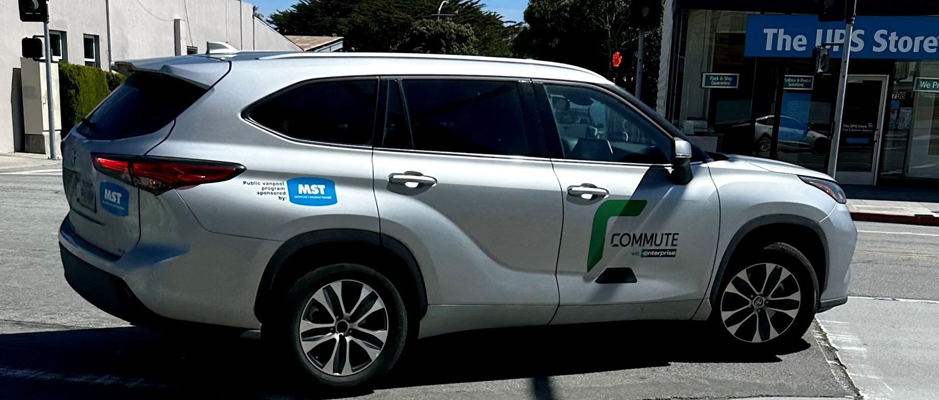
Commute with Enterprise Vanpool Program
Notes:
The Commute with Enterprise Vanpool Program is a partnership between Monterey -Salinas Transit and Enterprise to increase transportation options for commuters in Monterey County.
Launched in 2022 with the goal of offering a better alternative to traditional commuting where fixed-route bus service isn’t the best option, or an option at all, there are currently 32 active vanpools operating, with over 240 participants.
Vanpool participants are made up of commuters from both public and private sectors.

Slide 64
Cost Savings Benefits
MST offers a $500/month/vehicle subsidy to offset the cost for vanpool participants.

Slide 65
Cost Savings Benefits
The monthly cost includes:
  A recent model van, SUV or crossover
  Comprehensive maintenance program
  24/7 roadside assistance
  Insurance & physical damage protection

Slide 66
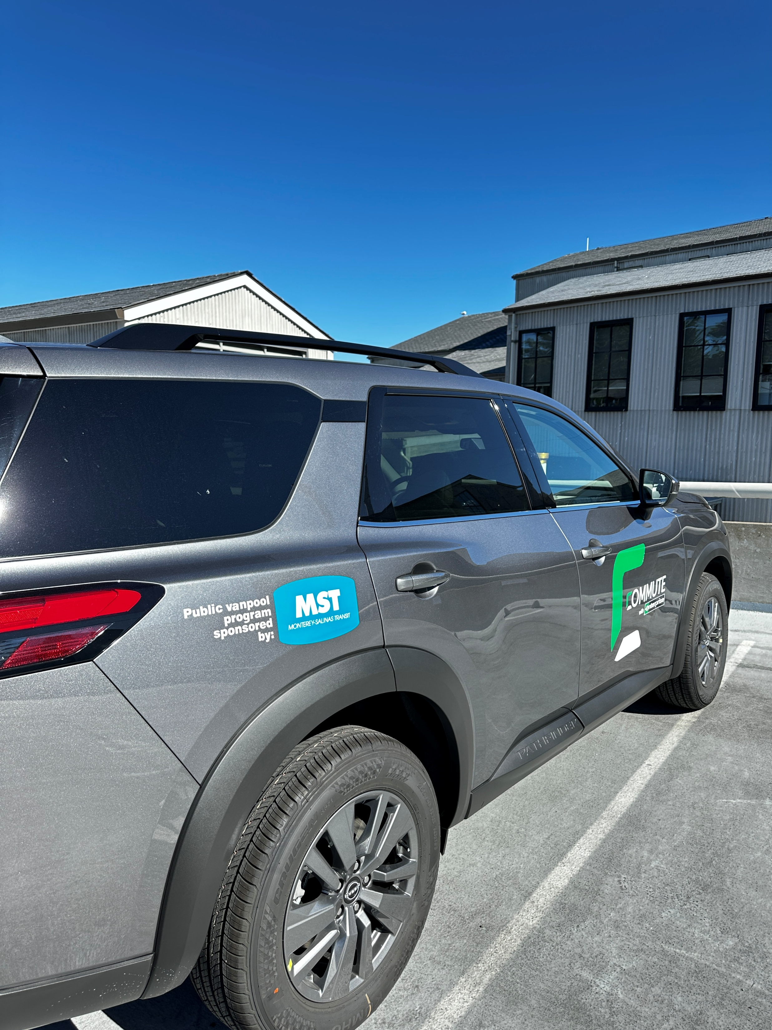
Environmental & Traffic Reduction Benefits
545,320 tons of CO2 emissions have been reduced in the last year alone.
Over 108,000 trips in a single occupancy vehicle travelling have been removed from already congested roadways.
Notes:
Environmental Benefits: 545,320 tons of CO2 emissions have been reduced in the last year alone. This is equivalent to carbon sequestered by 248 acres of U.S. forests in one year.
Traffic Reduction: Over 108,000 trips in a single occupancy vehicle travelling over 858,000 miles have been removed from already congested roadways.

Slide 67
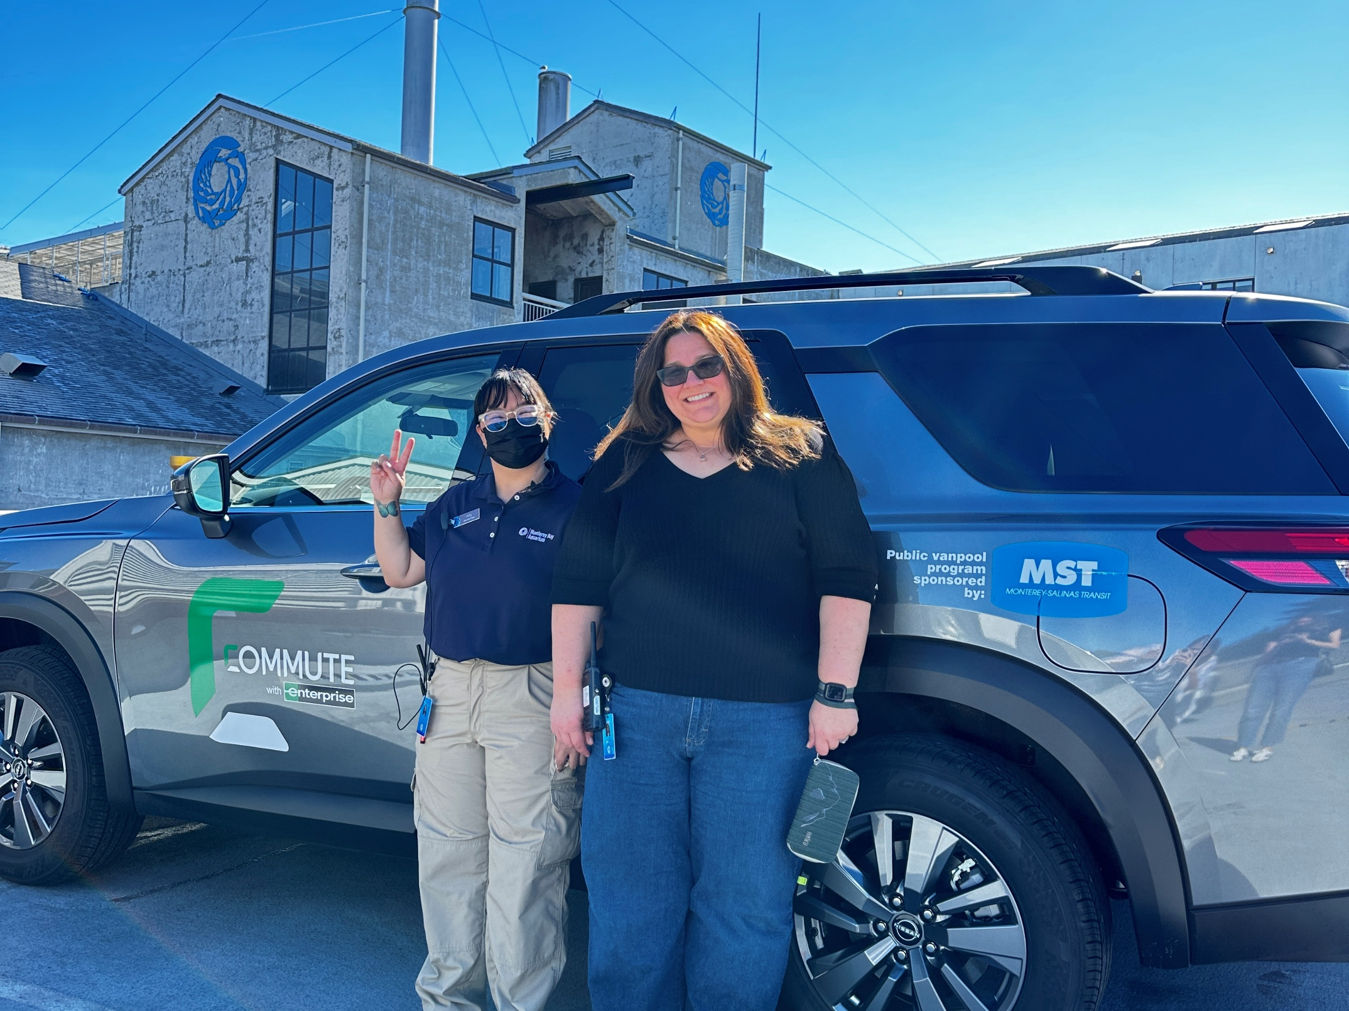
The Happiness Factor
The Happiness Factor
Notes:
Participants enjoy a relaxing commute to their destination, and can work, read, connect with their fellow commuters, or catch up on some sleep! Taking turns driving or leaving the driving to the person who enjoys it is a win for everyone.

Slide 68
Congratulations to:
Commute with Enterprise Vanpool Program
2024 Transportation Excellence
Awards Honoree !
Notes:
Monterey Salinas Transit, Enterprise

Slide 69
23rd Annual Transportation Excellence Awards
TAMC Employee Recognition
Notes:
At this time, I will turn this over now, to our Executive Director, Todd Muck to finish out the rest of the ceremony.

Slide 70

TAMC Employee
Certificates of Appreciation
10 Years of Service

Slide 71
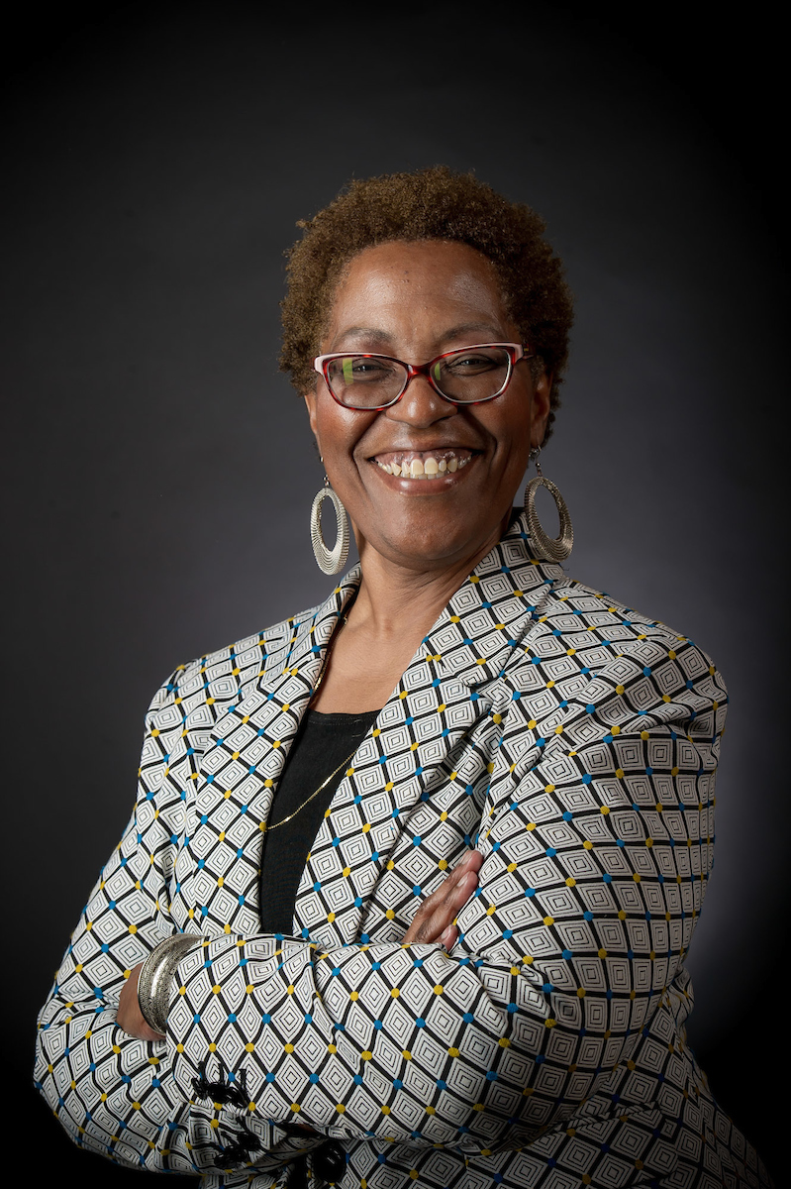
Theresa Wright
Community
Outreach
Coordinator

Slide 72
23rd Annual Transportation Excellence Awards
Outgoing TAMC
Board Chair

Slide 73
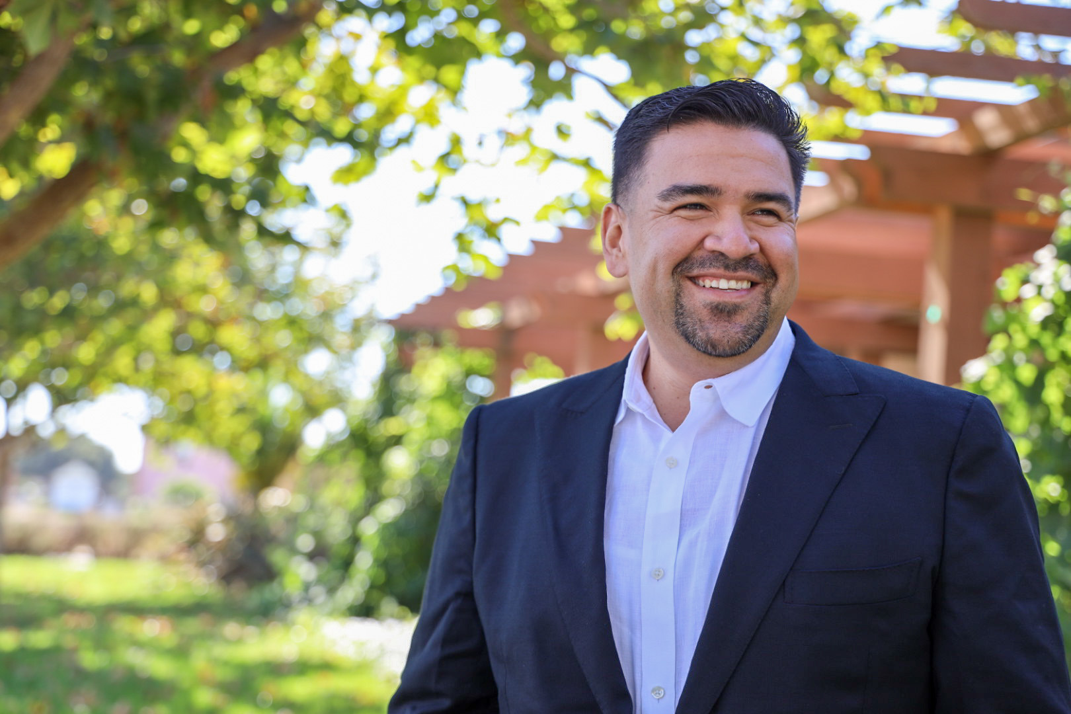
Chris Lopez
Supervisor, District 3
Supervisor, District 3
Chris Lopez

Slide 74
Congratulations to all!
2024 Transportation Excellence Awards
Notes:
As we close, congratulations to all of the recipients. We look forward to celebrating the 22nd Anniversary of this award ceremony next year and invite you to join us!

Slide 75
24th Anniversary
Transportation Excellence Awards
Board of Directors Meeting January 21, 2026
Notes:
Plug the 23rd and encourage everyone to think about projects or programs that they are working on this year that could be showcased in the 23rd awards presentation.

