Slide 1


Scenic Route 68 Corridor Improvement Project
TAMC TAC
January 11, 2024

Slide 2
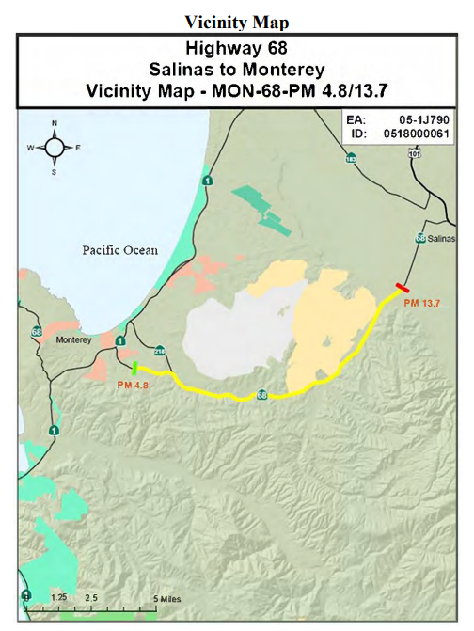
Project Study Area
Scenic Route 68 Corridor Improvement Project

Slide 3
Project Objectives
Address safety concerns
Improve traffic flow
Connect wildlife
Scenic Route 68 Corridor Improvement Project

Slide 4
Scenic Route 68 Corridor Improvement Project

Slide 5
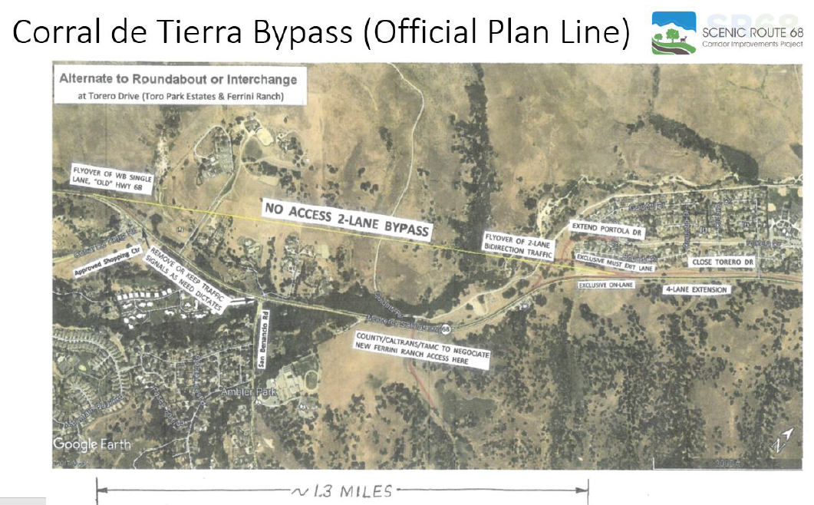
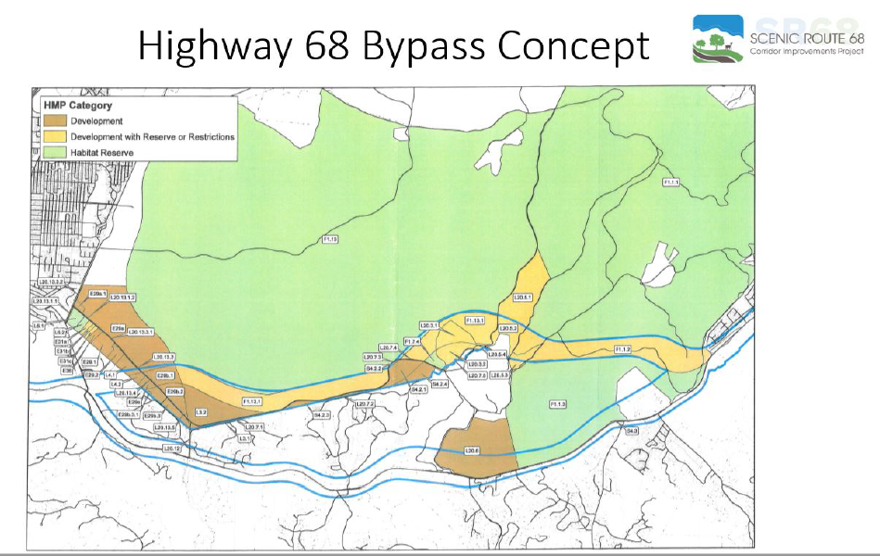
Alternatives Not Considered
Scenic Route 68 Corridor Improvement Project

Slide 6
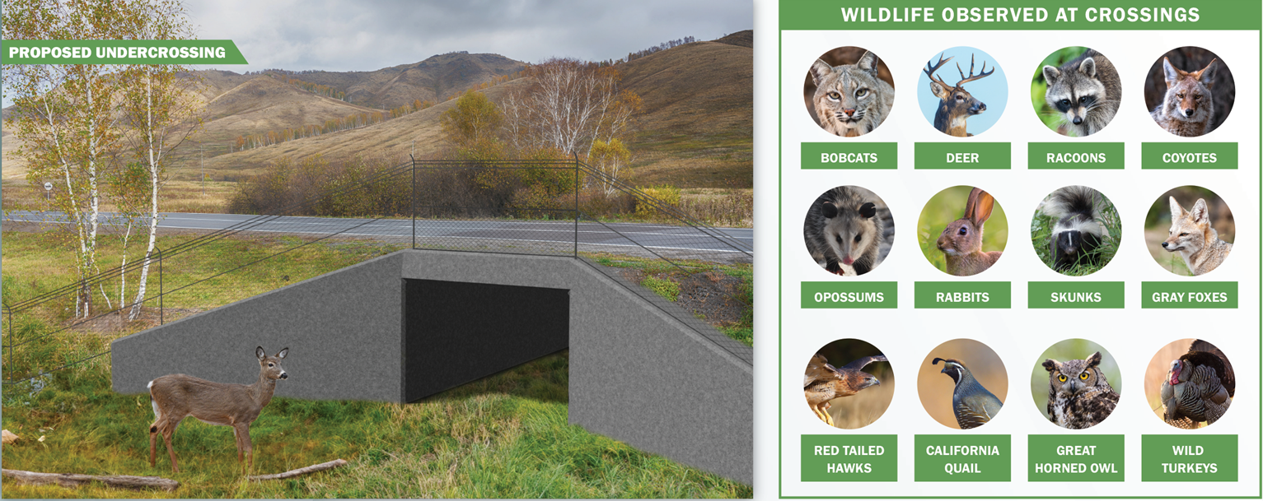
Wildlife Crossings:
Scenic Route 68 Corridor Improvement Project

Slide 7
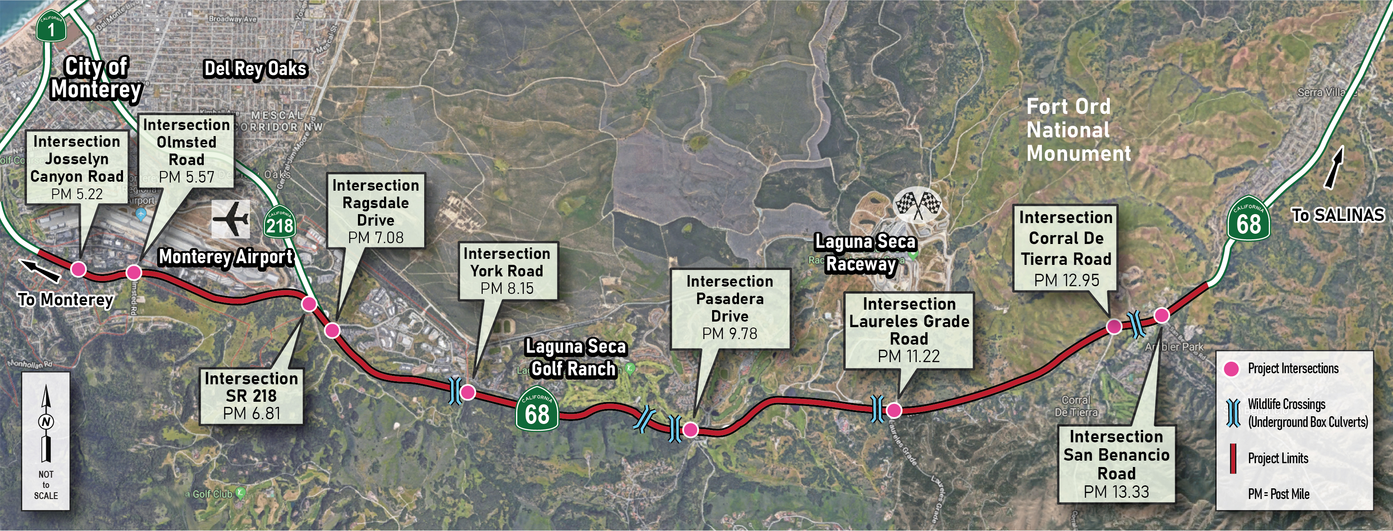
Wildlife Crossings: 5 new, 3 upgrades
Scenic Route 68 Corridor Improvement Project

Slide 8
Two Alternatives to Address Traffic Issues
Alternative 1: Roundabouts
Alternative 2: Signal Modifications (intersection widening)
Scenic Route 68 Corridor Improvement Project

Slide 9
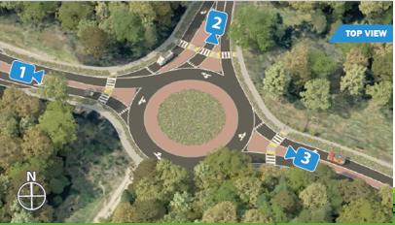
Scenic Route 68 Corridor Improvement Project

Slide 10
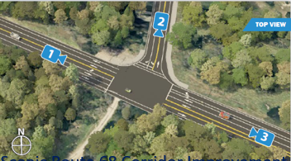
Scenic Route 68 Corridor Improvement Project

Slide 11
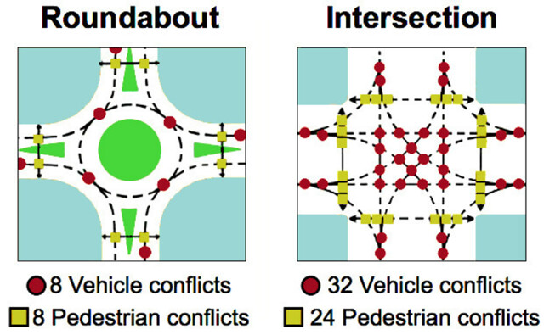
Conflict points
Scenic Route 68 Corridor Improvement Project

Slide 12
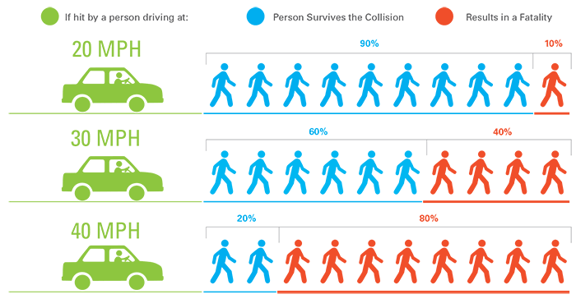
Vehicle Travel Speeds and Pedestrian Injuries
Scenic Route 68 Corridor Improvement Project

Slide 13
Capital Construction Costs:
 | Alt 1 Roundabouts | Alt 2 Signal intersection modifications
Construction Capital (Roadway + Structure) | $153.1 M | $176.6 M
Note: M = Million; costs escalated to first phase of construction
Scenic Route 68 Corridor Improvement Project

Slide 14
Right of Way Impacts:
 | Alt 1 RAs | Alt 2 Signal intersection modifications | Unit
Assessor Parcels | 56 | 99 | Number
Temporary Easements | 4.01 | 1.56 | Acres
Permanent Easements (incl. drainage, subsurface, slope) | 18.52 | 40.52 | Acres
R/W Capital Cost | $40.1 M | $67.2 M | Dollars
Note: M = Million
Scenic Route 68 Corridor Improvement Project

Slide 15
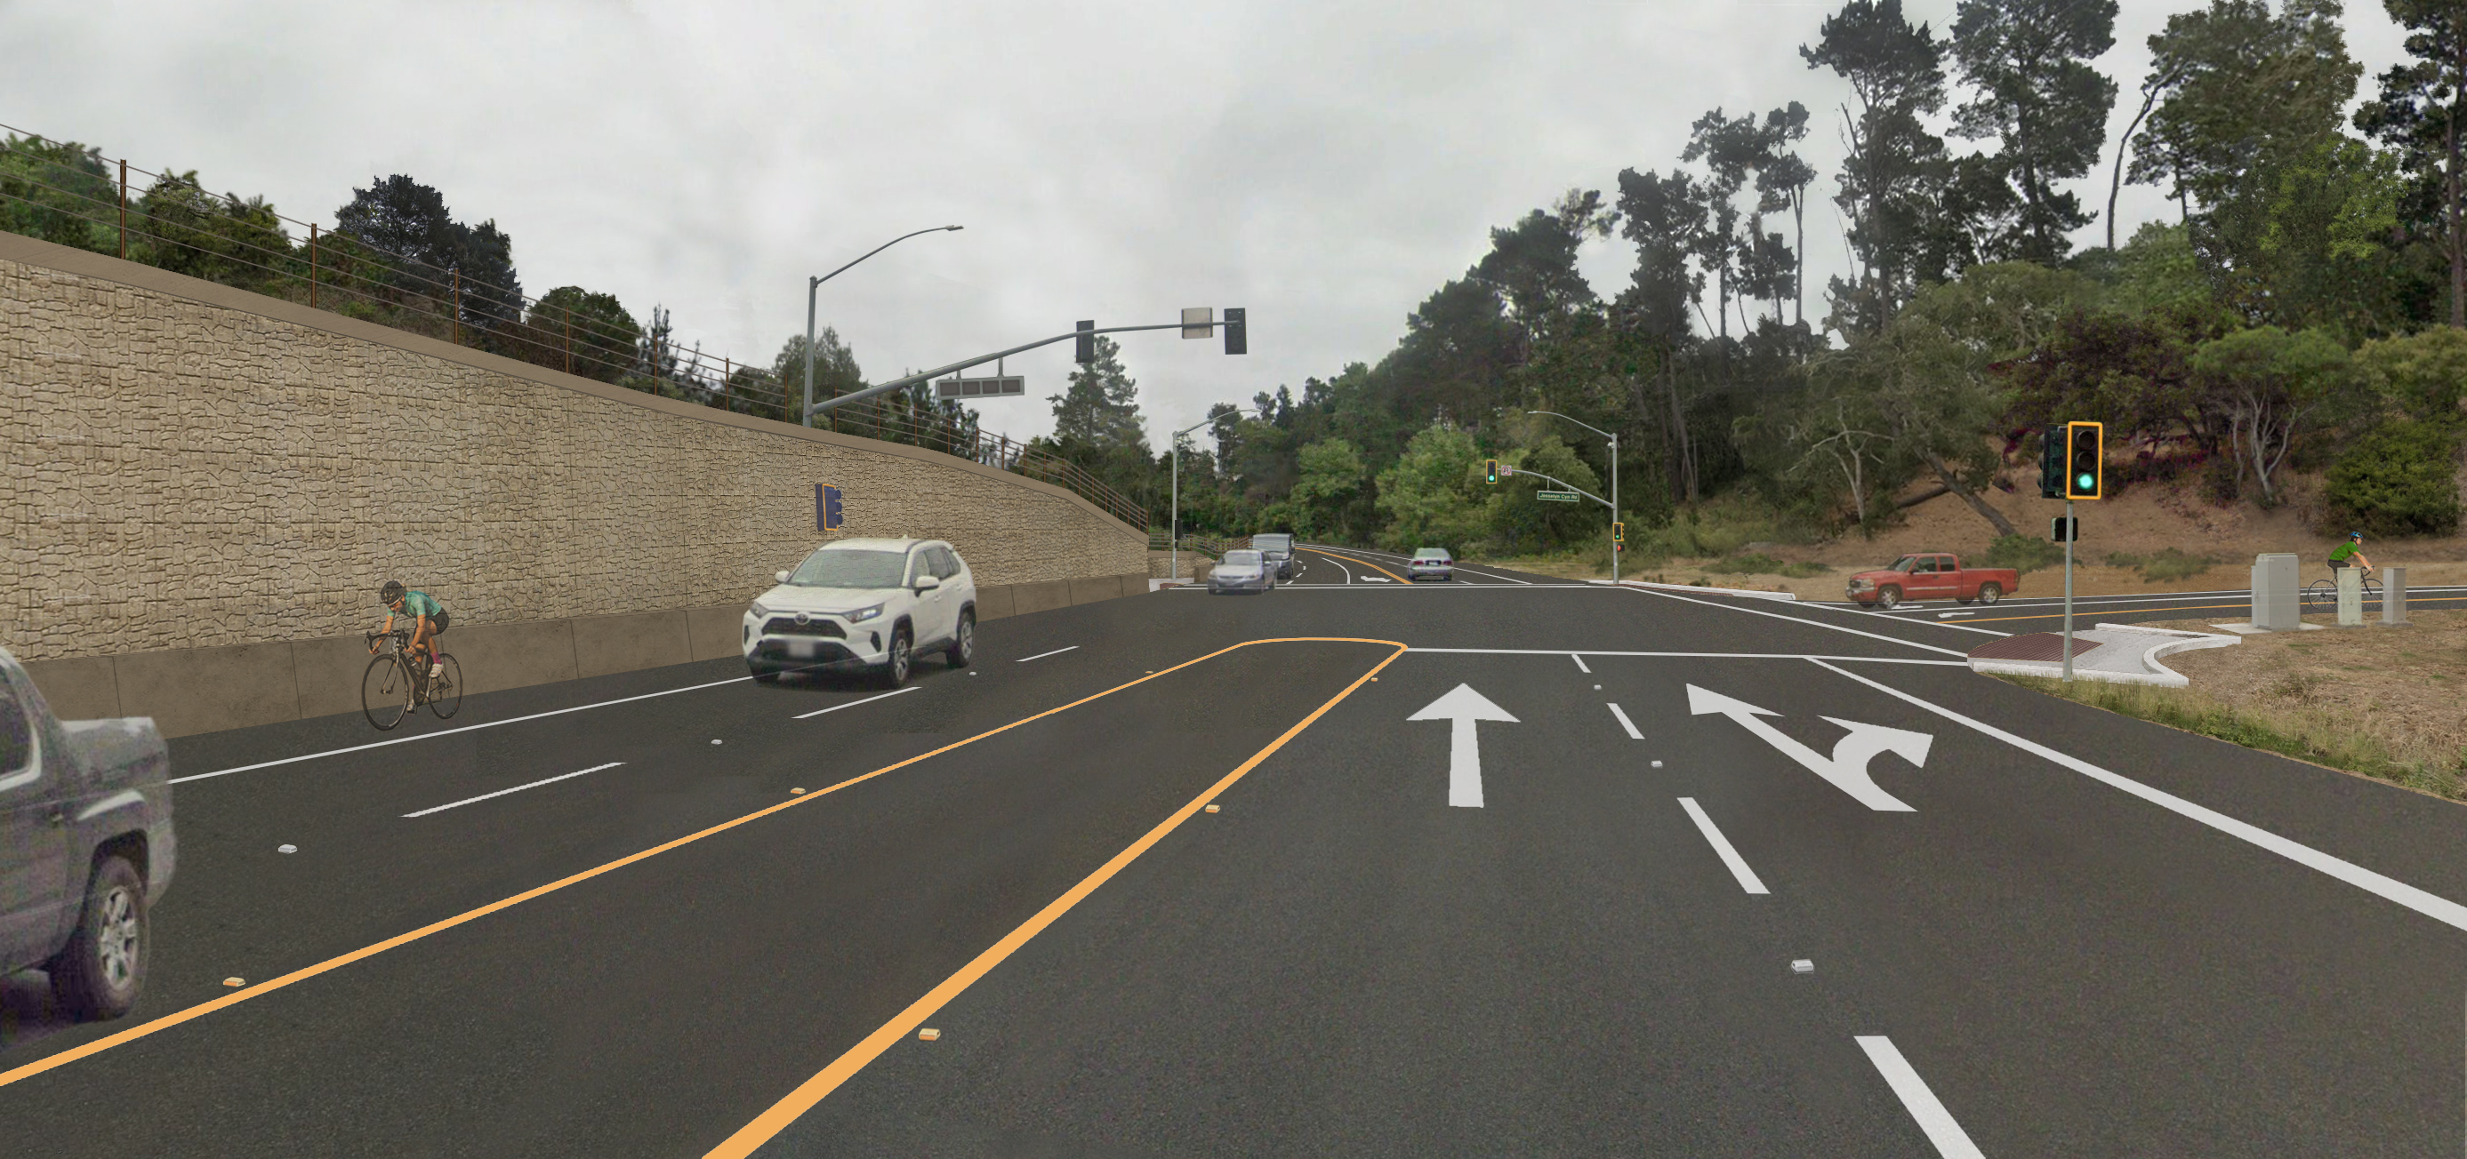
Josselyn Canyon Rd Signal intersection Modification (Alternative 2)
Scenic Route 68 Corridor Improvement Project

Slide 16
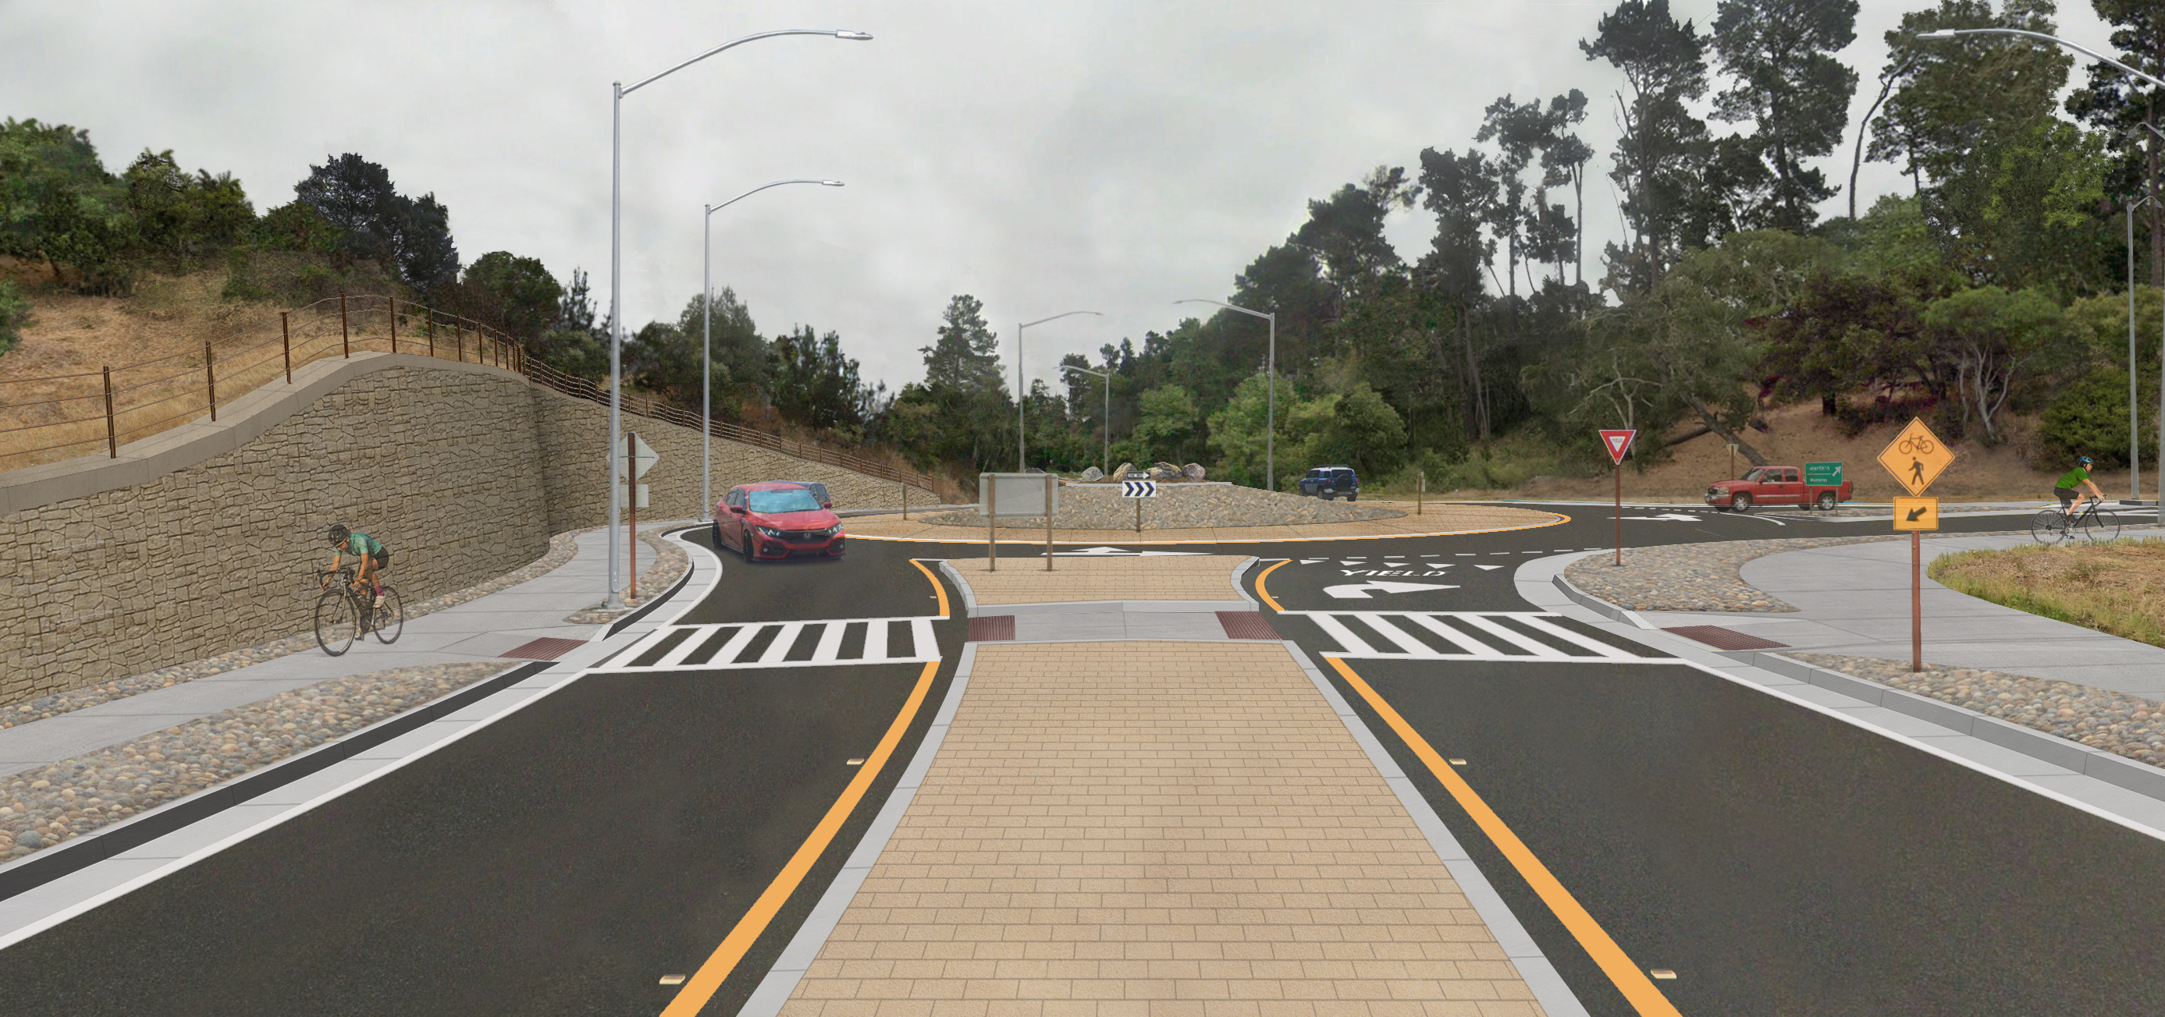
Josselyn Canyon Rd Roundabout (Alternative 1, hardscaped)
Scenic Route 68 Corridor Improvement Project

Slide 17
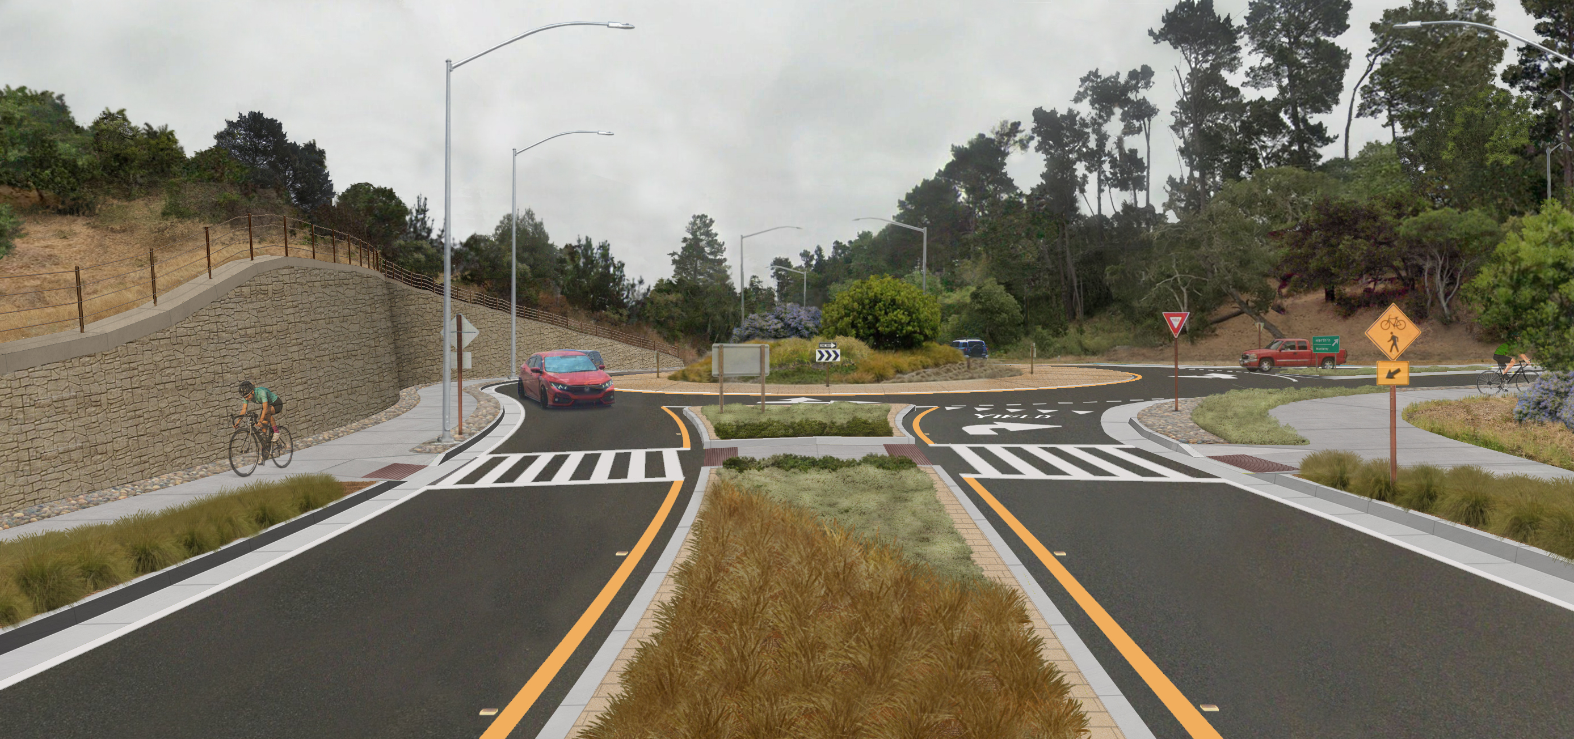
Josselyn Canyon Rd Roundabout (Alternative 1, landscaped)
Scenic Route 68 Corridor Improvement Project

Slide 18
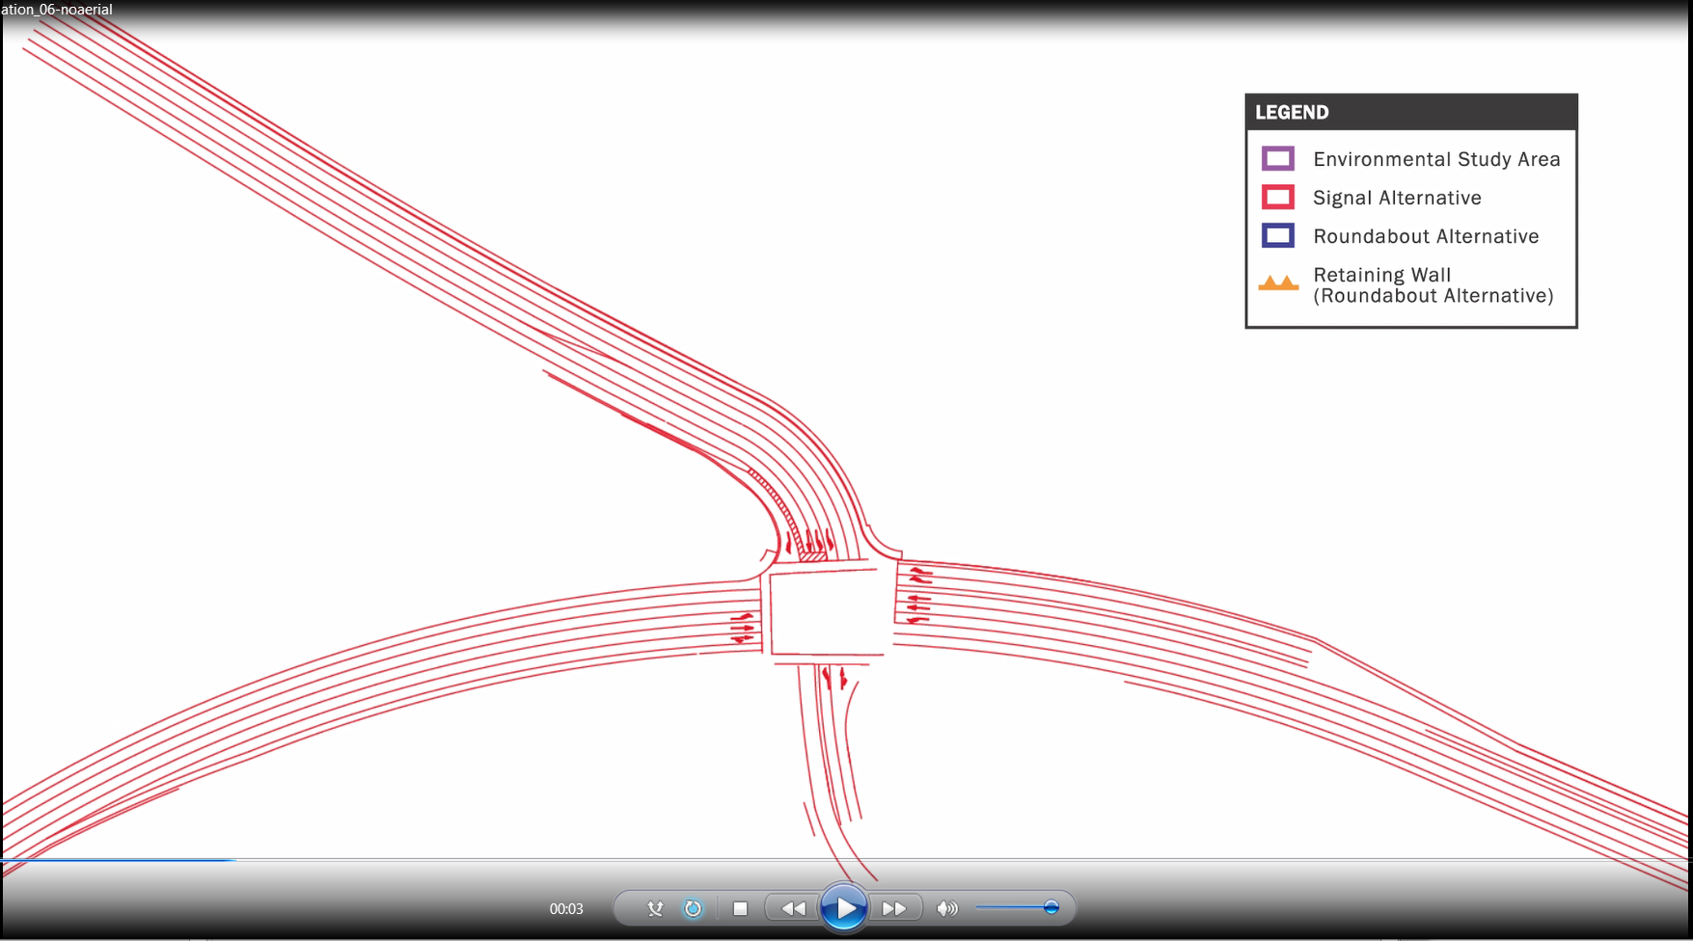
Roundabouts and
Signal Mod
Scenic Route 68 Corridor Improvement Project

Slide 19
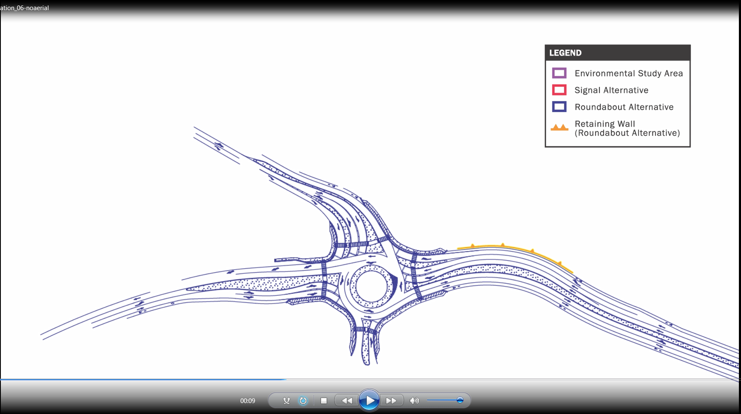
Roundabouts and
Signal Mod
Scenic Route 68 Corridor Improvement Project

Slide 20
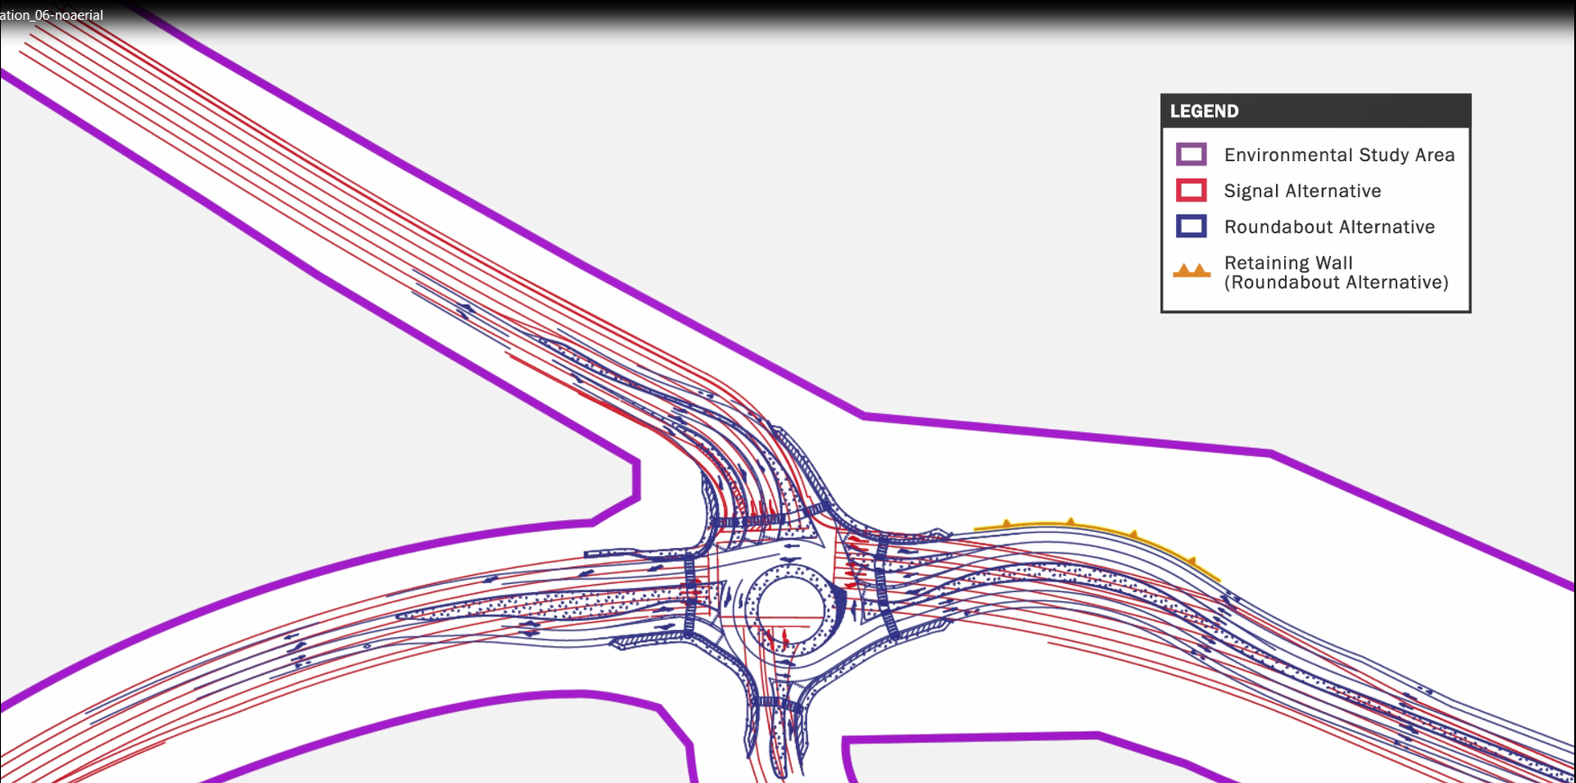
Roundabouts and
Signal Mod
Scenic Route 68 Corridor Improvement Project

Slide 21
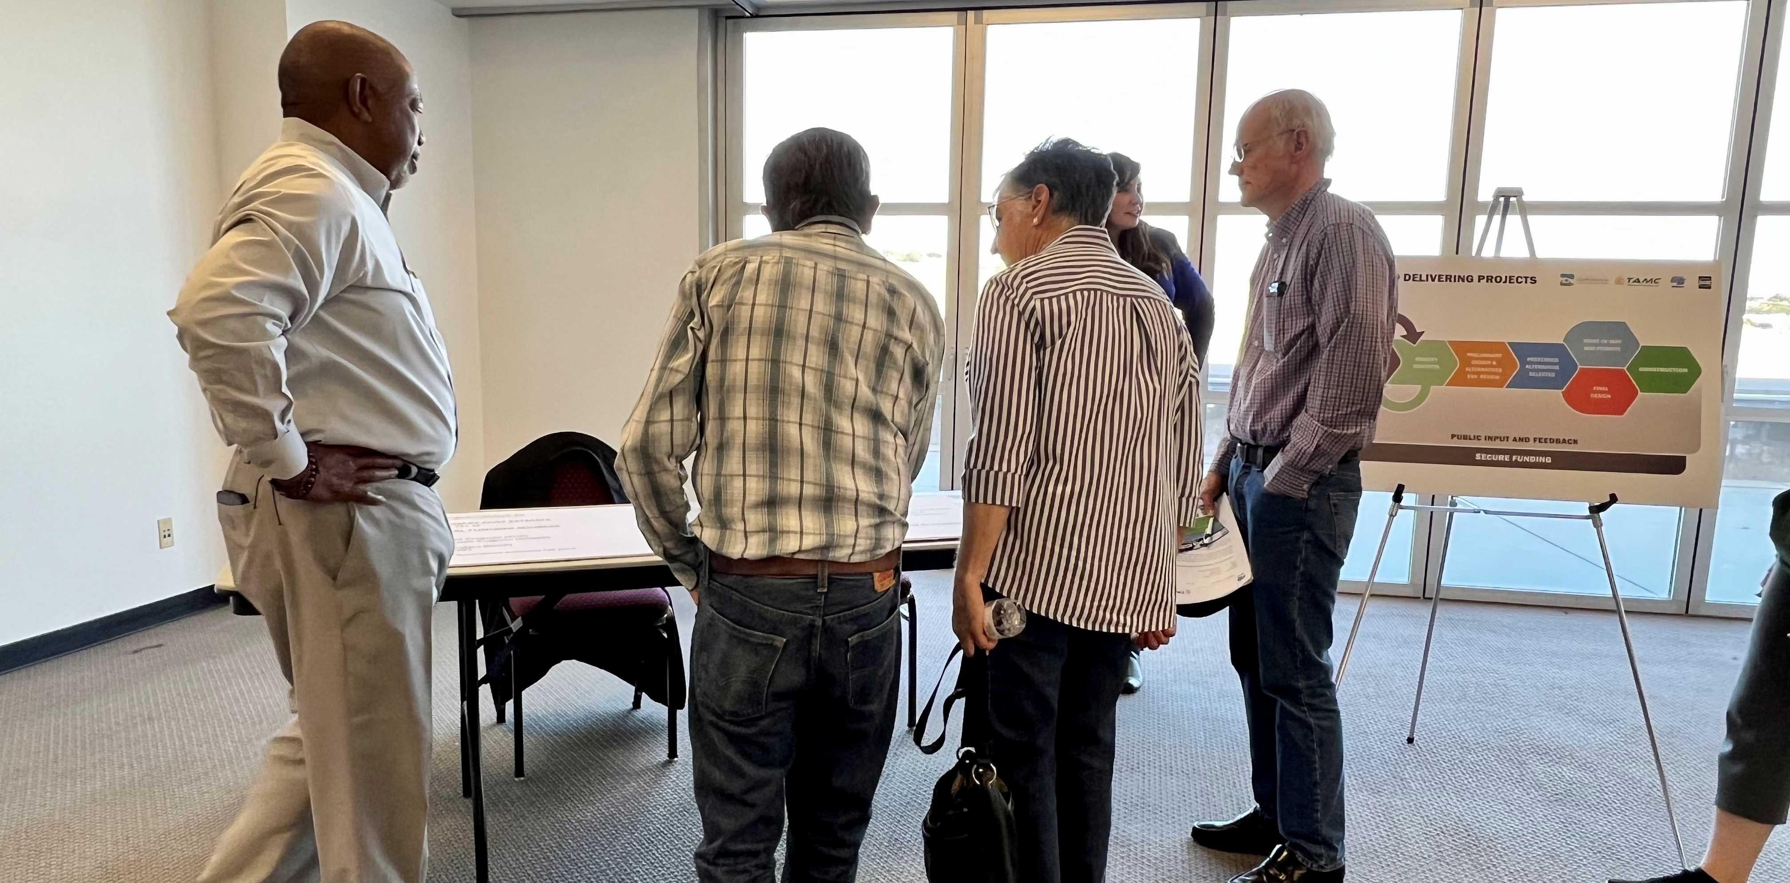
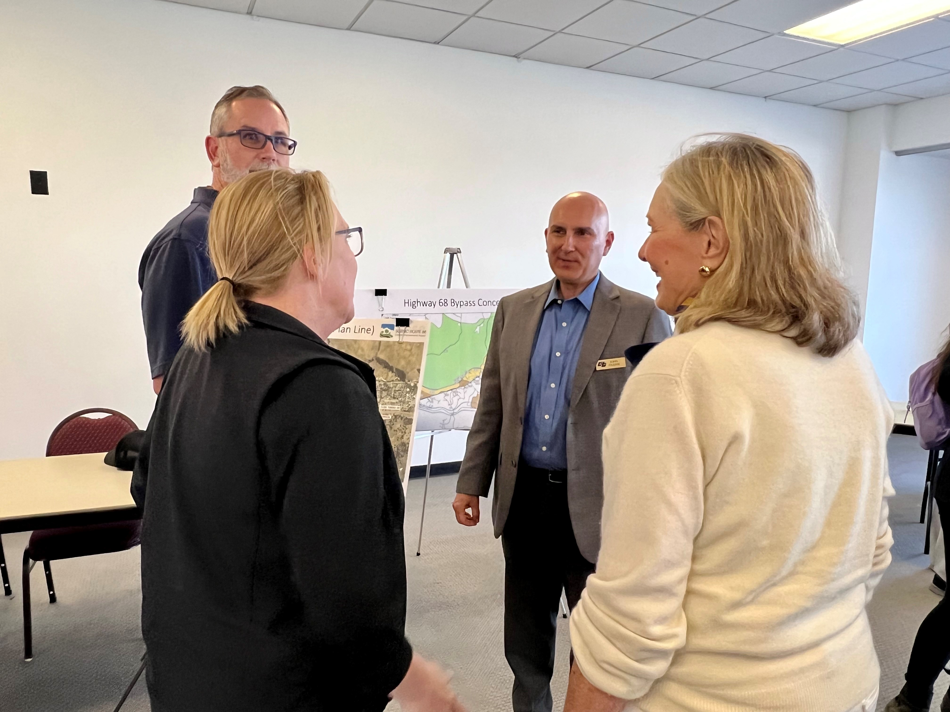
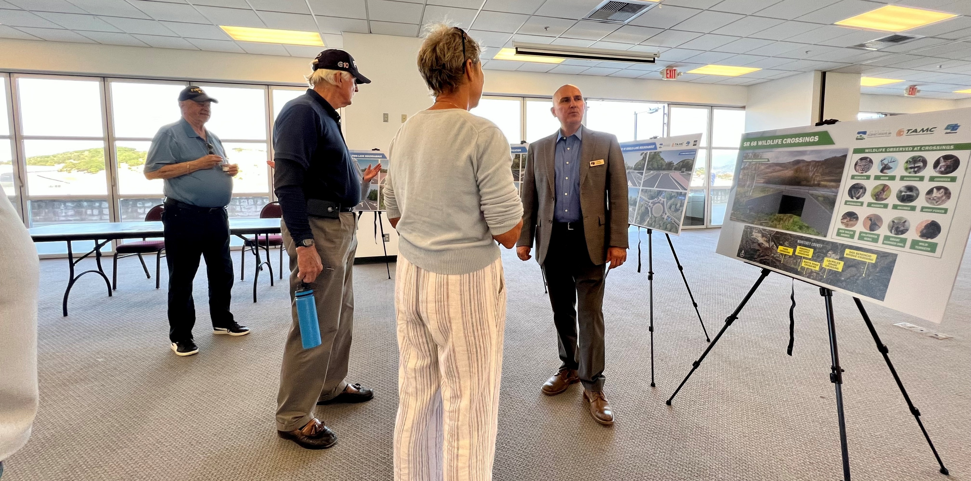
Objectives of Community Outreach Effort
Scenic Route 68 Corridor Improvement Project

Slide 22
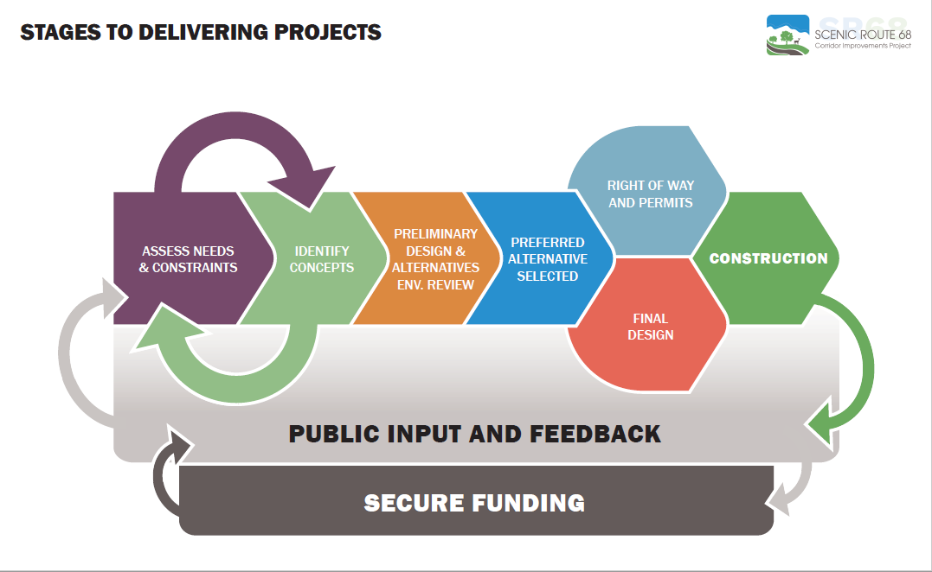
Scenic Route 68 Corridor Improvement Project

Slide 23
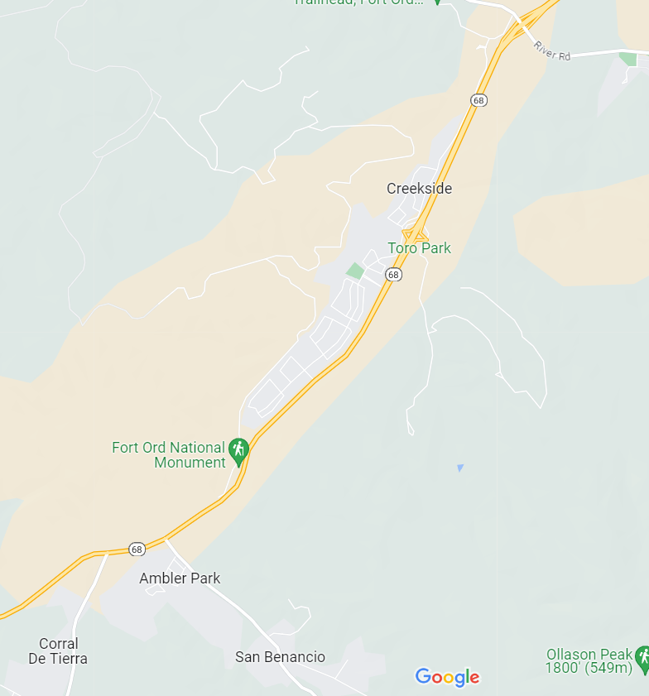



Cut Through Traffic
Scenic Route 68 Corridor Improvement Project

Slide 24
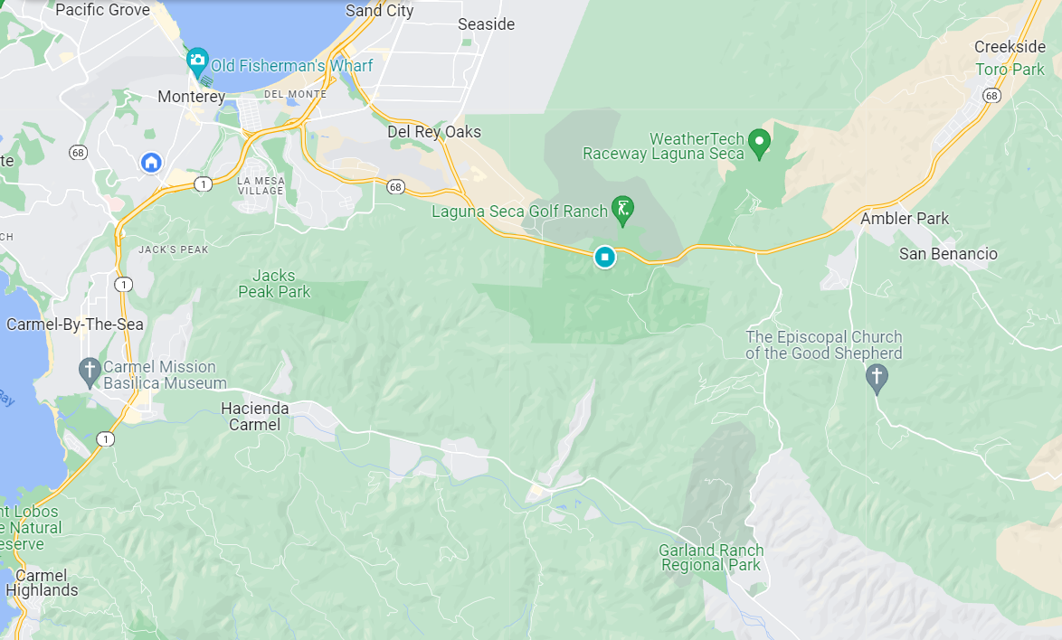



Cut Through Traffic
Scenic Route 68 Corridor Improvement Project

Slide 25
Questions
Scenic Route 68 Corridor Improvement Project

Slide 26
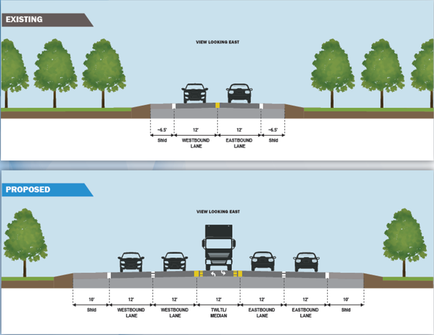
Scenic Route 68 Corridor Improvement Project

Slide 27
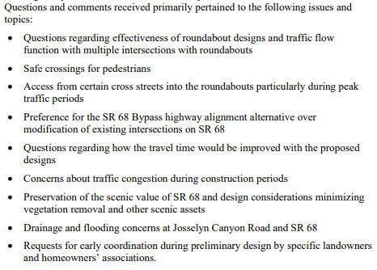
Summary of 2019 Public Outreach
Scenic Route 68 Corridor Improvement Project

