Slide 1

City of Salinas
Measure X Projects
David Jacobs, Public Works Director
February 16, 2021

Slide 2
Current Projects
Traffic Calming Improvements
Main Street Streetscape Project
Alisal Complete Streets Project
Street Maintenance Equipment Replacement
Annual Street Rehabilitations
Sidewalk Repairs
Alvin Safe Routes To School
Traffic Signal @ Alvin and Linwood

Slide 3
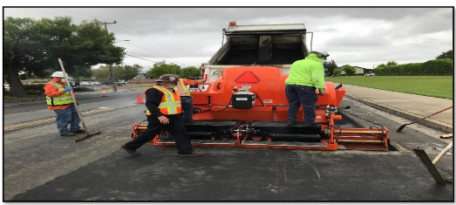
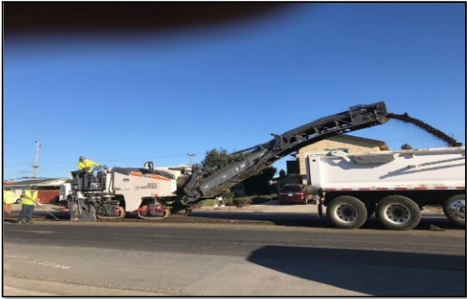
Street Maintenance Equipment
Paving Machine
Milling Machine

Slide 4
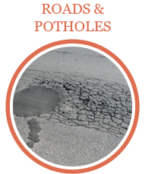
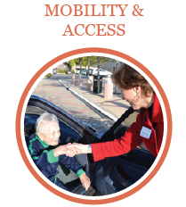
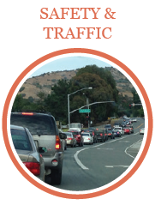

Main Street Streetscape: Project Benefits
Improves pavement condition and extends life of pavement
Improves pedestrian and cycling safety
Improves visitor access and experience to local businesses
Reinvigorates street aesthetics
Creates a District identity

Slide 5
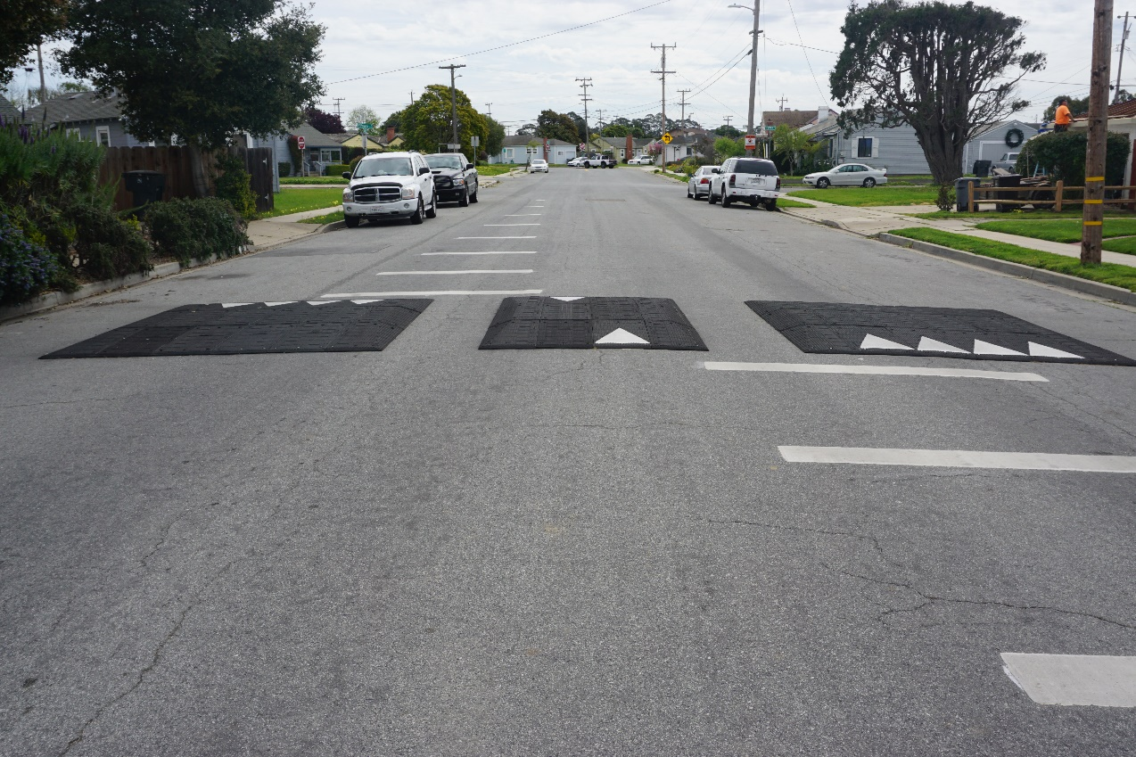
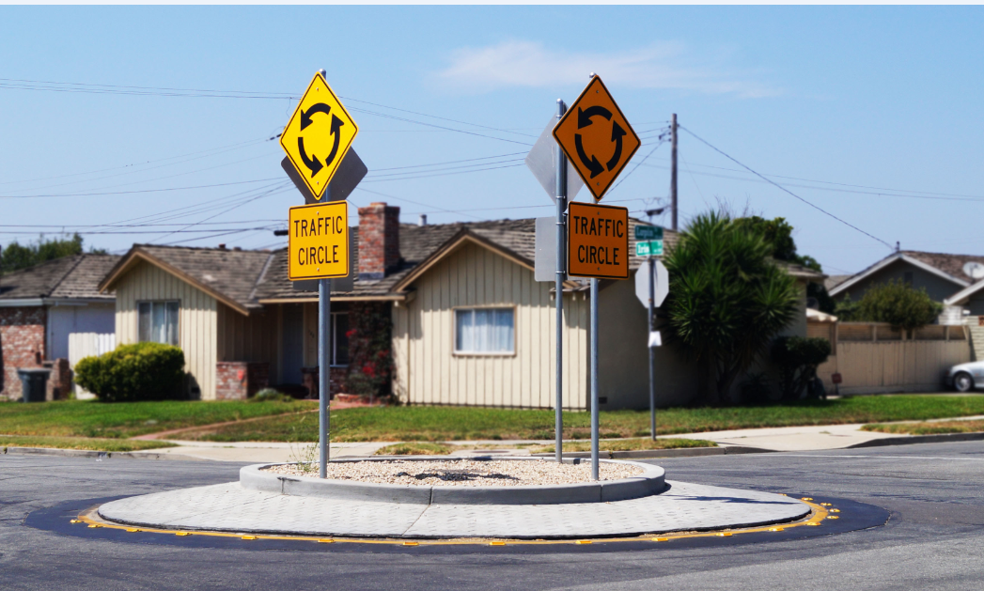
Traffic Calming
Speed Cushion
Traffic Circle

Slide 6
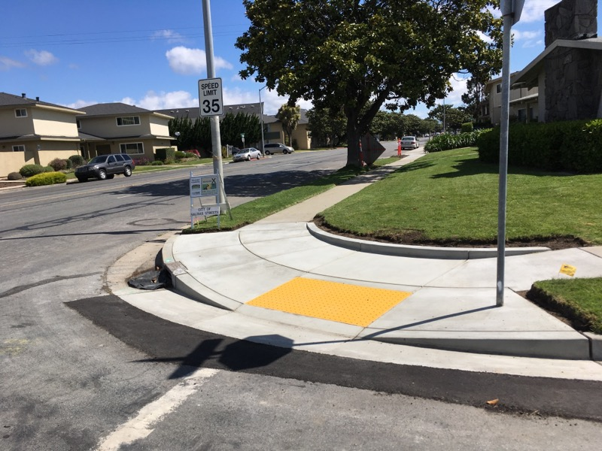
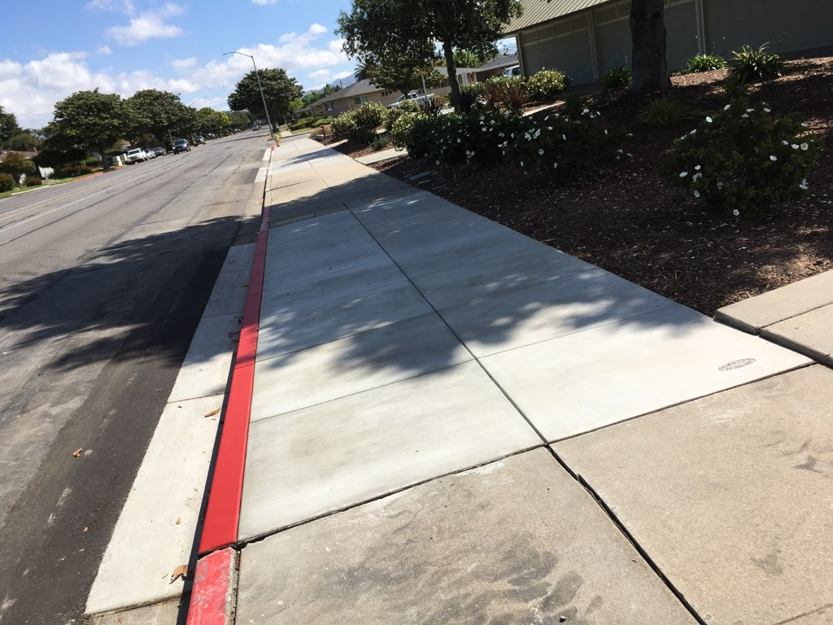
Sidewalk Improvements
New Curb Ramp
Curb, Gutter and Sidewalk replacement

Slide 7
East Laurel Drive Sidewalk Improvement Project
Construct a sidewalk from North Sanborn Road to Constitution Boulevard
Provide pedestrian access to the Salinas Soccer Complex and Natividad Hospital from East Laurel Drive
Provide street lighting along East Laurel Drive
Improve access to Carr Lake trails
Construction scheduled to start in March
Construction cost $5,240,000

Slide 8
Upcoming Measure X Projects
Bardin Road Safe Route To School
Boronda Road Congestion Relief Project
Street Tree Trimming
Various Collector and Arterial Chip Seal Projects
San Juan Grade Pavement Rehabilitation
Work Street Pavement Rehabilitation
Asphalt Crack Filling Machine Replacement

